Slide 1

9 Autowired Annotation
Peter H. Chen

Slide 2
9 Autowired Annotation
https://www.youtube.com/watch?v=oTy2pUILpdQ&list=PLsyeobzWxl7rFkYFysfTwBu1JBPaNNDrk&index=8
The @autowired annotation can be used directly on properties, therefore, eliminating the need for getters and setters.
The property in the XML can be connected directly to the data attribute in @component class.

Slide 3
9.1 Add Private Data

Slide 4
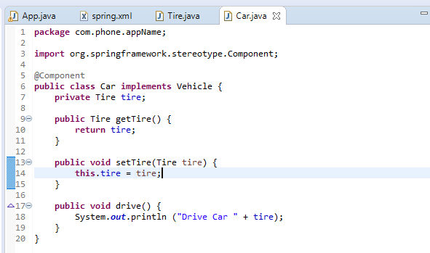
9.1 Add Private Data
https://www.youtube.com/watch?v=HFt_q0wYYLU&list=PLsyeobzWxl7rFkYFysfTwBu1JBPaNNDrk&index=9
Add private data member tire.

Slide 5
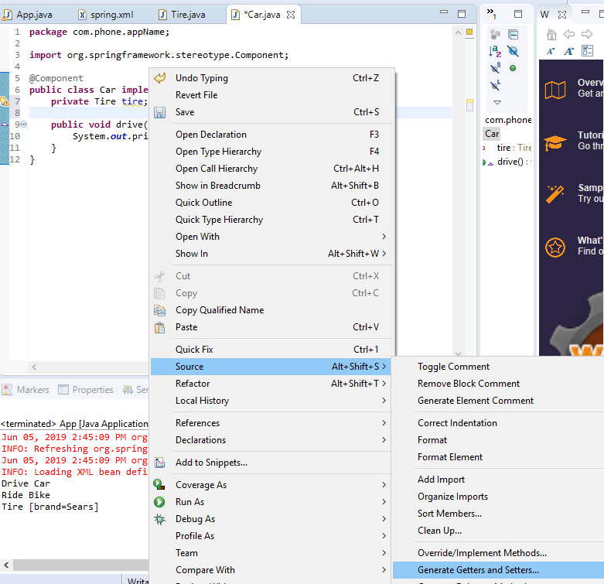
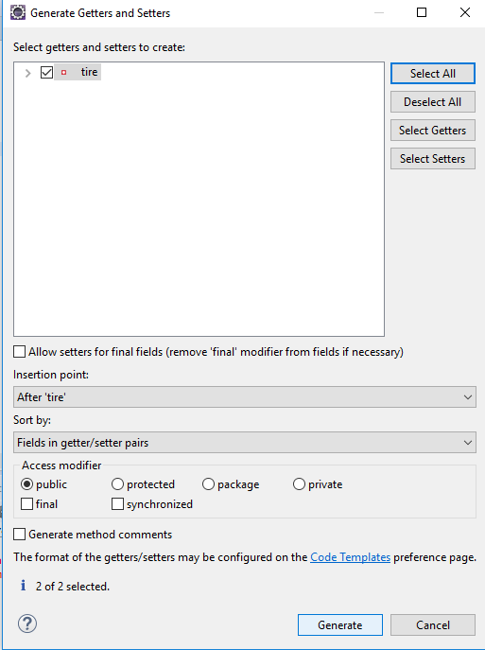
9.1 Add Private Data
https://www.youtube.com/watch?v=HFt_q0wYYLU&list=PLsyeobzWxl7rFkYFysfTwBu1JBPaNNDrk&index=9
Add getter and setter for tire.

Slide 6
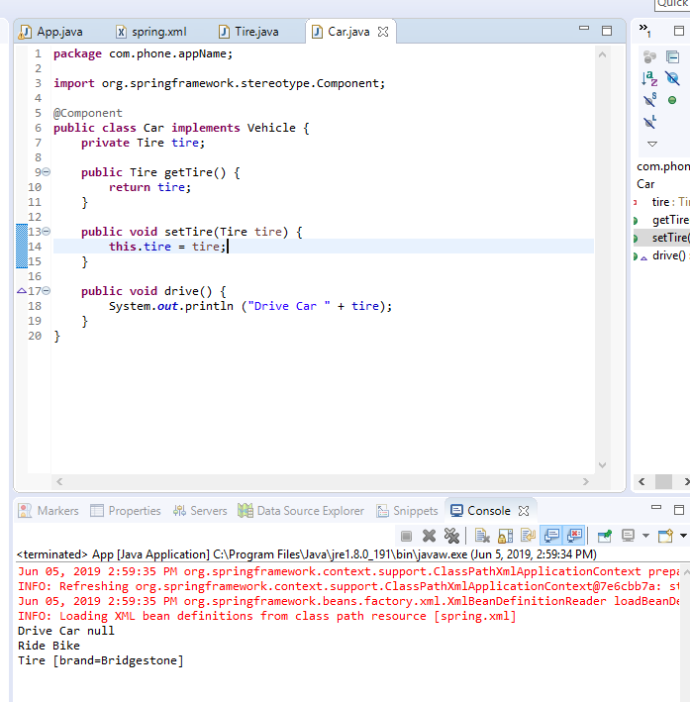
9.1 Add Private Data
https://www.youtube.com/watch?v=HFt_q0wYYLU&list=PLsyeobzWxl7rFkYFysfTwBu1JBPaNNDrk&index=9
Run it. The tire is null. The @Component class Car cannot see the private tire.

Slide 7
9.2 Add @Autowired

Slide 8
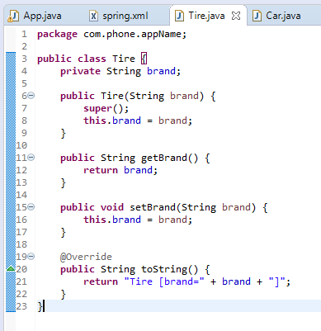
9.2 Add @Autowire
https://www.youtube.com/watch?v=HFt_q0wYYLU&list=PLsyeobzWxl7rFkYFysfTwBu1JBPaNNDrk&index=9
We still keep the Tire constructor to construct the data.
This is irrelevant to @autowire.

Slide 9
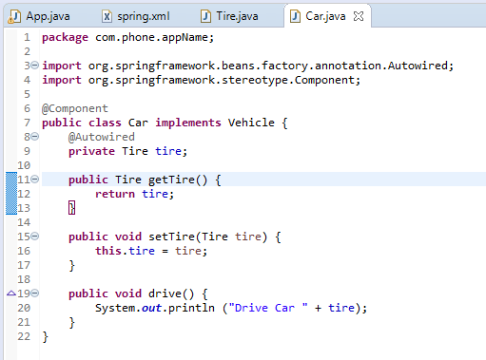
9.2 Add @Autowire
https://www.youtube.com/watch?v=HFt_q0wYYLU&list=PLsyeobzWxl7rFkYFysfTwBu1JBPaNNDrk&index=9
How the class Car can see the private data from xml?
The answer is use “@Autowired”

Slide 10
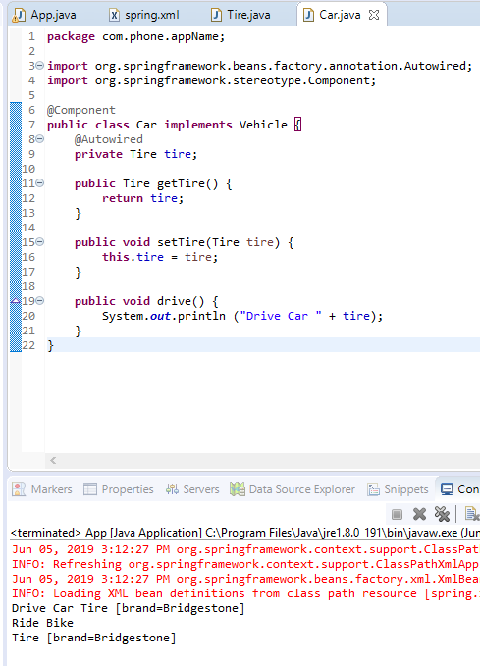
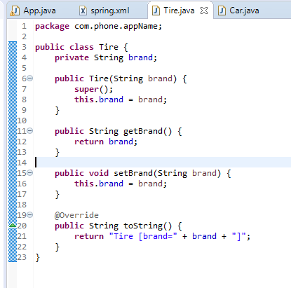
9.2 Add @Autowire
https://www.youtube.com/watch?v=HFt_q0wYYLU&list=PLsyeobzWxl7rFkYFysfTwBu1JBPaNNDrk&index=9
Run it.

Slide 11
End of Chapter

