Slide 1

8 Constructor Injection
Peter H. Chen

Slide 2
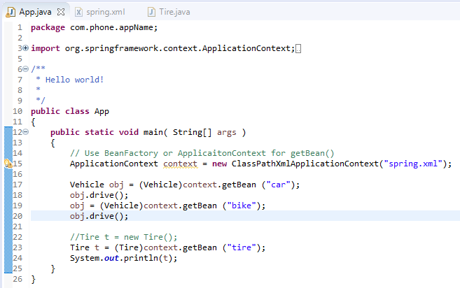
8 Constructor Injection
https://www.youtube.com/watch?v=oTy2pUILpdQ&list=PLsyeobzWxl7rFkYFysfTwBu1JBPaNNDrk&index=8
This section discusses the Bean Property.
Last section, we get the instance by getBean().
When you use getBean(“tire”), we will get the instance of the tire.

Slide 3
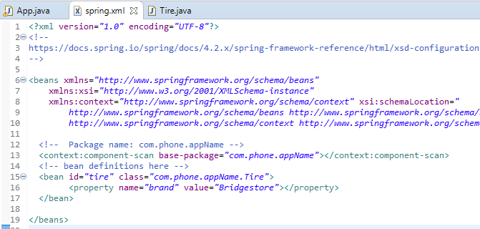
8 Constructor Injection
https://www.youtube.com/watch?v=oTy2pUILpdQ&list=PLsyeobzWxl7rFkYFysfTwBu1JBPaNNDrk&index=8
The instance and Bean property name “brand” and value ”Bridgestone”. They are created in maven.xml.

Slide 4
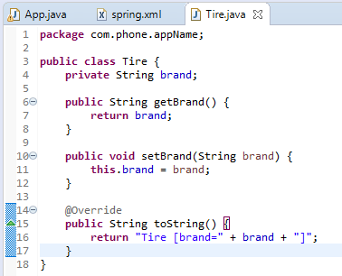
8 Constructor Injection
https://www.youtube.com/watch?v=oTy2pUILpdQ&list=PLsyeobzWxl7rFkYFysfTwBu1JBPaNNDrk&index=8
The property tag has property name “brand”.
We can use setter and getter.

Slide 5
8.2 Create Constructor Class

Slide 6
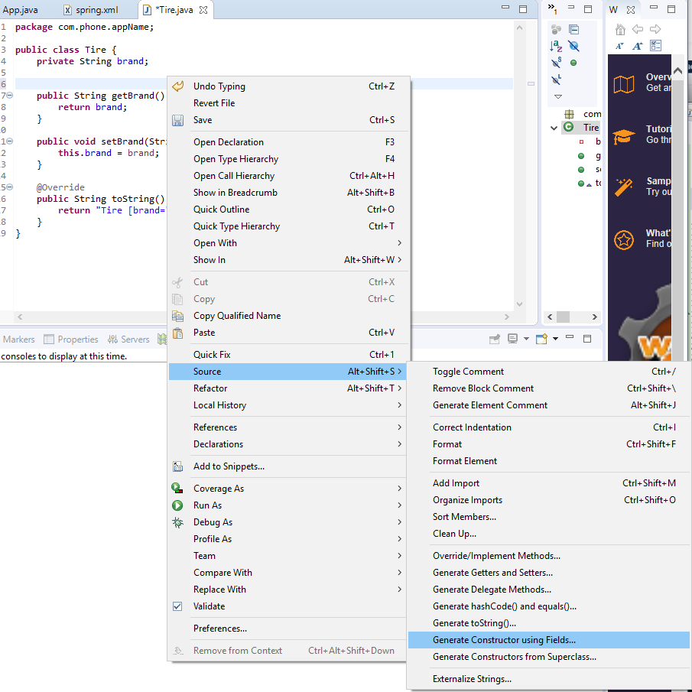
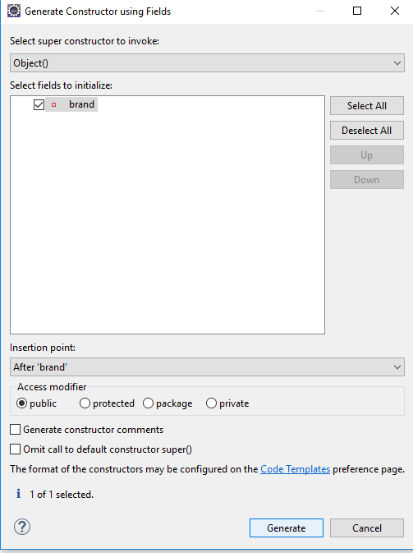
8.2 Create Constructor Class
https://www.youtube.com/watch?v=oTy2pUILpdQ&list=PLsyeobzWxl7rFkYFysfTwBu1JBPaNNDrk&index=8
In order to use constructor injection, we have to create the constructor.
RMB: Source > Generate Constructor using Fields …

Slide 7
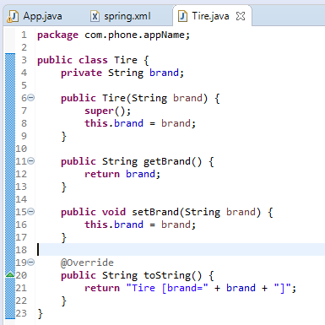
8.2 Create Constructor Class
https://www.youtube.com/watch?v=oTy2pUILpdQ&list=PLsyeobzWxl7rFkYFysfTwBu1JBPaNNDrk&index=8
In order to use constructor injection, we have to create the constructor.
RMB: Source > Generate Constructor using Fields …

Slide 8
8.3 Configure Constructor in XML

Slide 9
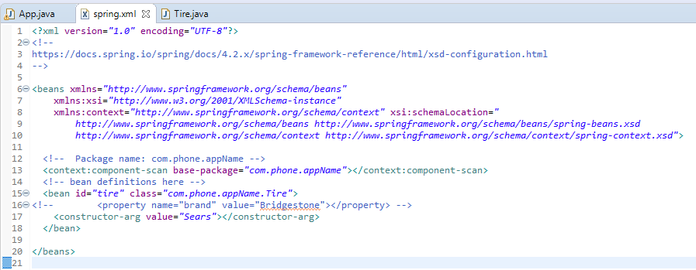
8.3 Configure Constructor in XML
https://www.youtube.com/watch?v=oTy2pUILpdQ&list=PLsyeobzWxl7rFkYFysfTwBu1JBPaNNDrk&index=8
Comment out the property.
Use constructor-arg value=“Sears” to configure the constructor class.

Slide 10
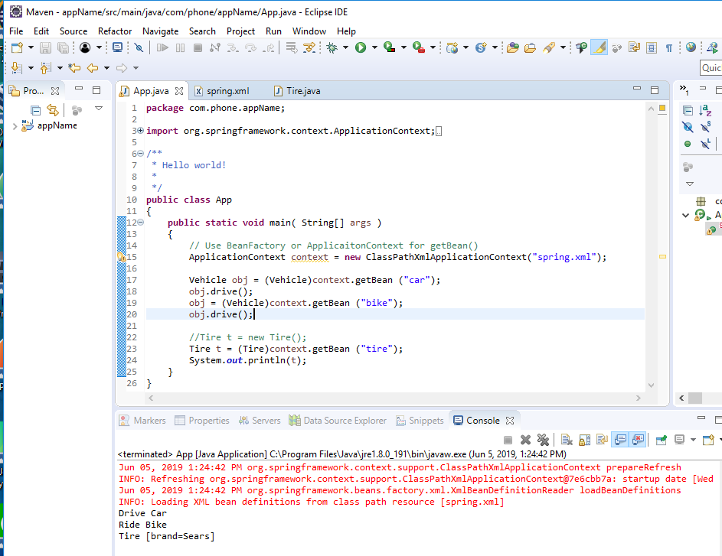
8.3 Configure Constructor in XML
https://www.youtube.com/watch?v=oTy2pUILpdQ&list=PLsyeobzWxl7rFkYFysfTwBu1JBPaNNDrk&index=8
Run.

Slide 11
End of Chapter

