Slide 1

5 Spring Core Framework
Peter H. Chen

Slide 2
5 Spring Core Framework
https://www.youtube.com/watch?v=Lw_PszjKu68&list=PLsyeobzWxl7rFkYFysfTwBu1JBPaNNDrk&index=5
This section discusses the Spring Core Framework of Maven.

Slide 3
5.1 Create spring.xml

Slide 4
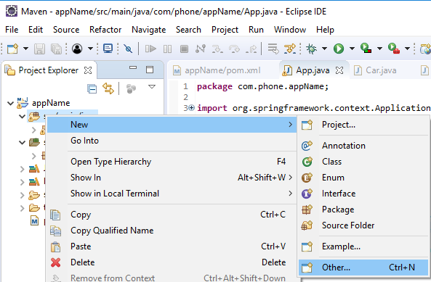
5.1 Create spring.xml
https://www.youtube.com/watch?v=Lw_PszjKu68&list=PLsyeobzWxl7rFkYFysfTwBu1JBPaNNDrk&index=5
Create XML file:
RMB: > New > Other …

Slide 5
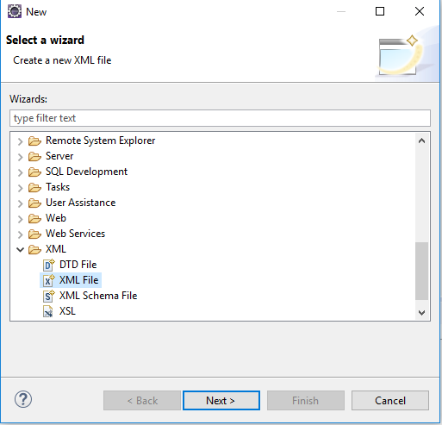
5.1 Create spring.xml
https://www.youtube.com/watch?v=Lw_PszjKu68&list=PLsyeobzWxl7rFkYFysfTwBu1JBPaNNDrk&index=5
XML > XML File

Slide 6
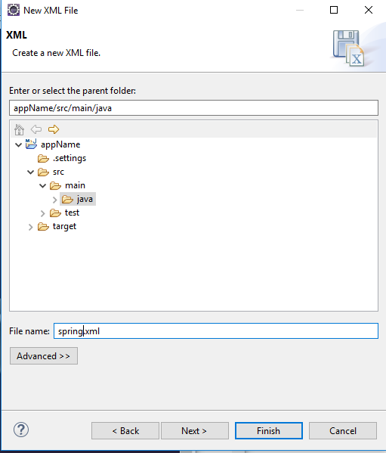
5.1 Create spring.xml
https://www.youtube.com/watch?v=Lw_PszjKu68&list=PLsyeobzWxl7rFkYFysfTwBu1JBPaNNDrk&index=5
Under Java folder, give XML name “spring.xml”

Slide 7
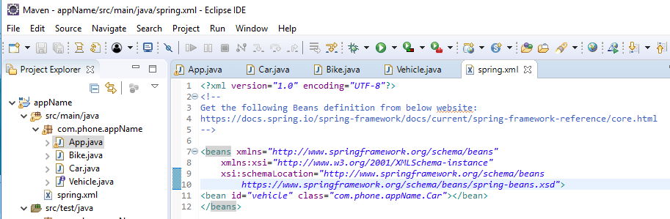
5.1 Create spring.xml
https://www.youtube.com/watch?v=Lw_PszjKu68&list=PLsyeobzWxl7rFkYFysfTwBu1JBPaNNDrk&index=5
In the spring.xml, define:
<beans Location-of-Beans>
<bean id=“vehicle” class=“com.phone.appName.Car”></bean>
</beans>
Whenever the id=vehicle get called, the class Car is invoked.

Slide 8
5.2 Upload spring.xml

Slide 9
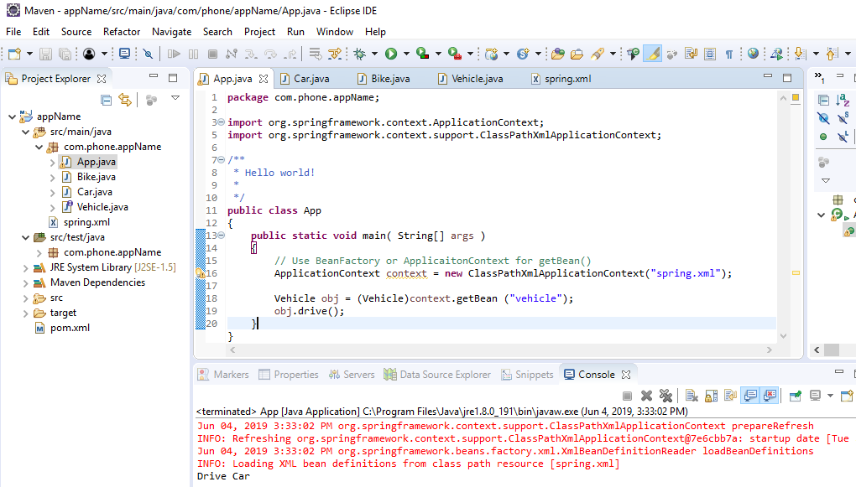
5.2 Upload spring.xml
https://www.youtube.com/watch?v=Lw_PszjKu68&list=PLsyeobzWxl7rFkYFysfTwBu1JBPaNNDrk&index=5
In the App.java, classPathXmlAppliacitonContext (“sping.xml”).

Slide 10
5.2 Upload spring.xml
https://www.youtube.com/watch?v=Lw_PszjKu68&list=PLsyeobzWxl7rFkYFysfTwBu1JBPaNNDrk&index=5
Run it, the class Car is called and “Drive Car” is displayed.

Slide 11
5.3 Change Car into Bike in spring.xml

Slide 12
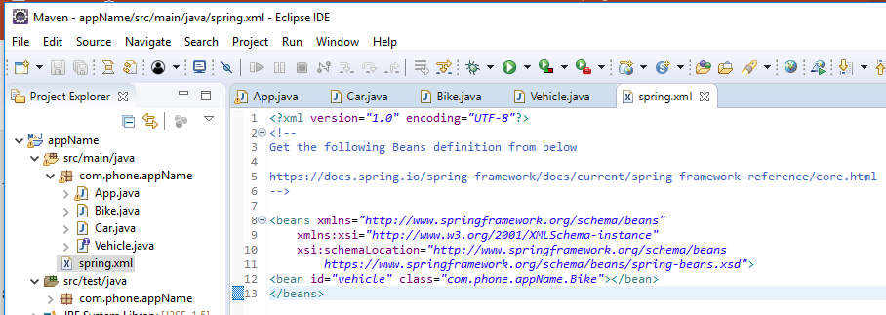
5.3 Change Car into Bike in spring.xml
https://www.youtube.com/watch?v=Lw_PszjKu68&list=PLsyeobzWxl7rFkYFysfTwBu1JBPaNNDrk&index=5
In spring.xml, change the Car into Bike.

Slide 13
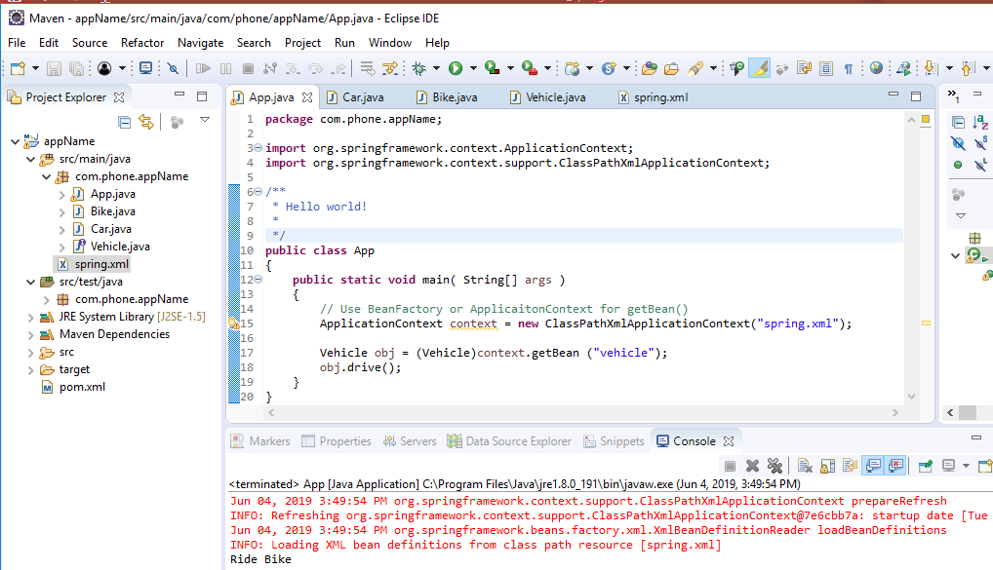
5.3 Change Car into Bike in spring.xml
https://www.youtube.com/watch?v=Lw_PszjKu68&list=PLsyeobzWxl7rFkYFysfTwBu1JBPaNNDrk&index=5
Run it, we have “Ride Bike” displayed.

Slide 14
5.3 Change Car into Bike in spring.xml
https://www.youtube.com/watch?v=Lw_PszjKu68&list=PLsyeobzWxl7rFkYFysfTwBu1JBPaNNDrk&index=5
We display the “Drive Car” or “Ride Bike” from external dependency.
We did not change any Java code.
The external dependency change from spring.xml is called dependency injection.

Slide 15
End of Chapter

