Slide 1

7 Bean Property
Peter H. Chen

Slide 2
7 Bean Property
https://www.youtube.com/watch?v=1MDpTdCit9s&list=PLsyeobzWxl7rFkYFysfTwBu1JBPaNNDrk&index=7
This section discusses the Bean Property.

Slide 3
7.1 Create Tire Class

Slide 4
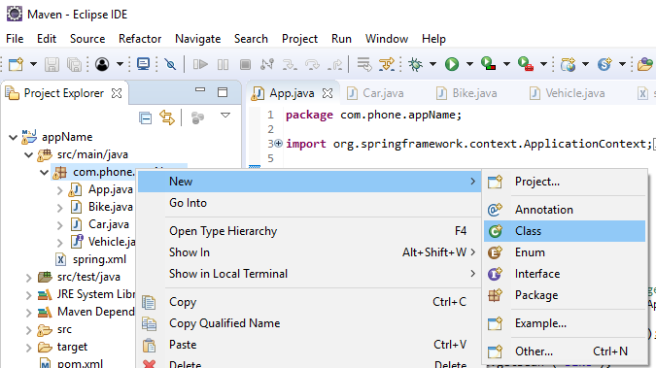
7.1 Create Tire Class
https://www.youtube.com/watch?v=1MDpTdCit9s&list=PLsyeobzWxl7rFkYFysfTwBu1JBPaNNDrk&index=7
Click “com.phone.appName”. RMB: New > Class

Slide 5
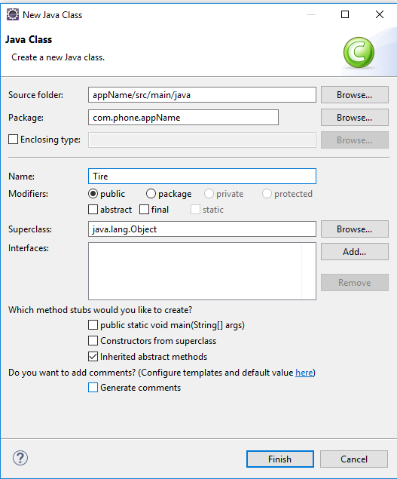
7.1 Create Tire Class
https://www.youtube.com/watch?v=1MDpTdCit9s&list=PLsyeobzWxl7rFkYFysfTwBu1JBPaNNDrk&index=7
Class Name: Tire

Slide 6
7.2 Getter and Setter

Slide 7
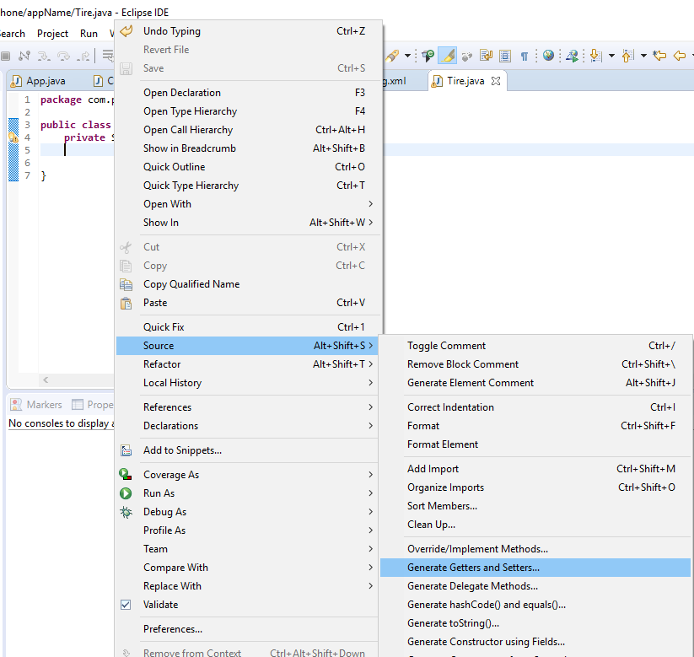
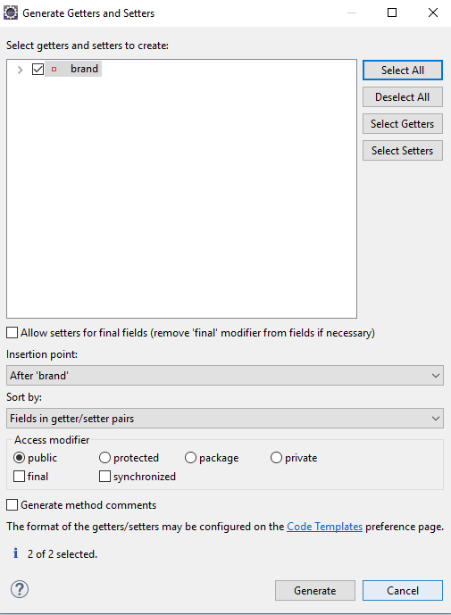
7.2 Getter and Setter
https://www.youtube.com/watch?v=1MDpTdCit9s&list=PLsyeobzWxl7rFkYFysfTwBu1JBPaNNDrk&index=7
RMB: Source > Generate Getters and Settters …
Select All
Click “Generate”

Slide 8
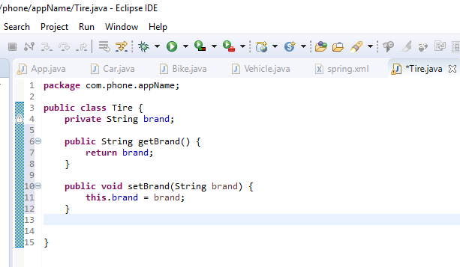
7.2 Getter and Setter
https://www.youtube.com/watch?v=1MDpTdCit9s&list=PLsyeobzWxl7rFkYFysfTwBu1JBPaNNDrk&index=7
Class Tire.

Slide 9
7.3 Print Object String

Slide 10
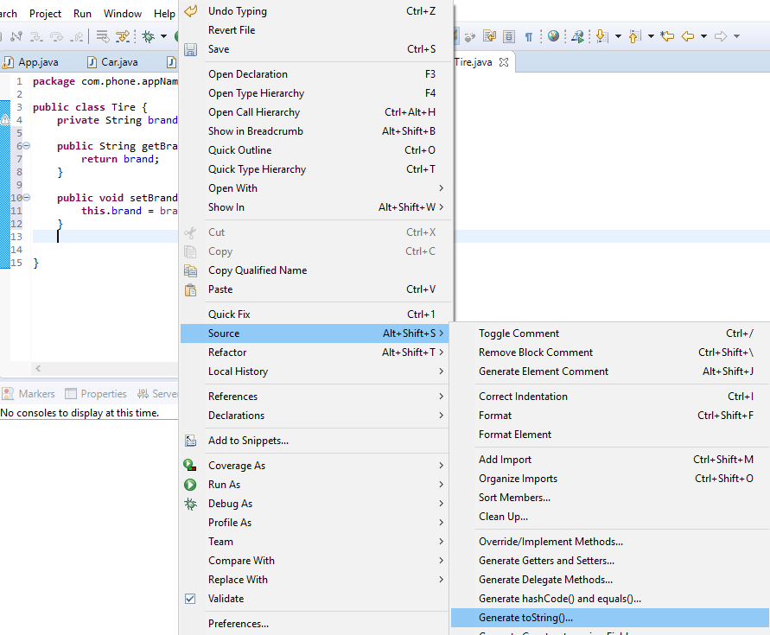
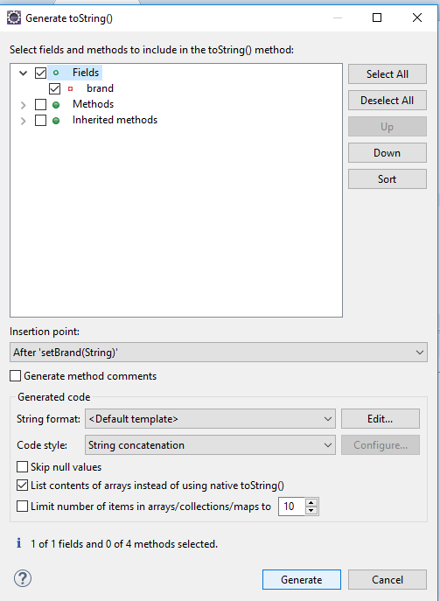
7.3 Print Object String
https://www.youtube.com/watch?v=1MDpTdCit9s&list=PLsyeobzWxl7rFkYFysfTwBu1JBPaNNDrk&index=7
Let’s print the data. RMB: Source > Generate toString()

Slide 11
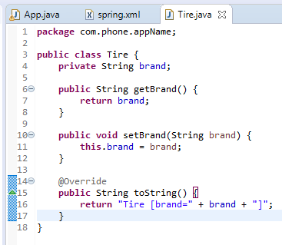
7.3 Print Object String
https://www.youtube.com/watch?v=1MDpTdCit9s&list=PLsyeobzWxl7rFkYFysfTwBu1JBPaNNDrk&index=7
Tire Tire.java

Slide 12
7.4 Create Bean and Property

Slide 13
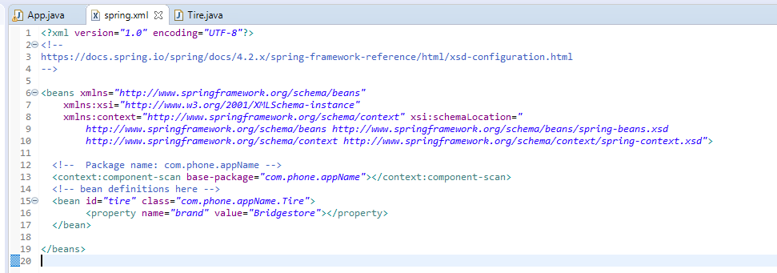
7.4 Create Bean and Property
https://www.youtube.com/watch?v=1MDpTdCit9s&list=PLsyeobzWxl7rFkYFysfTwBu1JBPaNNDrk&index=7
<bean id=“tire” class=“com.phone.appName.Tire”>
<property name=“brand” value=“Bridgestone”></property>
</bean>

Slide 14
7.5 Create tire Object

Slide 15
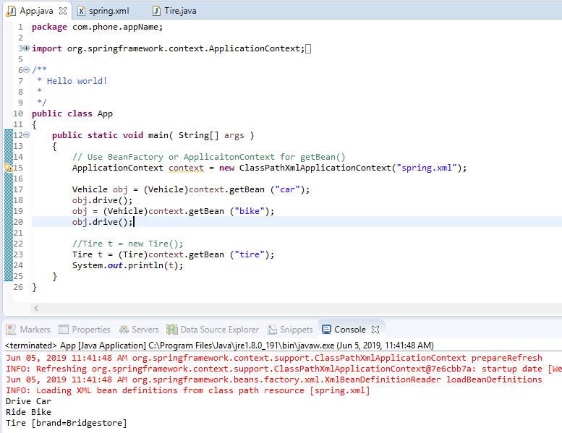
7.5 Create tire Object
https://www.youtube.com/watch?v=1MDpTdCit9s&list=PLsyeobzWxl7rFkYFysfTwBu1JBPaNNDrk&index=7
Tire t = (Tire)context.getBean (“tire”)
System.out.println(t)

Slide 16
7.6 Run

Slide 17
7.6 Run
https://www.youtube.com/watch?v=1MDpTdCit9s&list=PLsyeobzWxl7rFkYFysfTwBu1JBPaNNDrk&index=7
Run it.

Slide 18
End of Chapter

