Slide 1

6 Annotation Configuration
Peter H. Chen

Slide 2
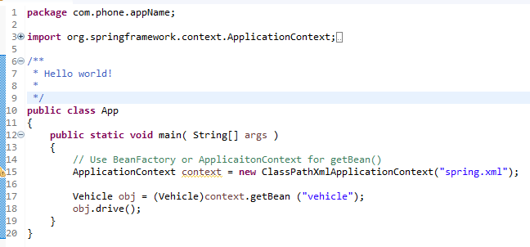
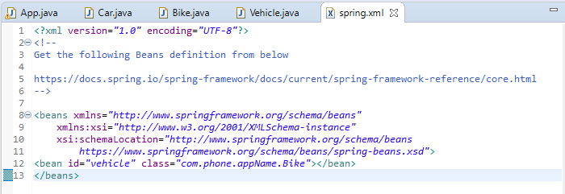
6 Annotation Configuration
https://www.youtube.com/watch?v=4fZJfqpnyWg&list=PLsyeobzWxl7rFkYFysfTwBu1JBPaNNDrk&index=6
Last section discusses the Dependency Injection.
We achieve that by external spring.xml.

Slide 3
6 Annotation Configuration
https://www.youtube.com/watch?v=4fZJfqpnyWg&list=PLsyeobzWxl7rFkYFysfTwBu1JBPaNNDrk&index=6
This section discusses different types of configuration.
We have mentioned the beans in xml file. The context object is responsible to give those beans.

Slide 4
6.1 Add Context in spring.xml

Slide 5
6.1 Add Context in spring.xml
https://www.youtube.com/watch?v=4fZJfqpnyWg&list=PLsyeobzWxl7rFkYFysfTwBu1JBPaNNDrk&index=6
This is the xml configuration.

Slide 6
6.1 Add Context in spring.xml
https://www.youtube.com/watch?v=4fZJfqpnyWg&list=PLsyeobzWxl7rFkYFysfTwBu1JBPaNNDrk&index=6
The first way is xml configuration.
The first way is annotation configuration. This section discusses the annotation configuration.
The third way is Java configuration.

Slide 7
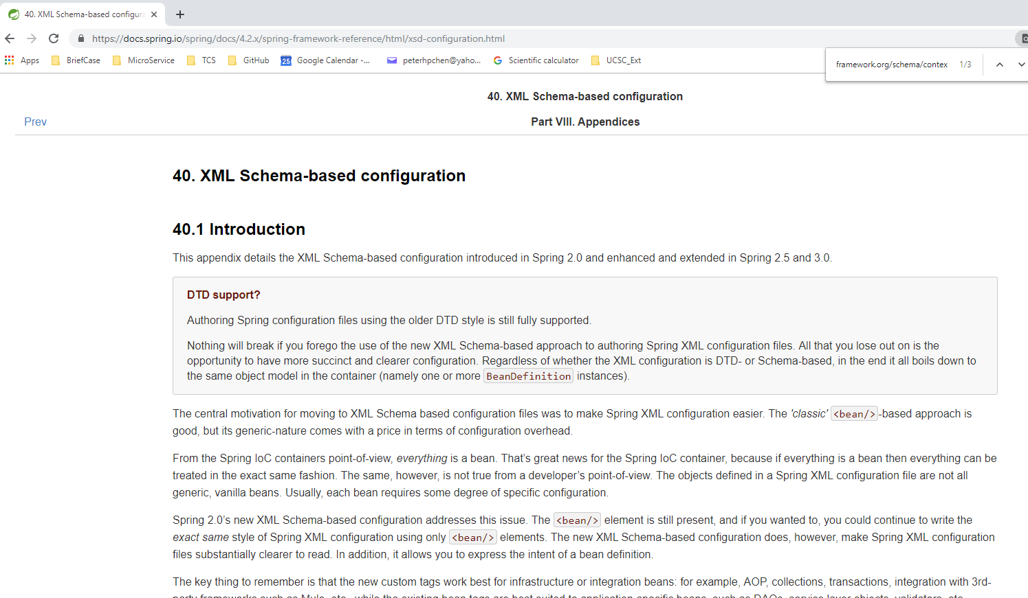
6.1 Add Context in spring.xml
https://www.youtube.com/watch?v=4fZJfqpnyWg&list=PLsyeobzWxl7rFkYFysfTwBu1JBPaNNDrk&index=6
For the annotation configuration,
https://docs.spring.io/spring/docs/4.2.x/spring-framework-reference/html/xsd-configuration.html

Slide 8
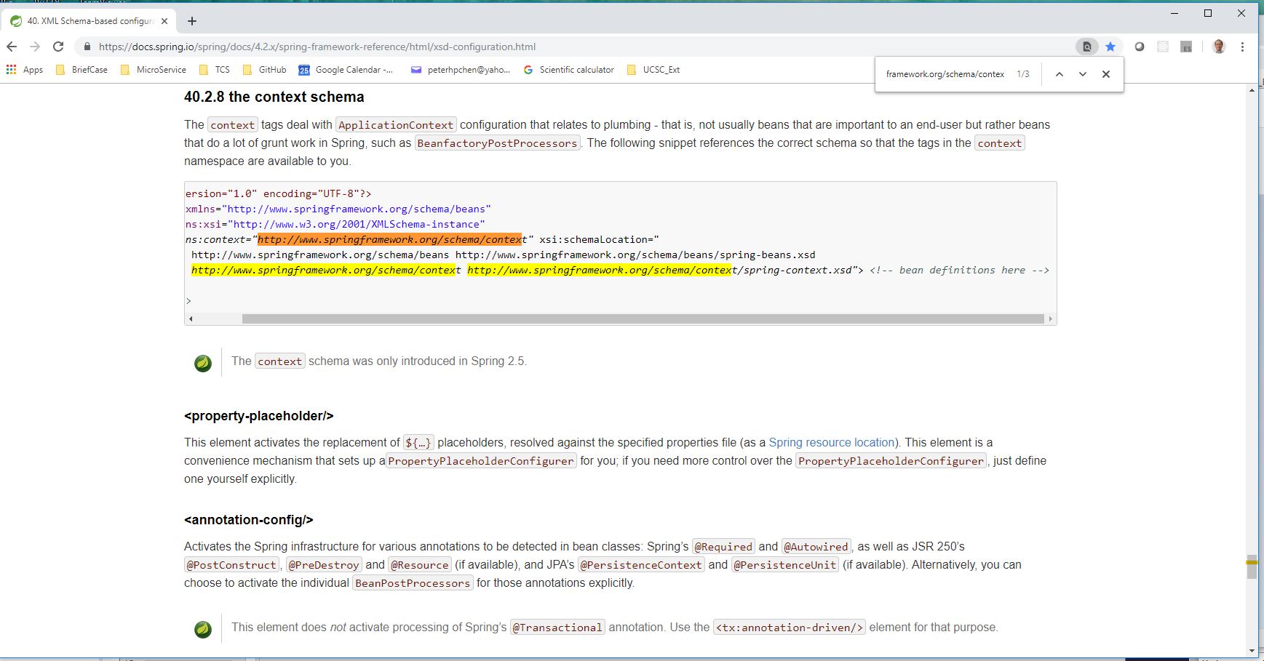
6.1 Add Context in spring.xml
https://www.youtube.com/watch?v=4fZJfqpnyWg&list=PLsyeobzWxl7rFkYFysfTwBu1JBPaNNDrk&index=6
In
https://docs.spring.io/spring/docs/4.2.x/spring-framework-reference/html/xsd-configuration.html
Scroll down to context schema.

Slide 9
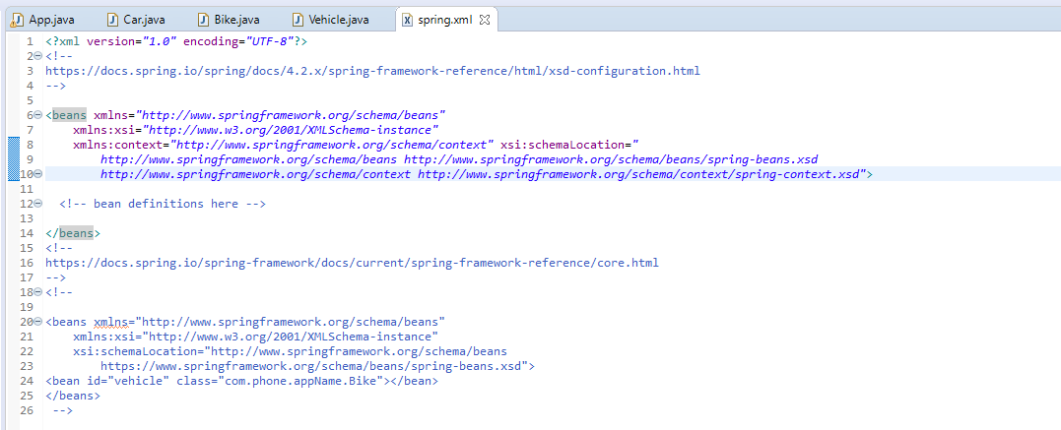
6.1 Add Context in spring.xml
https://www.youtube.com/watch?v=4fZJfqpnyWg&list=PLsyeobzWxl7rFkYFysfTwBu1JBPaNNDrk&index=6
We have to include xmlns:context=“http://www.springframework.org/schema/context”
And
http://www.springframework.org/schema/context
http://www.springframework.org/schema/context/spring-context-4.0.xsd
Note: Make sure copy the xml code from the above web site to prevent the compilation error.

Slide 10
6.1 Add Context in spring.xml
https://www.youtube.com/watch?v=4fZJfqpnyWg&list=PLsyeobzWxl7rFkYFysfTwBu1JBPaNNDrk&index=6
Next thing is: Why I have to configure here?
We can comment it out.

Slide 11
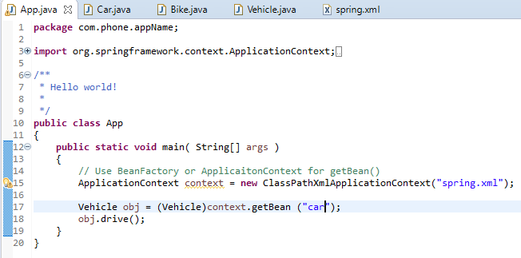
6.1 Add Context in spring.xml
https://www.youtube.com/watch?v=4fZJfqpnyWg&list=PLsyeobzWxl7rFkYFysfTwBu1JBPaNNDrk&index=6
We try to configure different vehicle by annotation configuration.
We want to configure in Java code getBean(“car”).

Slide 12
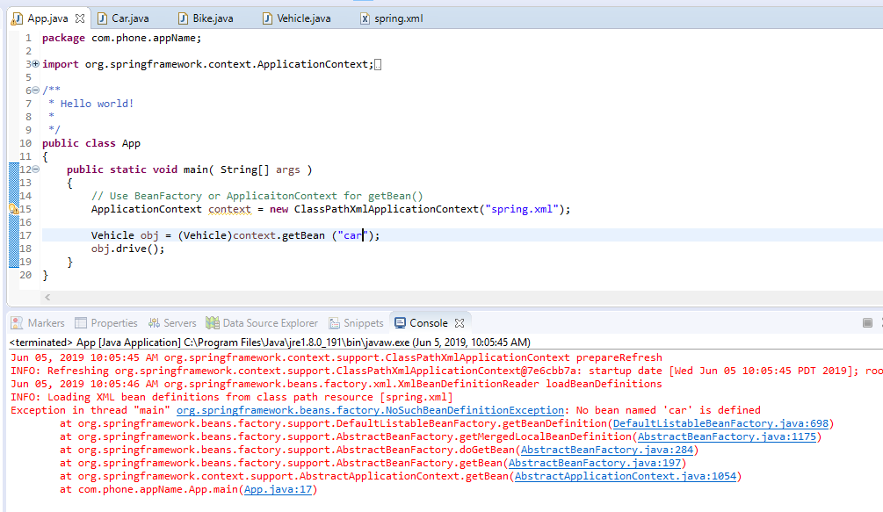
6.1 Add Context in spring.xml
https://www.youtube.com/watch?v=4fZJfqpnyWg&list=PLsyeobzWxl7rFkYFysfTwBu1JBPaNNDrk&index=6
Run again. It says: No bean named ‘car’ is defined.

Slide 13
6.2 Add Car Annotation

Slide 14
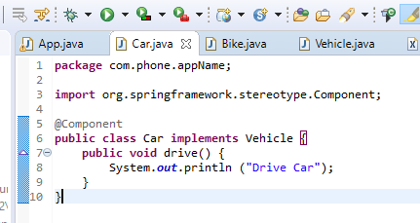
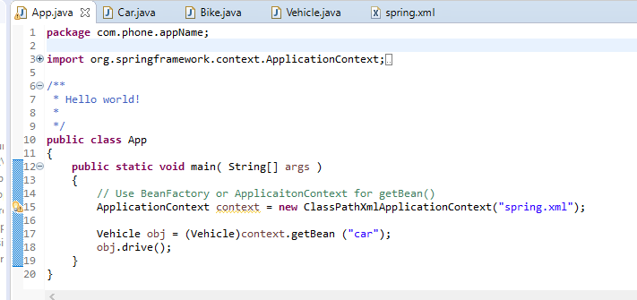
6.2 Add Car Annotation
https://www.youtube.com/watch?v=4fZJfqpnyWg&list=PLsyeobzWxl7rFkYFysfTwBu1JBPaNNDrk&index=6
In XML, we mentioned “vehicle” and then map to class “Car”.
What is the default name for this car object? The object name is automatically de-capitalized.

Slide 15
6.2 Add Car Annotation
https://www.youtube.com/watch?v=4fZJfqpnyWg&list=PLsyeobzWxl7rFkYFysfTwBu1JBPaNNDrk&index=6
Add annotation @Component for class Car.

Slide 16
6.2 Add Car Annotation
https://www.youtube.com/watch?v=4fZJfqpnyWg&list=PLsyeobzWxl7rFkYFysfTwBu1JBPaNNDrk&index=6
Whenever we use Annotation, we do not need to mentioned the
<bean id=… ></bean>
in the XML code (We already commented all of the <bean> section.

Slide 17
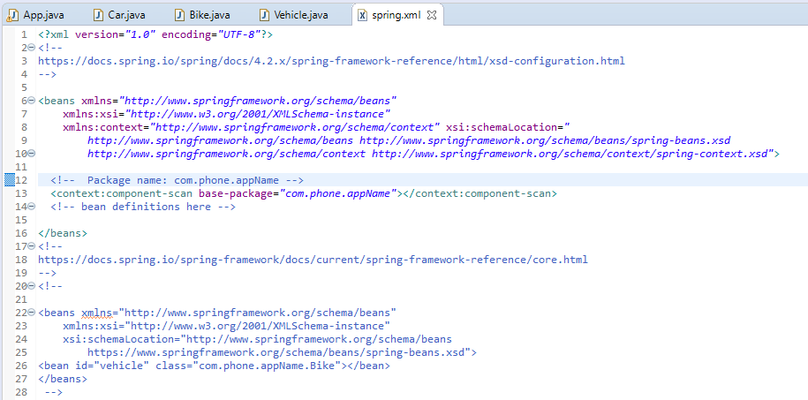
6.2 Add Car Annotation
https://www.youtube.com/watch?v=4fZJfqpnyWg&list=PLsyeobzWxl7rFkYFysfTwBu1JBPaNNDrk&index=6
We have to configurate the package name (folder path) in XML file.

Slide 18
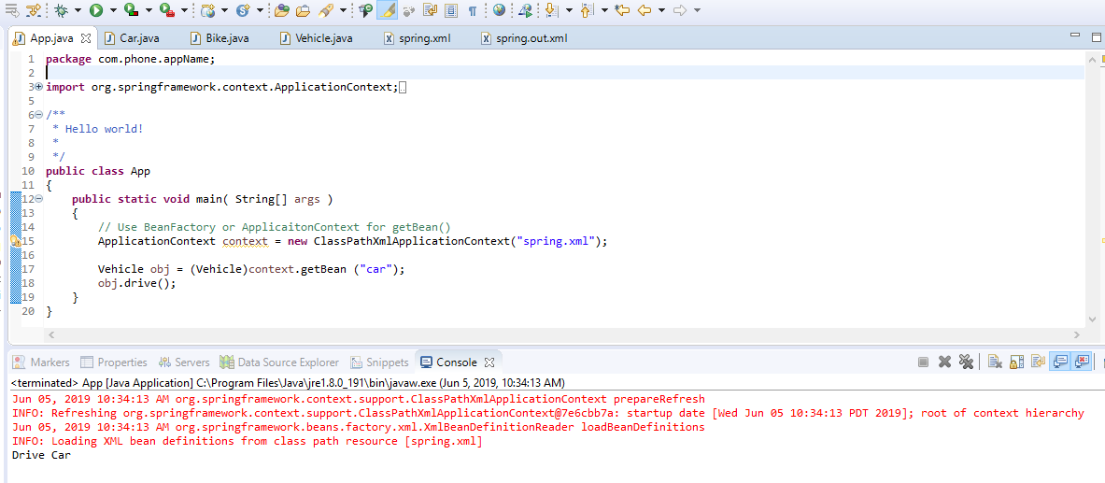
6.2 Add Car Annotation
https://www.youtube.com/watch?v=4fZJfqpnyWg&list=PLsyeobzWxl7rFkYFysfTwBu1JBPaNNDrk&index=6
Run it.

Slide 19
6.3 Add Bike Annotation

Slide 20
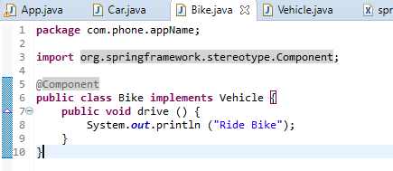
6.3 Add Bike Annotation
https://www.youtube.com/watch?v=4fZJfqpnyWg&list=PLsyeobzWxl7rFkYFysfTwBu1JBPaNNDrk&index=6
Add Annotation @Component for class Bike.

Slide 21
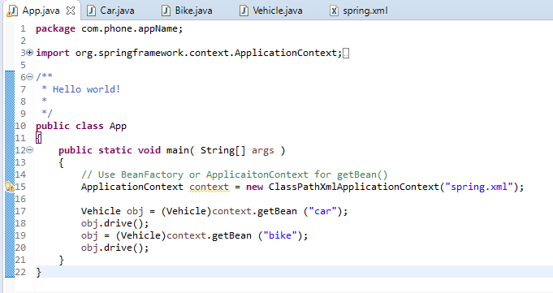
6.3 Add Bike Annotation
https://www.youtube.com/watch?v=4fZJfqpnyWg&list=PLsyeobzWxl7rFkYFysfTwBu1JBPaNNDrk&index=6
Add dependency injection for car object and bike object.
The context (package name) configuration is in xml files.

Slide 22
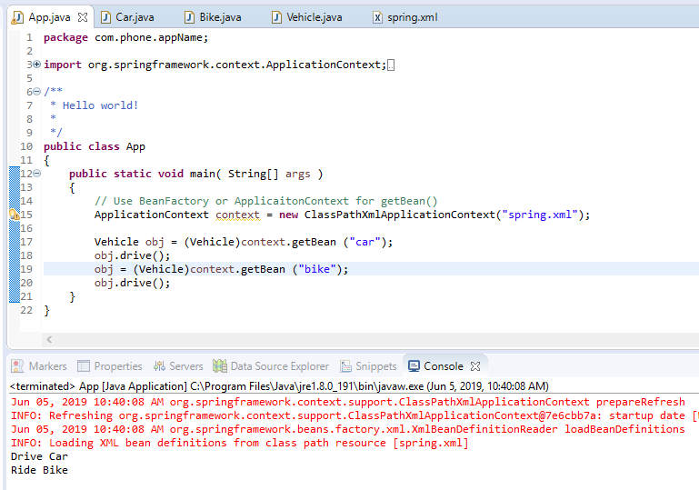
6.3 Add Bike Annotation
https://www.youtube.com/watch?v=4fZJfqpnyWg&list=PLsyeobzWxl7rFkYFysfTwBu1JBPaNNDrk&index=6
Run it. We have both “car” and “bike” object displayed

Slide 23
End of Chapter

