Slide 1

11 Autowired Primary Qualifier
Peter H. Chen

Slide 2
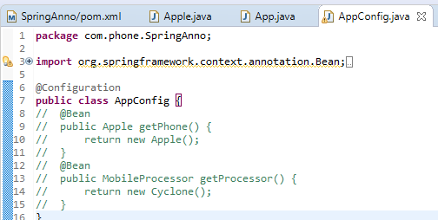
11 Autowired Primary Qualifier
https://www.youtube.com/watch?v=VIaBbNaYDaU&list=PLsyeobzWxl7rFkYFysfTwBu1JBPaNNDrk&index=11
This section discusses Spring Core Component, Autowired, and Primary Qualifier.
We will see how to create Bean without Bean Tag.

Slide 3
11 Autowired Primary Qualifier
https://www.youtube.com/watch?v=VIaBbNaYDaU&list=PLsyeobzWxl7rFkYFysfTwBu1JBPaNNDrk&index=11
This section discusses Spring Core Component, Autowired, and Primary Qualifier.
We will see how to create Bean without Bean Tag.
These Bean above is a replacement of the XML file below:
<bean>
<bean id=“phone” class=“Apple” />
<bean id=“cpu” class = “Cyclone” />
</bean>

Slide 4
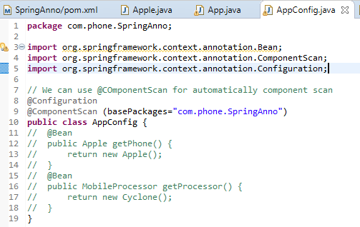
11 Autowired Primary Qualifier
https://www.youtube.com/watch?v=VIaBbNaYDaU&list=PLsyeobzWxl7rFkYFysfTwBu1JBPaNNDrk&index=11
The @ComponentScan is added from class AppConfig.

Slide 5
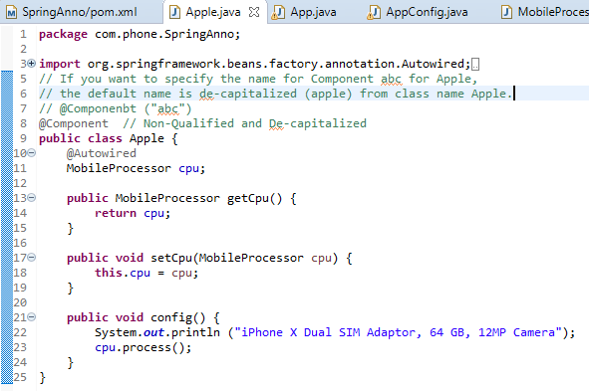
11 Autowired Primary Qualifier
https://www.youtube.com/watch?v=VIaBbNaYDaU&list=PLsyeobzWxl7rFkYFysfTwBu1JBPaNNDrk&index=11
Add @Component for class Apple.

Slide 6
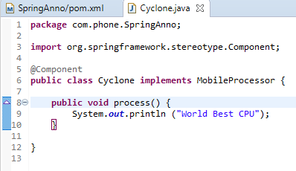
11 Autowired Primary Qualifier
https://www.youtube.com/watch?v=VIaBbNaYDaU&list=PLsyeobzWxl7rFkYFysfTwBu1JBPaNNDrk&index=11
Add @Component for class Cyclone.

Slide 7
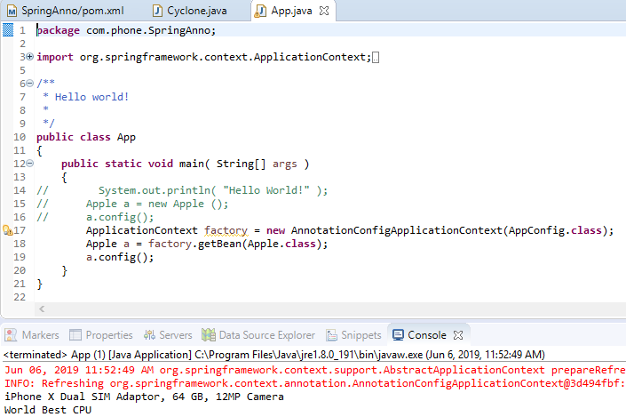
11 Autowired Primary Qualifier
https://www.youtube.com/watch?v=VIaBbNaYDaU&list=PLsyeobzWxl7rFkYFysfTwBu1JBPaNNDrk&index=11
Run app.

Slide 8
10.1 Create Another Class for Interface

Slide 9
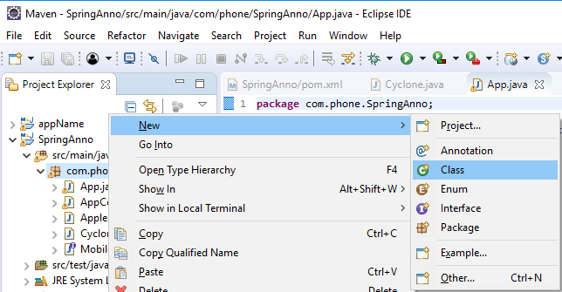
11 Autowired Primary Qualifier
https://www.youtube.com/watch?v=VIaBbNaYDaU&list=PLsyeobzWxl7rFkYFysfTwBu1JBPaNNDrk&index=11
Click “com.phone” package. RMB: New > class.

Slide 10
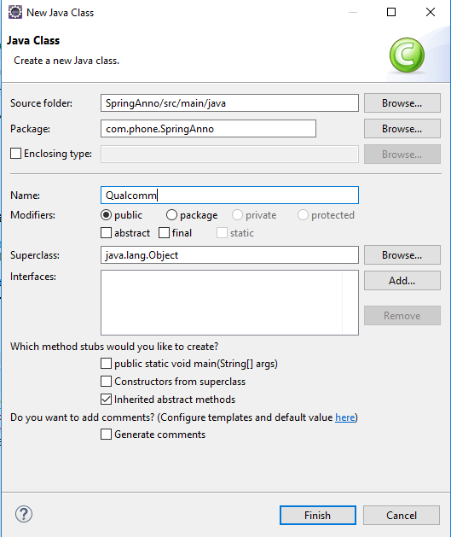
11 Autowired Primary Qualifier
https://www.youtube.com/watch?v=VIaBbNaYDaU&list=PLsyeobzWxl7rFkYFysfTwBu1JBPaNNDrk&index=11
Class Name: Qualcomm.

Slide 11
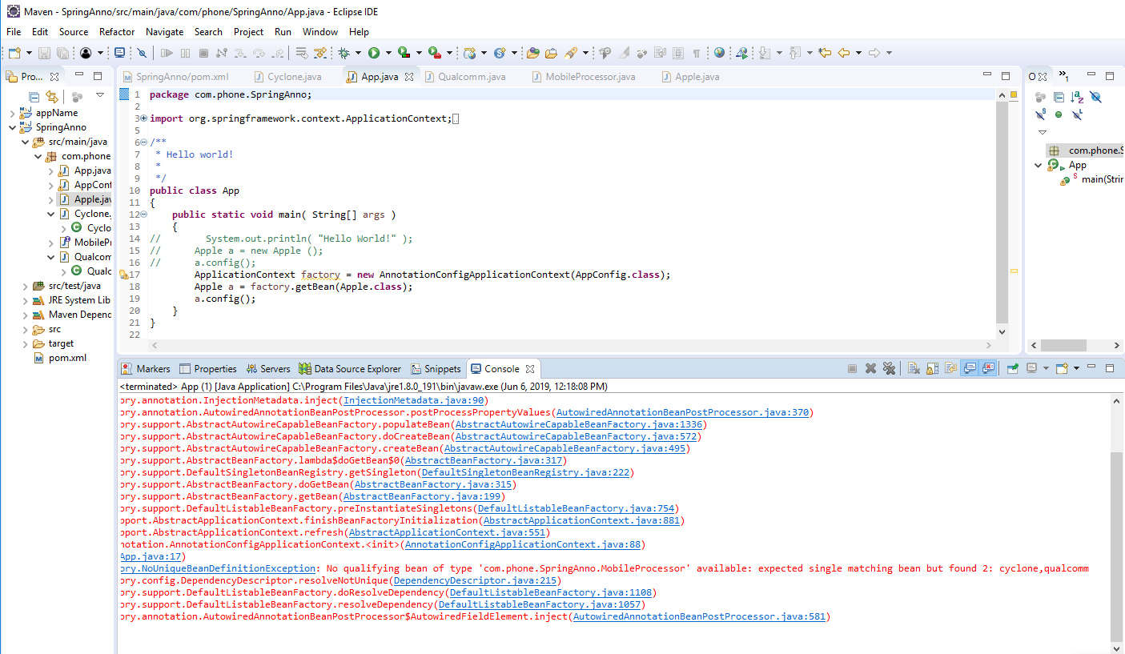
11 Autowired Primary Qualifier
https://www.youtube.com/watch?v=VIaBbNaYDaU&list=PLsyeobzWxl7rFkYFysfTwBu1JBPaNNDrk&index=11
Run it. Cyclone and Qualcomm CPU are confusing.

Slide 12
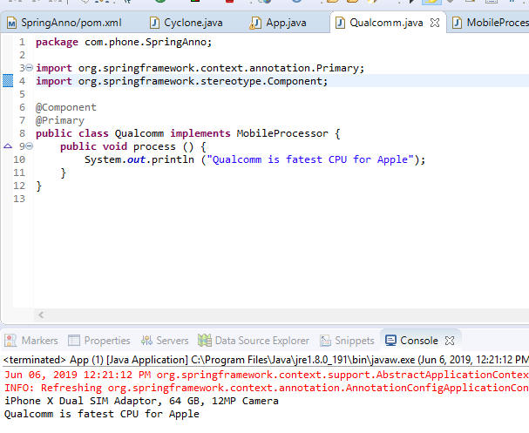
11 Autowired Primary Qualifier
https://www.youtube.com/watch?v=VIaBbNaYDaU&list=PLsyeobzWxl7rFkYFysfTwBu1JBPaNNDrk&index=11
Setup @Primary for class Qualcomm. Run it.

Slide 13
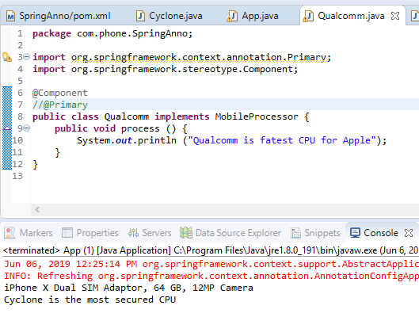
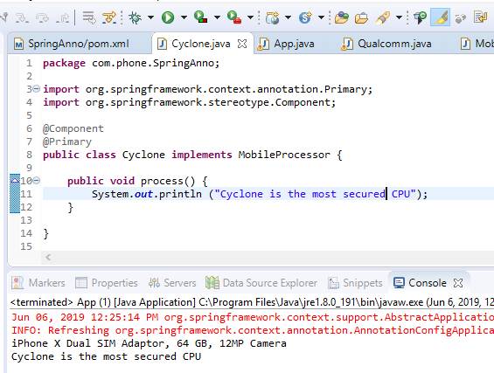
11 Autowired Primary Qualifier
https://www.youtube.com/watch?v=VIaBbNaYDaU&list=PLsyeobzWxl7rFkYFysfTwBu1JBPaNNDrk&index=11
Setup @Primary for Cyclone and remove @Primary for class Qualcomm.

Slide 14
End of Chapter

