Slide 1

10 Spring Core Annotation
Peter H. Chen

Slide 2
10 Spring Core Annotation
https://www.youtube.com/watch?v=5zUTc-kge8I&list=PLsyeobzWxl7rFkYFysfTwBu1JBPaNNDrk&index=10
This section discusses Spring Framework.
We will configure Spring application with the help of annotations.
The Spring Frameworks focus on how to use XML configuration.
We focus more on annotation of basic Spring Framework configuration.

Slide 3
10.1 Create Maven Project

Slide 4
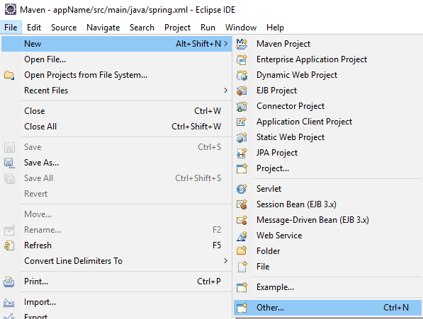
10.1 Create Maven Project
https://www.youtube.com/watch?v=5zUTc-kge8I&list=PLsyeobzWxl7rFkYFysfTwBu1JBPaNNDrk&index=10
Create a new Maven Project
File > New > Other …

Slide 5
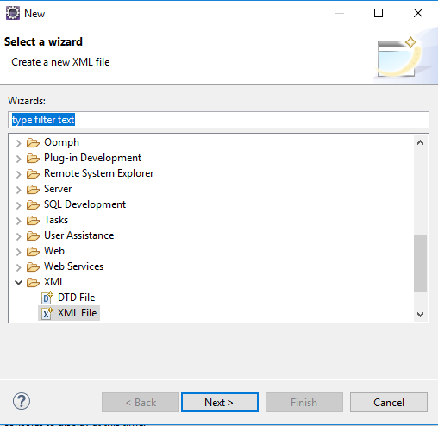
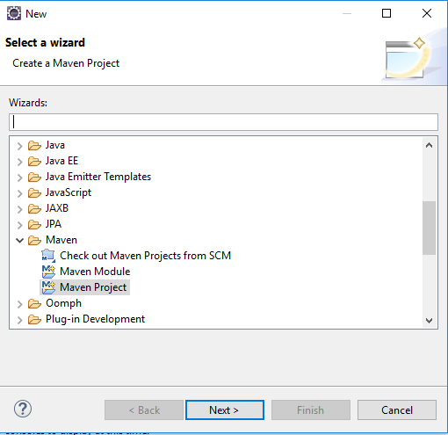
10.1 Create Maven Project
https://www.youtube.com/watch?v=5zUTc-kge8I&list=PLsyeobzWxl7rFkYFysfTwBu1JBPaNNDrk&index=10
You do not want all the libraries.
Scroll up and find Maven > Maven Project

Slide 6
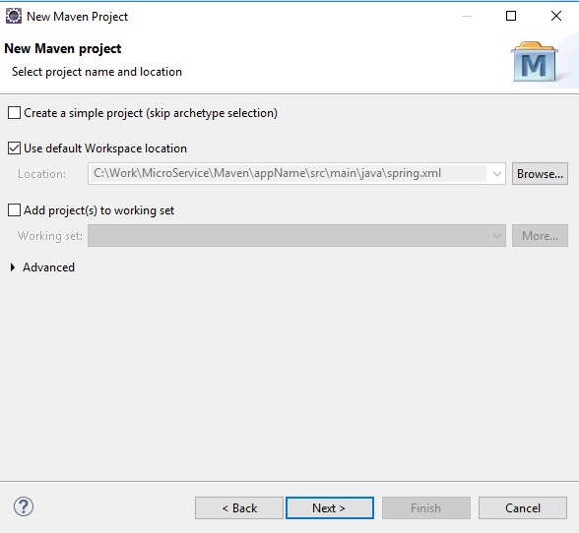
10.1 Create Maven Project
https://www.youtube.com/watch?v=5zUTc-kge8I&list=PLsyeobzWxl7rFkYFysfTwBu1JBPaNNDrk&index=10
Create custom project: Skip the simple project.

Slide 7
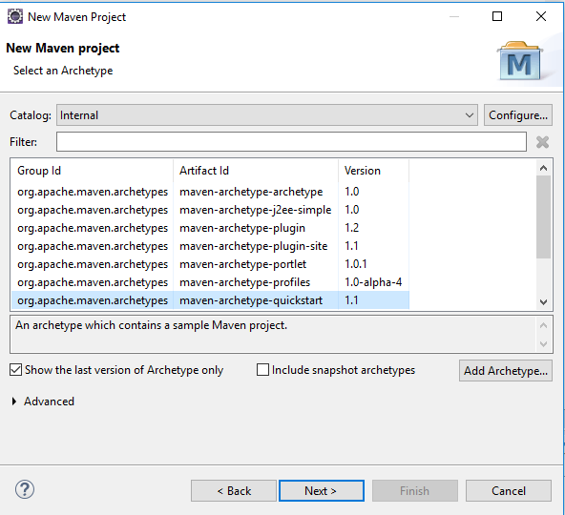
10.1 Create Maven Project
https://www.youtube.com/watch?v=5zUTc-kge8I&list=PLsyeobzWxl7rFkYFysfTwBu1JBPaNNDrk&index=10
Select the internal and quickstart which is a Maven application.

Slide 8
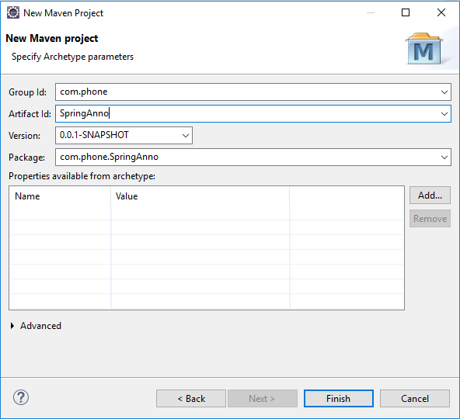
10.1 Create Maven Project
https://www.youtube.com/watch?v=5zUTc-kge8I&list=PLsyeobzWxl7rFkYFysfTwBu1JBPaNNDrk&index=10
We can go for Spring Web for their application. You can go for quick start core job application.
Give Group Id: com.phone. The Artifact Id: SpringAnno is the project name.

Slide 9
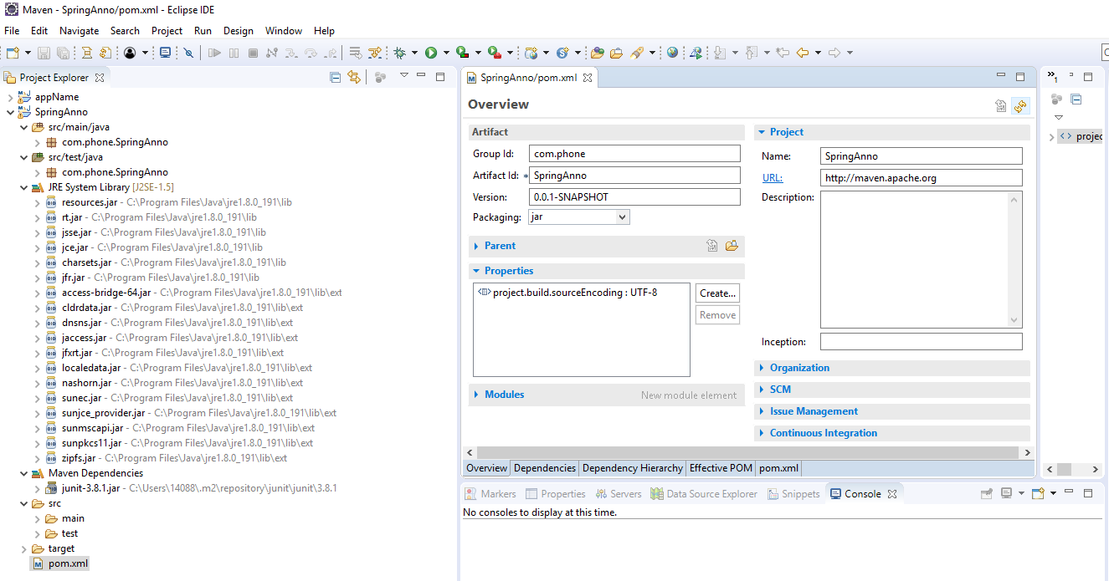
10.1 Create Maven Project
https://www.youtube.com/watch?v=5zUTc-kge8I&list=PLsyeobzWxl7rFkYFysfTwBu1JBPaNNDrk&index=10
We have a new project: SpringAnno.
Click pom.xml and click Overview.

Slide 10
10.2 Search Spring Dependency

Slide 11
10.2 Search Spring Dependency
https://www.youtube.com/watch?v=5zUTc-kge8I&list=PLsyeobzWxl7rFkYFysfTwBu1JBPaNNDrk&index=10
We have a new project: SpringAnno.
Click pom.xml and click Overview.

Slide 12
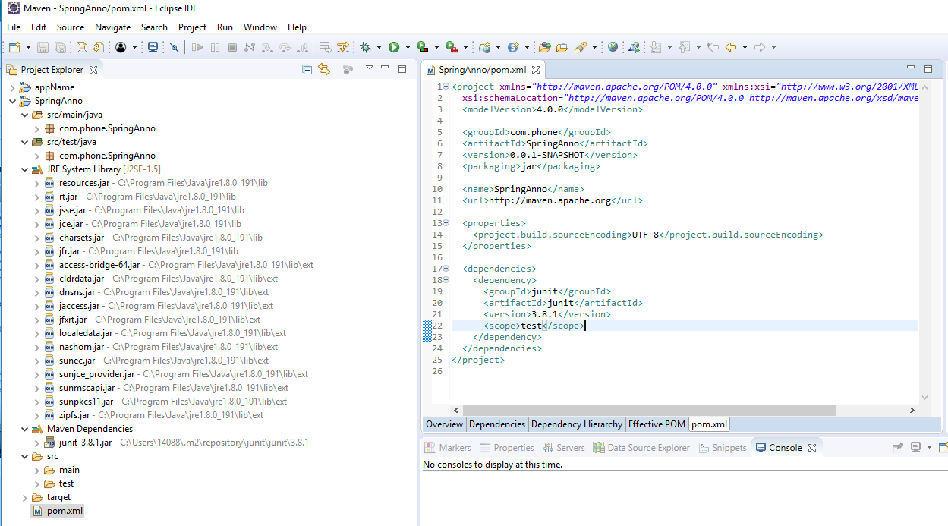
10.2 Search Spring Dependency
https://www.youtube.com/watch?v=5zUTc-kge8I&list=PLsyeobzWxl7rFkYFysfTwBu1JBPaNNDrk&index=10
Click pom.xml.

Slide 13
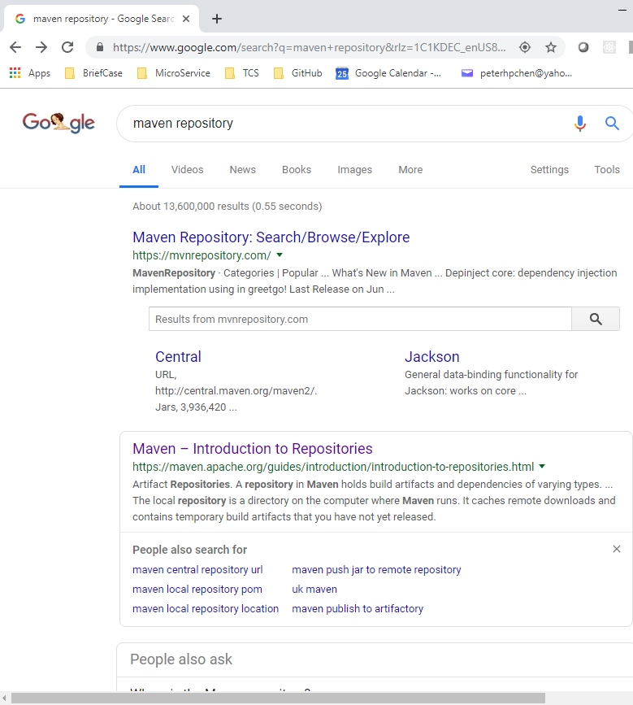
10.2 Search Spring Dependency
https://www.youtube.com/watch?v=5zUTc-kge8I&list=PLsyeobzWxl7rFkYFysfTwBu1JBPaNNDrk&index=10
In the pom.xml, add dependency in the <dependency> area.
Google “maven dependencies”

Slide 14
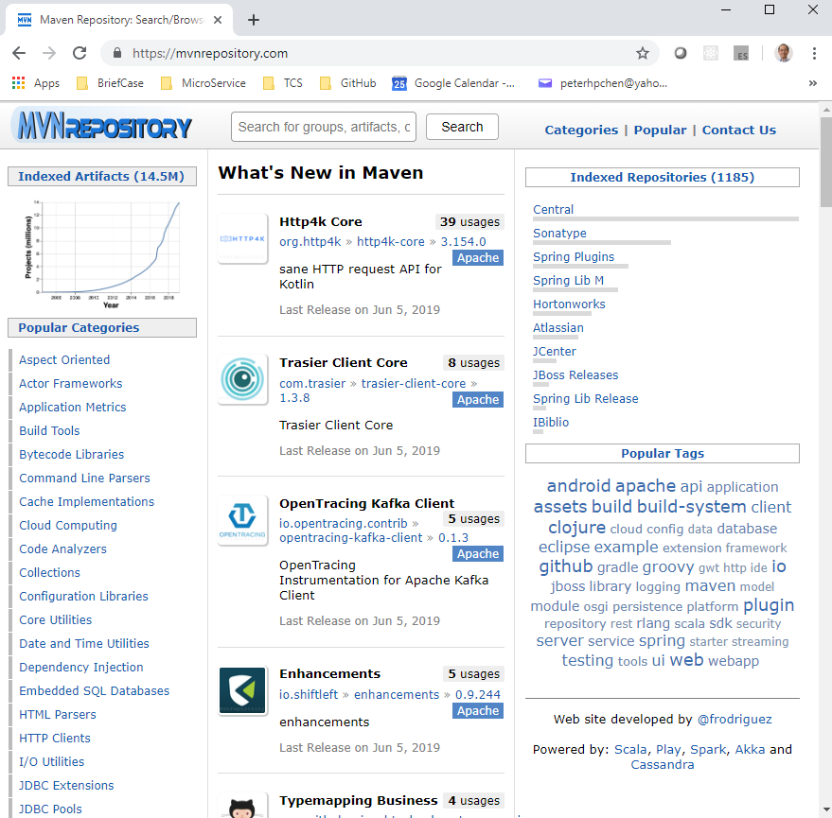
10.2 Search Spring Dependency
https://www.youtube.com/watch?v=5zUTc-kge8I&list=PLsyeobzWxl7rFkYFysfTwBu1JBPaNNDrk&index=10
In the pom.xml, add dependency in the <dependency> area.

Slide 15
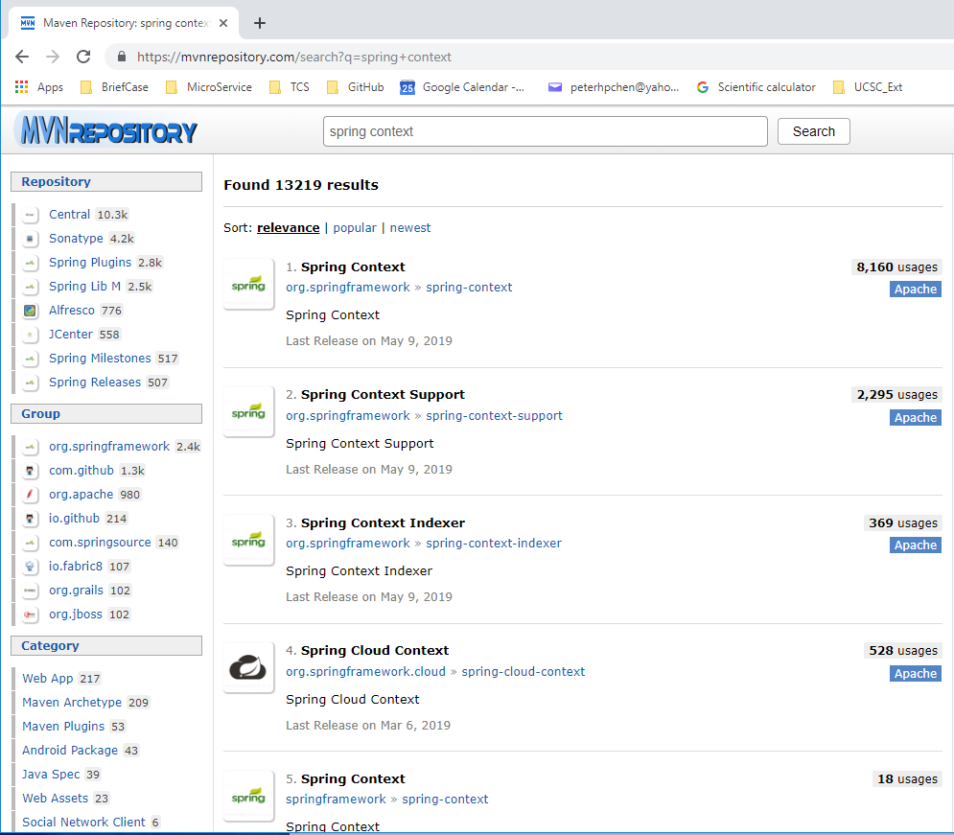
10.2 Search Spring Dependency
https://www.youtube.com/watch?v=5zUTc-kge8I&list=PLsyeobzWxl7rFkYFysfTwBu1JBPaNNDrk&index=10
In the repository, search for “Spring Context”.
Click “Spring Context”

Slide 16
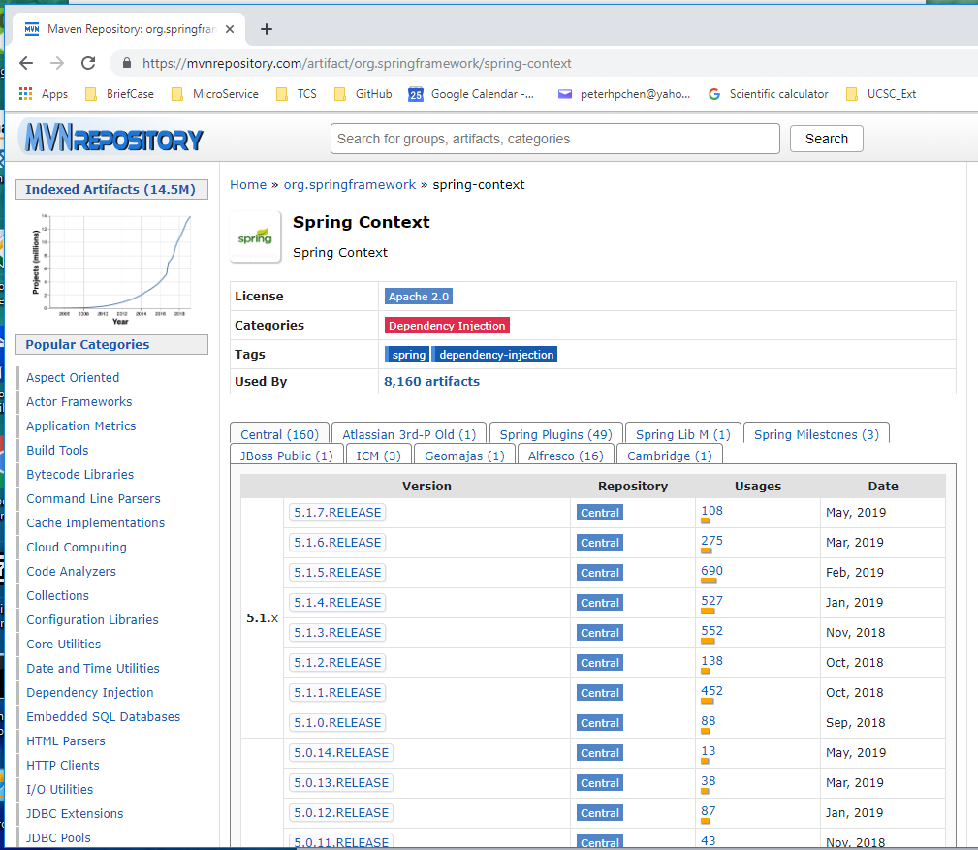
10.2 Search Spring Dependency
https://www.youtube.com/watch?v=5zUTc-kge8I&list=PLsyeobzWxl7rFkYFysfTwBu1JBPaNNDrk&index=10
Current version is 5.1.x. Scroll down one lower version (5.0.x) for stable reason.

Slide 17
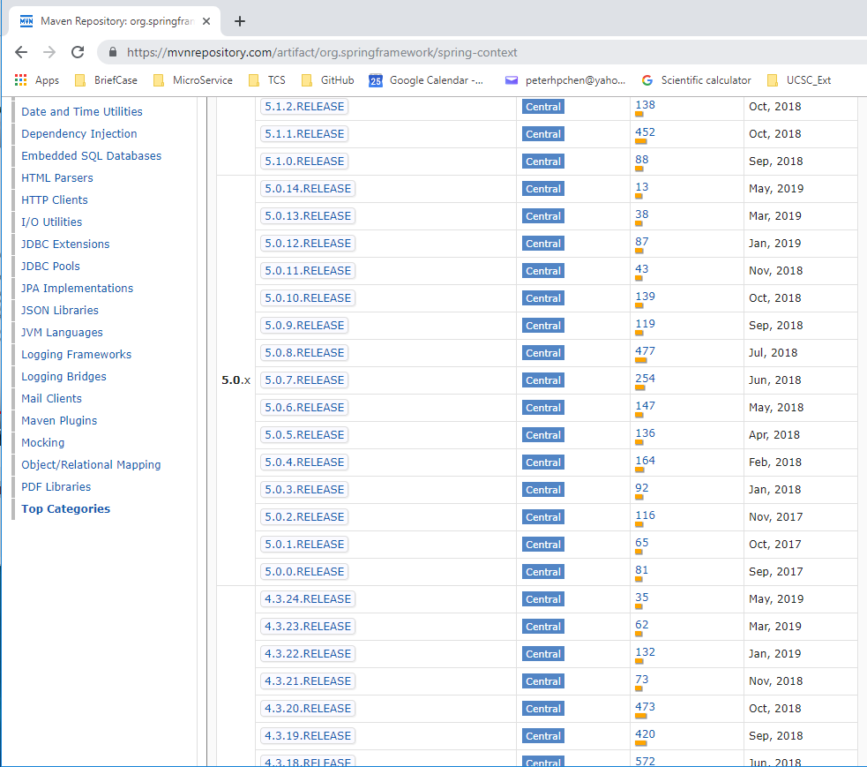
10.2 Search Spring Dependency
https://www.youtube.com/watch?v=5zUTc-kge8I&list=PLsyeobzWxl7rFkYFysfTwBu1JBPaNNDrk&index=10
5.0.14 is the one lower version with latest stable release.
Click 5.0.14.

Slide 18
10.3 Copy Dependency

Slide 19
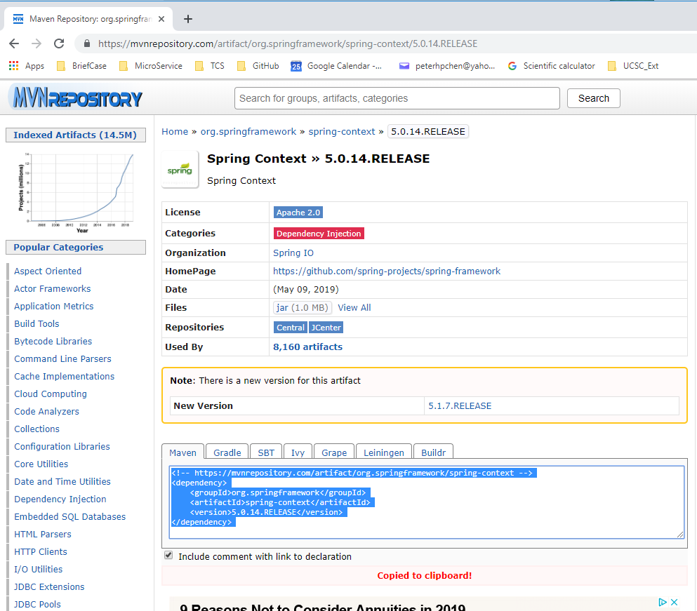
10.3 Copy Dependency
https://www.youtube.com/watch?v=5zUTc-kge8I&list=PLsyeobzWxl7rFkYFysfTwBu1JBPaNNDrk&index=10
Click Maven tab and highlighted and copy dependency.

Slide 20
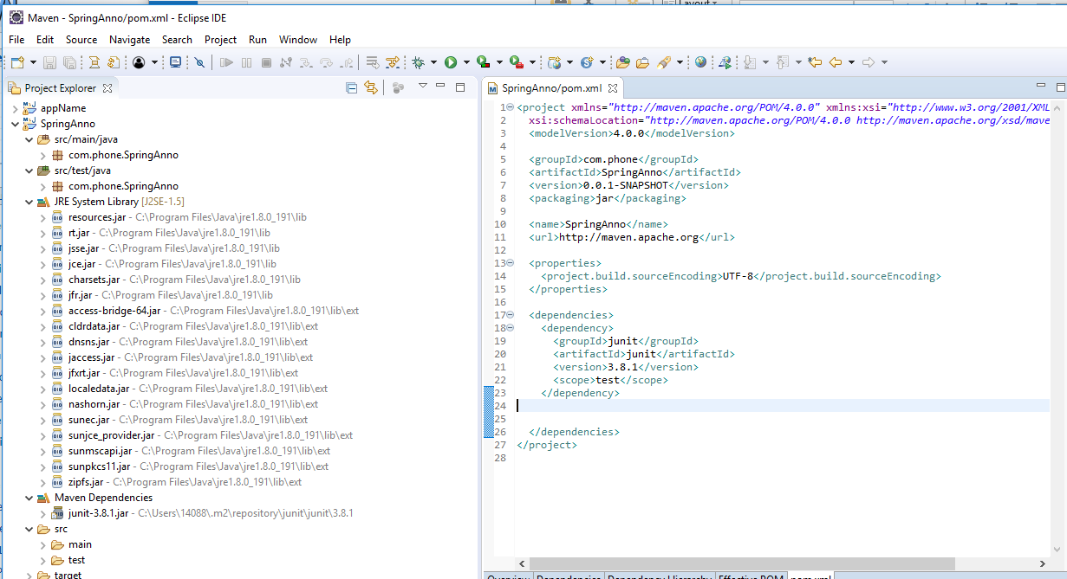
10.3 Copy Dependency
https://www.youtube.com/watch?v=5zUTc-kge8I&list=PLsyeobzWxl7rFkYFysfTwBu1JBPaNNDrk&index=10
In the pom.xml file, find the </dependency> location.

Slide 21
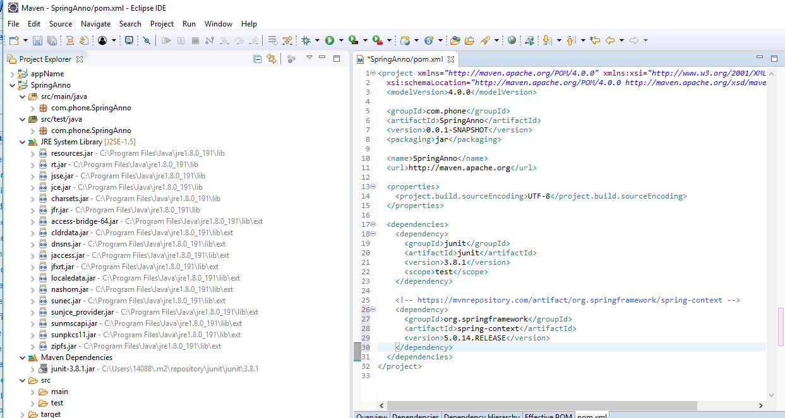
10.3 Copy Dependency
https://www.youtube.com/watch?v=5zUTc-kge8I&list=PLsyeobzWxl7rFkYFysfTwBu1JBPaNNDrk&index=10
In the pom.xml file, copy Spring dependency in the below <dependency>Junit </dependency>

Slide 22
10.4 Download Dependency

Slide 23
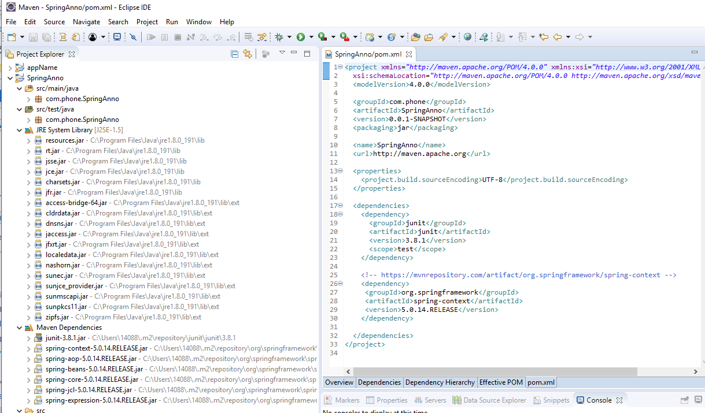
10.4 Download Dependency
https://www.youtube.com/watch?v=5zUTc-kge8I&list=PLsyeobzWxl7rFkYFysfTwBu1JBPaNNDrk&index=10
Save the pom.xml file, the dependencies are downloaded automatically.
1
Save pom.xml
2
Maven Dependencies are automatically downloaded.

Slide 24
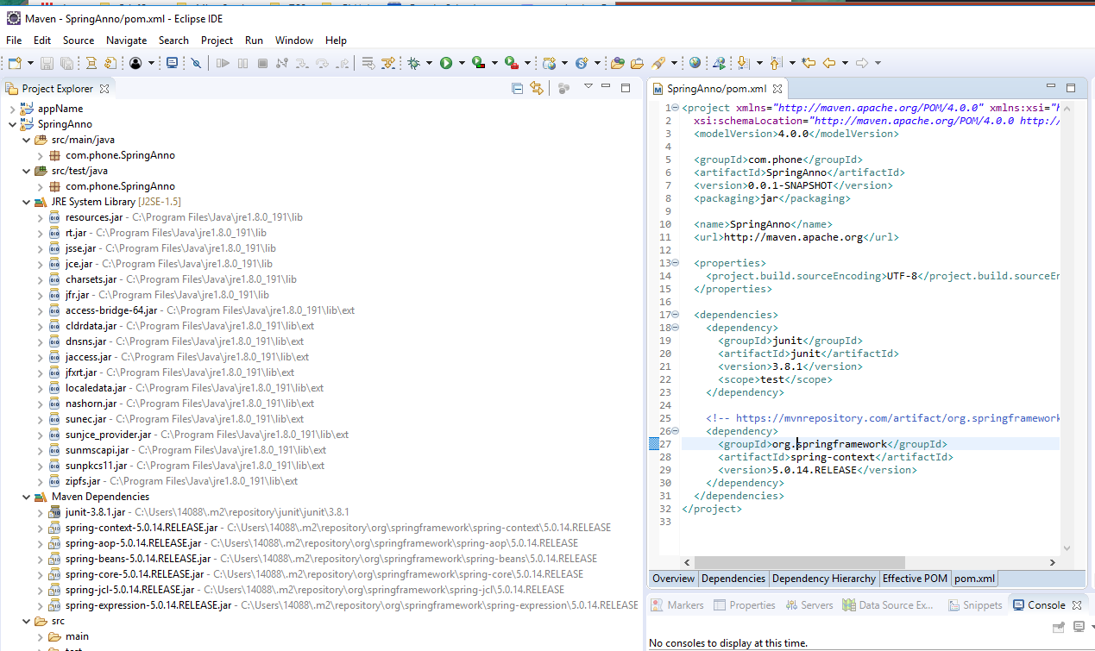
10.4 Download Dependency
https://www.youtube.com/watch?v=5zUTc-kge8I&list=PLsyeobzWxl7rFkYFysfTwBu1JBPaNNDrk&index=10
The local Maven Dependencies are locate under C:\Users\14088\.m2
The home path “.\m2” has all the maven dependencies there.

Slide 25
10.5 Create Apple Application

Slide 26
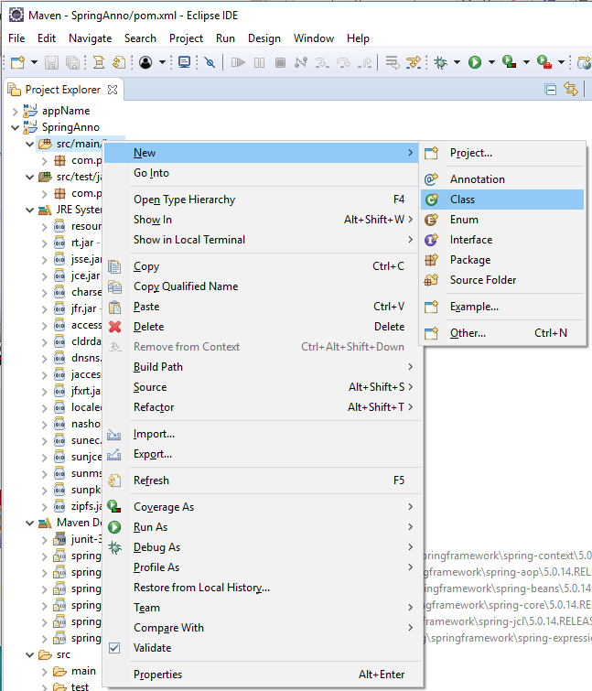
10.5 Create Apple Application
https://www.youtube.com/watch?v=5zUTc-kge8I&list=PLsyeobzWxl7rFkYFysfTwBu1JBPaNNDrk&index=10
Create an Apple Application.
SpringAnno: src/main/java: RMB: New > Class

Slide 27
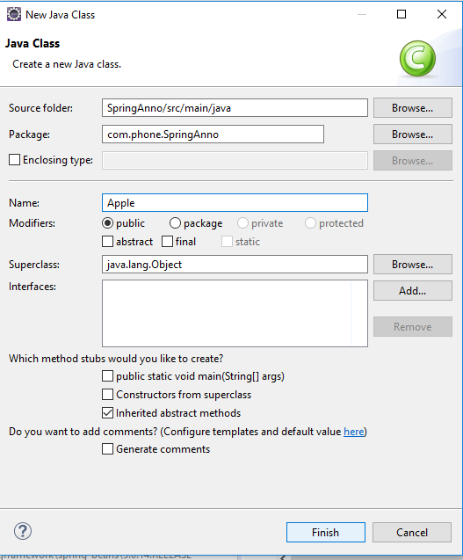
10.5 Create Apple Application
https://www.youtube.com/watch?v=5zUTc-kge8I&list=PLsyeobzWxl7rFkYFysfTwBu1JBPaNNDrk&index=10
Class Name: Apple

Slide 28
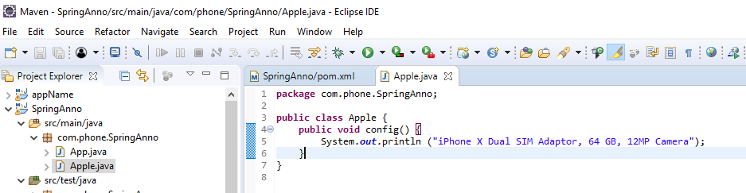
10.5 Create Apple Application
https://www.youtube.com/watch?v=5zUTc-kge8I&list=PLsyeobzWxl7rFkYFysfTwBu1JBPaNNDrk&index=10
Class Name: Apple
public void config () { …}

Slide 29
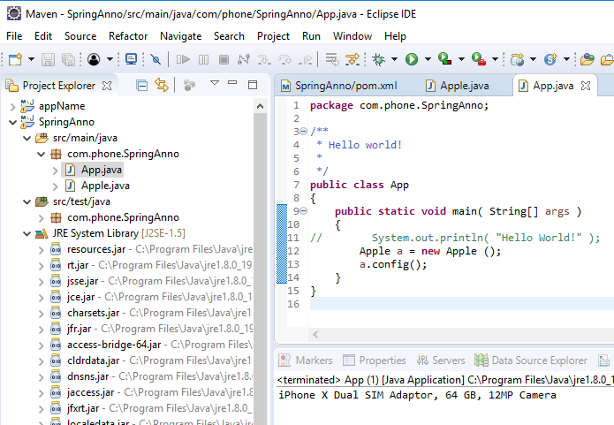
10.5 Create Apple Application
https://www.youtube.com/watch?v=5zUTc-kge8I&list=PLsyeobzWxl7rFkYFysfTwBu1JBPaNNDrk&index=10
In App.java,
public void main (String[] args) { Apple a = new Apple (); s.config() }
Run it.

Slide 30
10.6 Create AppConfig Class

Slide 31
10.6 Create AppConfig Class
https://www.youtube.com/watch?v=5zUTc-kge8I&list=PLsyeobzWxl7rFkYFysfTwBu1JBPaNNDrk&index=10
We do not want to use “new Apple()”. We want to use Dependency Injection instead.
How to change the new Apple() into Dependency Injection?

Slide 32
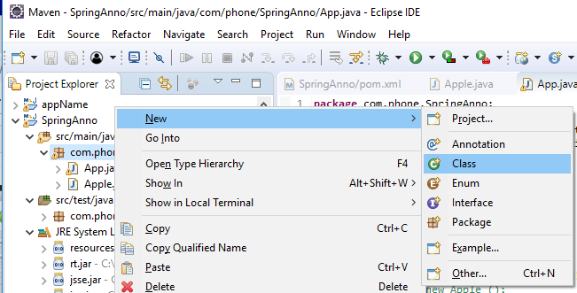
10.6 Create AppConfig Class
https://www.youtube.com/watch?v=5zUTc-kge8I&list=PLsyeobzWxl7rFkYFysfTwBu1JBPaNNDrk&index=10
Create class: New > Class.

Slide 33
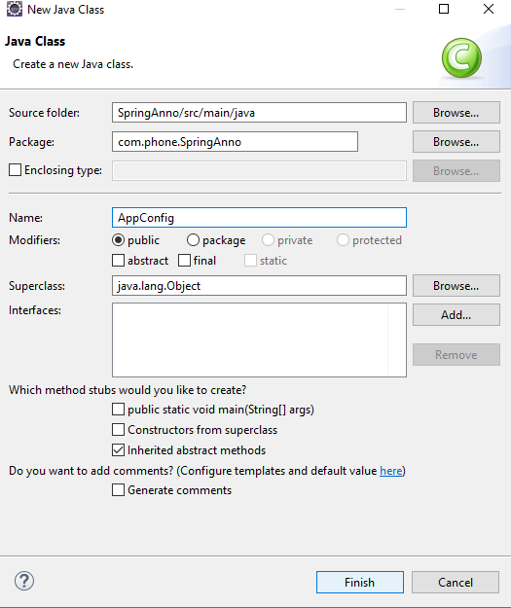
10.6 Create AppConfig Class
https://www.youtube.com/watch?v=5zUTc-kge8I&list=PLsyeobzWxl7rFkYFysfTwBu1JBPaNNDrk&index=10
Class Name: AppConfig

Slide 34
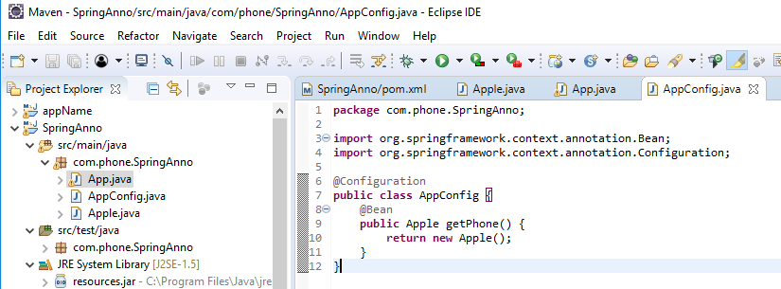
10.6 Create AppConfig Class
https://www.youtube.com/watch?v=5zUTc-kge8I&list=PLsyeobzWxl7rFkYFysfTwBu1JBPaNNDrk&index=10
In AppConfig.java, we need
@Configuration
public class AppConfig {
@Bean public Apple getBean () {
return new Apple()
}
}

Slide 35
10.7 Create factory

Slide 36
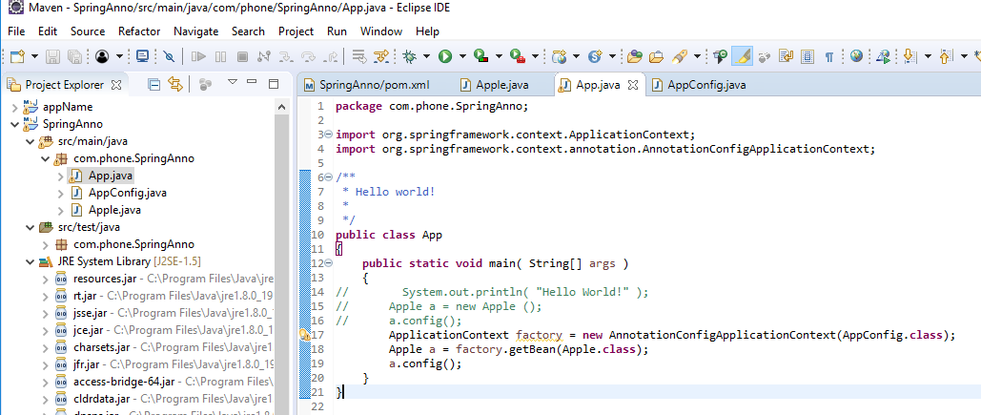
10.7 Create factory
https://www.youtube.com/watch?v=5zUTc-kge8I&list=PLsyeobzWxl7rFkYFysfTwBu1JBPaNNDrk&index=10
In App.java, remove “Apple a = new Apple();”
Add “ApplicationContext factory = new ApplicationConfigApplicaitonContext (AppConfig.class); Apple a = factory.getBean (Apple.class)”

Slide 37
10.7 Create factory
https://www.youtube.com/watch?v=5zUTc-kge8I&list=PLsyeobzWxl7rFkYFysfTwBu1JBPaNNDrk&index=10
In App.java, remove “Apple a = new Apple();”
Add “ApplicationContext factory = new ApplicationConfigApplicaitonContext (AppConfig.class); Apple a = factory.getBean (Apple.class)”
This factory need to know which class (AppConfig.class) to work with.

Slide 38
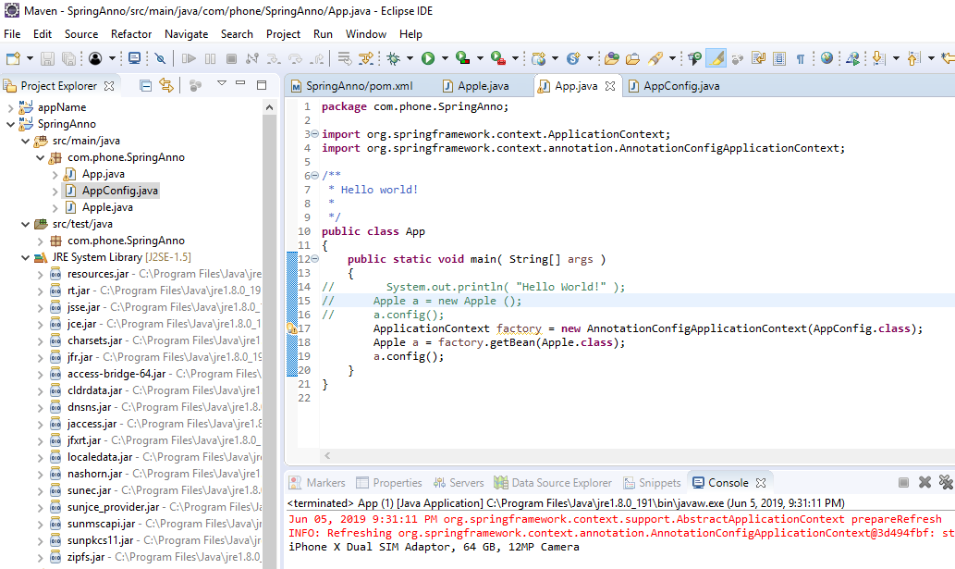
10.7 Create factory
https://www.youtube.com/watch?v=5zUTc-kge8I&list=PLsyeobzWxl7rFkYFysfTwBu1JBPaNNDrk&index=10
Run it.
You can see that we did not use any dependency file here.

Slide 39
10.8 Add CPU Data to Apple

Slide 40
10.8 Add CPU Data to Apple
https://www.youtube.com/watch?v=5zUTc-kge8I&list=PLsyeobzWxl7rFkYFysfTwBu1JBPaNNDrk&index=10
We have
<beans>
<bean id=“phone” class=“Apple” />
<bean id=“cpu” class=“Snapdragon” />
</beans>
How to change our Java code?

Slide 41
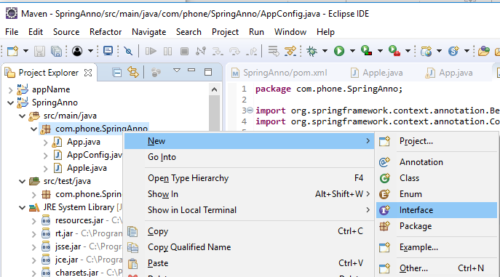
10.8 Add CPU Data to Apple
https://www.youtube.com/watch?v=5zUTc-kge8I&list=PLsyeobzWxl7rFkYFysfTwBu1JBPaNNDrk&index=10
How to create another CPU?
Create an Interface “MobileProcessor”
Select Package “com.phone.SpringAnno”. RMB: New > Interface

Slide 42
10.9 Create Interface MobileProcessor

Slide 43
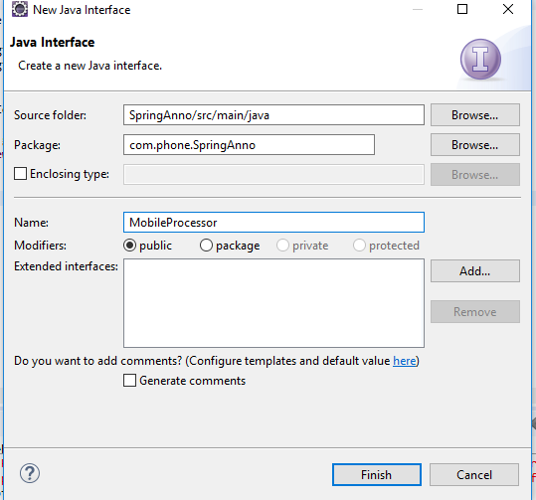
10.9 Create Interface MobileProcessor
https://www.youtube.com/watch?v=5zUTc-kge8I&list=PLsyeobzWxl7rFkYFysfTwBu1JBPaNNDrk&index=10
Interface Name: MobileProcessor

Slide 44
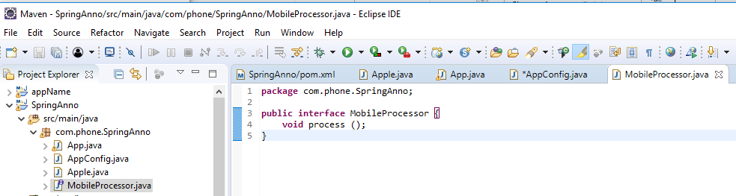
10.9 Create Interface MobileProcessor
https://www.youtube.com/watch?v=5zUTc-kge8I&list=PLsyeobzWxl7rFkYFysfTwBu1JBPaNNDrk&index=10
Add “void process()” for class Interface.

Slide 45
10.9 Create Class Cyclone

Slide 46
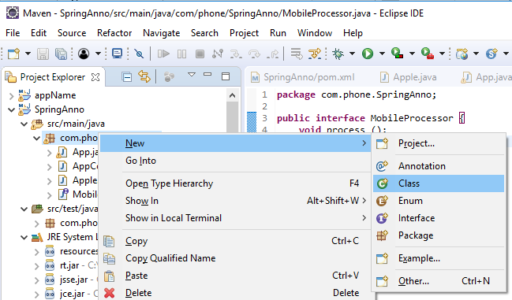
10.9 Create Class Cyclone
https://www.youtube.com/watch?v=5zUTc-kge8I&list=PLsyeobzWxl7rFkYFysfTwBu1JBPaNNDrk&index=10
To Implement the Interface, we create iPhone CPU name for class Cyclone

Slide 47
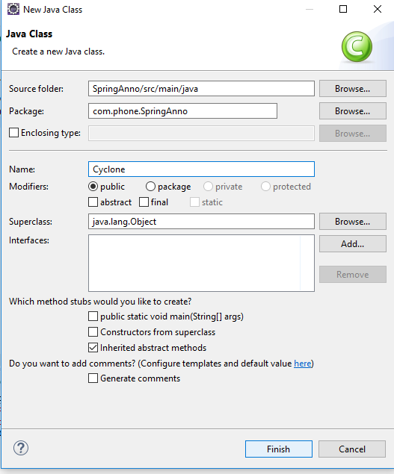
10.9 Create Class Cyclone
https://www.youtube.com/watch?v=5zUTc-kge8I&list=PLsyeobzWxl7rFkYFysfTwBu1JBPaNNDrk&index=10
To Implement the Interface, we create iPhone CPU name for class Cyclone (= Samsung Snapdragon).

Slide 48
10.10 Add Interface to Cyclone

Slide 49
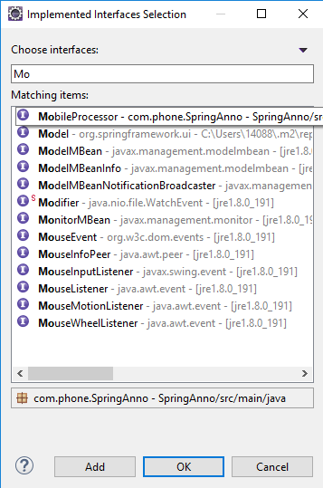
10.10 Add Interface to Cyclone
https://www.youtube.com/watch?v=5zUTc-kge8I&list=PLsyeobzWxl7rFkYFysfTwBu1JBPaNNDrk&index=10
To Implement the Interface, we create iPhone CPU name for class Cyclone (= Samsung Snapdragon).

Slide 50
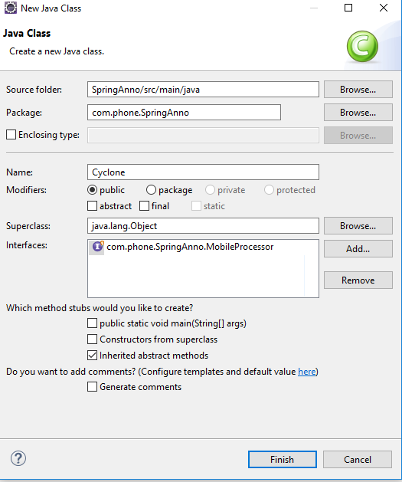
10.10 Add Interface to Cyclone
https://www.youtube.com/watch?v=5zUTc-kge8I&list=PLsyeobzWxl7rFkYFysfTwBu1JBPaNNDrk&index=10
Add Interface “com.phone.SpringAnno.MonbileProcessor” for class Cyclone.

Slide 51
10.11 Add Process() to Cyclone

Slide 52
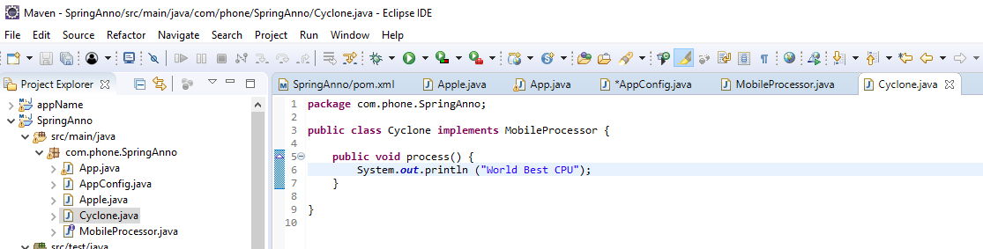
10.11 Add Process() to Cyclone
https://www.youtube.com/watch?v=5zUTc-kge8I&list=PLsyeobzWxl7rFkYFysfTwBu1JBPaNNDrk&index=10
You can see class Cyclone implements the interface MonbileProcessor

Slide 53
10.12 Add cpu, get, and set to Apple

Slide 54
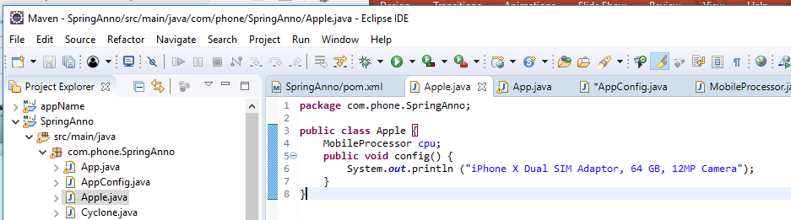
10.12 Add cpu, get, and set to Apple
https://www.youtube.com/watch?v=5zUTc-kge8I&list=PLsyeobzWxl7rFkYFysfTwBu1JBPaNNDrk&index=10
Inside the Apple, we add “MobileProcess cpu”

Slide 55
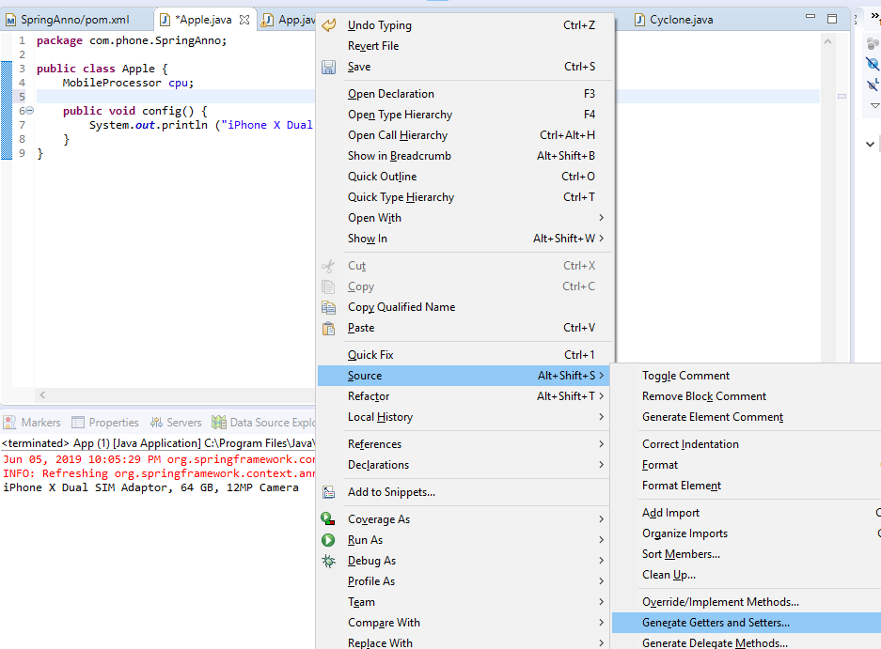
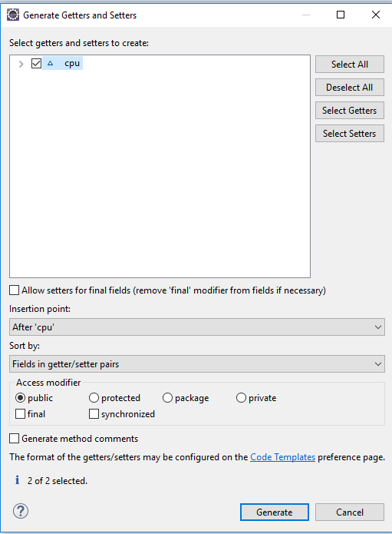
10.12 Add cpu, get, and set to Apple
https://www.youtube.com/watch?v=5zUTc-kge8I&list=PLsyeobzWxl7rFkYFysfTwBu1JBPaNNDrk&index=10
We need setter() and getter()

Slide 56
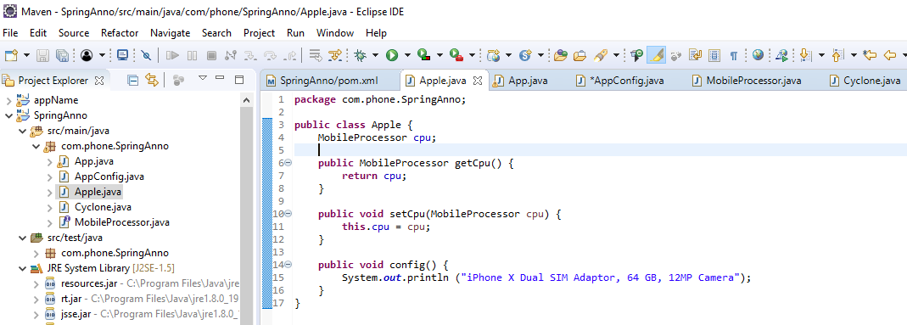
10.12 Add cpu, get, and set to Apple
https://www.youtube.com/watch?v=5zUTc-kge8I&list=PLsyeobzWxl7rFkYFysfTwBu1JBPaNNDrk&index=10
We have getCpu() and setCpu()

Slide 57
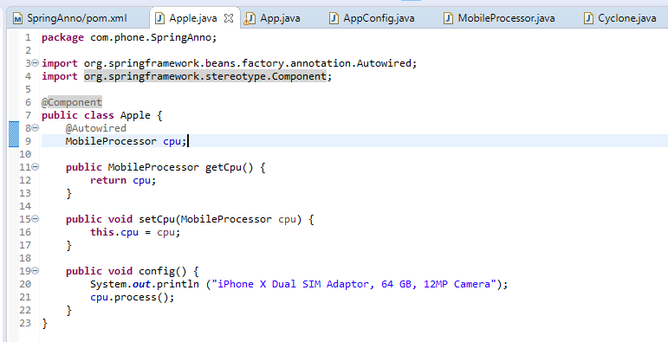
10.12 Add cpu, get, and set to Apple
https://www.youtube.com/watch?v=5zUTc-kge8I&list=PLsyeobzWxl7rFkYFysfTwBu1JBPaNNDrk&index=10
We add cpu.Process()
We need @autowire for variable and @Component for class Apple.

Slide 58
10.13 Run

Slide 59
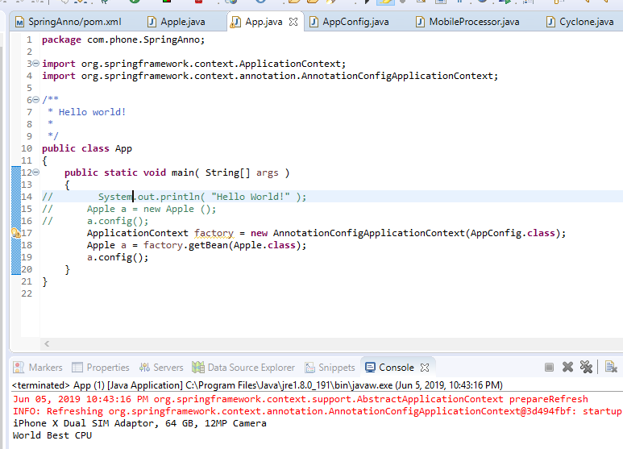
10.13 Run
https://www.youtube.com/watch?v=5zUTc-kge8I&list=PLsyeobzWxl7rFkYFysfTwBu1JBPaNNDrk&index=10
Run application.

Slide 60
End of Chapter

