Slide 1

4 Application Context
Peter H. Chen

Slide 2
4 Application Context
https://www.youtube.com/watch?v=jdRd5hR9ON8&list=PLsyeobzWxl7rFkYFysfTwBu1JBPaNNDrk&index=4
This section discusses the Application Context of Maven.
We have Apom.xml, dependency for Spring, and App.java.
We can use Spring for dependency injection.
For example, we want to create a car, we have tire and engine. In stead creating everything by yourself at runtime, we can ask someone else to you us by those dependencies.
In the future, you do not have to change your code.
Rod Johnson has book on Spring. This is a very good book.

Slide 3
4.1 Create Car Class
Peter H. Chen

Slide 4
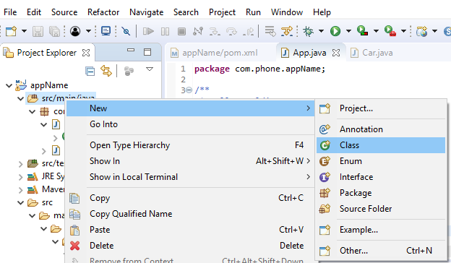
4.1 Create Car Class
https://www.youtube.com/watch?v=jdRd5hR9ON8&list=PLsyeobzWxl7rFkYFysfTwBu1JBPaNNDrk&index=4
Click “src/main/java”. RMB: New > class

Slide 5
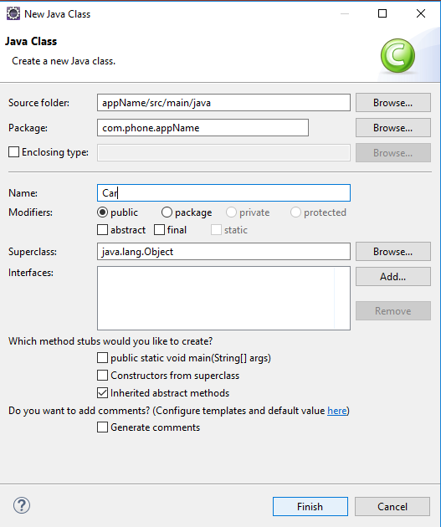
4.1 Create Car Class
https://www.youtube.com/watch?v=jdRd5hR9ON8&list=PLsyeobzWxl7rFkYFysfTwBu1JBPaNNDrk&index=4
In Java Class Menu,
Name: Car

Slide 6
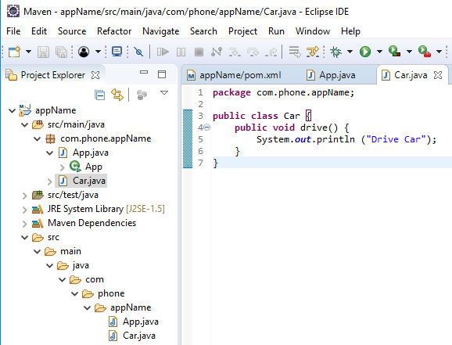
4.1 Create Car Class
https://www.youtube.com/watch?v=jdRd5hR9ON8&list=PLsyeobzWxl7rFkYFysfTwBu1JBPaNNDrk&index=4
Add public method “public void drive() { … }”.

Slide 7
4.2 Create car Object
Peter H. Chen

Slide 8
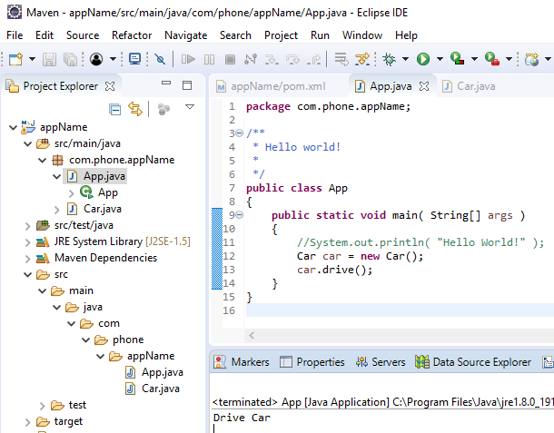
4.2 Create car Object
https://www.youtube.com/watch?v=jdRd5hR9ON8&list=PLsyeobzWxl7rFkYFysfTwBu1JBPaNNDrk&index=4
In the App.java, add “ Car car = new car(); car.drive”
Run it. We see the print out of “Drive Car”

Slide 9
4.3 Create Bike Class
Peter H. Chen

Slide 10
4.3 Create Bike Class
https://www.youtube.com/watch?v=jdRd5hR9ON8&list=PLsyeobzWxl7rFkYFysfTwBu1JBPaNNDrk&index=4
In the future, we may not use car. We use bike.
Create a class Bike.

Slide 11
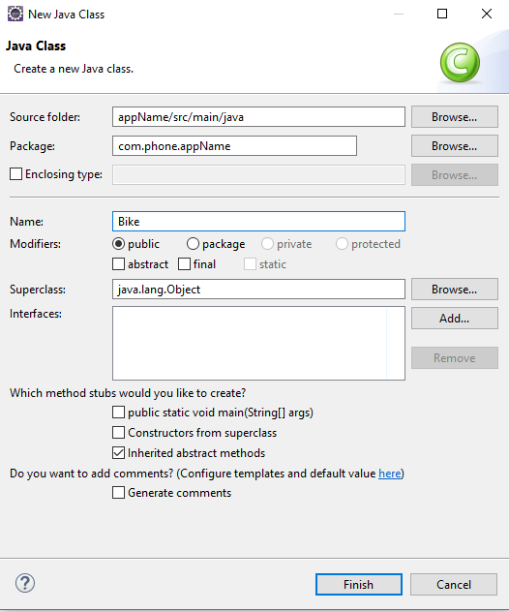
4.3 Create Bike Class
https://www.youtube.com/watch?v=jdRd5hR9ON8&list=PLsyeobzWxl7rFkYFysfTwBu1JBPaNNDrk&index=4
In Java Class Menu,
Name: Bike

Slide 12
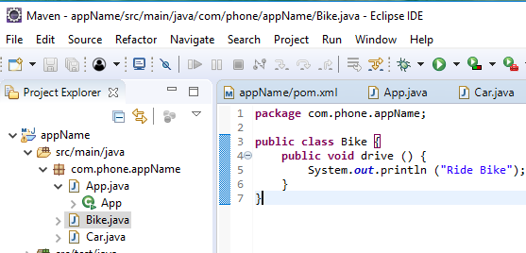
4.3 Create Bike Class
https://www.youtube.com/watch?v=jdRd5hR9ON8&list=PLsyeobzWxl7rFkYFysfTwBu1JBPaNNDrk&index=4
In Bike class, add same method name drive: “public void drive () { … }”.

Slide 13
4.4 Create car and bike Objects
Peter H. Chen

Slide 14
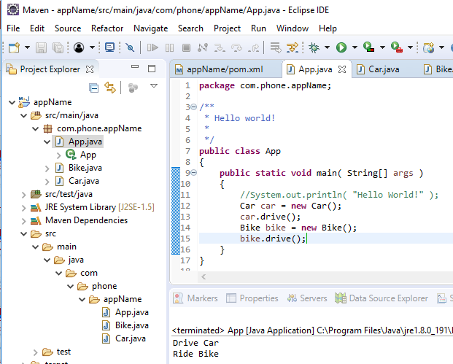
4.4 Create car and bike Objects
https://www.youtube.com/watch?v=jdRd5hR9ON8&list=PLsyeobzWxl7rFkYFysfTwBu1JBPaNNDrk&index=4
In App.java, add both car and bike objects.
Run it, we have both display in Drive car and Ride Bike.

Slide 15
4.5 Create Interface Vehicle
Peter H. Chen

Slide 16
4.5 Create Interface Vehicle
https://www.youtube.com/watch?v=jdRd5hR9ON8&list=PLsyeobzWxl7rFkYFysfTwBu1JBPaNNDrk&index=4
In App.java, the objects should be independent of class.
How to remove this dependency? We have to use the concept of dependency injection. We have class name dependency on right side and dependency on the left side
Let create an interface.

Slide 17
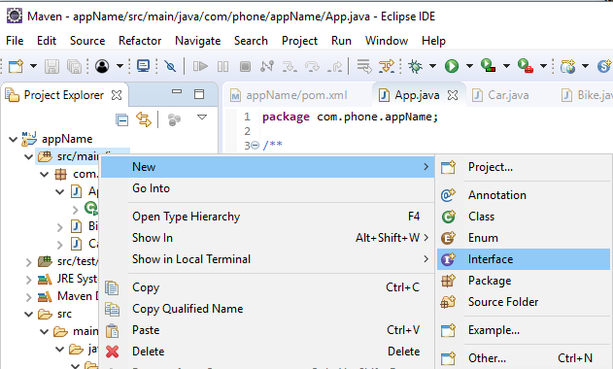
4.5 Create Interface Vehicle
https://www.youtube.com/watch?v=jdRd5hR9ON8&list=PLsyeobzWxl7rFkYFysfTwBu1JBPaNNDrk&index=4
Create an Interface: Click “src/main/java”.
RMB: New > Interface

Slide 18
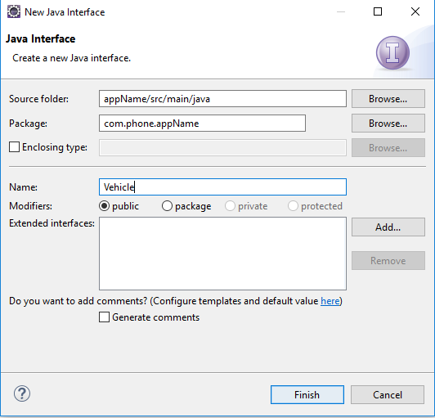
4.5 Create Interface Vehicle
https://www.youtube.com/watch?v=jdRd5hR9ON8&list=PLsyeobzWxl7rFkYFysfTwBu1JBPaNNDrk&index=4
Create an Interface: Both Car and Bike are Vehicle.

Slide 19
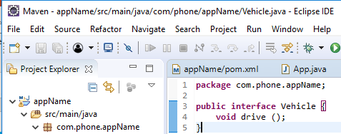
4.5 Create Interface Vehicle
https://www.youtube.com/watch?v=jdRd5hR9ON8&list=PLsyeobzWxl7rFkYFysfTwBu1JBPaNNDrk&index=4
In Interface Vehicle, add public method “void drive()”.
This drive() is an interface used for both Car and Bike.
The “public” can be removed since the interface methods are all public.

Slide 20
4.6 Car and Bike Implement Vehicle
Peter H. Chen

Slide 21
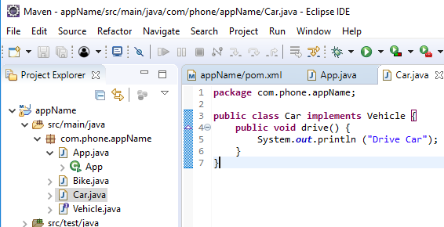
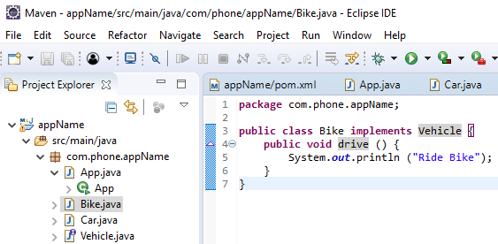
4.6 Car and Bike Implement Vehicle
https://www.youtube.com/watch?v=jdRd5hR9ON8&list=PLsyeobzWxl7rFkYFysfTwBu1JBPaNNDrk&index=4
Now, we can implement Interface Vehicle for both class Car and class Bike.

Slide 22
4.7 Replace Right Side
Peter H. Chen

Slide 23
4.7 Replace Right Side
https://www.youtube.com/watch?v=jdRd5hR9ON8&list=PLsyeobzWxl7rFkYFysfTwBu1JBPaNNDrk&index=4
Now, we can replace the right side with Dependency Injection.
How to do that?
Instead of “new Car()” and “new Bike()”, we use “getBean()”
How to use “getBean()”? We can use “BeanFactory” or “ApplicaitonContext”
For small application, we can use BeanFactory, for the big Application, we use ApplicationContext.
How to remember all these names?
You have to remember the Application context interface name ApplicaiotnContext and class ClassPathXmlApplicaitonContext.

Slide 24
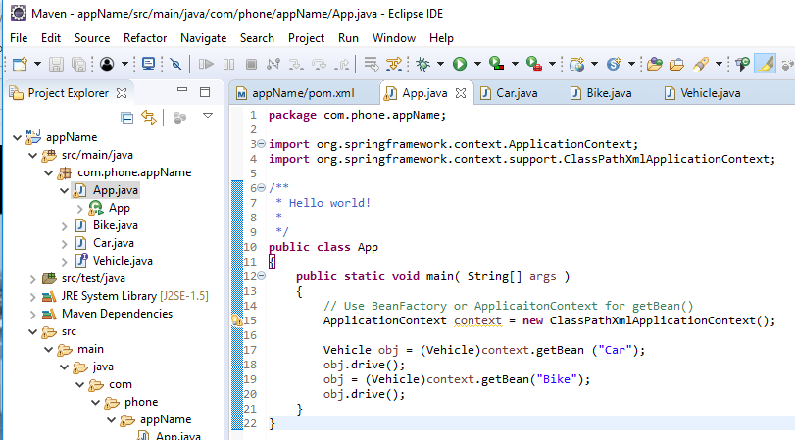
4.7 Replace Right Side
https://www.youtube.com/watch?v=jdRd5hR9ON8&list=PLsyeobzWxl7rFkYFysfTwBu1JBPaNNDrk&index=4
We use ApplicationContext from Spring to create the context.
The Vehicle obj = (Vehicle)context.getBean(“Car”); performs the polymorphism.

Slide 25
End of Chapter

