Slide 1

1 Introduction
Peter H. Chen

Slide 2
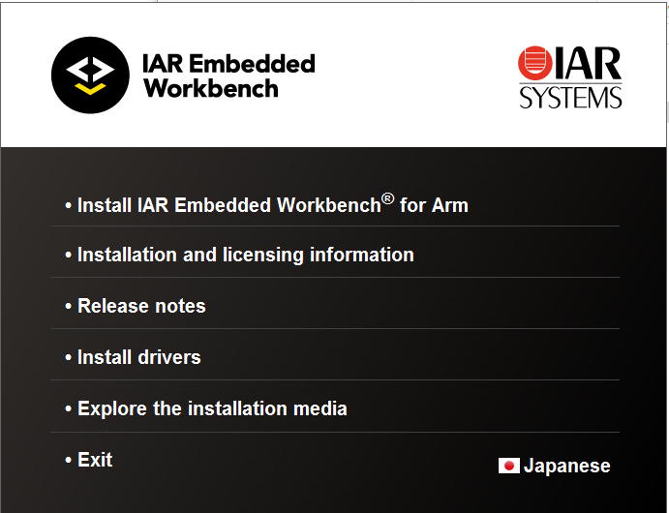
1 Introduction
https://www.youtube.com/watch?v=3V9eqvkMzHA&list=PLPW8O6W-1chwyTzI3BHwBLbGQoPFxPAPM
Introduction
Download IAR (Integrate ARM System) Workbench.
The software offers: 3 months trial or unlimited during the installation.
Note: Turn off the security.

Slide 3
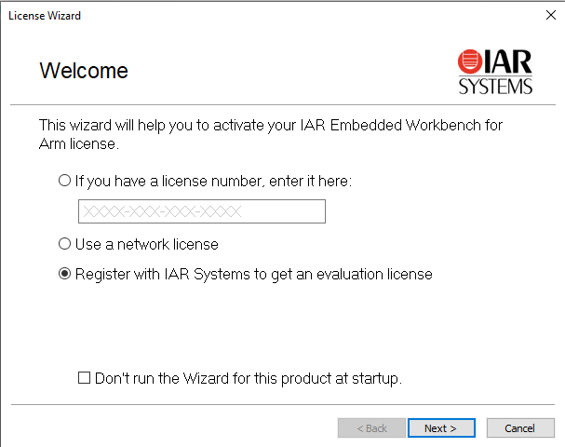
1 Introduction
https://www.youtube.com/watch?v=3V9eqvkMzHA&list=PLPW8O6W-1chwyTzI3BHwBLbGQoPFxPAPM
Introduction
First time registration.

Slide 4
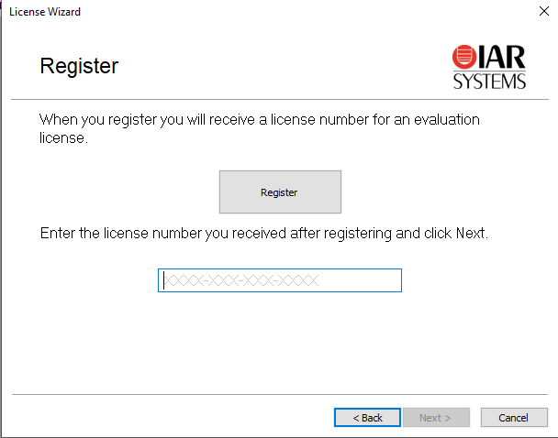
1 Introduction
https://www.youtube.com/watch?v=3V9eqvkMzHA&list=PLPW8O6W-1chwyTzI3BHwBLbGQoPFxPAPM
Introduction
First time registration.

Slide 5
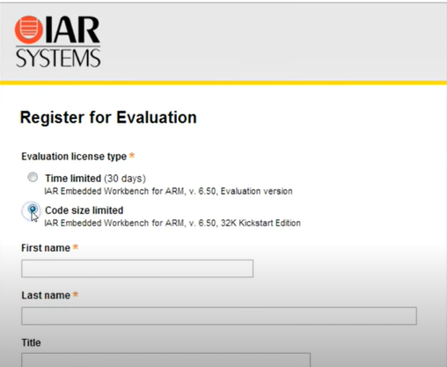
1 Introduction
https://www.youtube.com/watch?v=3V9eqvkMzHA&list=PLPW8O6W-1chwyTzI3BHwBLbGQoPFxPAPM
Introduction
First time registration.

Slide 6
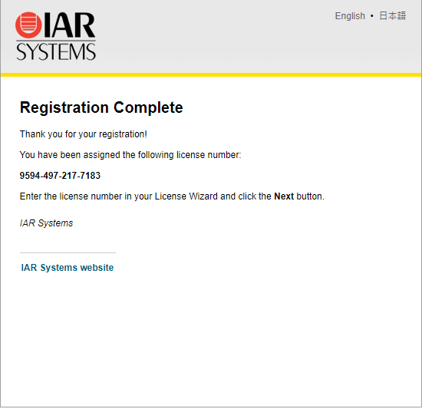
1 Introduction
https://www.youtube.com/watch?v=3V9eqvkMzHA&list=PLPW8O6W-1chwyTzI3BHwBLbGQoPFxPAPM
Introduction
Get license number from email.

Slide 7
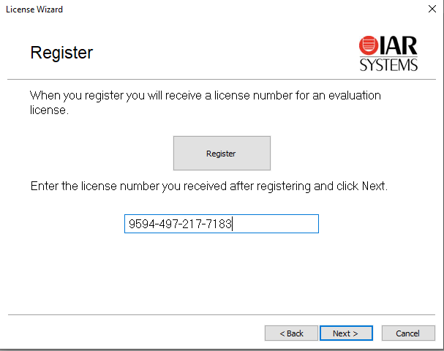
1 Introduction
https://www.youtube.com/watch?v=3V9eqvkMzHA&list=PLPW8O6W-1chwyTzI3BHwBLbGQoPFxPAPM
Introduction
Fill in the license number.

Slide 8
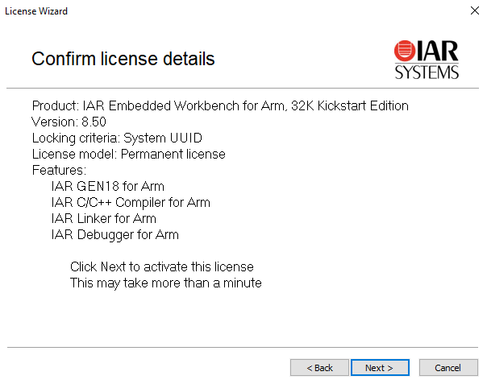
1 Introduction
https://www.youtube.com/watch?v=3V9eqvkMzHA&list=PLPW8O6W-1chwyTzI3BHwBLbGQoPFxPAPM
Introduction
Confirmed License.

Slide 9
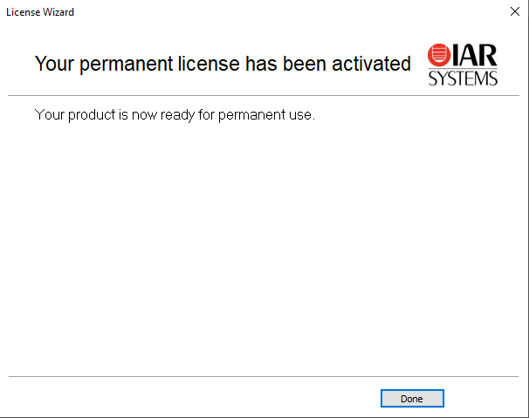
1 Introduction
https://www.youtube.com/watch?v=3V9eqvkMzHA&list=PLPW8O6W-1chwyTzI3BHwBLbGQoPFxPAPM
Introduction
Complete installation.

Slide 10
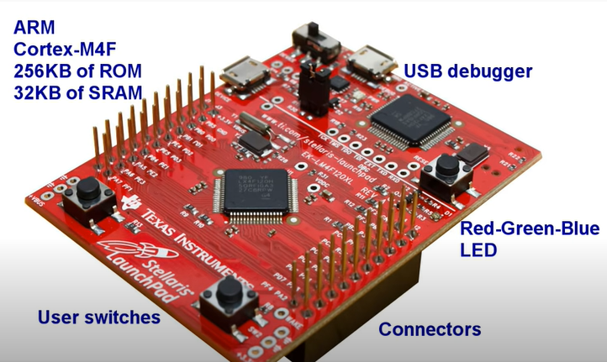
1 Introduction
https://www.youtube.com/watch?v=3V9eqvkMzHA&list=PLPW8O6W-1chwyTzI3BHwBLbGQoPFxPAPM
Introduction
TI Microcontroller has the complete self-contained board: USB debugger, ARM Cortex-M4F microcontroller, RGB LED, two user switches, and connectors for experiment.

Slide 11
1.1 Quiz

Slide 12
1.1 Quiz
https://www.youtube.com/watch?v=3V9eqvkMzHA&list=PLPW8O6W-1chwyTzI3BHwBLbGQoPFxPAPM
Quiz
1. What is IAR stand for?
Ans: IAM is Sweden company name stand for “Engineering Company of Andrew Rundgren)
2. What is IAR for?
Ans: It is IDE for firmware development. It provide the simulation and integrates ARM based device driver for TI, NXP, and etc.

Slide 13
End of Chapter

