Slide 1

2 First Project
Peter H. Chen

Slide 2
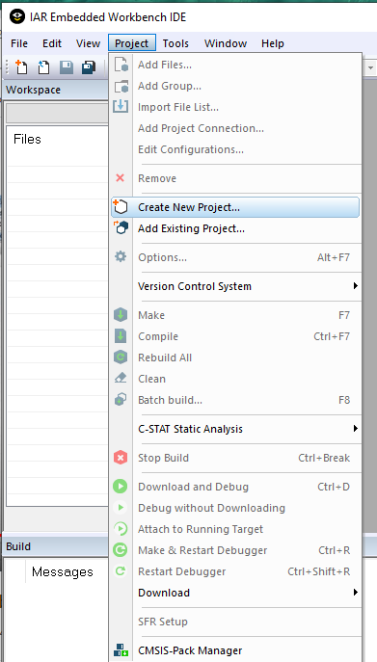
2 First Project
https://www.youtube.com/watch?v=gQOv8o5lS2k&list=PLPW8O6W-1chwyTzI3BHwBLbGQoPFxPAPM&index=2
First Project
Project > Create New Project.

Slide 3
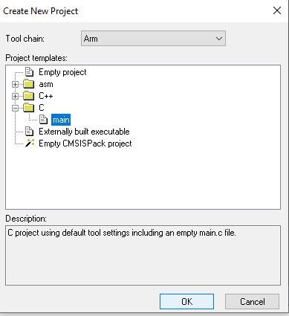
2 First Project
https://www.youtube.com/watch?v=gQOv8o5lS2k&list=PLPW8O6W-1chwyTzI3BHwBLbGQoPFxPAPM&index=2
First Project
Select: C
Select: main

Slide 4
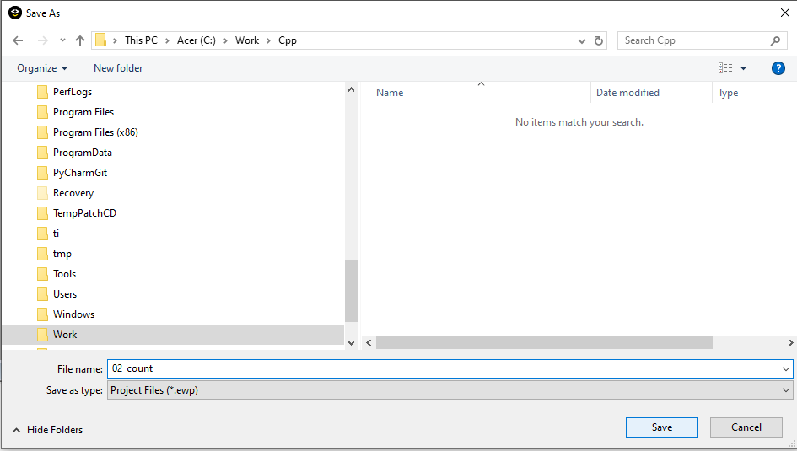
2 First Project
https://www.youtube.com/watch?v=gQOv8o5lS2k&list=PLPW8O6W-1chwyTzI3BHwBLbGQoPFxPAPM&index=2
First Project
File name: 02_count

Slide 5
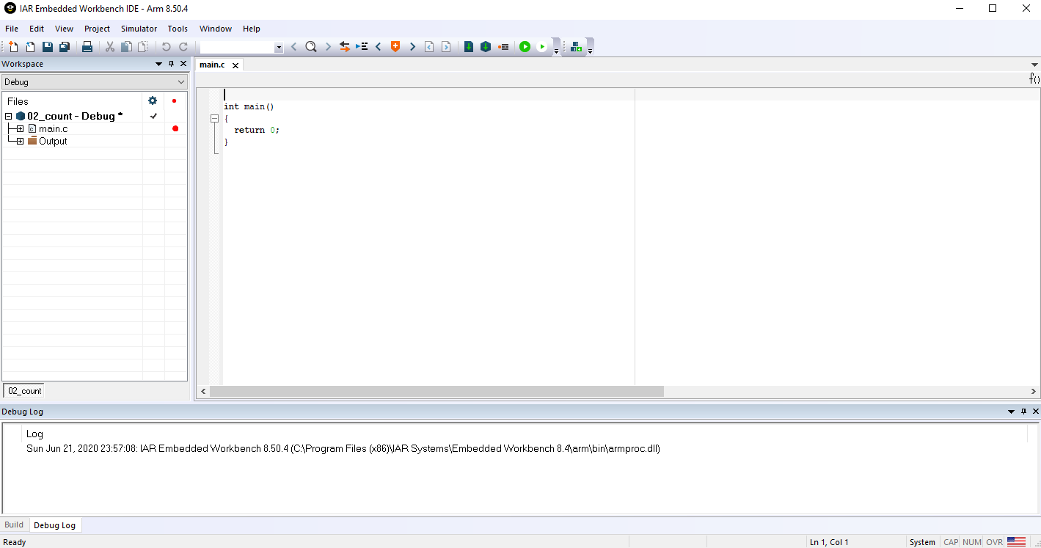
2 First Project
https://www.youtube.com/watch?v=gQOv8o5lS2k&list=PLPW8O6W-1chwyTzI3BHwBLbGQoPFxPAPM&index=2
First Project

Slide 6
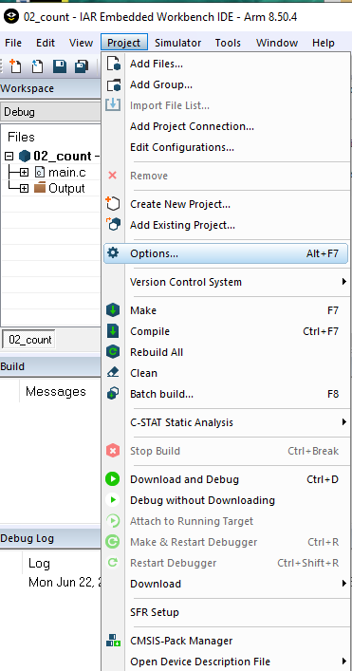
2 First Project
https://www.youtube.com/watch?v=gQOv8o5lS2k&list=PLPW8O6W-1chwyTzI3BHwBLbGQoPFxPAPM&index=2
First Project > Options

Slide 7
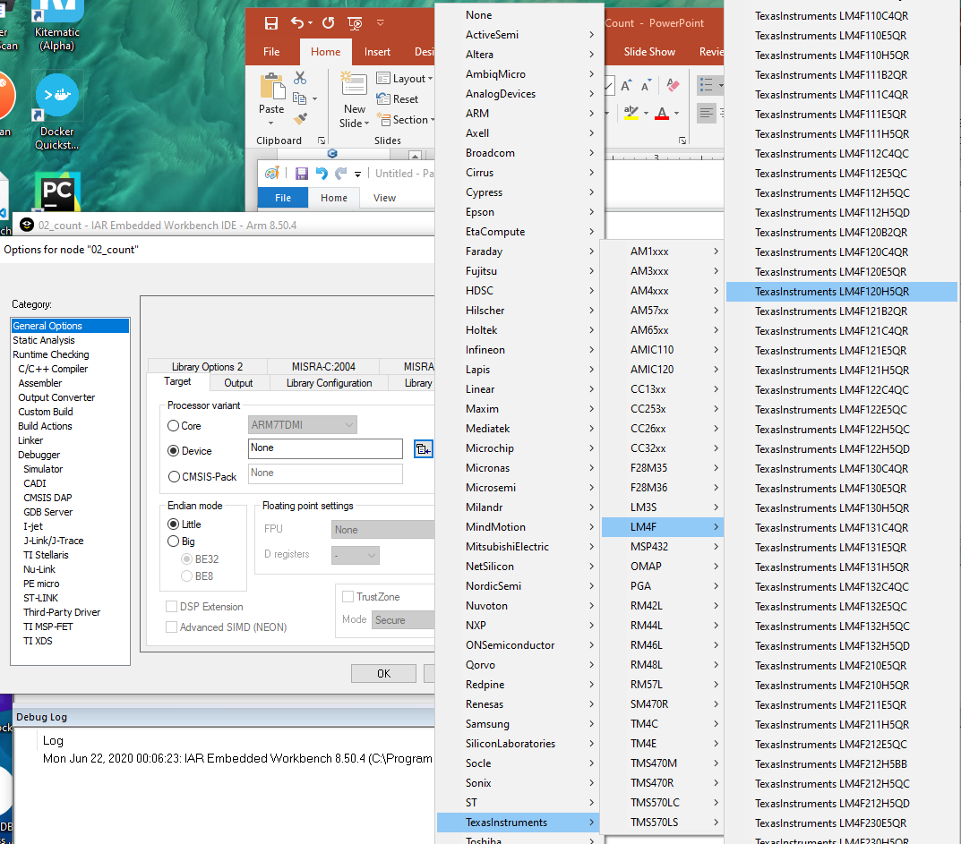
2 First Project
https://www.youtube.com/watch?v=gQOv8o5lS2k&list=PLPW8O6W-1chwyTzI3BHwBLbGQoPFxPAPM&index=2
Choose the target device: LM4F120H5QR
Device > Texas Instruments > LM4F > Texas Instruments LM4F120H5QR

Slide 8
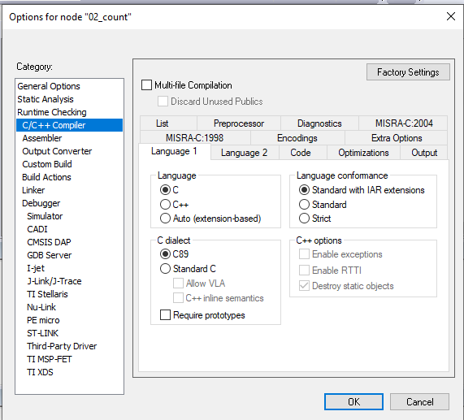
2 First Project
https://www.youtube.com/watch?v=gQOv8o5lS2k&list=PLPW8O6W-1chwyTzI3BHwBLbGQoPFxPAPM&index=2
Options > C/C++ Compiler

Slide 9
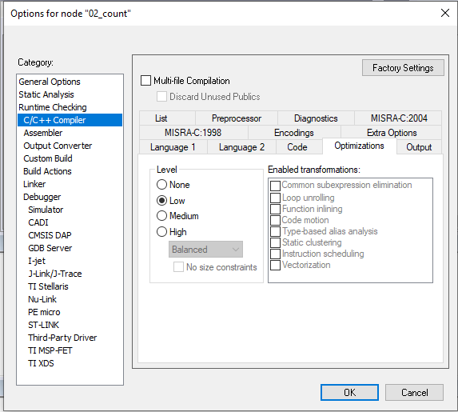
2 First Project
https://www.youtube.com/watch?v=gQOv8o5lS2k&list=PLPW8O6W-1chwyTzI3BHwBLbGQoPFxPAPM&index=2
Options > Optimization Level to Low.
A lot of program will not work for high optimization.

Slide 10
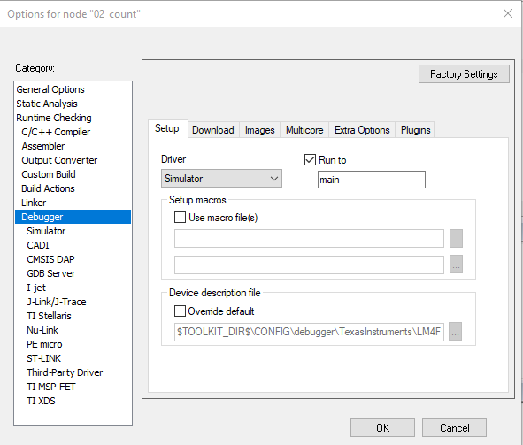
2 First Project
https://www.youtube.com/watch?v=gQOv8o5lS2k&list=PLPW8O6W-1chwyTzI3BHwBLbGQoPFxPAPM&index=2
Before use the Simulator, Make sire device is Simulator.
Project > Options > Debugger: Check Device is set to “Simulator”.

Slide 11
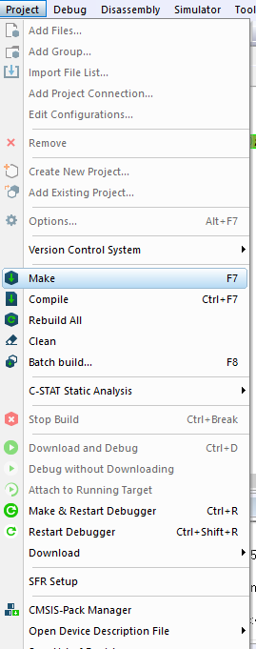
2 First Project
https://www.youtube.com/watch?v=gQOv8o5lS2k&list=PLPW8O6W-1chwyTzI3BHwBLbGQoPFxPAPM&index=2
Before we can use the Disassembly debugger, we need to make and download and start debugger
> Project > Make
> Enter “02_iar_setup”
After make, we can start debugger.

Slide 12
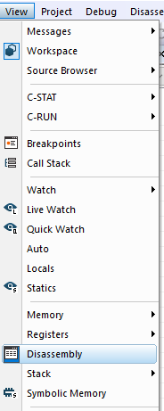
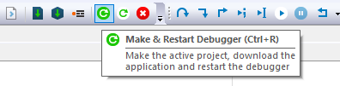
2 First Project
https://www.youtube.com/watch?v=gQOv8o5lS2k&list=PLPW8O6W-1chwyTzI3BHwBLbGQoPFxPAPM&index=2
Before we can use the debugger,
> “Download and Debugger” or “Make & Restart Debugger”
> View > Disassembly

Slide 13
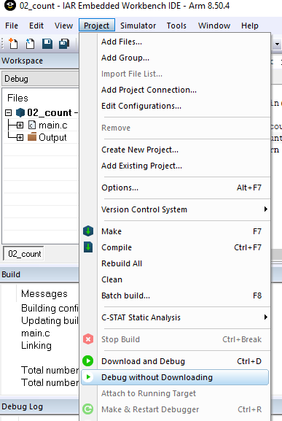
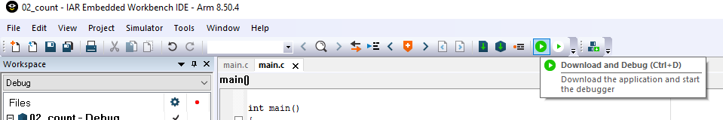
2 First Project
https://www.youtube.com/watch?v=gQOv8o5lS2k&list=PLPW8O6W-1chwyTzI3BHwBLbGQoPFxPAPM&index=2
You have two options to run debugger.
Project > Download and Debug or

Slide 14
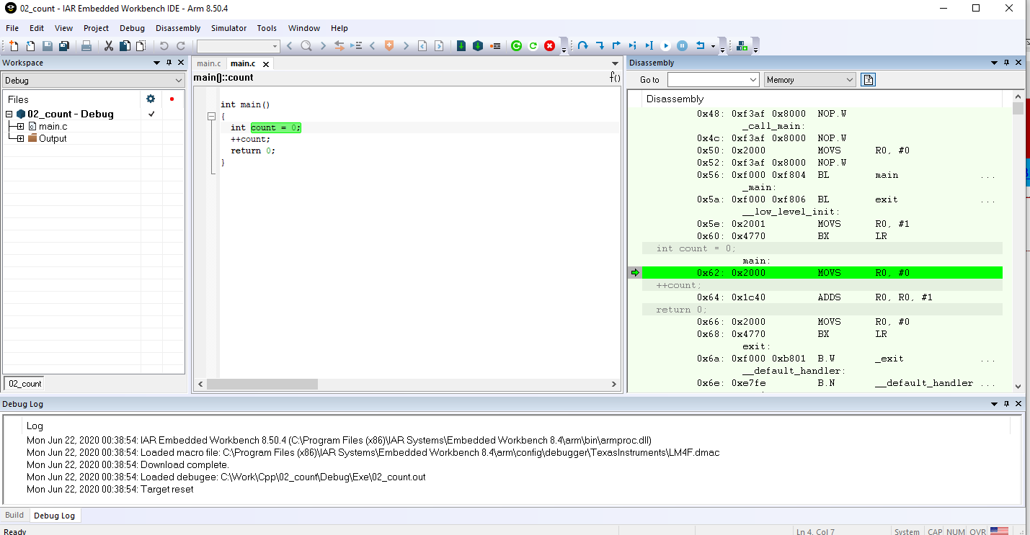
2 First Project
https://www.youtube.com/watch?v=gQOv8o5lS2k&list=PLPW8O6W-1chwyTzI3BHwBLbGQoPFxPAPM&index=2
Start the debug mode
View > Disassembly

Slide 15
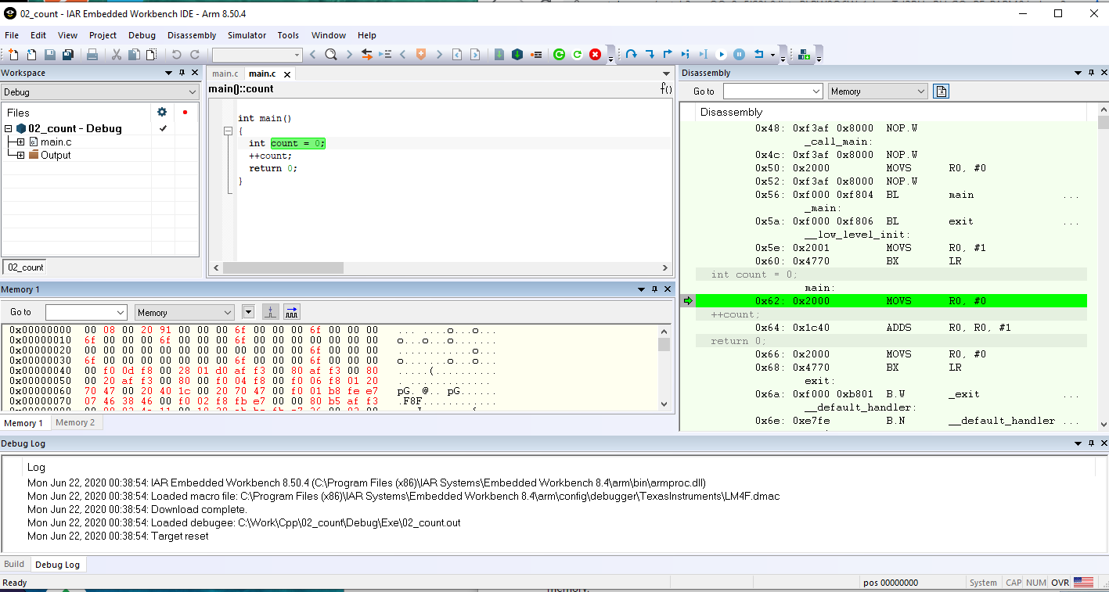
2 First Project
https://www.youtube.com/watch?v=gQOv8o5lS2k&list=PLPW8O6W-1chwyTzI3BHwBLbGQoPFxPAPM&index=2
Start the debug mode
View > Memory

Slide 16
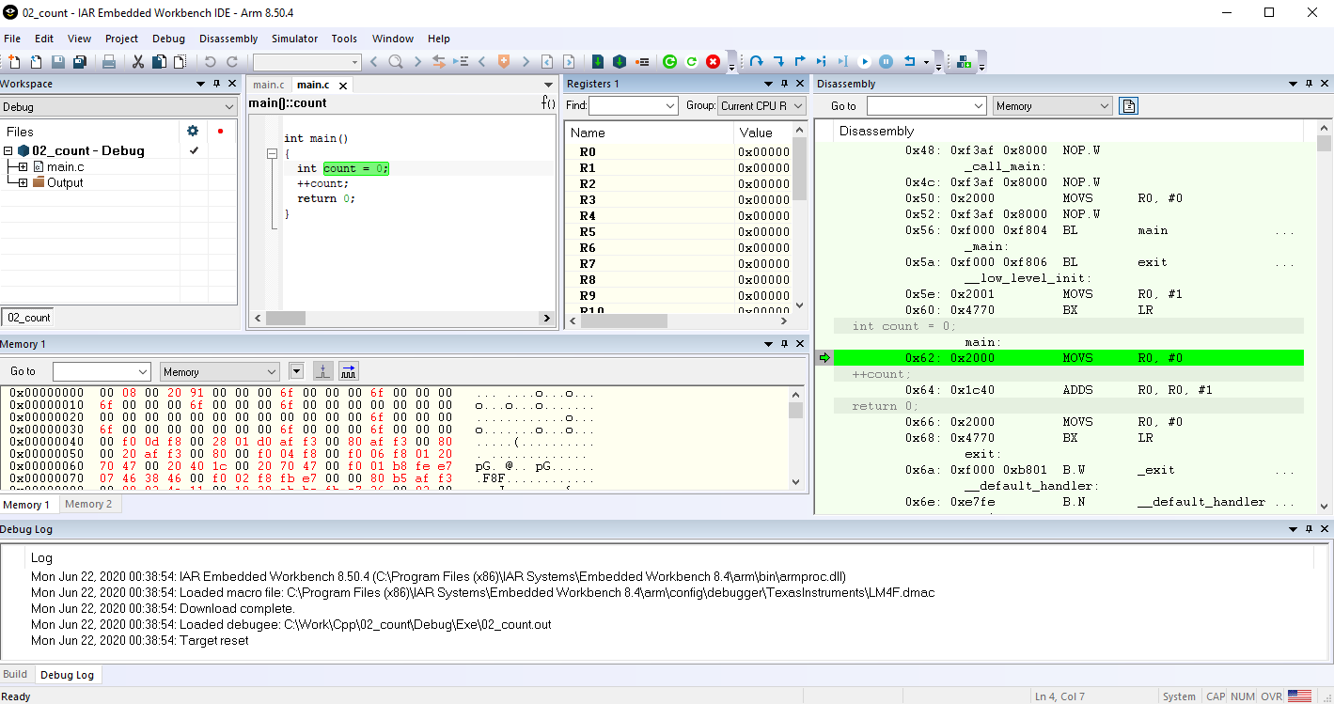
2 First Project
https://www.youtube.com/watch?v=gQOv8o5lS2k&list=PLPW8O6W-1chwyTzI3BHwBLbGQoPFxPAPM&index=2
Start the debug mode
View > Register

Slide 17
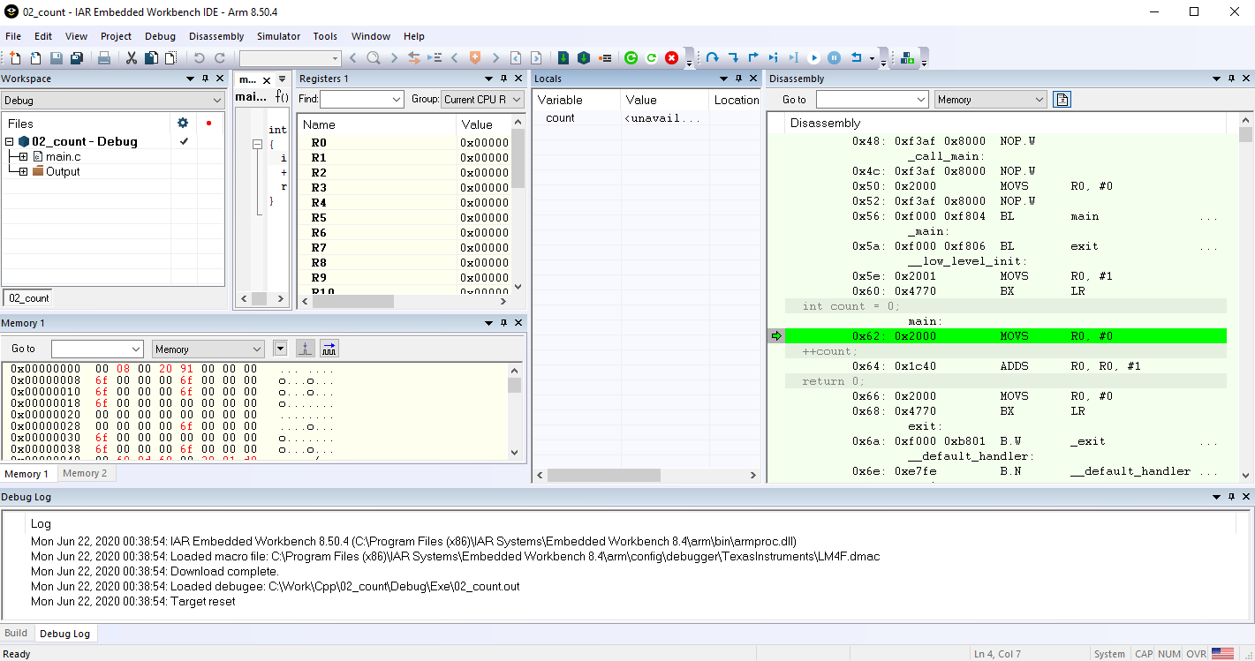
2 First Project
https://www.youtube.com/watch?v=gQOv8o5lS2k&list=PLPW8O6W-1chwyTzI3BHwBLbGQoPFxPAPM&index=2
Start the debug mode
View > Locals

Slide 18
2.1 Quiz

Slide 19
2.1 Quiz
https://www.youtube.com/watch?v=gQOv8o5lS2k&list=PLPW8O6W-1chwyTzI3BHwBLbGQoPFxPAPM&index=2
Quiz
1. How to choose target device LM4F120H5QR?
Ans: Device > Texas Instruments > LM4F > Texas Instruments LM4F120H5QR
2. In order to use the debugger, which step need to do?
Ans: Project > Make and then download and start debugger.
2. How to debug the assembly code?
Ans: View > Disassembly.
3. How to debug memory?
Ans: View > Memory
4. How to debug register?
Ans: View > Register
5. How to debug local variable?
Ans: View > Locals

Slide 20
End of Chapter

