Slide 1

3 Flow Control
Peter H. Chen

Slide 2
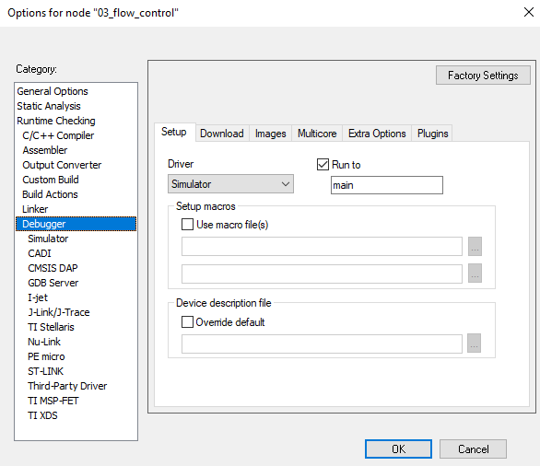
3 Flow Control
https://www.youtube.com/watch?v=cZj284kfuE8&list=PLPW8O6W-1chwyTzI3BHwBLbGQoPFxPAPM&index=3
Flow Control
Project > Create New Project.
Make sure debugger is simulator:
Project > Options > Debugger> Device: Simulator

Slide 3
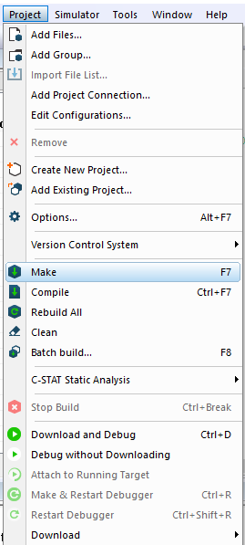
3 Flow Control
https://www.youtube.com/watch?v=cZj284kfuE8&list=PLPW8O6W-1chwyTzI3BHwBLbGQoPFxPAPM&index=3
Flow Control
Project > Make

Slide 4
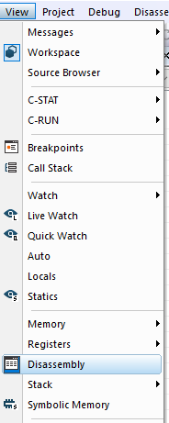
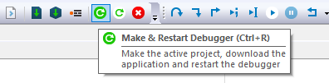
3 Flow Control
https://www.youtube.com/watch?v=cZj284kfuE8&list=PLPW8O6W-1chwyTzI3BHwBLbGQoPFxPAPM&index=3
Flow Control
> “Download and Debugger” or “Make & Restart Debugger”
> View > Disassembly

Slide 5
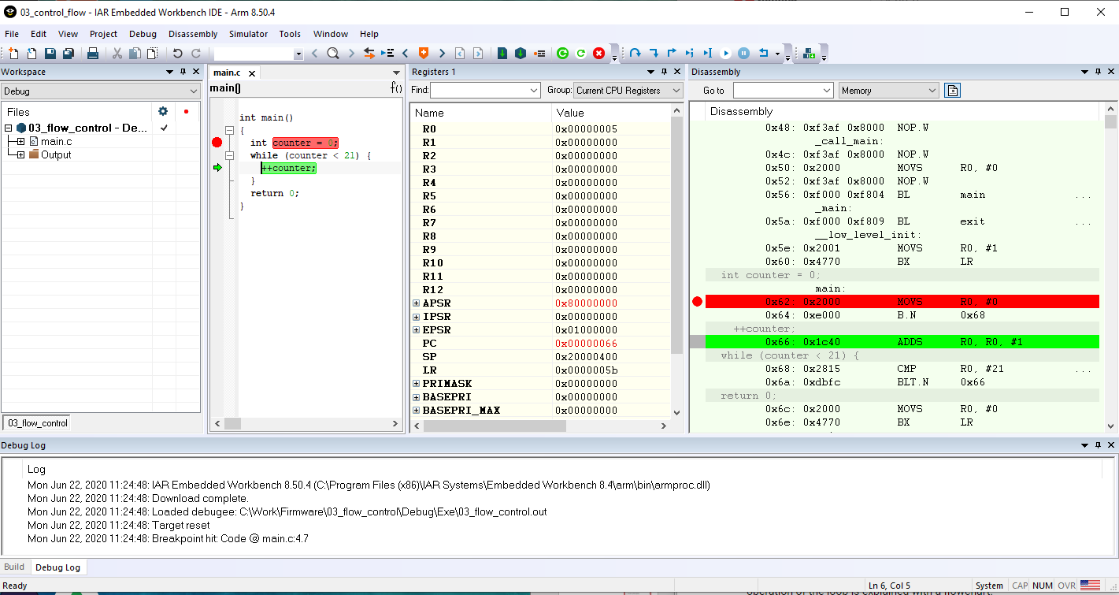
3 Flow Control
https://www.youtube.com/watch?v=cZj284kfuE8&list=PLPW8O6W-1chwyTzI3BHwBLbGQoPFxPAPM&index=3
Flow Control
Write a small while loop.
Use debugger to step and check the disassembly instruction and registers.

Slide 6
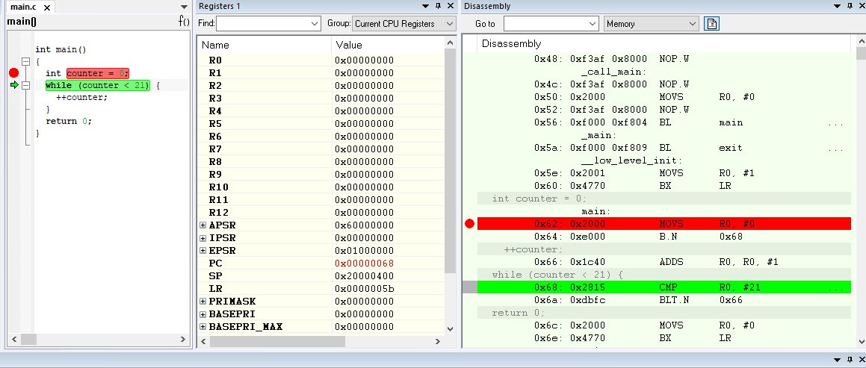
3 Flow Control
https://www.youtube.com/watch?v=cZj284kfuE8&list=PLPW8O6W-1chwyTzI3BHwBLbGQoPFxPAPM&index=3
Flow Control
R0 register is for ++counter.
PC (Program Counter) is address/location of code.
CMP instruction compare the R0 with #21.

Slide 7
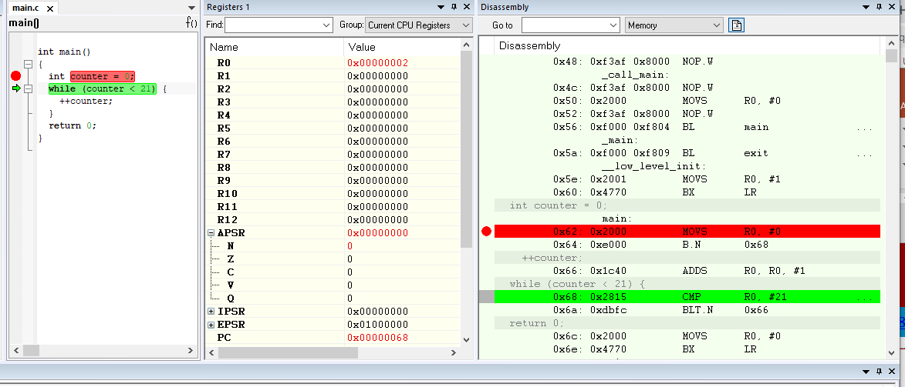
3 Flow Control
https://www.youtube.com/watch?v=cZj284kfuE8&list=PLPW8O6W-1chwyTzI3BHwBLbGQoPFxPAPM&index=3
Flow Control
APSR (Application Program Status Register) holds copies of ALU (Arithmetic Logic Unit) status flags (N, Z, C, V, Q) during the while loop computation.
N: Negative Flag, Z: Zero Flag, C: Carry/Borrow Flag, V: Overflow Flag, Q: Saturation Flag.
When compare R0 with 21. “R0-21” is conditional change to N flag set to 0 (21) and 1 (-21).

Slide 8
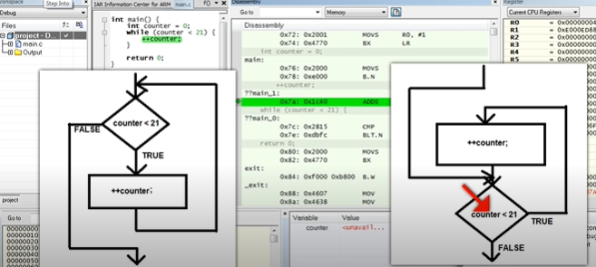
3 Flow Control
https://www.youtube.com/watch?v=cZj284kfuE8&list=PLPW8O6W-1chwyTzI3BHwBLbGQoPFxPAPM&index=3
Flow Control
Left hand side is while loop C code. Right hand side is assembly code.

Slide 9
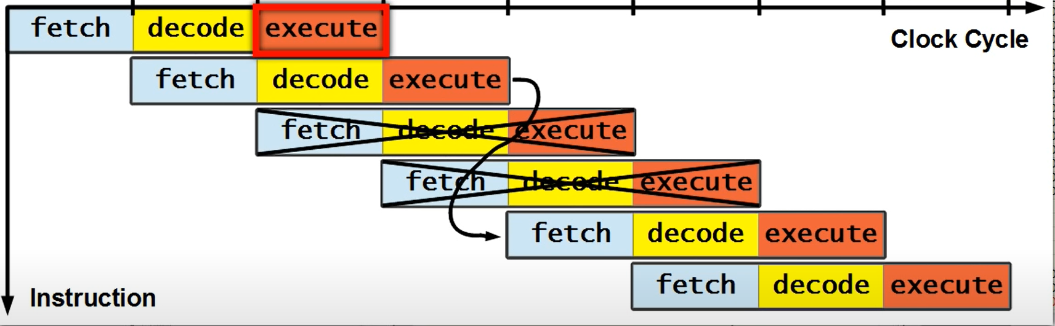
3 Flow Control
https://www.youtube.com/watch?v=cZj284kfuE8&list=PLPW8O6W-1chwyTzI3BHwBLbGQoPFxPAPM&index=3
Flow Control
The code is execute in pipeline.: Fetch from memory, decode, and then execute.
It executes in order until the loop is over.

Slide 10
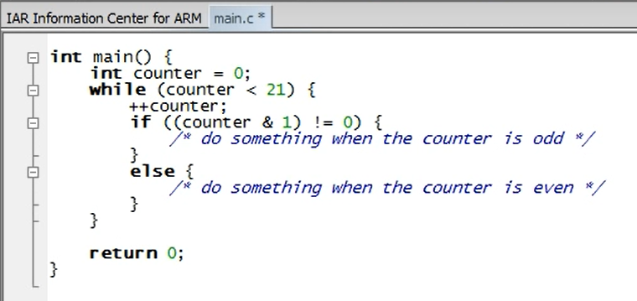
3 Flow Control
https://www.youtube.com/watch?v=cZj284kfuE8&list=PLPW8O6W-1chwyTzI3BHwBLbGQoPFxPAPM&index=3
Flow Control
The code is execute in pipeline.: Fetch from memory, decode, and then execute.
It executes in order until the loop is over.

Slide 11
3.1 Quiz

Slide 12
3.1 Quiz
https://www.youtube.com/watch?v=cZj284kfuE8&list=PLPW8O6W-1chwyTzI3BHwBLbGQoPFxPAPM&index=3
Quiz
1. What is APSR?
Ans: APSR (Application Program Status Register) holds copies of ALU (Arithmetic Logic Unit) status flags (N, Z, C, V, Q) during the while loop computation.
2. What is N, Z, C, V, Q in SPSR?
Ans: N: Negative Flag, Z: Zero Flag, C: Carry/Borrow Flag, V: Overflow Flag, Q: Saturation Flag.
3. What is N flag change with register R0 and constant 21?
Ans: When compare R0 with 21. “R0-21” is conditional change to N flag set to 0 (21) and 1 (-21).
4. What is execute cycle in pipeline?
Ans: Fetch from memory, decode, and then execution.

Slide 13
3.1 Quiz
https://www.youtube.com/watch?v=cZj284kfuE8&list=PLPW8O6W-1chwyTzI3BHwBLbGQoPFxPAPM&index=3
Quiz
5. How to add conditional odd or even control?
Ans:
if (counter & 1) != 0 {
/* not odd => even, do something */
} else {
/* not even => odd, do something */
}

Slide 14
End of Chapter

