Slide 1

4 Variable and Pointer
Peter H. Chen

Slide 2
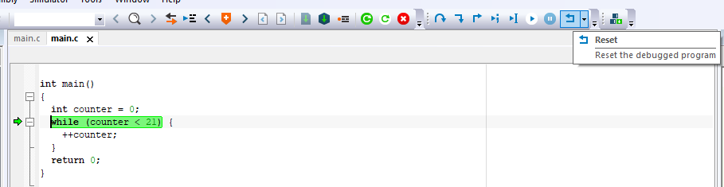
4 Variable and Pointer
https://www.youtube.com/watch?v=o9WpXYBqdPU&list=PLPW8O6W-1chwyTzI3BHwBLbGQoPFxPAPM&index=4
Flow Control
You can copy the folder and double the project to start.
You can click “reset” and “step over” to see the debugger back and forward of statement.

Slide 3
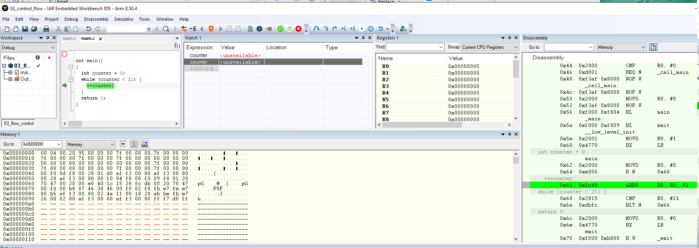
4 Variable and Pointer
https://www.youtube.com/watch?v=o9WpXYBqdPU&list=PLPW8O6W-1chwyTzI3BHwBLbGQoPFxPAPM&index=4
Flow Control
Copy counter variable inside the main.
Variable counter is outside the main() and cannot be seen.
Use view > Watch to see the variable and location.
Counter variable is with location of register R0 and variable value is 0x0000005, 0x0000006, and etc.

Slide 4
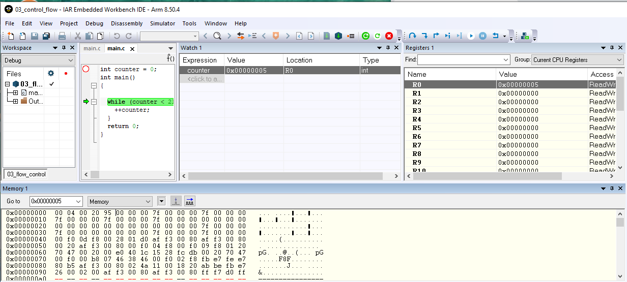
4 Variable and Pointer
https://www.youtube.com/watch?v=o9WpXYBqdPU&list=PLPW8O6W-1chwyTzI3BHwBLbGQoPFxPAPM&index=4
Flow Control
Copy counter variable outside the main.
Variable counter is outside the main() and cannot be seen.
Use view > Watch to see the variable and location.
Counter variable is with location of register R0 and variable value is 0x0000005, 0x0000006, and etc.

Slide 5
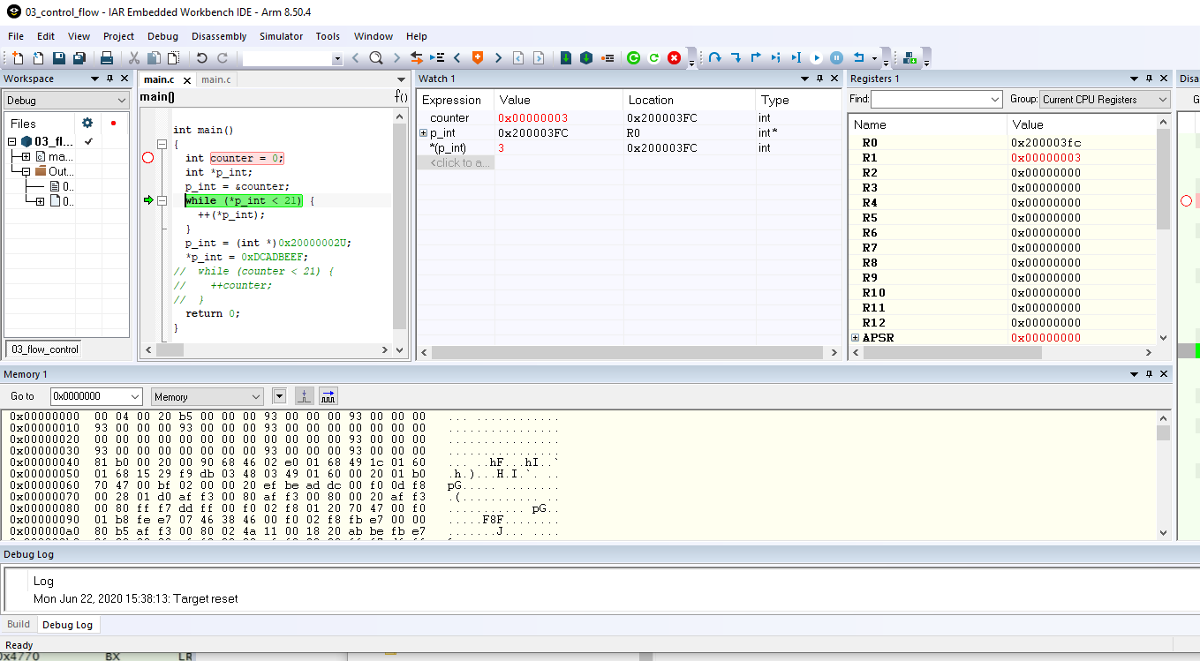
4 Variable and Pointer
https://www.youtube.com/watch?v=o9WpXYBqdPU&list=PLPW8O6W-1chwyTzI3BHwBLbGQoPFxPAPM&index=4
Flow Control
Pointer variable declaration: int *p_int;
Pointer variable assignment: *p_int = counter
Pointer point to variable location: p_int = &counter

Slide 6
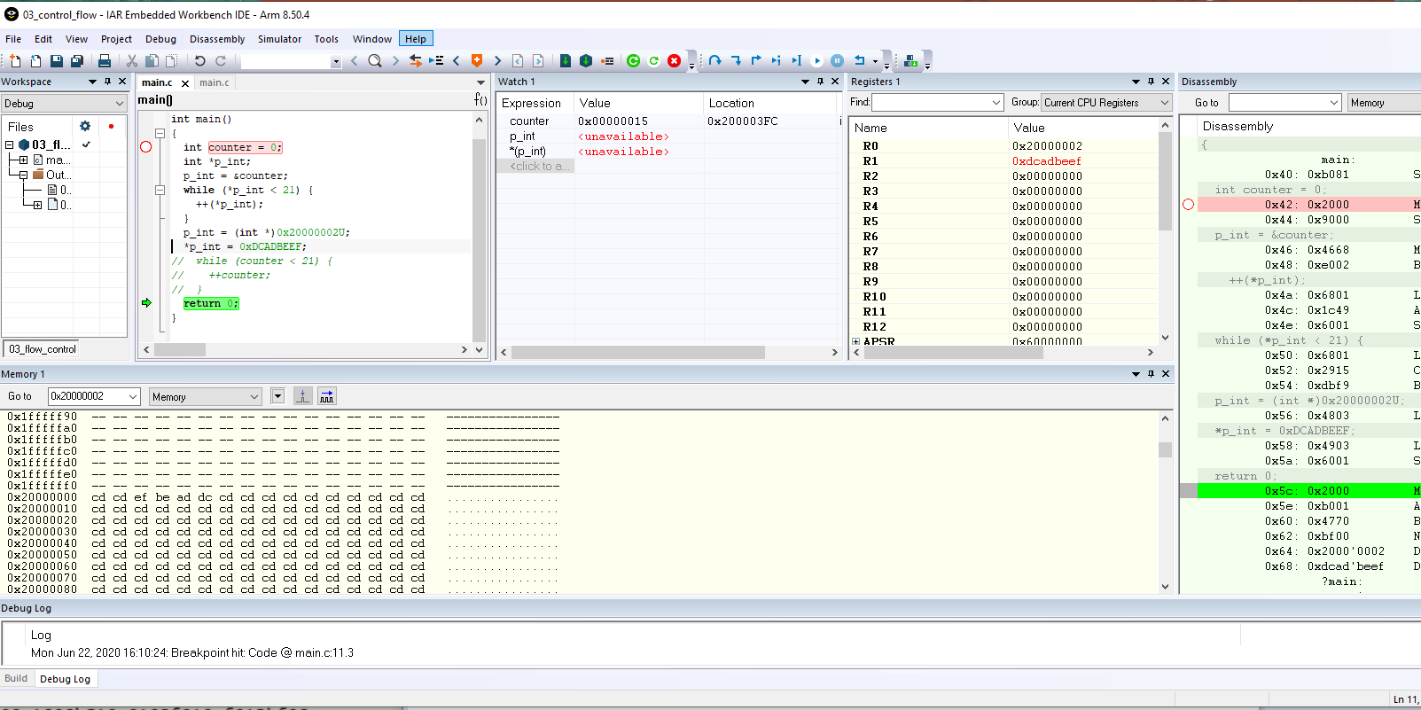
4 Variable and Pointer
https://www.youtube.com/watch?v=o9WpXYBqdPU&list=PLPW8O6W-1chwyTzI3BHwBLbGQoPFxPAPM&index=4
Flow Control
> p_int = (int *)0x20000002U;
> *p_int = 0xDCADBEEF
Note: It is very dangerous to assign the value in pointer.

Slide 7
4.1 Quiz

Slide 8
4.1 Quiz
https://www.youtube.com/watch?v=o9WpXYBqdPU&list=PLPW8O6W-1chwyTzI3BHwBLbGQoPFxPAPM&index=4
Quiz
1. How to continue to previous setting?
Ans: Copy the entire folder and rename to new name. In the folder, double click the project name.
2. In the debugger, how to backward and forward the command?
Ans: Click “Reset” and “Step Over” to backward and forward.
3. Where is the value of variable counter?
Ans: The register R0 is the pointer for variable counter.
4. How to declare Pointer variable?
Ans: int *p_int;
5. How to assign pointer variable?
Ans: *p_int = counter
6. How to assign pointer to variable location?
Ans: p_int = &counter

Slide 9
End of Chapter

