Slide 1

1 Introduction
Peter H. Chen

Slide 2
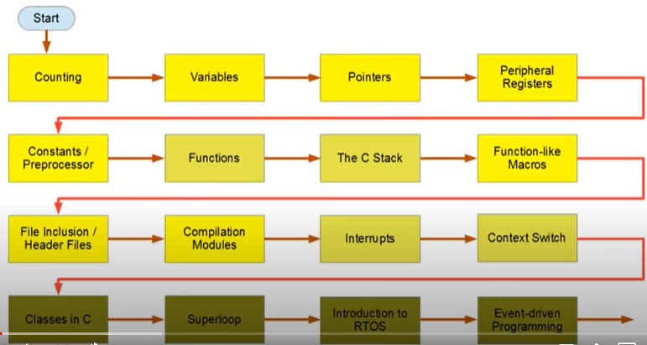
1 Introduction
https://www.youtube.com/watch?v=3V9eqvkMzHA&list=PLPW8O6W-1chwyTzI3BHwBLbGQoPFxPAPM
Introduction
Outlines:

Slide 3
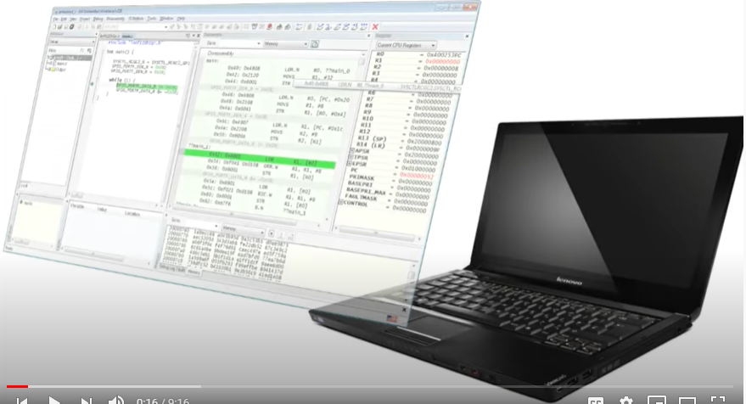
1 Introduction
https://www.youtube.com/watch?v=3V9eqvkMzHA&list=PLPW8O6W-1chwyTzI3BHwBLbGQoPFxPAPM
Introduction
Software developer tool: IAR (Engineering Company of Ander Rundgren at Sweden)

Slide 4
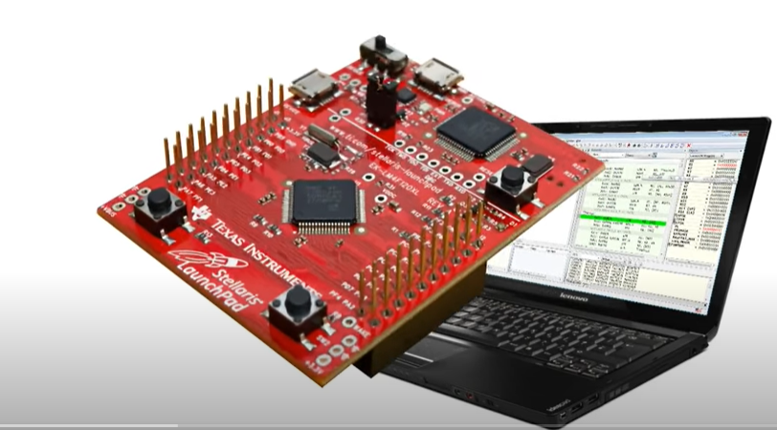
1 Introduction
https://www.youtube.com/watch?v=3V9eqvkMzHA&list=PLPW8O6W-1chwyTzI3BHwBLbGQoPFxPAPM
Introduction
Hardware tool kit: Texas Instrument Stellaris Microcontroller
You can develop with software Simulator without the board.

Slide 5
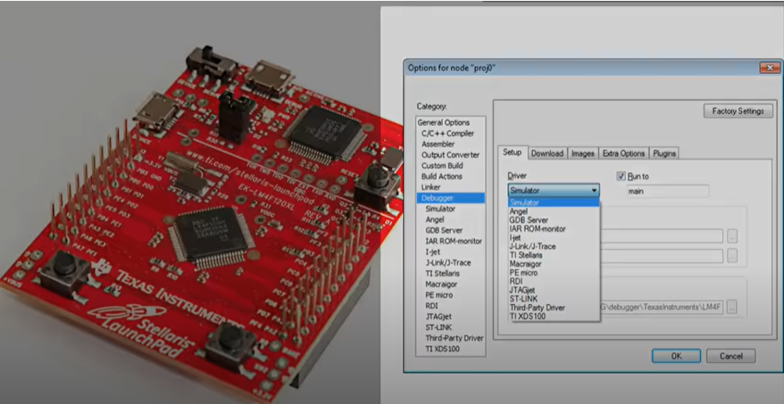
1 Introduction
https://www.youtube.com/watch?v=3V9eqvkMzHA&list=PLPW8O6W-1chwyTzI3BHwBLbGQoPFxPAPM
Introduction
We can use instruction set simulator.

Slide 6
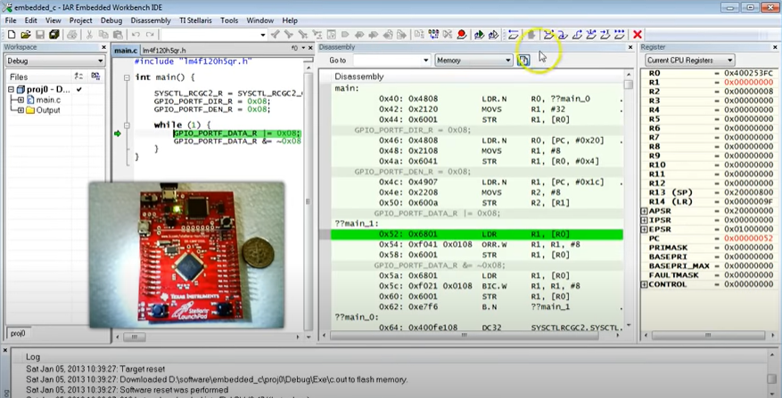
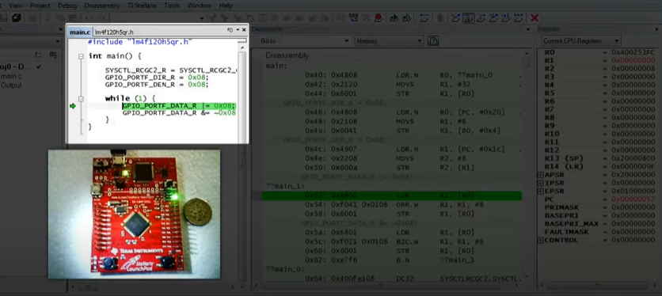
1 Introduction
https://www.youtube.com/watch?v=3V9eqvkMzHA&list=PLPW8O6W-1chwyTzI3BHwBLbGQoPFxPAPM
Introduction
The C-Language that we are use for high-level programming language.

Slide 7
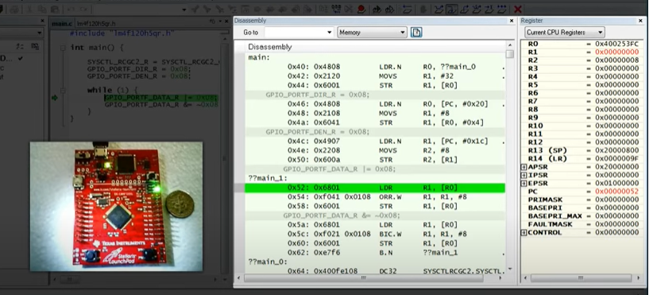
1 Introduction
https://www.youtube.com/watch?v=3V9eqvkMzHA&list=PLPW8O6W-1chwyTzI3BHwBLbGQoPFxPAPM
Introduction
We also step down to the machine code and see what happen inside the embedded processor.
We can see how the processor execute the code and manipulate data, such as, turn on and off the LED. How the C translate into the machine instruction.

Slide 8
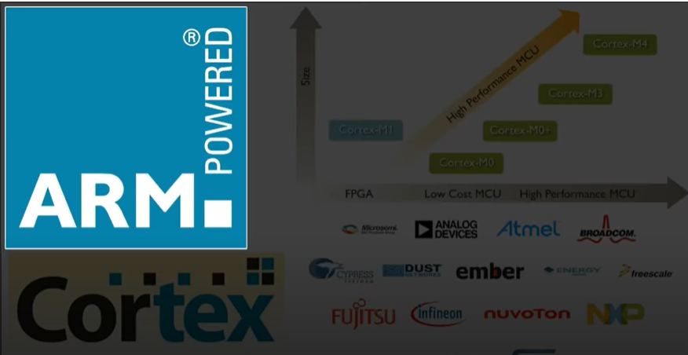
1 Introduction
https://www.youtube.com/watch?v=3V9eqvkMzHA&list=PLPW8O6W-1chwyTzI3BHwBLbGQoPFxPAPM
Introduction
We use ARM Cortex-M4 as the processor.

Slide 9
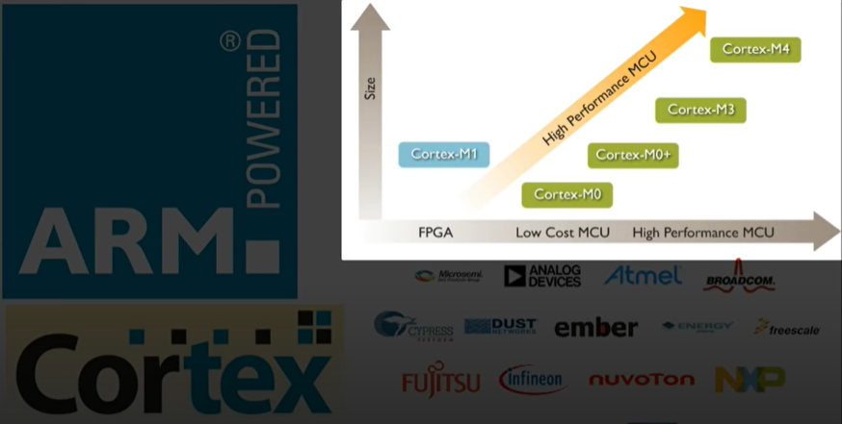
1 Introduction
https://www.youtube.com/watch?v=3V9eqvkMzHA&list=PLPW8O6W-1chwyTzI3BHwBLbGQoPFxPAPM
Introduction
Cortex-M Family from Cortex-M0, Cortex-M0+, Cortex-M3, and Cortex-M4.

Slide 10
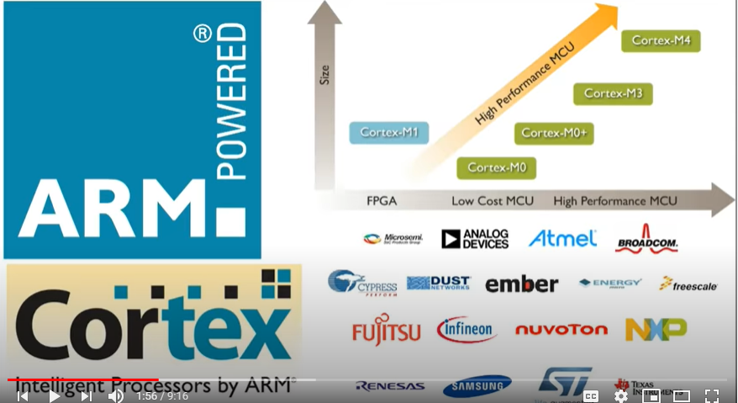
1 Introduction
https://www.youtube.com/watch?v=3V9eqvkMzHA&list=PLPW8O6W-1chwyTzI3BHwBLbGQoPFxPAPM
Introduction
Many companies, such as, Texas Instrument, NXP, Renesas, and etc., develop microcontroller by Cortex-M Family.

Slide 11
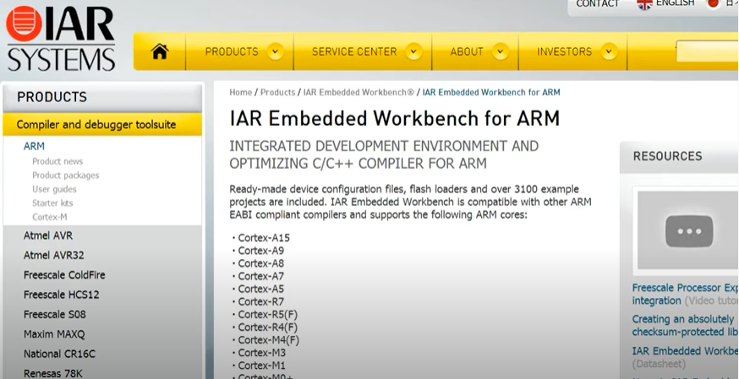
1 Introduction
https://www.youtube.com/watch?v=3V9eqvkMzHA&list=PLPW8O6W-1chwyTzI3BHwBLbGQoPFxPAPM
Introduction
We use the Tool set from IAR (Engineering Company of Anders Rundgren at Sweden).

Slide 12
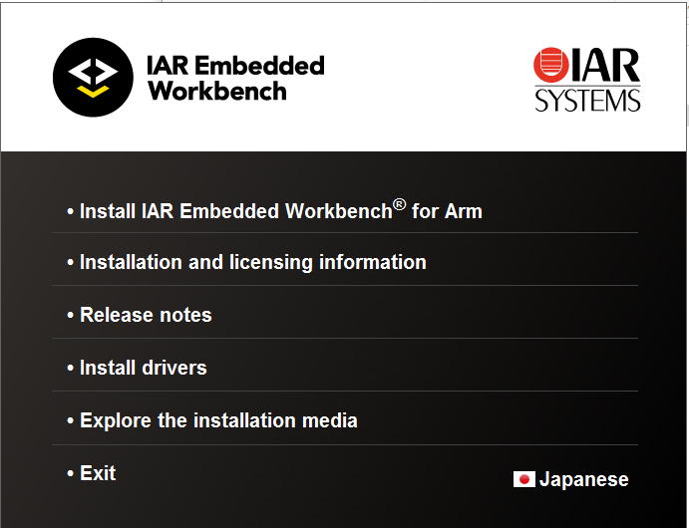
1 Introduction
https://www.youtube.com/watch?v=3V9eqvkMzHA&list=PLPW8O6W-1chwyTzI3BHwBLbGQoPFxPAPM
Introduction
Download IAR (Integrate ARM System) Workbench.
The software offers: 3 months trial or unlimited during the installation.
Note: Turn off the security.

Slide 13
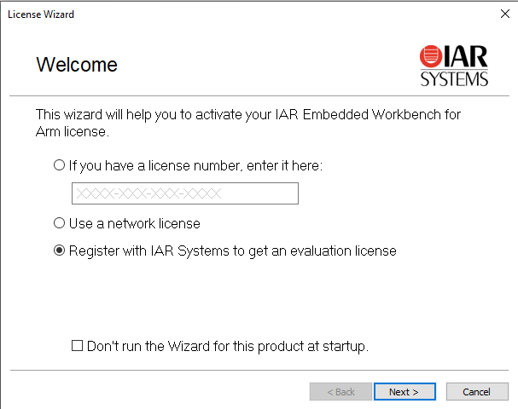
1 Introduction
https://www.youtube.com/watch?v=3V9eqvkMzHA&list=PLPW8O6W-1chwyTzI3BHwBLbGQoPFxPAPM
Introduction
First time registration.

Slide 14
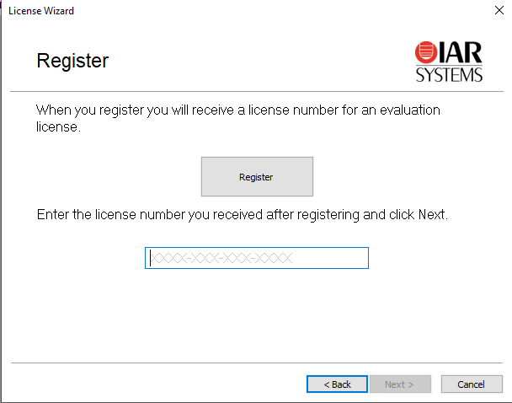
1 Introduction
https://www.youtube.com/watch?v=3V9eqvkMzHA&list=PLPW8O6W-1chwyTzI3BHwBLbGQoPFxPAPM
Introduction
First time registration.

Slide 15
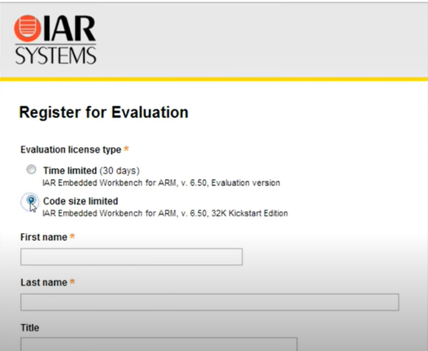
1 Introduction
https://www.youtube.com/watch?v=3V9eqvkMzHA&list=PLPW8O6W-1chwyTzI3BHwBLbGQoPFxPAPM
Introduction
First time registration.

Slide 16
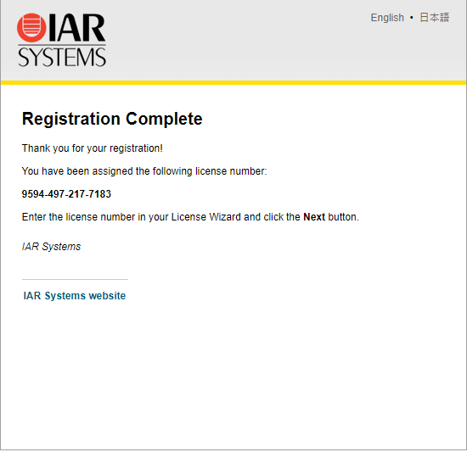
1 Introduction
https://www.youtube.com/watch?v=3V9eqvkMzHA&list=PLPW8O6W-1chwyTzI3BHwBLbGQoPFxPAPM
Introduction
Get license number from email.

Slide 17
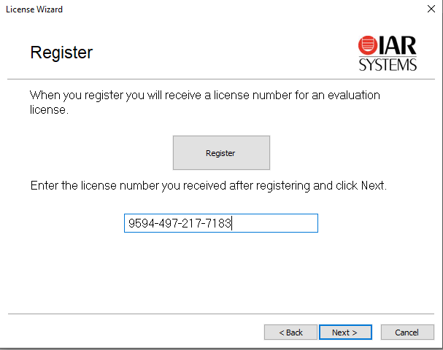
1 Introduction
https://www.youtube.com/watch?v=3V9eqvkMzHA&list=PLPW8O6W-1chwyTzI3BHwBLbGQoPFxPAPM
Introduction
Fill in the license number.

Slide 18
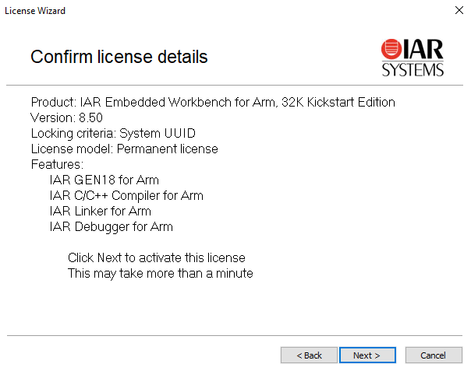
1 Introduction
https://www.youtube.com/watch?v=3V9eqvkMzHA&list=PLPW8O6W-1chwyTzI3BHwBLbGQoPFxPAPM
Introduction
Confirmed License.

Slide 19
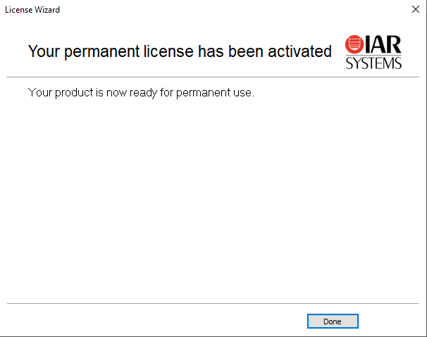
1 Introduction
https://www.youtube.com/watch?v=3V9eqvkMzHA&list=PLPW8O6W-1chwyTzI3BHwBLbGQoPFxPAPM
Introduction
Complete installation.

Slide 20
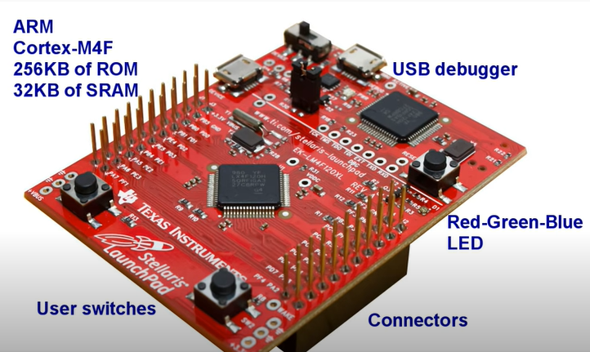
1 Introduction
https://www.youtube.com/watch?v=3V9eqvkMzHA&list=PLPW8O6W-1chwyTzI3BHwBLbGQoPFxPAPM
Introduction
TI Microcontroller has the complete self-contained board: USB debugger, ARM Cortex-M4F microcontroller, RGB LED, two user switches, and connectors for experiment.

Slide 21
1.1 Quiz

Slide 22
1.1 Quiz
https://www.youtube.com/watch?v=3V9eqvkMzHA&list=PLPW8O6W-1chwyTzI3BHwBLbGQoPFxPAPM
Quiz
1. What is IAR stand for?
Ans: IAM is Sweden company name stand for “Engineering Company of Andrew Rundgren)
2. What is IAR for?
Ans: It is IDE for firmware development. It provide the simulation and integrates ARM based device driver for TI, NXP, and etc.

Slide 23
End of Chapter

