Slide 1

1 Angular, Node, and MySQL
Peter H. Chen

Slide 2
1 Angular, Node, and MySQL
https://www.apress.com/us/book/9781484231975
Create a simple Angular application, which will have 3 fields and display the data in UI.
1. User Id - Text field
2. Submit – Button
3. Clear – Button
On clicking ’Submit’, button, system must pull values related to that user from DB. The list must have below values
User Id
First Name
Last Name
Theater
Region
On clicking ’Clear’, button, system must remove value from ‘User Id’ text field.
DB: Oracle/MYSQL

Slide 3
1 Angular, Node, and MySQL
https://www.apress.com/us/book/9781484231975
Below are the tables you need to have and try to fetch data from these tables.
user: user_id is the primary key,
user_role_map: User_id is the primary key,
USER - Table
================
Name Null? Type
----------------------------------------- -------- ----------------------------
USER_ID VARCHAR2(20)
ACTIVE VARCHAR2(255 CHAR)
CEC_ID VARCHAR2(255 CHAR)
FIRST_NAME VARCHAR2(255 CHAR)
LAST_NAME VARCHAR2(255 CHAR)
REGION NUMBER(10)
THEATER NUMBER(10)
CREATED_DT DATE
CREATED_BY VARCHAR2(20 CHAR)
UPDATED_BY VARCHAR2(20 CHAR)
UPDATED_DT DATE
ID NUMBER

Slide 4
1 Angular, Node, and MySQL
https://www.apress.com/us/book/9781484231975
USER_ROLE_MAP – Table
============================
Name Null? Type
----------------------------------------- -------- ----------------------------
USER_ROLE_ID NOT NULL NUMBER(10)
ROLE_ID NUMBER(10)
USER_ID VARCHAR2(20)
PROXY_USER_ID VARCHAR2(20)
CREATED_DT DATE
CREATED_BY VARCHAR2(20 CHAR)
UPDATED_BY VARCHAR2(20 CHAR)
UPDATED_DT DATE
STATUS VARCHAR2(20 CHAR)
REGION NUMBER
THEATER NUMBER

Slide 5
1 Angular, Node, and MySQL
https://www.apress.com/us/book/9781484231975
This chapter overview the front end to back end technology stack.
We will use angular for Front end and H2 I memory database for backend.
The hibernate for database framework. Tomcat is used for default web server.
Fullstack Angular/Java: Spring is too big. Use spring boot instead for micro-service is opinionated for 80% application.
This chapter installs the STS (Spring Tool Suite).
You can configure the POM.XML by Spring Initializr and STS.
In this chapter, we STS to configure the basic web provided by Spring boot.
We run “Hello world” using Tomcat web server.
Web Application
Client Libraries
(Bootstrap, Angular, jQuery)
REST API
Server Application
Database
HTTP
NodeJS
Native Client Technologies
(CSS, HTML, JS)

Slide 6
1.1 MySQL

Slide 7
1.1 MySQL
https://www.apress.com/us/book/9781484231975of
Before installation, if you have MariaDB on your system, we need to remove it. MariaDB and MySQL are conclicted.
MySQL required Python, install the newest version of Python.

Slide 8
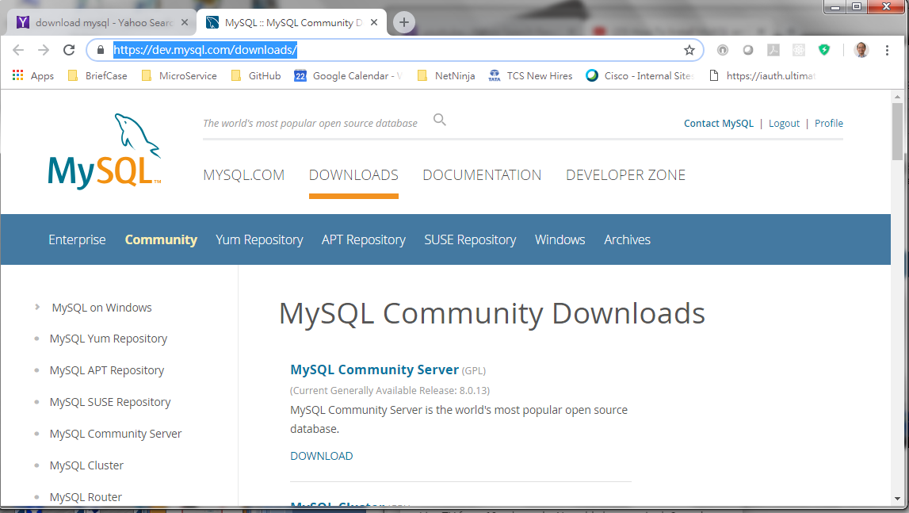
1.1 Download STS
https://www.apress.com/us/book/9781484231975
Go To: https://dev.mysql.com/downloads/

Slide 9
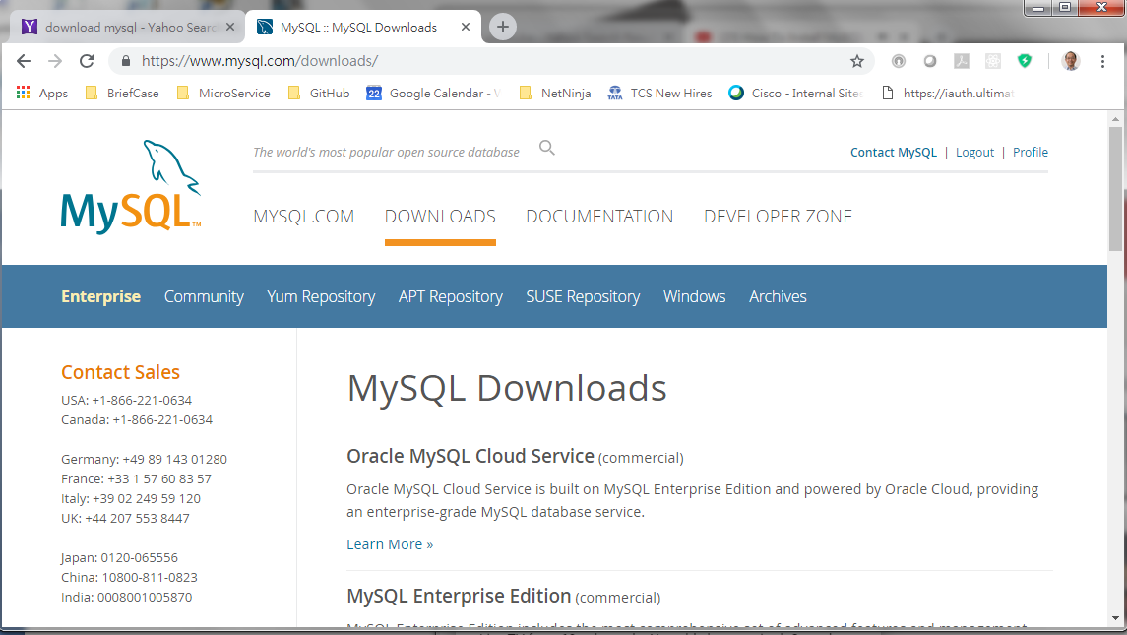
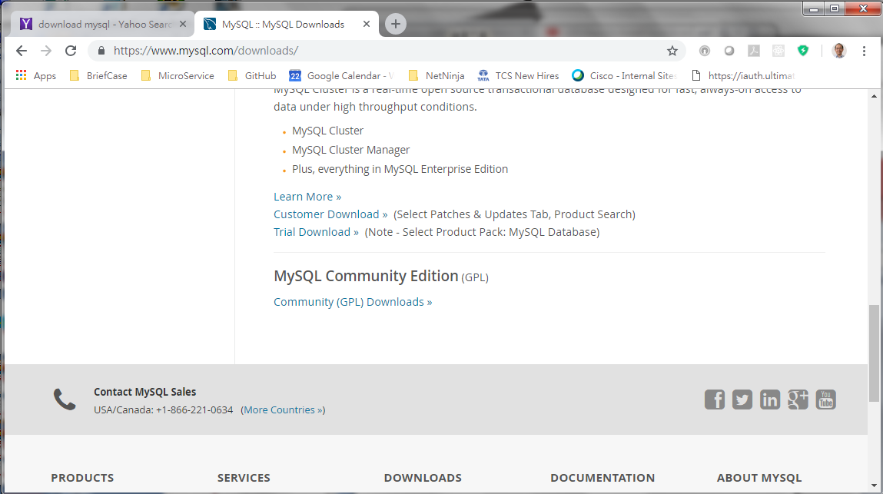
1.1 Download STS
https://www.apress.com/us/book/9781484231975
Scroll down to community Edition.

Slide 10
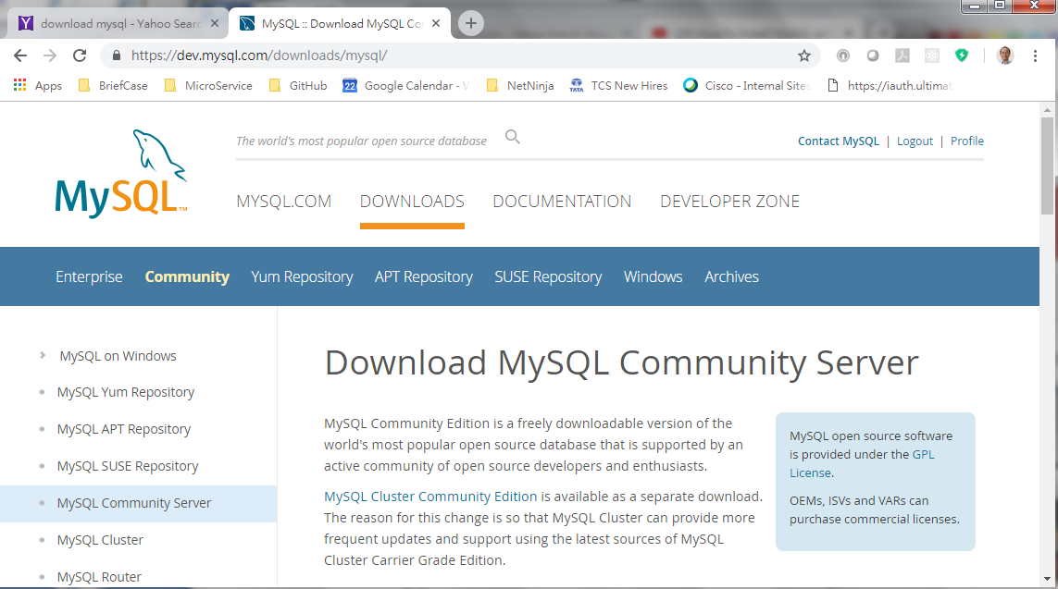
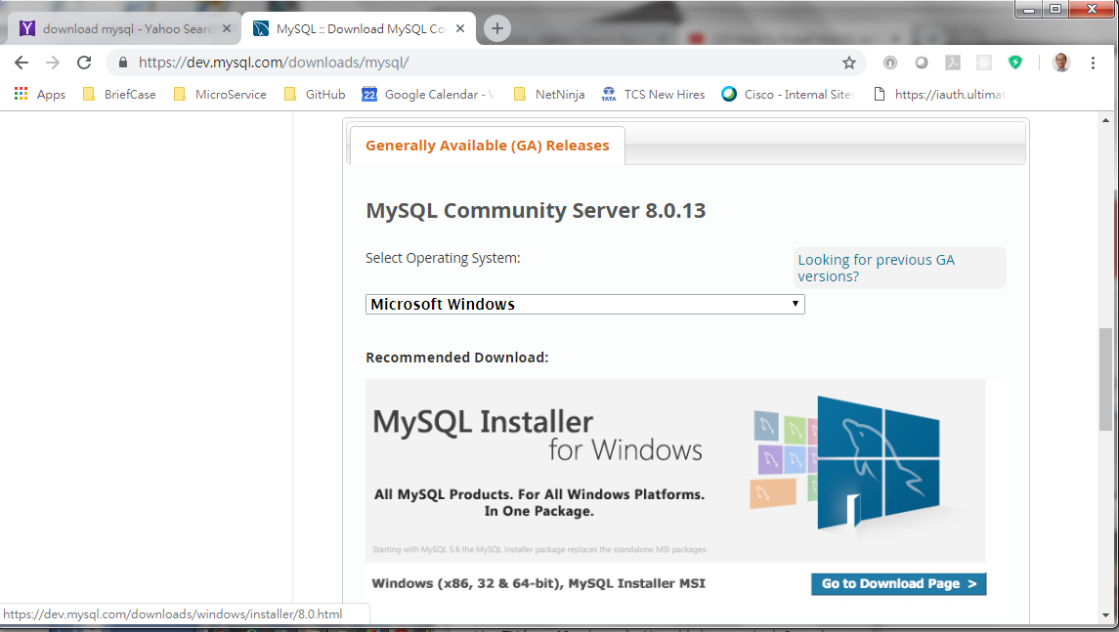
1.1 Download STS
https://www.apress.com/us/book/9781484231975
Community Server.

Slide 11
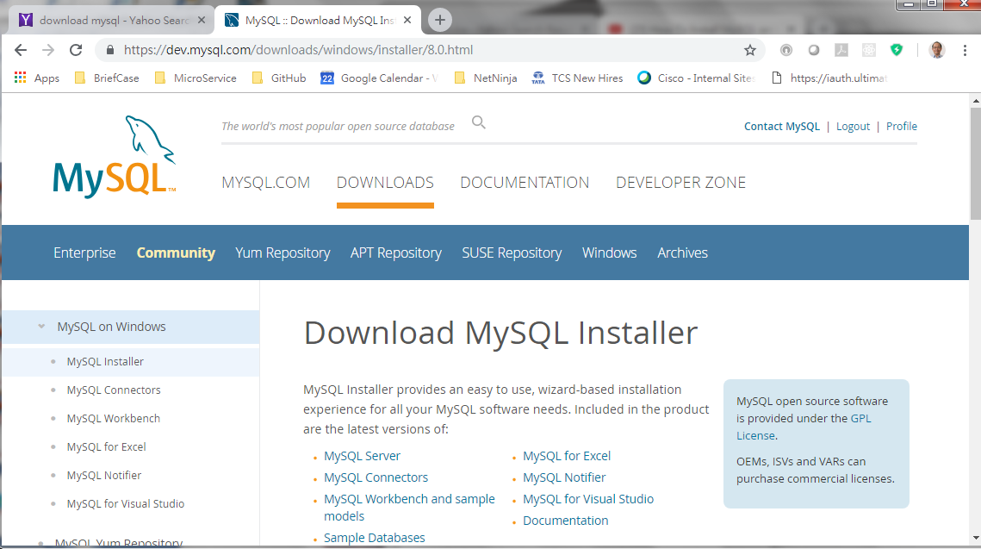
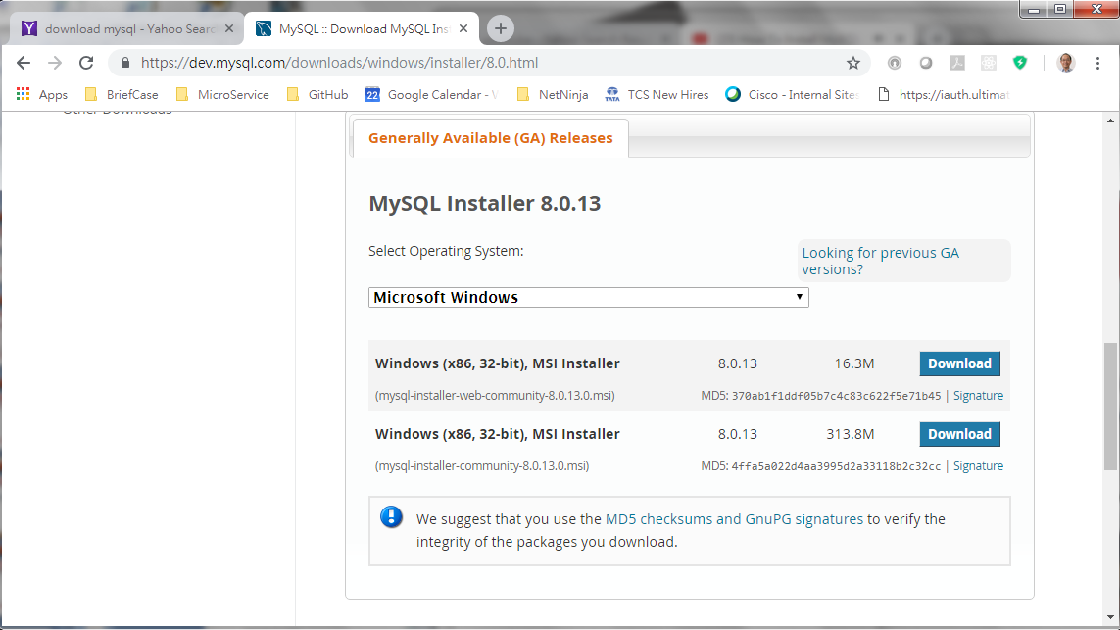
1.1 Download STS
https://www.apress.com/us/book/9781484231975
Download load the offline community version.

Slide 12
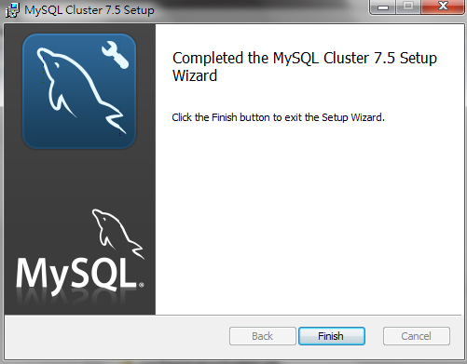
1.1 Download STS
https://www.apress.com/us/book/9781484231975
Go To: https://dev.mysql.com/downloads/

Slide 13
1.3 Start STS

Slide 14
End of Chapter

