Slide 1

3 Material Module
Peter H. Chen

Slide 2
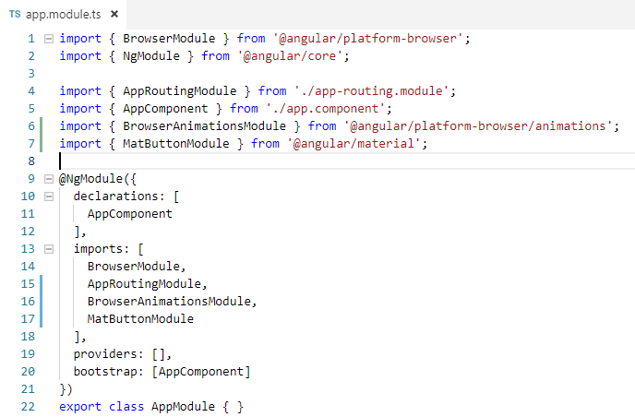
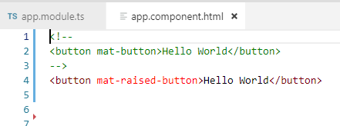
2 Get Started
https://www.youtube.com/watch?v=4ZugNBFA2mA&list=PLC3y8-rFHvwilEuCqFGTL5Gt5U6deIrsU&index=3
In the last section, we have Material Button Component in our application.
We have three steps. First step is to import the MatButtonModule. Second step is to add the imports array. The third step is to use in HTML.
1
2
3

Slide 3
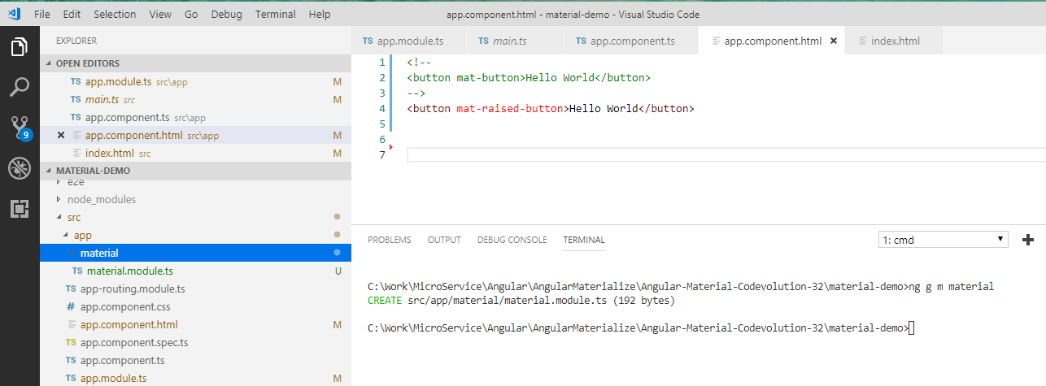
2 Get Started
https://www.youtube.com/watch?v=4ZugNBFA2mA&list=PLC3y8-rFHvwilEuCqFGTL5Gt5U6deIrsU&index=3
Although these steps works, however, there is a better and recommend approach.
That approach is to create a separate module that deal with import and export the material components, i.e., we want to put step 1 and step 2 together into a separate material module.
In the terminal,
> ng g m
g: generate, m: module, material: module name

Slide 4
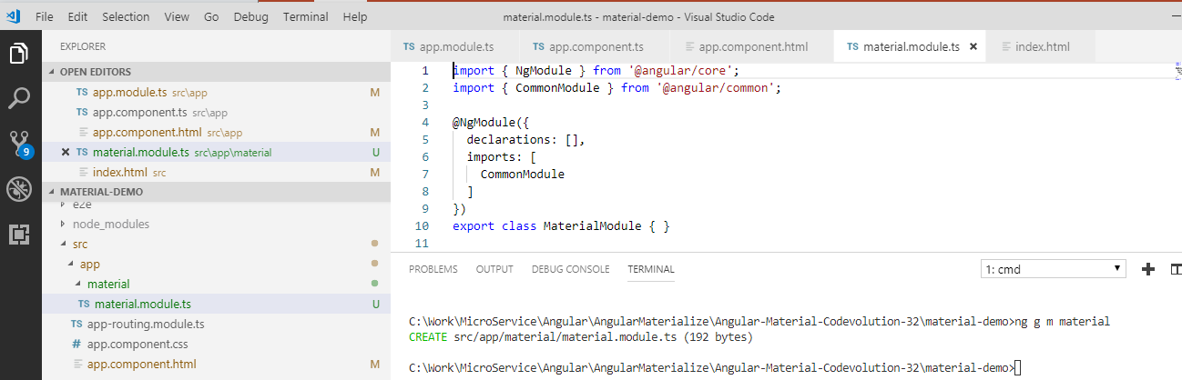
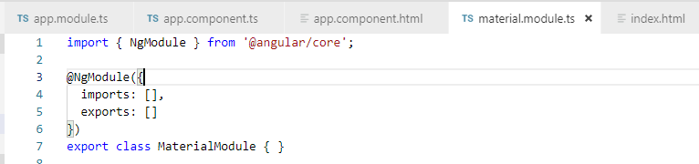
2 Get Started
https://www.youtube.com/watch?v=4ZugNBFA2mA&list=PLC3y8-rFHvwilEuCqFGTL5Gt5U6deIrsU&index=3
In the material folder, we should have the material.module.ts.
In this material, we only concern the import and export the material components.
Remove the CommonModule and declarations.
Add the imports:[], exports: []

Slide 5
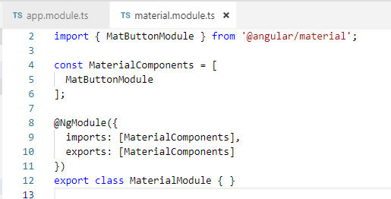
2 Get Started
https://www.youtube.com/watch?v=4ZugNBFA2mA&list=PLC3y8-rFHvwilEuCqFGTL5Gt5U6deIrsU&index=3
In the material folder, we should have the material.module.ts.
In this material, we only concern the import and export the material components.
Import the MatButtonModule
Add const MaterialComponents = [ MatButtonModule ];
Add the imports:[ MaterialCompoents ], exports: [ MterialCompoents ]
export MaterialModule class.

Slide 6
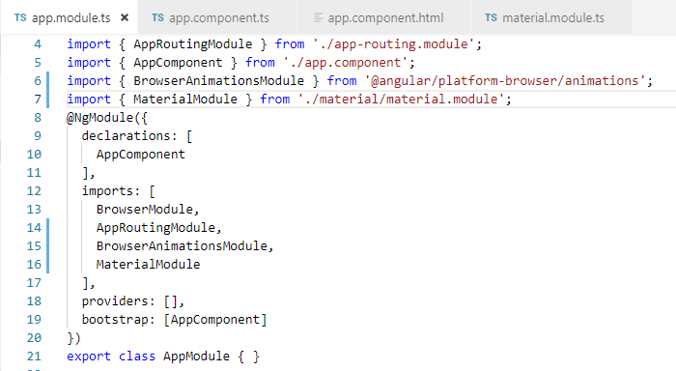
2 Get Started
https://www.youtube.com/watch?v=4ZugNBFA2mA&list=PLC3y8-rFHvwilEuCqFGTL5Gt5U6deIrsU&index=3
In the app.module, we add MterialModule.

Slide 7
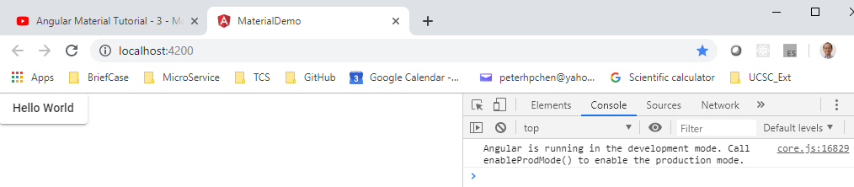
2 Get Started
https://www.youtube.com/watch?v=4ZugNBFA2mA&list=PLC3y8-rFHvwilEuCqFGTL5Gt5U6deIrsU&index=3
Restart the browser:
> ng serve -o

Slide 8
2 Get Started
https://www.youtube.com/watch?v=4ZugNBFA2mA&list=PLC3y8-rFHvwilEuCqFGTL5Gt5U6deIrsU&index=3
In the next section, we have the material module for all the modules we added.

Slide 9
End of Chapter

