Slide 1

10 NavBar
Peter H. Chen

Slide 2
10 NavBar
https://www.youtube.com/watch?v=3gtczOujFV0&list=PLC3y8-rFHvwilEuCqFGTL5Gt5U6deIrsU&index=10
This section discusses NavBar.
NavBar is used for branding screen title navigation and actions.
In this section, we only focus how the toolbar can be used as a navbar.

Slide 3
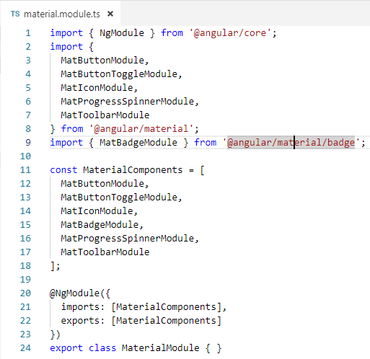
10 NavBar
https://www.youtube.com/watch?v=3gtczOujFV0&list=PLC3y8-rFHvwilEuCqFGTL5Gt5U6deIrsU&index=10
The first step is to import the MatToolbarModule and material Array in material.module.ts.

Slide 4
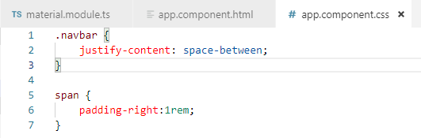
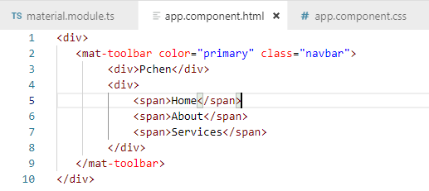
10 NavBar
https://www.youtube.com/watch?v=3gtczOujFV0&list=PLC3y8-rFHvwilEuCqFGTL5Gt5U6deIrsU&index=10
Now we can use the components in the HTML.
<mat-toolbar> is the basic tool bar. Now how to change the toolbar into navbar.
The navbar typically have the brand title on the left and a group of links on the right.

Slide 5
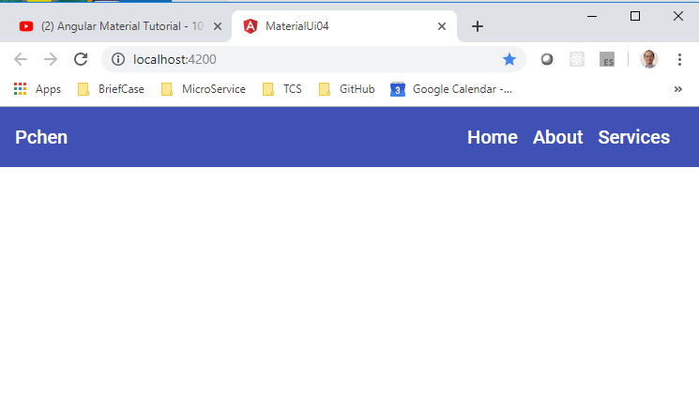
10 NavBar
https://www.youtube.com/watch?v=3gtczOujFV0&list=PLC3y8-rFHvwilEuCqFGTL5Gt5U6deIrsU&index=10
Take a look at the browser.
We have navbar on the left and Links on the right.

Slide 6
End of Chapter

