Slide 1

4 Typography
Peter H. Chen

Slide 2
4 Typography
https://www.youtube.com/watch?v=E_ztRpqs_Vs&list=PLC3y8-rFHvwilEuCqFGTL5Gt5U6deIrsU&index=4
This section discusses typography of Angular Material.
Typography basically deals with the style and appearance of text on your website.
If your web site has too many styles of font and font size that will spoil your UI.
Angular Material provides typography levels. Each level has a definite font size, font weight, a and line height.
Let’s take a look at the different typographic levels.
To display huge headers in the web page, we can use the material display classes.
There are four display classes. We can create four div tags. One for each display class.

Slide 3
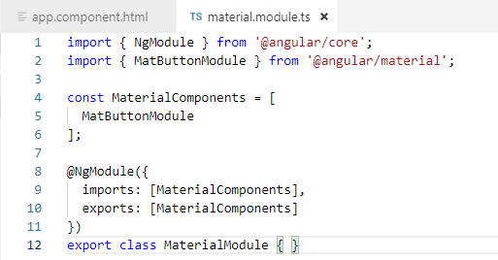
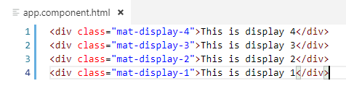
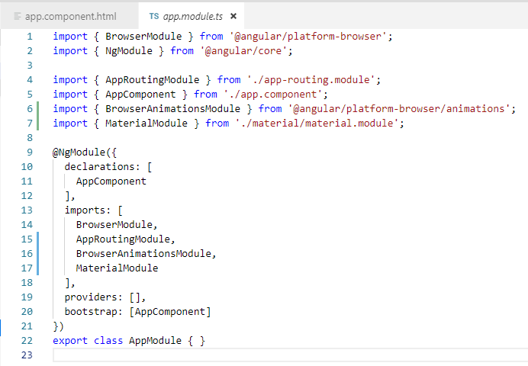
4 Typography
https://www.youtube.com/watch?v=E_ztRpqs_Vs&list=PLC3y8-rFHvwilEuCqFGTL5Gt5U6deIrsU&index=4
> cd material-ui04
Set up the Angular material.
> ng add @angular/material
Generate the module:
> ng g m material
Code modified:

Slide 4
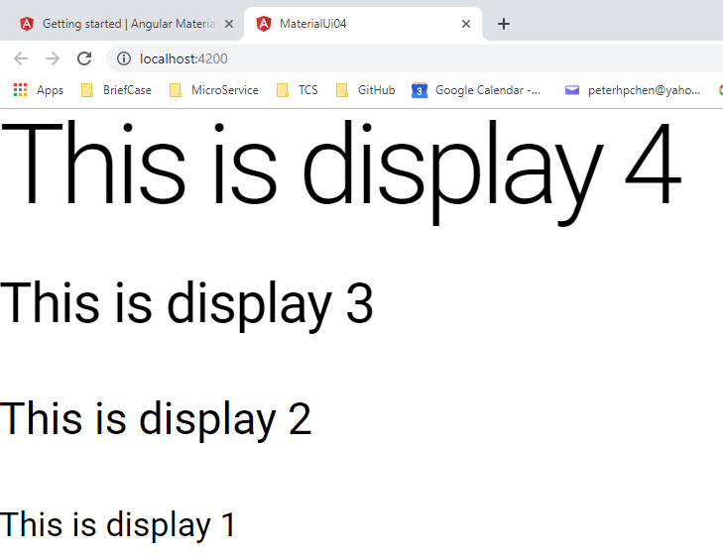
4 Typography
https://www.youtube.com/watch?v=E_ztRpqs_Vs&list=PLC3y8-rFHvwilEuCqFGTL5Gt5U6deIrsU&index=4
> ng serve -o

Slide 5
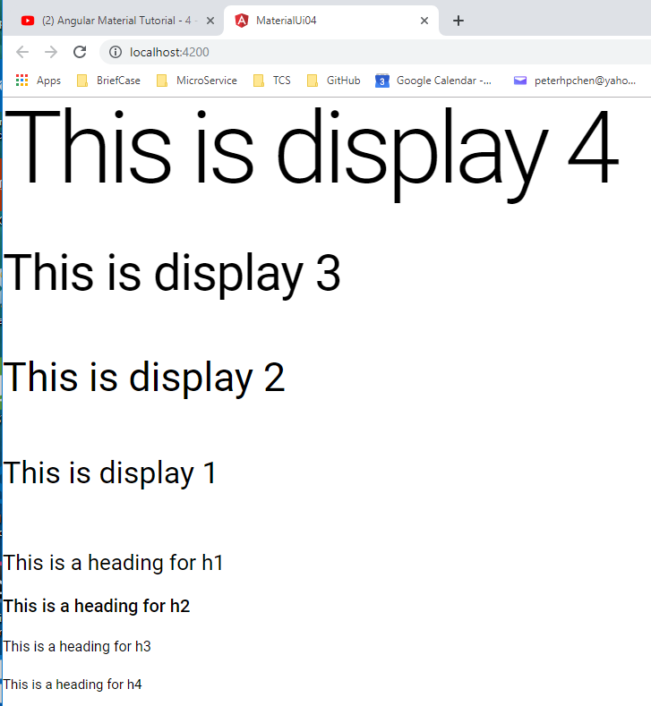
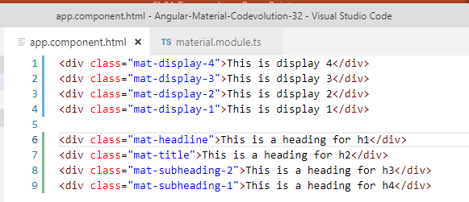
4 Typography
https://www.youtube.com/watch?v=E_ztRpqs_Vs&list=PLC3y8-rFHvwilEuCqFGTL5Gt5U6deIrsU&index=4
We have four more classes that correspond to H1, H2, H3, and H4 tags.
We have four more of div tags.
H1 to H4 are smaller.

Slide 6
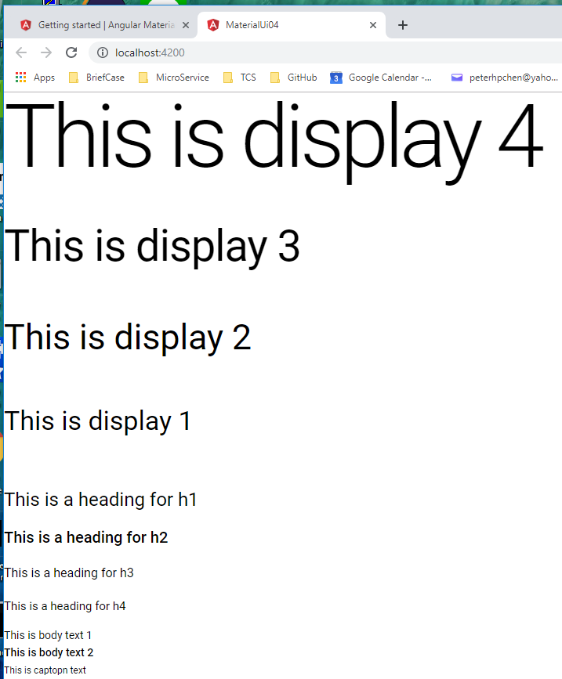
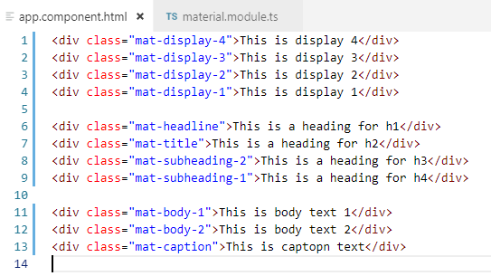
4 Typography
https://www.youtube.com/watch?v=E_ztRpqs_Vs&list=PLC3y8-rFHvwilEuCqFGTL5Gt5U6deIrsU&index=4
Then, we have body text.
Regular text: “body-1”
Body text: “body-2”
Caption: “caption”

Slide 7
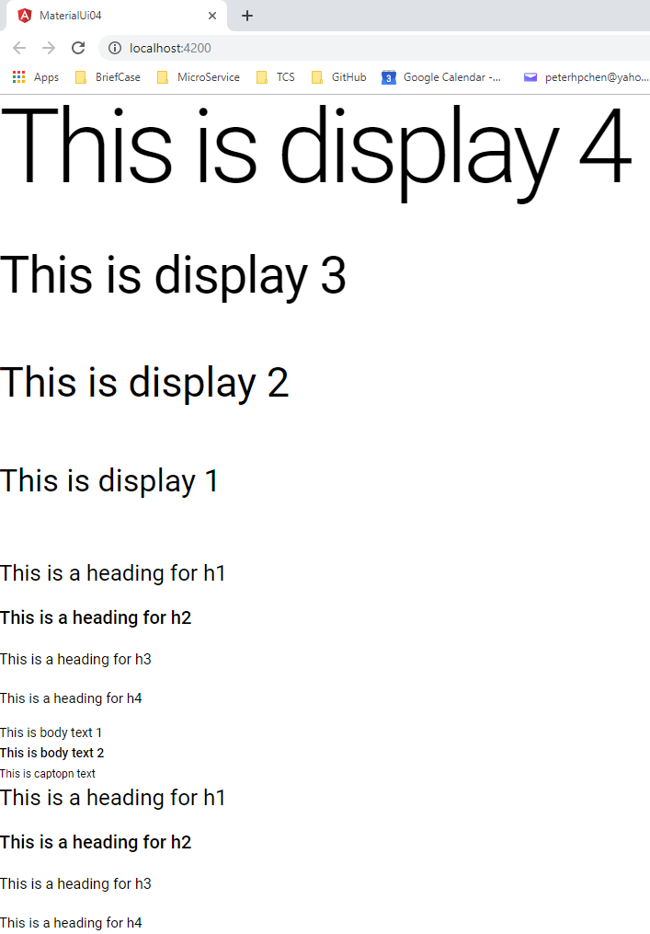
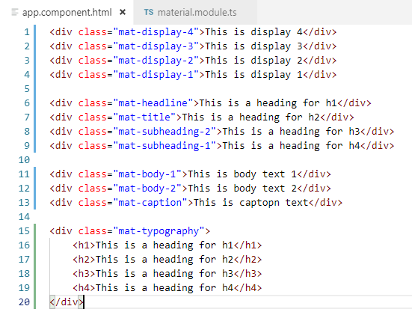
4 Typography
https://www.youtube.com/watch?v=E_ztRpqs_Vs&list=PLC3y8-rFHvwilEuCqFGTL5Gt5U6deIrsU&index=4
The final class is the typography text with <h1> to <h4>.

Slide 8
End of Chapter

