Slide 1

5 Button
Peter H. Chen

Slide 2
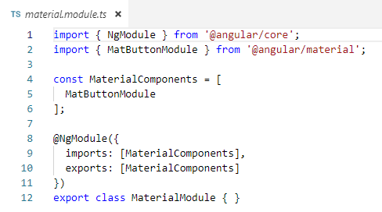
5 Button
https://www.youtube.com/watch?v=N_KxVoq2HyM&list=PLC3y8-rFHvwilEuCqFGTL5Gt5U6deIrsU&index=5
This section discusses angular button.
Angular Material Buttons are basically native button tags or anchor tags enhanced with material design.
We will take more detailed look of Material Buttons. We need to import the material button module.
In the material.module, import { MatButtonModule } from ‘@angular/material’ and added to MaterialComponents [] array.

Slide 3
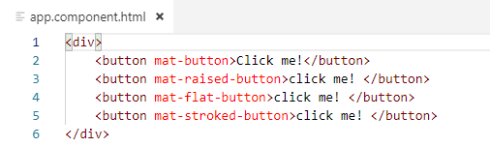
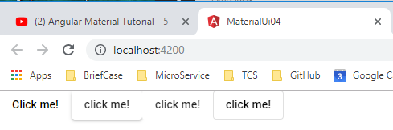
5 Button
https://www.youtube.com/watch?v=N_KxVoq2HyM&list=PLC3y8-rFHvwilEuCqFGTL5Gt5U6deIrsU&index=5
In app.component.html, create the simplest button
<button mat-button> click me!</button>

Slide 4
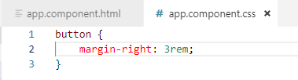
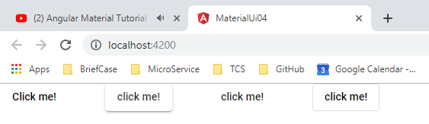
5 Button
https://www.youtube.com/watch?v=N_KxVoq2HyM&list=PLC3y8-rFHvwilEuCqFGTL5Gt5U6deIrsU&index=5
In app.component.html, create the simplest button
<button mat-button> click me!</button>

Slide 5
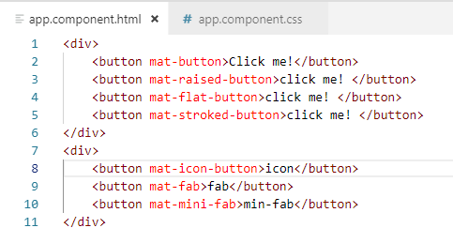
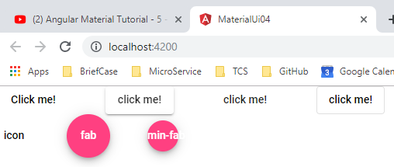
5 Button
https://www.youtube.com/watch?v=N_KxVoq2HyM&list=PLC3y8-rFHvwilEuCqFGTL5Gt5U6deIrsU&index=5
In aap.component.html, create the circle button.
<button mat-icon-button> icon</button>

Slide 6
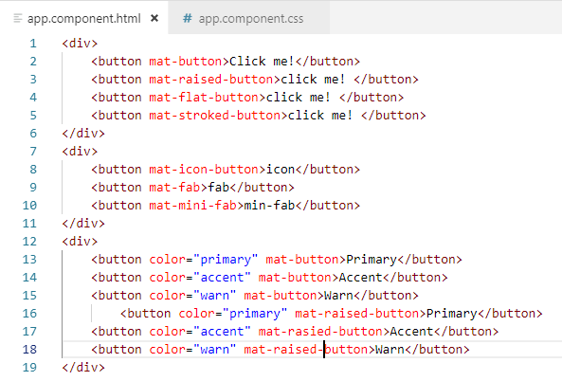
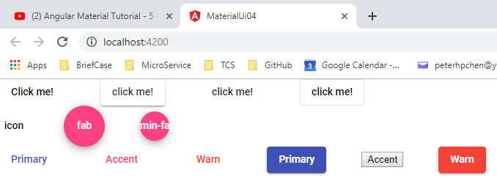
5 Button
https://www.youtube.com/watch?v=N_KxVoq2HyM&list=PLC3y8-rFHvwilEuCqFGTL5Gt5U6deIrsU&index=5
Next is colors. We have primary, accent, and warn color for rasied-button.

Slide 7
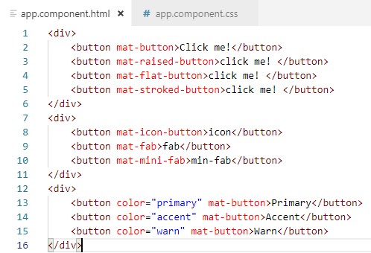
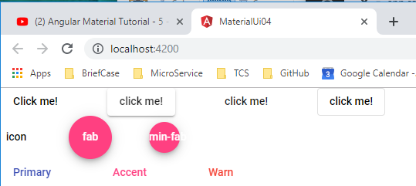
5 Button
https://www.youtube.com/watch?v=N_KxVoq2HyM&list=PLC3y8-rFHvwilEuCqFGTL5Gt5U6deIrsU&index=5
Next is colors. We have primary, accent, and warn color.

Slide 8
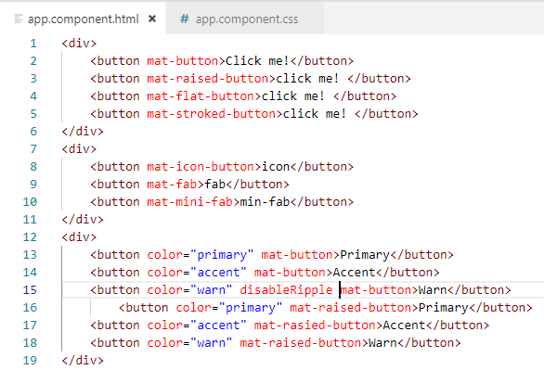
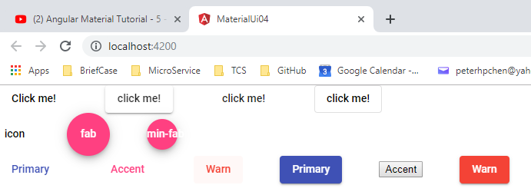
5 Button
https://www.youtube.com/watch?v=N_KxVoq2HyM&list=PLC3y8-rFHvwilEuCqFGTL5Gt5U6deIrsU&index=5
How to disable the ripple effect?

Slide 9
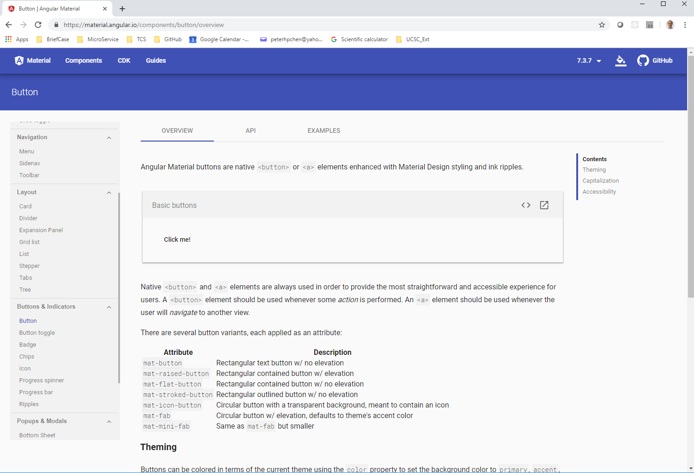
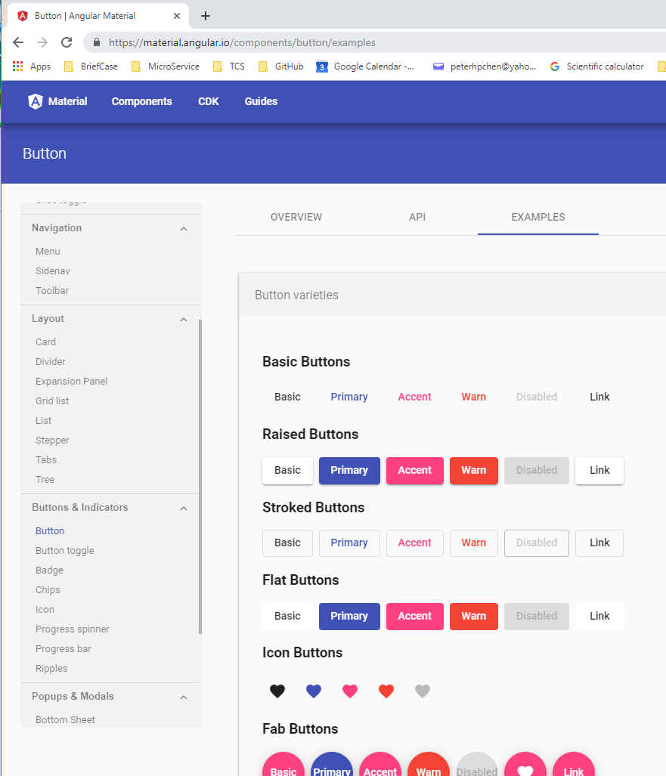
5 Button
https://www.youtube.com/watch?v=N_KxVoq2HyM&list=PLC3y8-rFHvwilEuCqFGTL5Gt5U6deIrsU&index=5
Go to the material.angular.io > components > button
Click on Examples

Slide 10
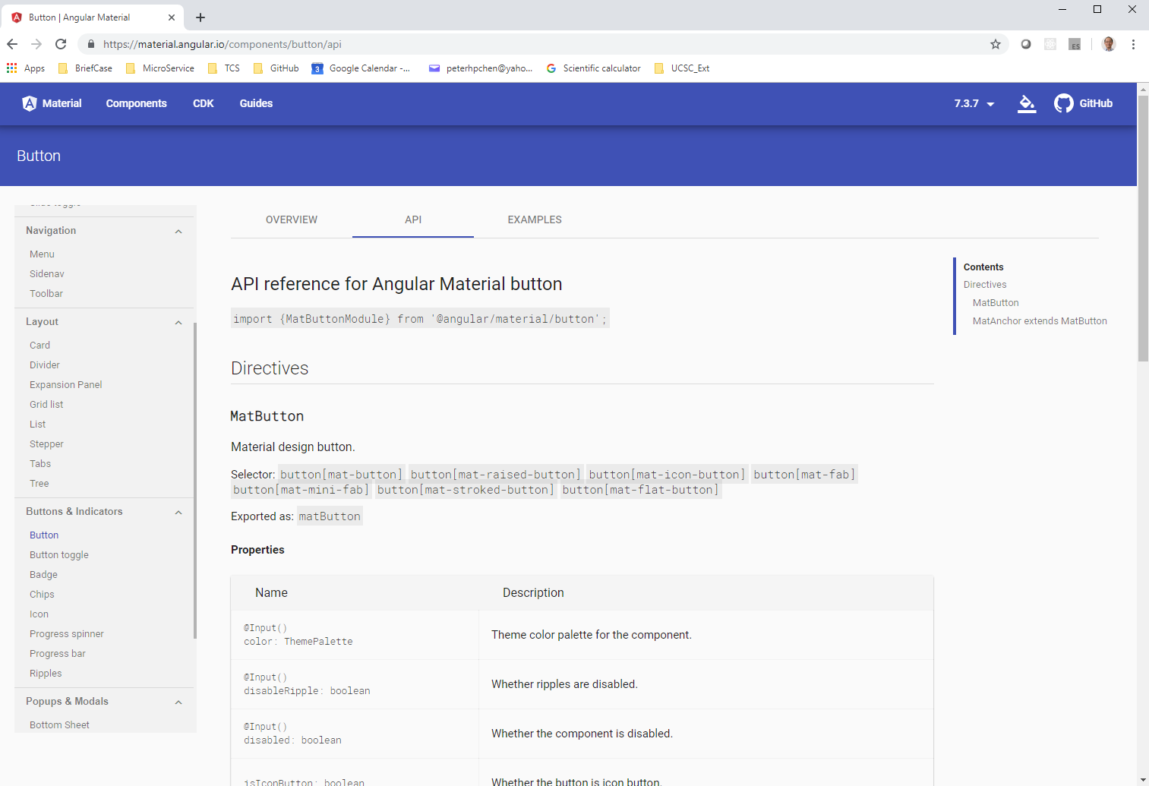
5 Button
https://www.youtube.com/watch?v=N_KxVoq2HyM&list=PLC3y8-rFHvwilEuCqFGTL5Gt5U6deIrsU&index=5
Click on API to see the import modules

Slide 11
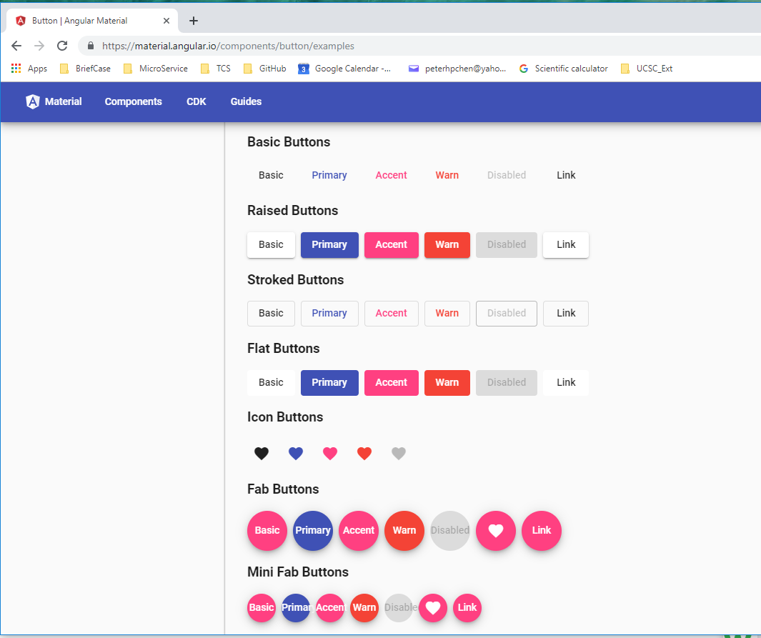
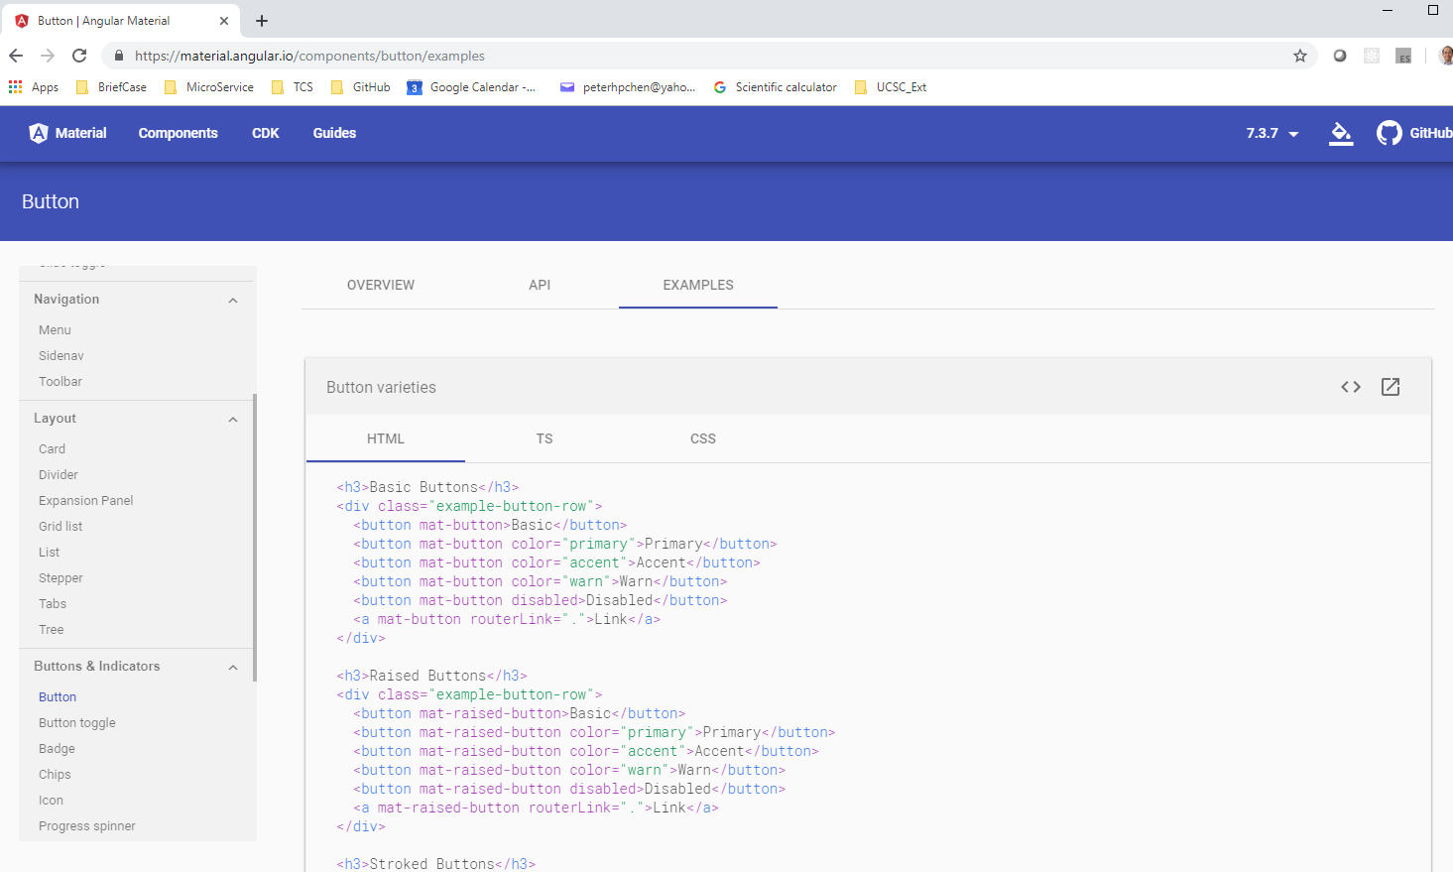
5 Button
https://www.youtube.com/watch?v=N_KxVoq2HyM&list=PLC3y8-rFHvwilEuCqFGTL5Gt5U6deIrsU&index=5
Click on <> (Code Icon).
We have all the examples of button.

Slide 12
End of Chapter

