Slide 1

8 Badge
Peter H. Chen

Slide 2
8 Badge
https://www.youtube.com/watch?v=SiIPlZAOnQ4&list=PLC3y8-rFHvwilEuCqFGTL5Gt5U6deIrsU&index=8
This section discusses Material Badges.
If you work with Bootstrap, badges should be familiar with you. Badges are small descriptor for UI elements, for example, if you want to display notification to a user or the number pof unread message in your Inbox, badges are the way to go.

Slide 3
8.1 Import Badge

Slide 4
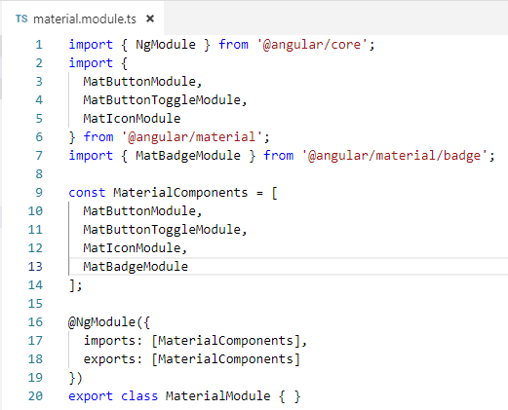
8.1 Import Badge
https://www.youtube.com/watch?v=SiIPlZAOnQ4&list=PLC3y8-rFHvwilEuCqFGTL5Gt5U6deIrsU&index=8
Let’s see what is Angular Material Badges.
We need to import the badge module.

Slide 5
8.2 Badge Position

Slide 6

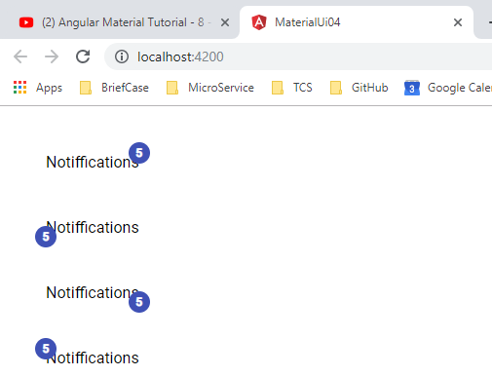
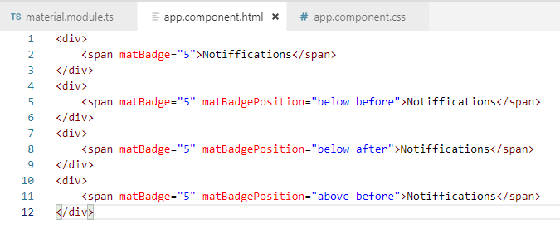
8.2 Badge Position
https://www.youtube.com/watch?v=SiIPlZAOnQ4&list=PLC3y8-rFHvwilEuCqFGTL5Gt5U6deIrsU&index=8
Let’s see what is Angular Material Badges. We need to import the badge module. The default badge is placed above and after the element it is associated with.
That is to the top right. We can put the position using the matBadgePosition attribute.

Slide 7
8.3 Badge Size

Slide 8
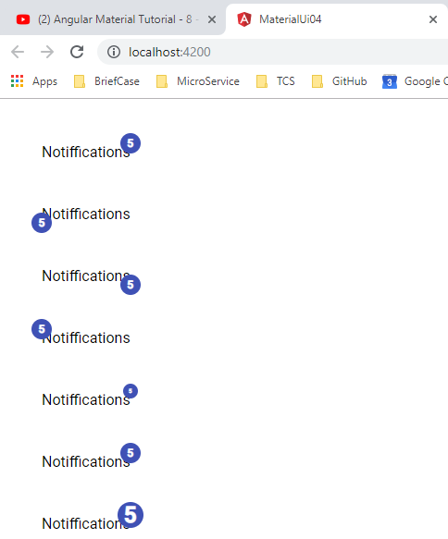
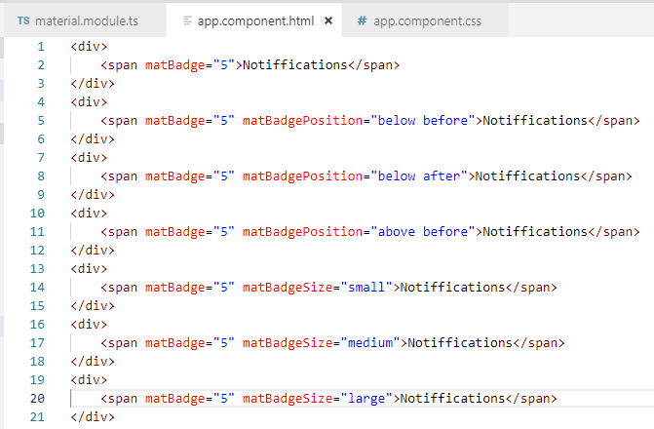
8.3 Badge Size
https://www.youtube.com/watch?v=SiIPlZAOnQ4&list=PLC3y8-rFHvwilEuCqFGTL5Gt5U6deIrsU&index=8
Badge Sizing:
We can specify the badge size by matBadgeSize attribute. We can use large, small, and medium with medium the default value.

Slide 9
8.3 Badge Color

Slide 10
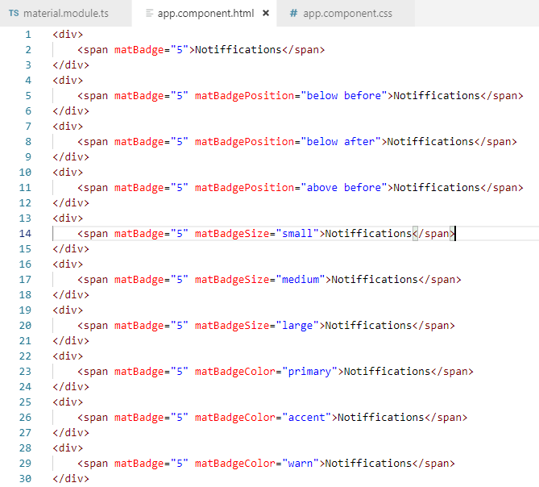
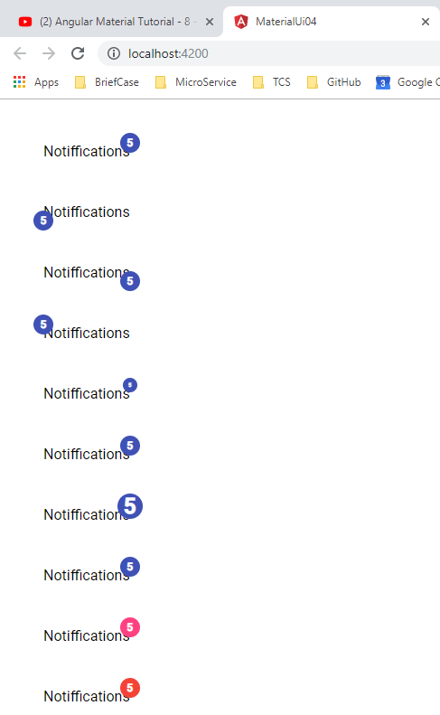
8.4 Badge Color
https://www.youtube.com/watch?v=SiIPlZAOnQ4&list=PLC3y8-rFHvwilEuCqFGTL5Gt5U6deIrsU&index=8
Badge Coloring:
We can specify the badge size by matBadgeColor attribute. We can use primary, accent, and warn with primary the default value. The color is determined by the theme.

Slide 11
8.4 Badge Overlap

Slide 12
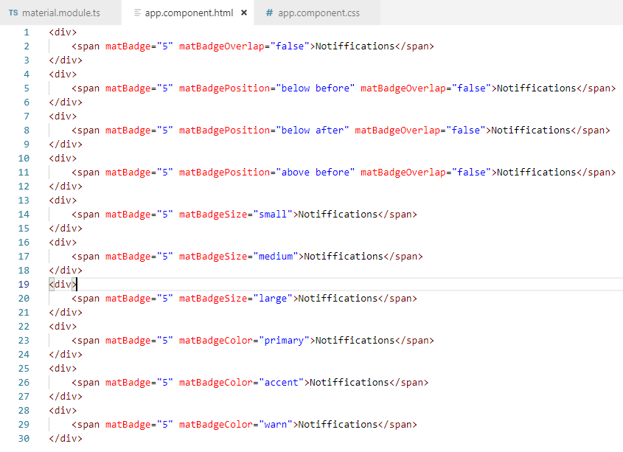
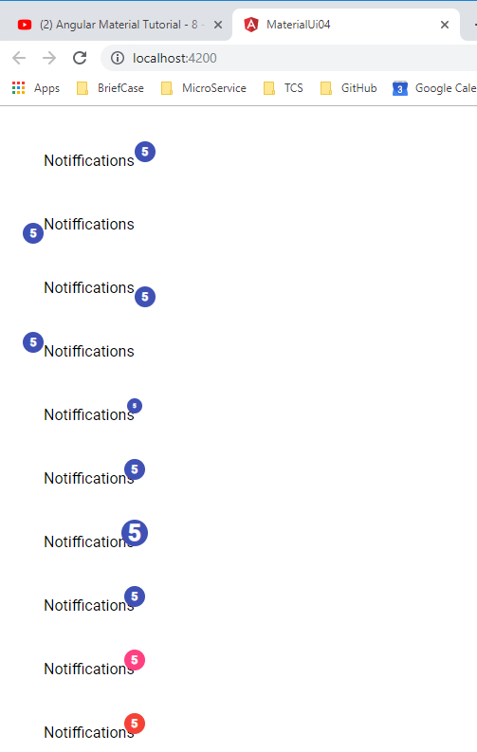
8.4 Badge Overlap
https://www.youtube.com/watch?v=SiIPlZAOnQ4&list=PLC3y8-rFHvwilEuCqFGTL5Gt5U6deIrsU&index=8
The badge text is overlapped with notification. We can set matBadgeOverlap=“false”

Slide 13
8.5 Badge Property Binding

Slide 14
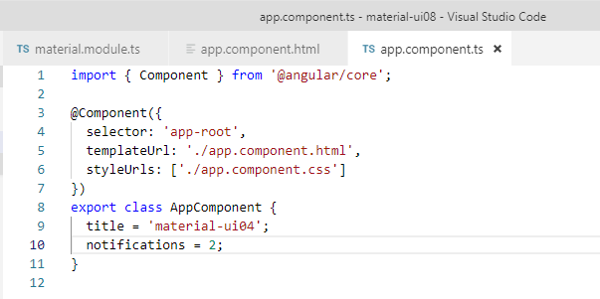
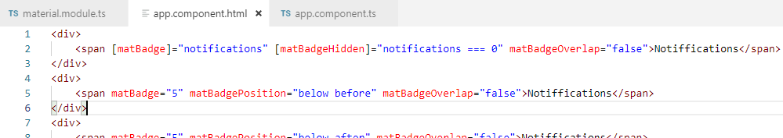
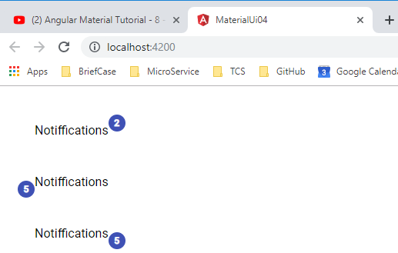
8.5 Badge Property Binding
https://www.youtube.com/watch?v=SiIPlZAOnQ4&list=PLC3y8-rFHvwilEuCqFGTL5Gt5U6deIrsU&index=8
We can bind the property into the element.

Slide 15
8.6 Badge Conditional Rendering

Slide 16
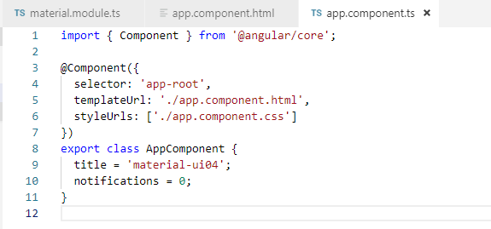
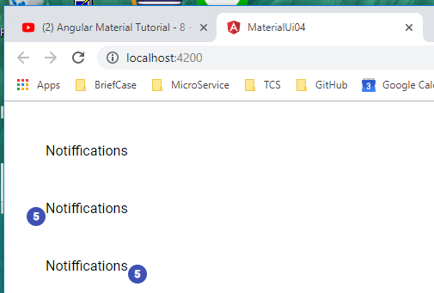
8.6 Badge Conditional Rendering
https://www.youtube.com/watch?v=SiIPlZAOnQ4&list=PLC3y8-rFHvwilEuCqFGTL5Gt5U6deIrsU&index=8
We can do the conditional rendering, for example, if the notifications is zero, it does not make sense to display the badge.

Slide 17
End of Chapter

