Slide 1

7 Icon
Peter H. Chen

Slide 2
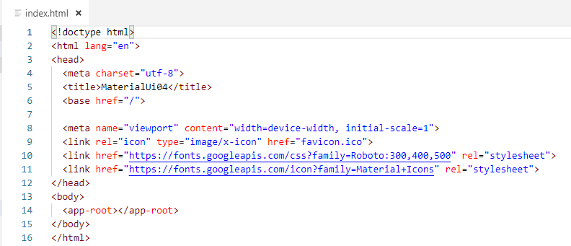
7 Icon
https://www.youtube.com/watch?v=wI6kQAORiVg&list=PLC3y8-rFHvwilEuCqFGTL5Gt5U6deIrsU&index=7
This section discusses Icon. First, check the CDN include the Icon.

Slide 3
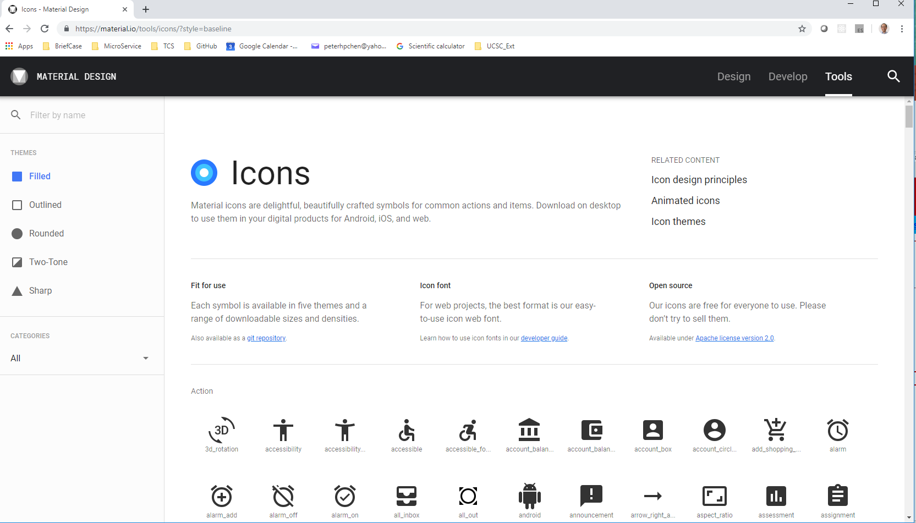
7 Icon
https://www.youtube.com/watch?v=wI6kQAORiVg&list=PLC3y8-rFHvwilEuCqFGTL5Gt5U6deIrsU&index=7
Mat-icon component accept the material icon fonts,
In the browser, go to “https://material.io”. Click tools > Icon.

Slide 4
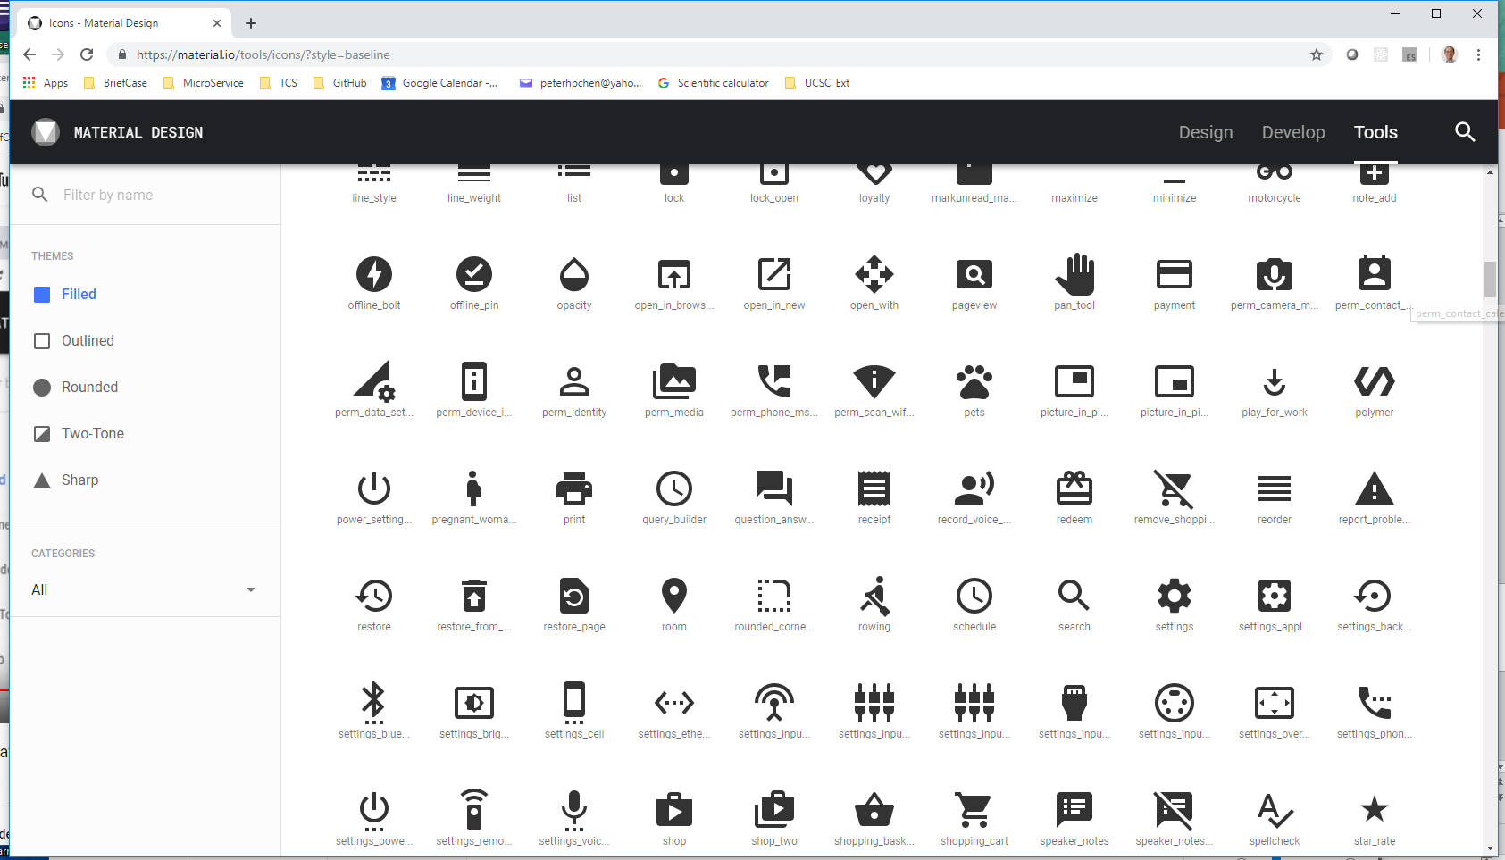
7 Icon
https://www.youtube.com/watch?v=wI6kQAORiVg&list=PLC3y8-rFHvwilEuCqFGTL5Gt5U6deIrsU&index=7
Here you can see all the material icon available.

Slide 5
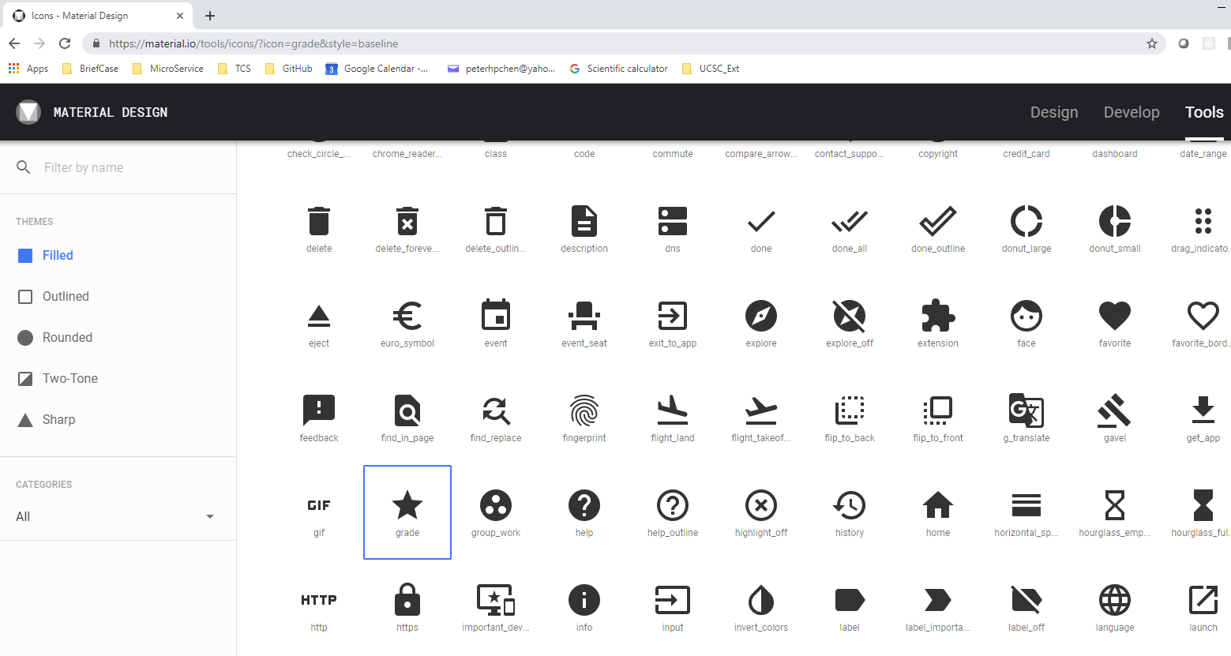
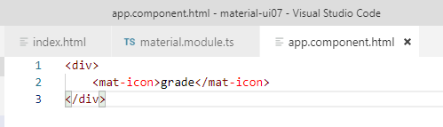
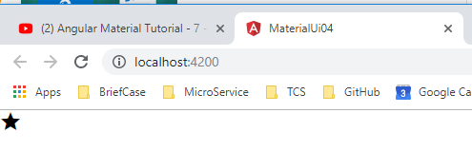
7 Icon
https://www.youtube.com/watch?v=wI6kQAORiVg&list=PLC3y8-rFHvwilEuCqFGTL5Gt5U6deIrsU&index=7
Get the text “grade” of icon and put in the HTML.

Slide 6
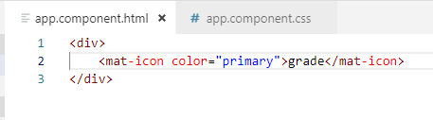
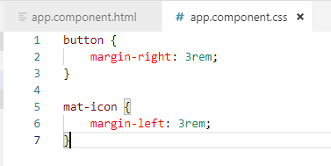
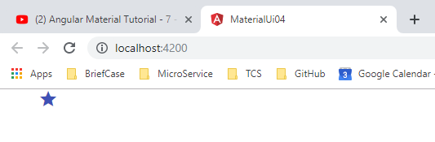
7 Icon
https://www.youtube.com/watch?v=wI6kQAORiVg&list=PLC3y8-rFHvwilEuCqFGTL5Gt5U6deIrsU&index=7
The primary color of icon. In our case is Indigo.

Slide 7
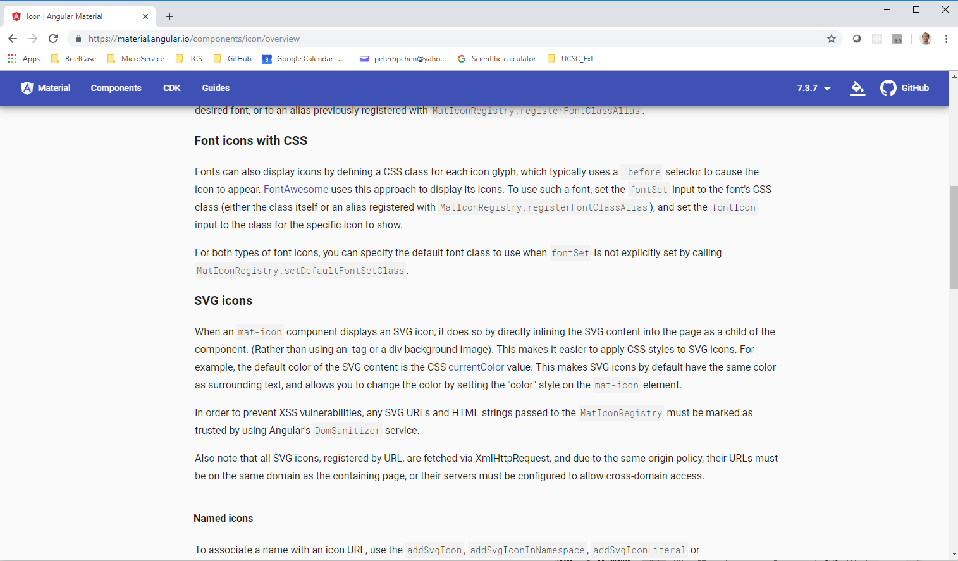
7 Icon
https://www.youtube.com/watch?v=wI6kQAORiVg&list=PLC3y8-rFHvwilEuCqFGTL5Gt5U6deIrsU&index=7
The angular.io contains the explanation of how to use the “svg icon.”

Slide 8
End of Chapter

