Slide 1

9 Progress Spinner
Peter H. Chen

Slide 2
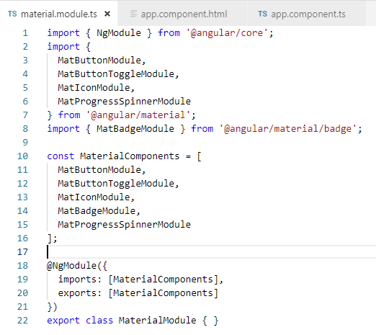
9 Progress Spinner
https://www.youtube.com/watch?v=cj42D7waOoU&list=PLC3y8-rFHvwilEuCqFGTL5Gt5U6deIrsU&index=9
This section discusses Progress Spinner.
We need to import the MatProgressSpinnerModule.

Slide 3
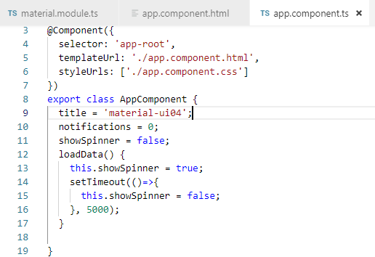
9 Progress Spinner
https://www.youtube.com/watch?v=cj42D7waOoU&list=PLC3y8-rFHvwilEuCqFGTL5Gt5U6deIrsU&index=9
Add property showSpinner = false.
Add function loadData() {
this.showSpinner = false;
setTimeout ( () => { this.showSpinner = false}, 5000)
}

Slide 4
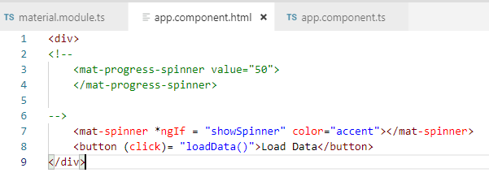
9 Progress Spinner
https://www.youtube.com/watch?v=cj42D7waOoU&list=PLC3y8-rFHvwilEuCqFGTL5Gt5U6deIrsU&index=9
In HTML, add *ngIf = “showSpinner” for spinner and button.

Slide 5
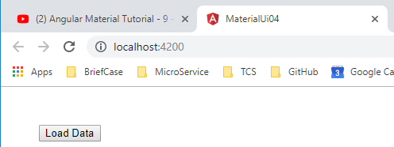
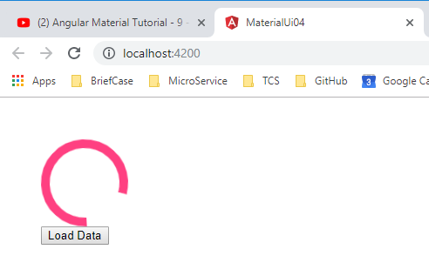
9 Progress Spinner
https://www.youtube.com/watch?v=cj42D7waOoU&list=PLC3y8-rFHvwilEuCqFGTL5Gt5U6deIrsU&index=9
Initially, no spinner. Click “Load Data”. The spinner display. After 5 second, the spinner is disabled.

Slide 6
End of Chapter

