Slide 1

11 SideNav
Peter H. Chen

Slide 2
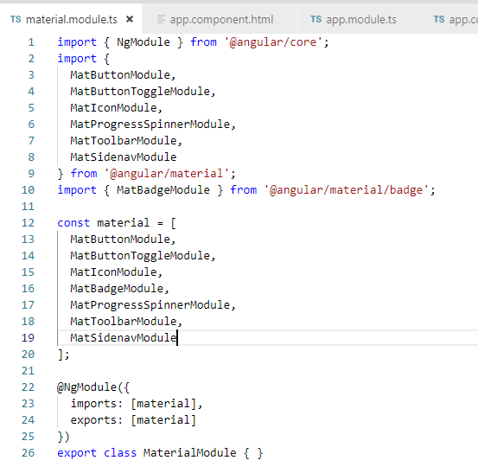
11 SideNav
https://www.youtube.com/watch?v=v8NpQYH2O5M&list=PLC3y8-rFHvwilEuCqFGTL5Gt5U6deIrsU&index=11
This section discusses SideNav.
First, we import the “MatSidenavModule”

Slide 3
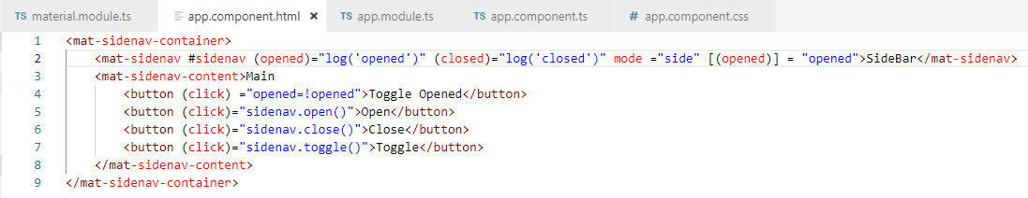
11 SideNav
https://www.youtube.com/watch?v=v8NpQYH2O5M&list=PLC3y8-rFHvwilEuCqFGTL5Gt5U6deIrsU&index=11
Now, add the SideNav into our application.
SideNav includes three components: mat-sidenav-container (main container), mat-sidenav (sidenav), and mat-sidenav-content (the main content).
It is important that you put the sidenav and content inside the main container.
You can put header or footer outside the container.
Container
SideNav
Main Content

Slide 4
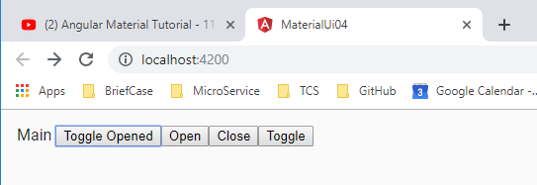
11 SideNav
https://www.youtube.com/watch?v=v8NpQYH2O5M&list=PLC3y8-rFHvwilEuCqFGTL5Gt5U6deIrsU&index=11
We can see the main content but the SideBar is not seen.
SideNav is always hidden by default.
There are several ways to open the sidenav.

Slide 5
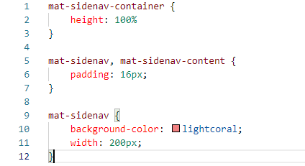
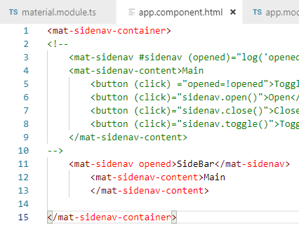
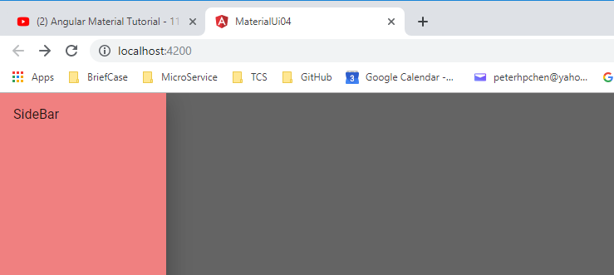
11 SideNav
https://www.youtube.com/watch?v=v8NpQYH2O5M&list=PLC3y8-rFHvwilEuCqFGTL5Gt5U6deIrsU&index=11
The easiest way is to add the opened sidenv for the open component.
Add css speficitcaiton.
Now is more clear, the sidenav overlap the main content.

Slide 6
11.1 Toggle SideNav Display
Peter H. Chen

Slide 7
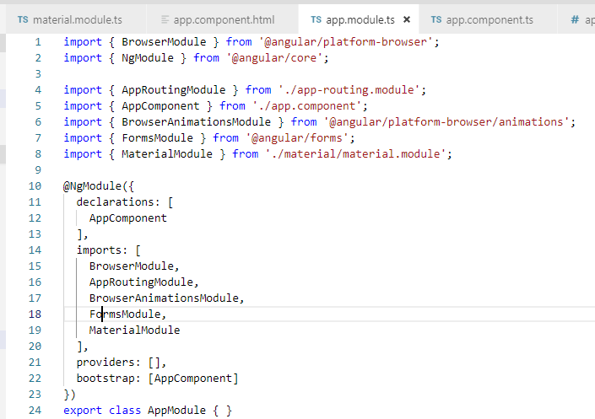
1.1 Toggle SideNav Display
https://www.youtube.com/watch?v=v8NpQYH2O5M&list=PLC3y8-rFHvwilEuCqFGTL5Gt5U6deIrsU&index=11
Once we close the sidenav, how do we re-open the sidenav? Right now, there is no way to reopen the sidenav again.
Rather than opened attribute, we can bind opened attribute into the property and then control by the button.
We will use formsModule. In app.modules, we import the formsModule.

Slide 8
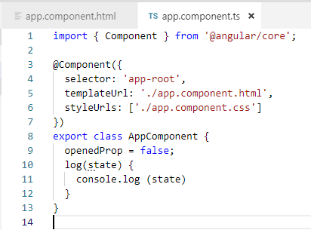
1.1 Toggle SideNav Display
https://www.youtube.com/watch?v=v8NpQYH2O5M&list=PLC3y8-rFHvwilEuCqFGTL5Gt5U6deIrsU&index=11
In app.component, add property openedProp and set to false.

Slide 9
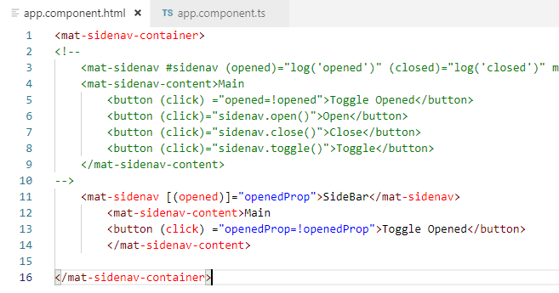
1.1 Toggle SideNav Display
https://www.youtube.com/watch?v=v8NpQYH2O5M&list=PLC3y8-rFHvwilEuCqFGTL5Gt5U6deIrsU&index=11
In app.acomponent.html, bind the opened attribute to the property value openedProp by two-value biding. We use banana in box.
[(opened)] = “openedProp’ (“openedProp” is the property we just created.
Use button to reset the state (click)=“openedProp=!openedProp”: set to !false = true.
opened attribute in two-way binding [()]
Property “openedProp” defined in app.component.
Use button to set the property state “openedProp”

Slide 10
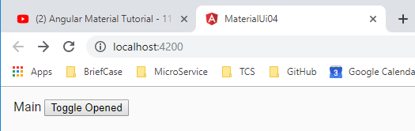
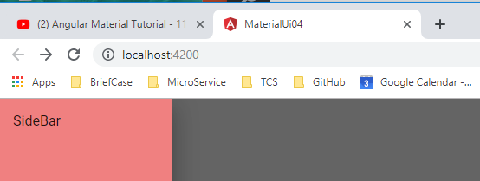
1.1 Toggle SideNav Display
https://www.youtube.com/watch?v=v8NpQYH2O5M&list=PLC3y8-rFHvwilEuCqFGTL5Gt5U6deIrsU&index=11
Toggle the sidebar display.
Click to reset openedProp = false and render into default display

Slide 11
11.2 Other SideNav Toggles
Peter H. Chen

Slide 12
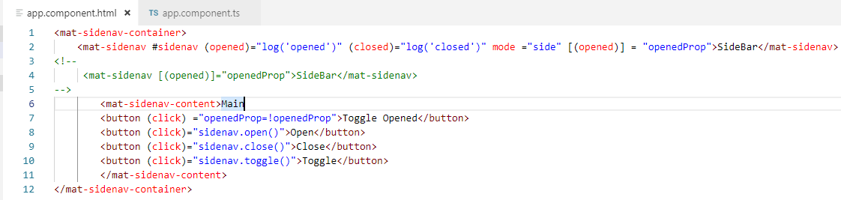
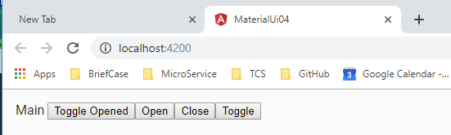
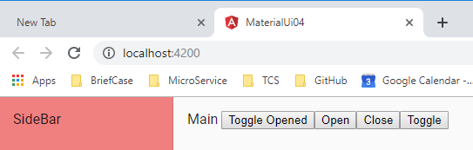
1.1 Toggle SideNav Display
https://www.youtube.com/watch?v=v8NpQYH2O5M&list=PLC3y8-rFHvwilEuCqFGTL5Gt5U6deIrsU&index=11
Toggle the SideNav display.

Slide 13
End of Chapter

