Slide 1

5 Button
Peter H. Chen

Slide 2
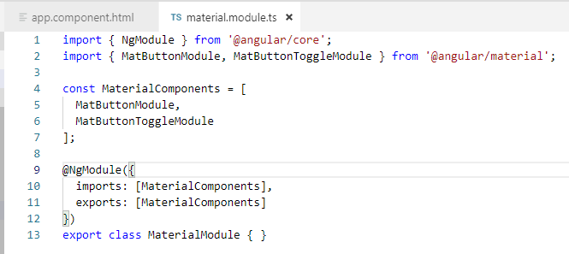
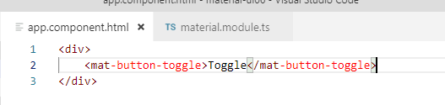
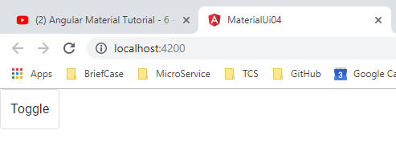
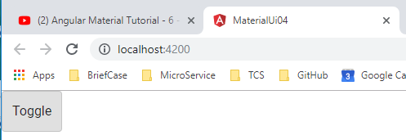
5 Button
https://www.youtube.com/watch?v=cRvqC9hPbLI&list=PLC3y8-rFHvwilEuCqFGTL5Gt5U6deIrsU&index=6
This section discusses Toggle Button.

Slide 3
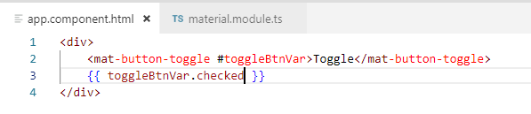
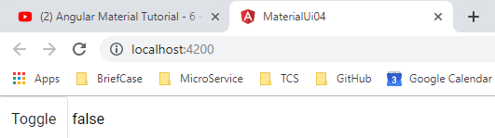
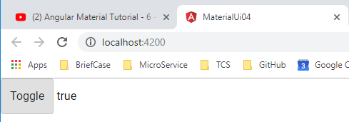
5 Button
https://www.youtube.com/watch?v=cRvqC9hPbLI&list=PLC3y8-rFHvwilEuCqFGTL5Gt5U6deIrsU&index=6
Add the toggle button state variable.

Slide 4
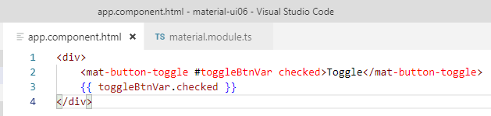
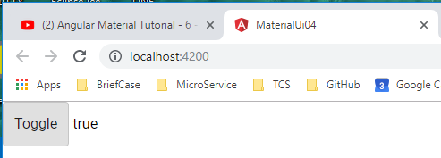
5 Button
https://www.youtube.com/watch?v=cRvqC9hPbLI&list=PLC3y8-rFHvwilEuCqFGTL5Gt5U6deIrsU&index=6
Change the default state from false to true

Slide 5
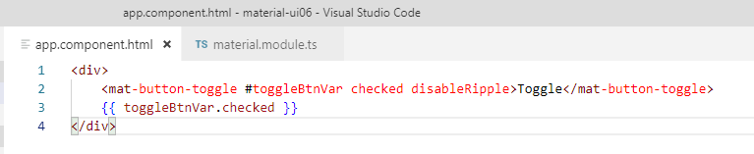
5 Button
https://www.youtube.com/watch?v=cRvqC9hPbLI&list=PLC3y8-rFHvwilEuCqFGTL5Gt5U6deIrsU&index=6
Disable Ripple Attribute

Slide 6
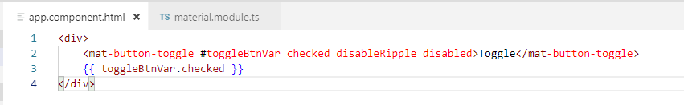
5 Button
https://www.youtube.com/watch?v=cRvqC9hPbLI&list=PLC3y8-rFHvwilEuCqFGTL5Gt5U6deIrsU&index=6
Disable Button

Slide 7
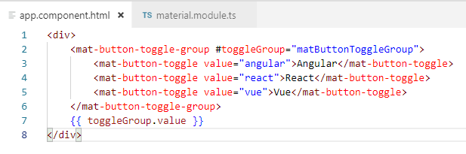
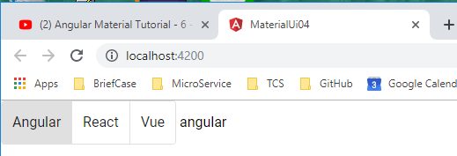
5 Button
https://www.youtube.com/watch?v=cRvqC9hPbLI&list=PLC3y8-rFHvwilEuCqFGTL5Gt5U6deIrsU&index=6
Toggle buttons are normally group together as the radio button or check boxes.
By default, it is the radio button. Only one of them is activate.

Slide 8
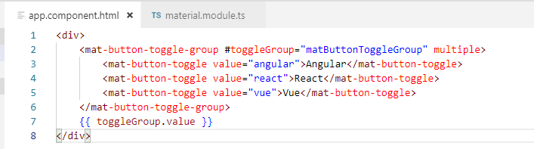
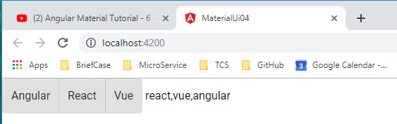
5 Button
https://www.youtube.com/watch?v=cRvqC9hPbLI&list=PLC3y8-rFHvwilEuCqFGTL5Gt5U6deIrsU&index=6
Add for multiple value toggle button. The values are comma separated list.

Slide 9
5 Button
https://www.youtube.com/watch?v=cRvqC9hPbLI&list=PLC3y8-rFHvwilEuCqFGTL5Gt5U6deIrsU&index=6
You can listen to the change event and execute some code written in the component class.
You can also get hold of the template reference variable in the class component and perform any required operation.

Slide 10
5 Button
https://www.youtube.com/watch?v=cRvqC9hPbLI&list=PLC3y8-rFHvwilEuCqFGTL5Gt5U6deIrsU&index=6
Add for multiple value toggle button.

Slide 11
End of Chapter

