Slide 1

6 Button Toggle
Peter H. Chen

Slide 2
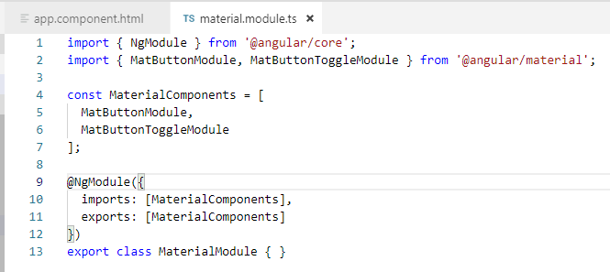
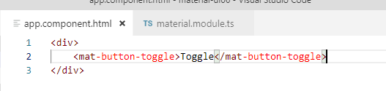
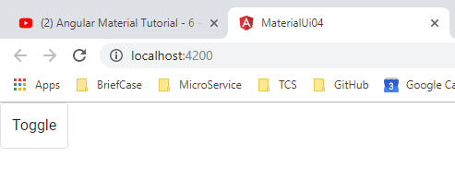
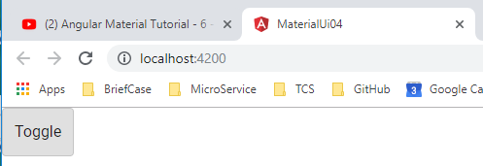
6 Button Toggle
https://www.youtube.com/watch?v=cRvqC9hPbLI&list=PLC3y8-rFHvwilEuCqFGTL5Gt5U6deIrsU&index=6
This section discusses Toggle Button.

Slide 3
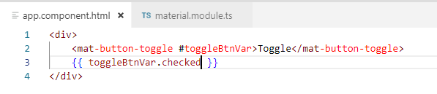
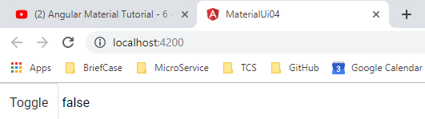
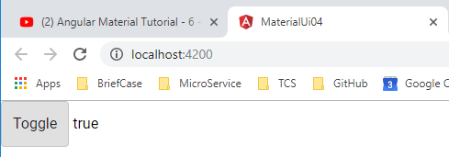
6 Button Toggle
https://www.youtube.com/watch?v=cRvqC9hPbLI&list=PLC3y8-rFHvwilEuCqFGTL5Gt5U6deIrsU&index=6
Add the toggle button state variable.

Slide 4
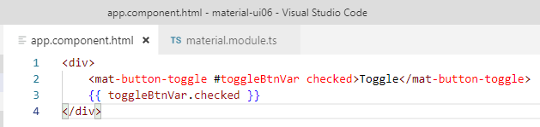
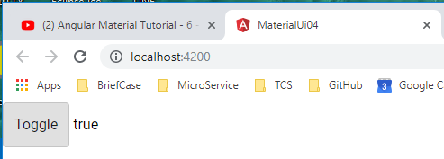
6 Button Toggle
https://www.youtube.com/watch?v=cRvqC9hPbLI&list=PLC3y8-rFHvwilEuCqFGTL5Gt5U6deIrsU&index=6
Change the default state from false to true

Slide 5
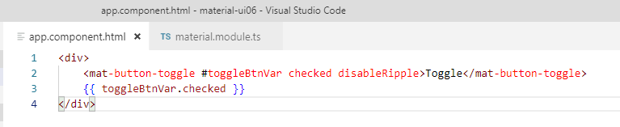
6 Button Toggle
https://www.youtube.com/watch?v=cRvqC9hPbLI&list=PLC3y8-rFHvwilEuCqFGTL5Gt5U6deIrsU&index=6
Disable Ripple Attribute

Slide 6
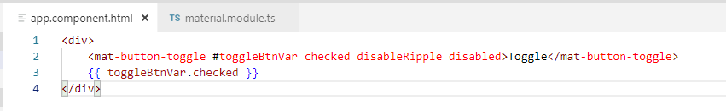
6 Button Toggle
https://www.youtube.com/watch?v=cRvqC9hPbLI&list=PLC3y8-rFHvwilEuCqFGTL5Gt5U6deIrsU&index=6
Disable Button

Slide 7
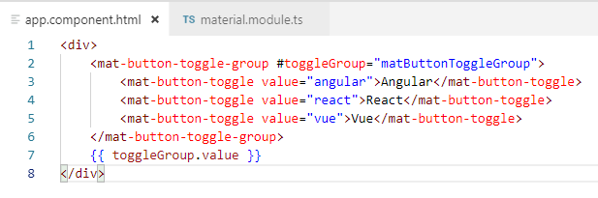
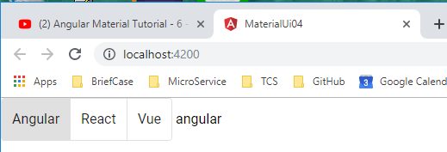
6 Button Toggle
https://www.youtube.com/watch?v=cRvqC9hPbLI&list=PLC3y8-rFHvwilEuCqFGTL5Gt5U6deIrsU&index=6
Toggle buttons are normally group together as the radio button or check boxes.
By default, it is the radio button. Only one of them is activate.

Slide 8
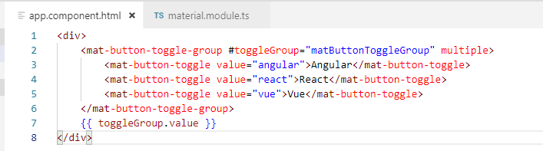
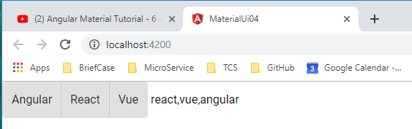
6 Button Toggle
https://www.youtube.com/watch?v=cRvqC9hPbLI&list=PLC3y8-rFHvwilEuCqFGTL5Gt5U6deIrsU&index=6
Add for multiple value toggle button. The values are comma separated list.

Slide 9
6 Button Toggle
https://www.youtube.com/watch?v=cRvqC9hPbLI&list=PLC3y8-rFHvwilEuCqFGTL5Gt5U6deIrsU&index=6
You can listen to the change event and execute some code written in the component class.
You can also get hold of the template reference variable in the class component and perform any required operation.

Slide 10
6 Button Toggle
https://www.youtube.com/watch?v=cRvqC9hPbLI&list=PLC3y8-rFHvwilEuCqFGTL5Gt5U6deIrsU&index=6
Add for multiple value toggle button.

Slide 11
End of Chapter

