Slide 1

2 Get Started
Peter H. Chen

Slide 2
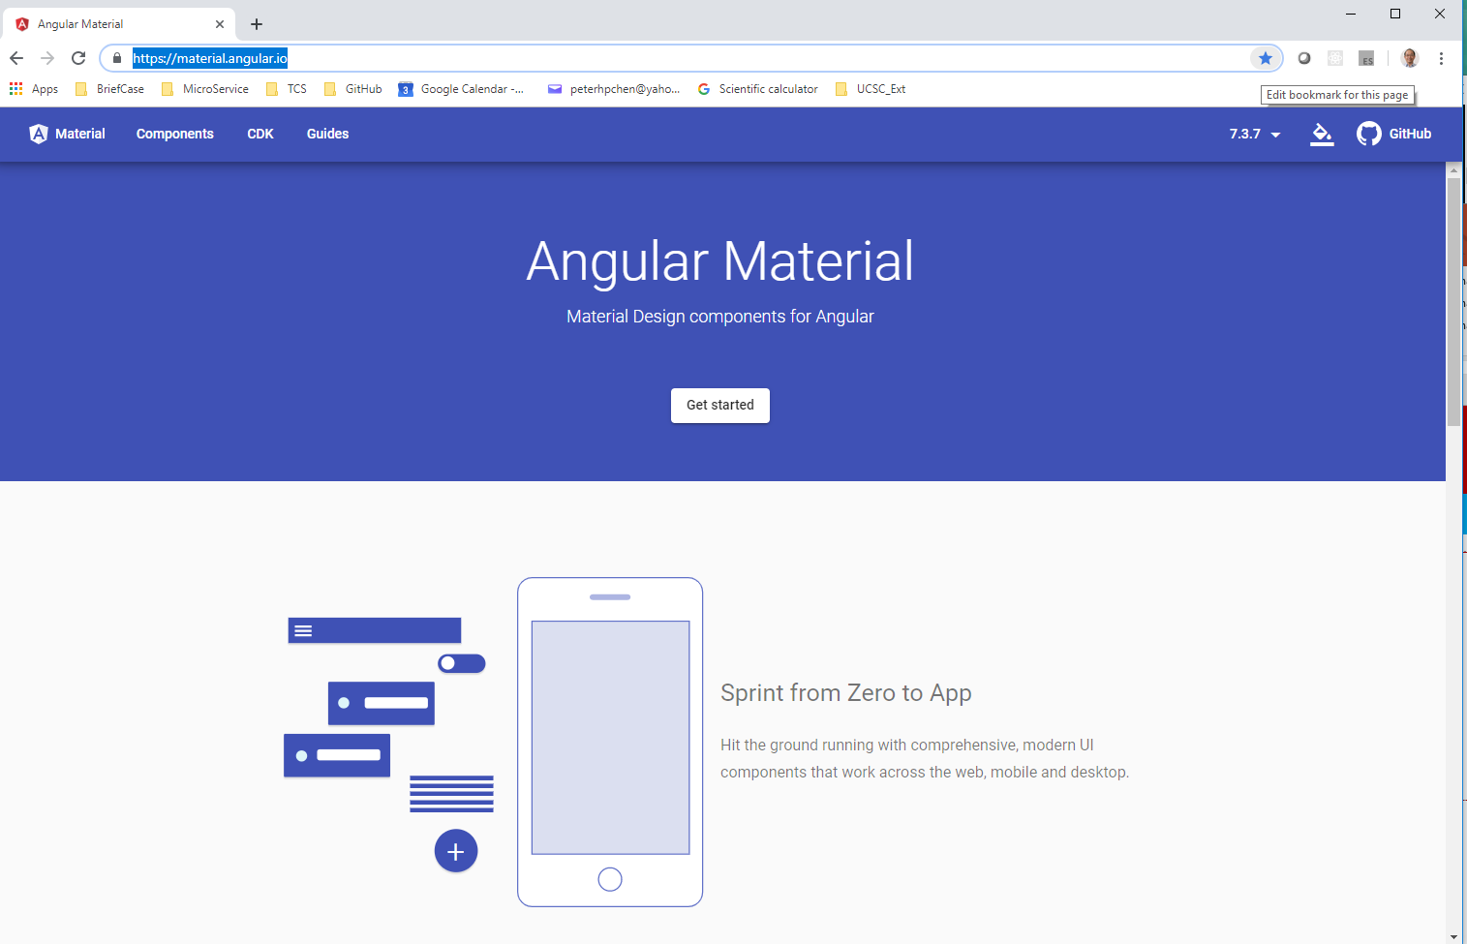
2 Get Started
https://www.youtube.com/watch?v=WzVeomoAFUU&list=PLC3y8-rFHvwilEuCqFGTL5Gt5U6deIrsU&index=2
Go to the Angular Material Web site: https://www.youtube.com/watch?v=WzVeomoAFUU&list=PLC3y8-rFHvwilEuCqFGTL5Gt5U6deIrsU&index=2/

Slide 3
2 Get Started
https://www.youtube.com/watch?v=WzVeomoAFUU&list=PLC3y8-rFHvwilEuCqFGTL5Gt5U6deIrsU&index=2/
We will look at the Angular Material web site document closely for
Update and changes. It is safe and rely on the documentation as it constantly updated.
The directives have to be used for different components. When we start writing code, we need to import certain components and it is impossible to know the component names without referring to the documentation.
Make sure you have tab open for the documentation when we discuss.
Let’s see how to add the Angular Material to an Angular Application.

Slide 4
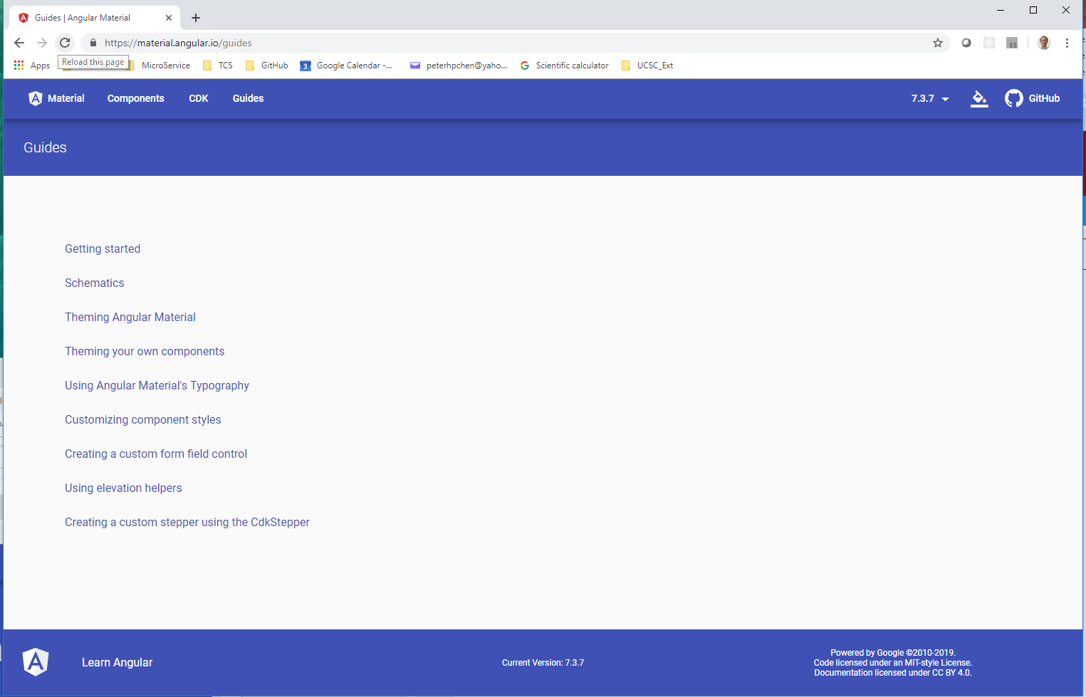
2 Get Started
https://www.youtube.com/watch?v=WzVeomoAFUU&list=PLC3y8-rFHvwilEuCqFGTL5Gt5U6deIrsU&index=2/
From the navbar, we click Guides.
We can see Getting started and Schematics headings. Both sections contain the information of how to install Angular Material depending on the version of you angular application.

Slide 5
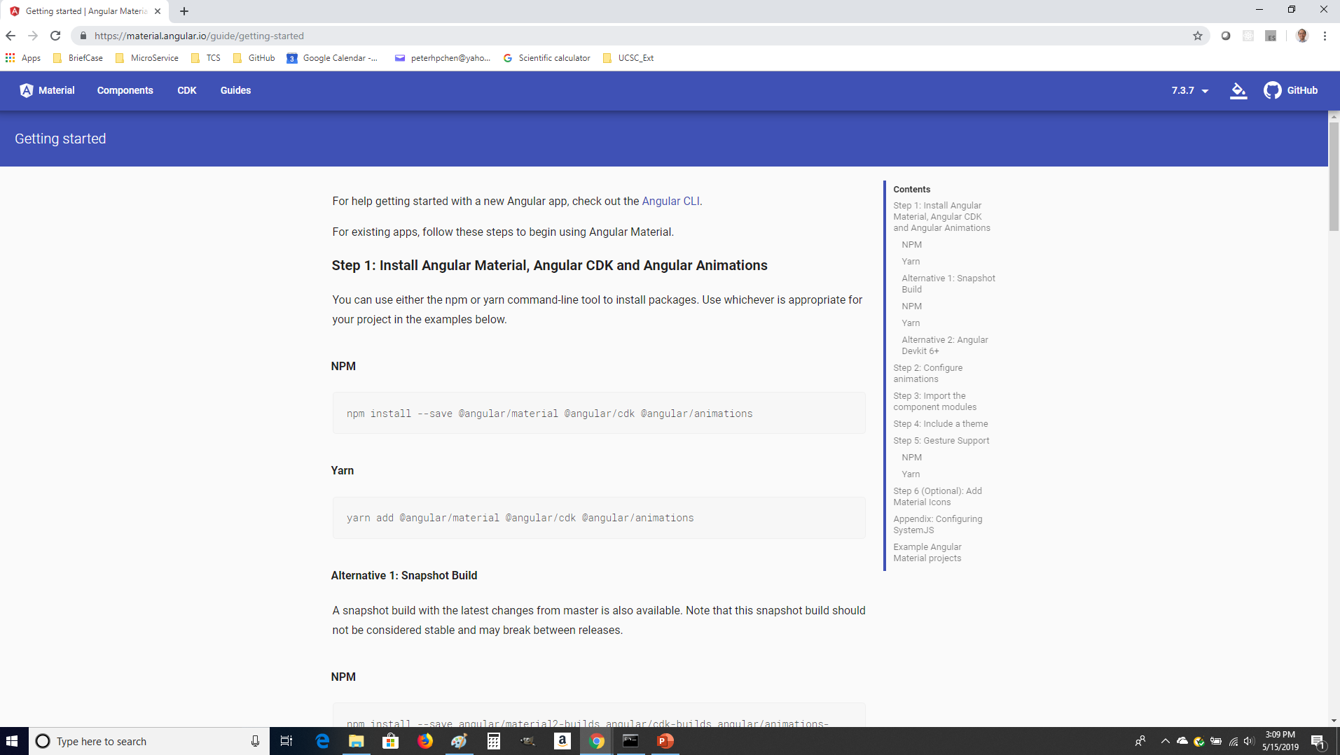
2 Get Started
https://www.youtube.com/watch?v=WzVeomoAFUU&list=PLC3y8-rFHvwilEuCqFGTL5Gt5U6deIrsU&index=2/
Click the Getting started
The Getting started section contains six different steps which you have to go through to set up Angular Material for your application. This is only if your project version is below version 6.
We will work on Angular Version 7. We will use Schematics in the next section.

Slide 6
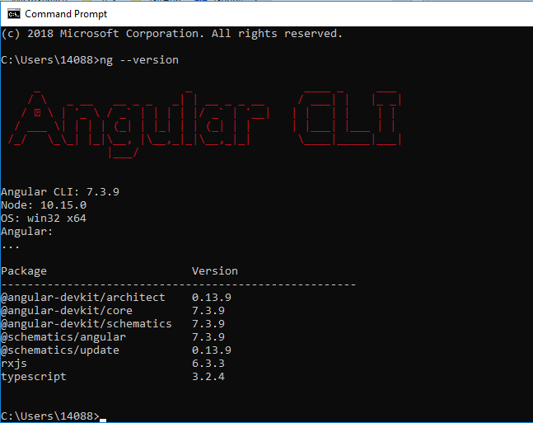
2 Get Started
https://www.youtube.com/watch?v=WzVeomoAFUU&list=PLC3y8-rFHvwilEuCqFGTL5Gt5U6deIrsU&index=2/
Open Command prompt.
> ng --version
>>> Angular CLI: 7.3.9
Make sure you have latest angular version.
To get the most update version of angular.
> npm uninstall –g angular-cli
> npm cache verify
> npm install –g @angular/cli@latest

Slide 7
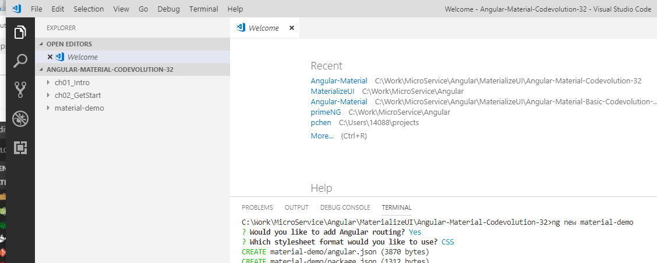
2 Get Started
https://www.youtube.com/watch?v=WzVeomoAFUU&list=PLC3y8-rFHvwilEuCqFGTL5Gt5U6deIrsU&index=2/
Let’s create new application.
> cd working-folder
Create a new angular project.
> ng new material-demo

Slide 8
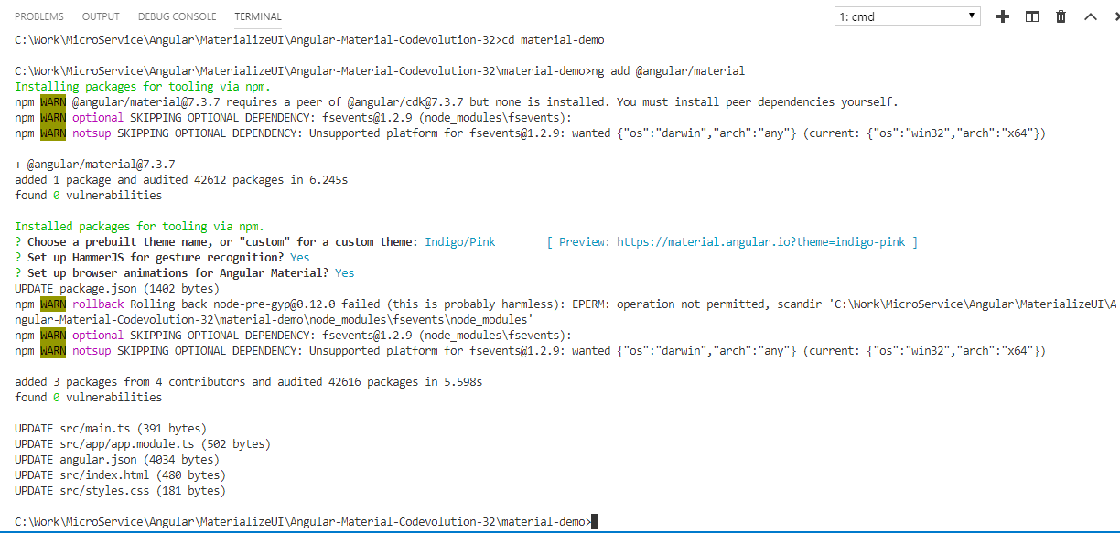
2 Get Started
https://www.youtube.com/watch?v=WzVeomoAFUU&list=PLC3y8-rFHvwilEuCqFGTL5Gt5U6deIrsU&index=2/
> cd material-demo
Set up the Angular material.
> ng add @angular/material

Slide 9
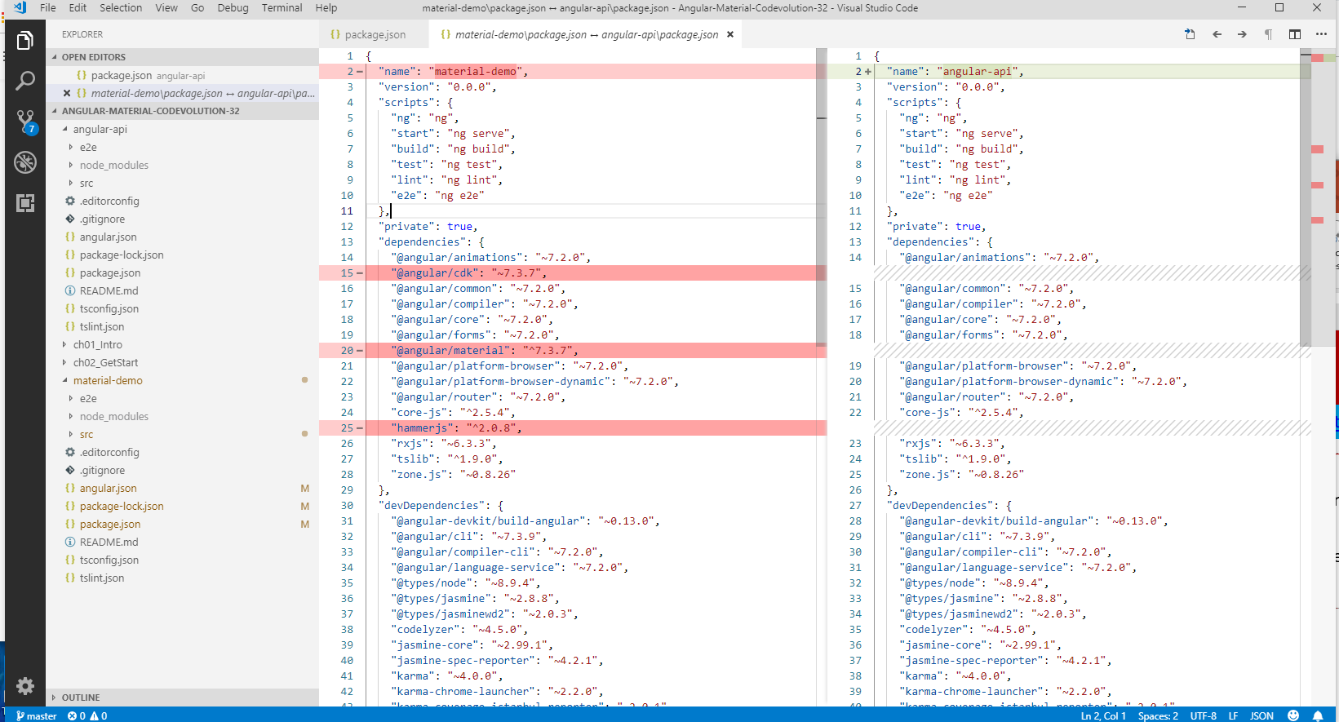
2 Get Started
https://www.youtube.com/watch?v=WzVeomoAFUU&list=PLC3y8-rFHvwilEuCqFGTL5Gt5U6deIrsU&index=2/
Difference of Package.json:
Click file ”angular-demo/angular.json” and RMB and Select: Select for Compare.
Click file “material-api/angular.json” and RMB and Select: Compare with Selected.
There are three differences: cdk, material, and hammderjs are added for the dependencies.

Slide 10
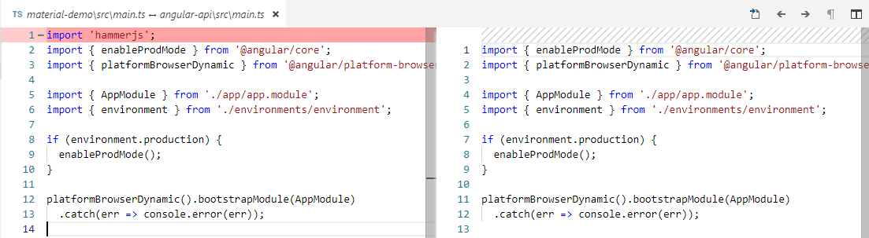
2 Get Started
https://www.youtube.com/watch?v=WzVeomoAFUU&list=PLC3y8-rFHvwilEuCqFGTL5Gt5U6deIrsU&index=2/
Difference of main.js:
Click file ”angular-demo/src/main.js” and RMB and Select: Select for Compare.
Click file “material-api/src/main.js” and RMB and Select: Compare with Selected.
There is one difference: hammderjs.

Slide 11
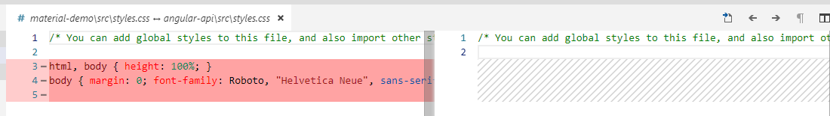
2 Get Started
https://www.youtube.com/watch?v=WzVeomoAFUU&list=PLC3y8-rFHvwilEuCqFGTL5Gt5U6deIrsU&index=2/
Difference of styles.css:
Click file ”angular-demo/src/styles.css” and RMB and Select: Select for Compare.
Click file “material-api/srcs/styles.css” and RMB and Select: Compare with Selected.
CSS is add to body tag.

Slide 12
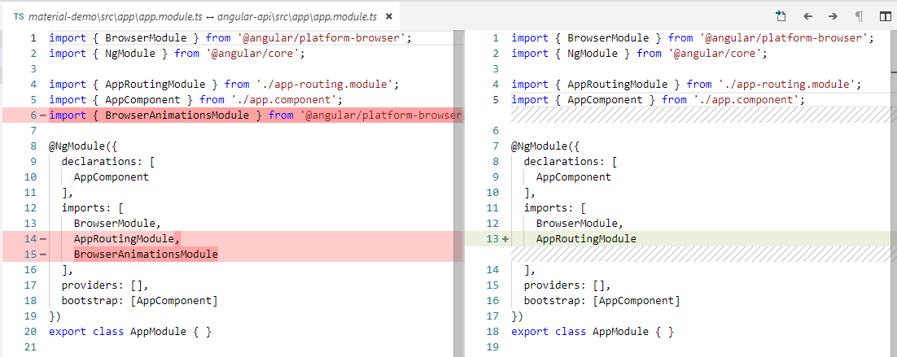
2 Get Started
https://www.youtube.com/watch?v=WzVeomoAFUU&list=PLC3y8-rFHvwilEuCqFGTL5Gt5U6deIrsU&index=2/
Difference of app.modules.js:
Click file ”angular-demo/src/app/app.modules.js” and RMB and Select: Select for Compare.
Click file “material-api/srcs/app/app.modules.js” and RMB and Select: Compare with Selected.
Animation modules is added.

Slide 13
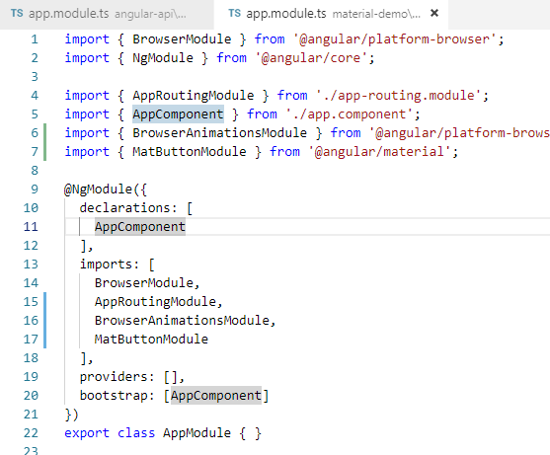
2 Get Started
https://www.youtube.com/watch?v=WzVeomoAFUU&list=PLC3y8-rFHvwilEuCqFGTL5Gt5U6deIrsU&index=2/
The materialize add the dependencies include them into the module and setup the style and theme for your angular application.
To test it is actually working, let’s use material button component.
There are three simple steps.
First step, imported in the app.modules.ts.
Second step, put “MatButtonModule” in the imports array.

Slide 14
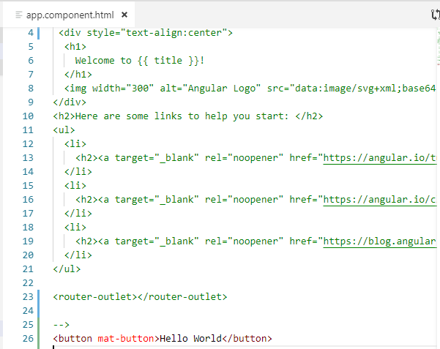
2 Get Started
https://www.youtube.com/watch?v=WzVeomoAFUU&list=PLC3y8-rFHvwilEuCqFGTL5Gt5U6deIrsU&index=2/
Third step, in app.component.html.
Comment out the existing HTML.
Add <button mat-button> Hello World</button>

Slide 15
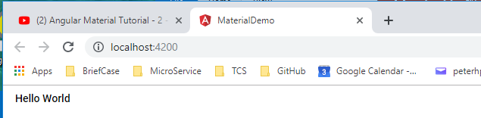
2 Get Started
https://www.youtube.com/watch?v=WzVeomoAFUU&list=PLC3y8-rFHvwilEuCqFGTL5Gt5U6deIrsU&index=2/
In the visual studio terminal
> ng serve -o
We have button display on browser. This button is styled with angular material.

Slide 16
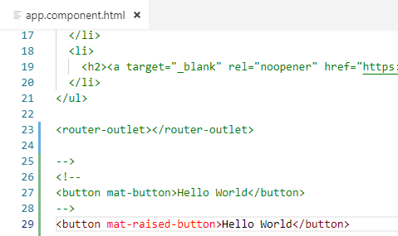
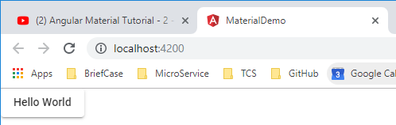
2 Get Started
https://www.youtube.com/watch?v=WzVeomoAFUU&list=PLC3y8-rFHvwilEuCqFGTL5Gt5U6deIrsU&index=2/
Let’s change the <button mat-raised-button> Hello World</button>
> ng serve -o

Slide 17
2 Get Started
https://www.youtube.com/watch?v=WzVeomoAFUU&list=PLC3y8-rFHvwilEuCqFGTL5Gt5U6deIrsU&index=2/
Next section, we will learn how to use this “mat-button” and “mat-raised-button” with reference to the document.

Slide 18
End of Chapter

