Slide 1

02 Get Started
Peter H. Chen

Slide 2
02 Get Started
https://www.w3schools.com/bootstrap/default.asp/
What is Bootstrap?
Bootstrap is a free front-end framework for faster and easier web development
Bootstrap includes HTML and CSS based design templates for typography, forms, buttons, tables, navigation, modals, image carousels and many other, as well as optional JavaScript plugins
Bootstrap also gives you the ability to easily create responsive designs
What is Responsive Web Design?
Responsive web design is about creating web sites which automatically adjust themselves to look good on all devices, from small phones to large desktops.

Slide 3
02 Get Started
https://www.w3schools.com/bootstrap/default.asp/
Bootstrap History
Bootstrap was developed by Mark Otto and Jacob Thornton at Twitter, and released as an open source product in August 2011 on GitHub.
In June 2014 Bootstrap was the No.1 project on GitHub!
Why Use Bootstrap?
Advantages of Bootstrap:
Easy to use: Anybody with just basic knowledge of HTML and CSS can start using Bootstrap
Responsive features: Bootstrap's responsive CSS adjusts to phones, tablets, and desktops
Mobile-first approach: In Bootstrap 3, mobile-first styles are part of the core framework
Browser compatibility: Bootstrap is compatible with all modern browsers (Chrome, Firefox, Internet Explorer, Edge, Safari, and Opera)

Slide 4
02 Get Started
https://www.w3schools.com/bootstrap/default.asp/
Where to Get Bootstrap?
There are two ways to start using Bootstrap on your own web site.
You can:
Download Bootstrap from getbootstrap.com
Include Bootstrap from a CDN
Downloading Bootstrap
If you want to download and host Bootstrap yourself, go to getbootstrap.com, and follow the instructions there.
Bootstrap CDN
If you don't want to download and host Bootstrap yourself, you can include it from a CDN (Content Delivery Network).
MaxCDN provides CDN support for Bootstrap's CSS and JavaScript. You must also include jQuery:

Slide 5
02 Get Started
https://www.w3schools.com/bootstrap/default.asp/
MaxCDN:
<!-- Latest compiled and minified CSS -->
<link rel="stylesheet"href="https://maxcdn.bootstrapcdn.com/bootstrap/3.4.0/css/bootstrap.min.css">
<!-- jQuery library -->
<script src="https://ajax.googleapis.com/ajax/libs/jquery/3.4.1/jquery.min.js">
</script>
<!-- Latest compiled JavaScript -->
<script src="https://maxcdn.bootstrapcdn.com/bootstrap/3.4.0/js/bootstrap.min.js">
</script>

Slide 6
02 Get Started
https://www.w3schools.com/bootstrap/default.asp/
One advantage of using the Bootstrap CDN:
Many users already have downloaded Bootstrap from MaxCDN when visiting another site.
As a result, it will be loaded from cache when they visit your site, which leads to faster loading time.
Also, most CDN's will make sure that once a user requests a file from it, it will be served from the server closest to them, which also leads to faster loading time.
jQuery
Bootstrap uses jQuery for JavaScript plugins (like modals, tooltips, etc).
However, if you just use the CSS part of Bootstrap, you don't need jQuery.

Slide 7
02 Get Started
https://www.w3schools.com/bootstrap/default.asp/
Create First Web Page With Bootstrap
1. Add the HTML5 doctype
Bootstrap uses HTML elements and CSS properties that require the HTML5 doctype.
Always include the HTML5 doctype at the beginning of the page, along with the lang attribute and the correct character set:
<!DOCTYPE html>
<html lang="en“>
<head>
<meta charset="utf-8">
</head>
</html>

Slide 8
02 Get Started
https://www.w3schools.com/bootstrap/default.asp/
2. Bootstrap 3 is mobile-first
Bootstrap 3 is designed to be responsive to mobile devices. Mobile-first styles are part of the core framework.
To ensure proper rendering and touch zooming, add the following <meta> tag inside the <head>element:
<meta name="viewport" content="width=device-width, initial-scale=1">
The width=device-width part sets the width of the page to follow the screen-width of the device (which will vary depending on the device).
The initial-scale=1 part sets the initial zoom level when the page is first loaded by the browser.

Slide 9

02 Get Started
https://www.w3schools.com/bootstrap/default.asp/
3. Containers
Bootstrap also requires a containing element to wrap site contents.
There are two container classes to choose from:
The .container class provides a responsive fixed width container
The .container-fluid class provides a full width container, spanning the entire width of the viewport

Slide 10
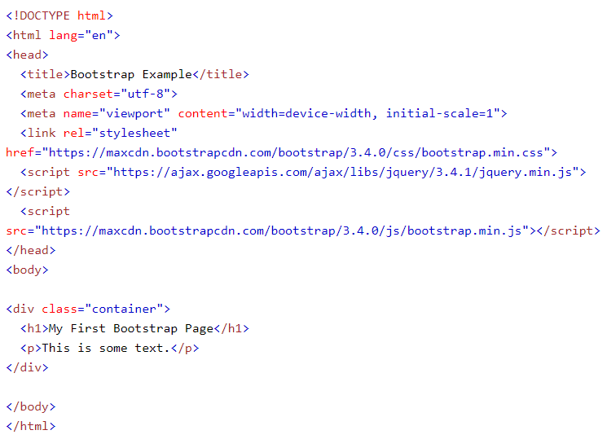
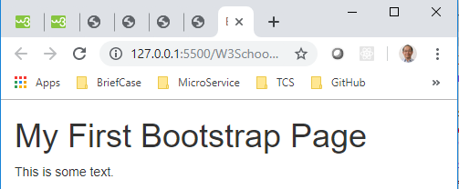
02 Get Started
https://www.w3schools.com/bootstrap/default.asp/
Two Basic Bootstrap Pages
The following example shows the code for a basic Bootstrap page (with a responsive fixed width container):

Slide 11
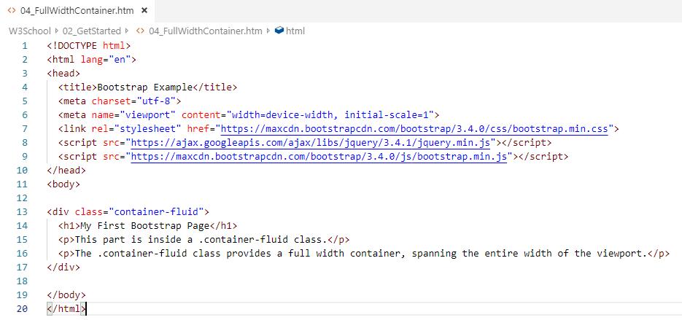
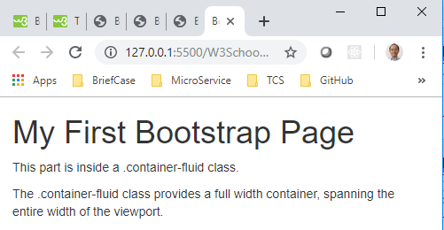
02 Get Started
https://www.w3schools.com/bootstrap/default.asp/
The following example shows the code for a basic Bootstrap page (container with a fluid with full width container):

Slide 12
End of Chapter

