Slide 1

03 Grid Basic
Peter H. Chen

Slide 2
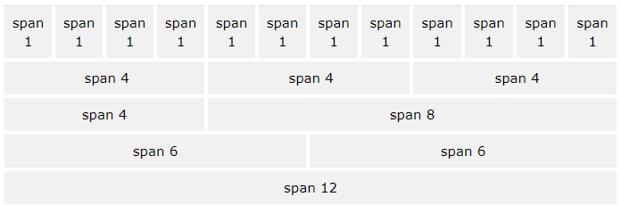
03 Grid Basic
https://www.w3schools.com/bootstrap/default.asp/
Bootstrap Grid System
Bootstrap's grid system allows up to 12 columns across the page.
If you do not want to use all 12 columns individually, you can group the columns together to create wider columns.
Bootstrap's grid system is responsive, and the columns will re-arrange automatically depending on the screen size.

Slide 3
03 Grid Basic
https://www.w3schools.com/bootstrap/default.asp/
Grid Classes
The Bootstrap grid system has four classes:
xs (for phones - screens less than 768px wide)
sm (for tablets - screens equal to or greater than 768px wide)
md (for small laptops - screens equal to or greater than 992px wide)
lg (for laptops and desktops - screens equal to or greater than 1200px wide)
The classes above can be combined to create more dynamic and flexible layouts.

Slide 4
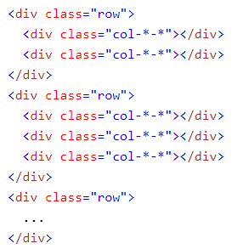
03 Grid Basic
https://www.w3schools.com/bootstrap/default.asp/
Basic Structure of a Bootstrap Grid
The following is a basic structure of a Bootstrap grid:
First; create a row (<div class="row">). Then, add the desired number of columns (tags with appropriate .col-*-* classes).
Note that numbers in .col-*-* should always add up to 12 for each row.
Below we have collected some examples of basic Bootstrap grid layouts.

Slide 5
03 Grid Basic
https://www.w3schools.com/bootstrap/default.asp/
Three Equal Columns:

Slide 6
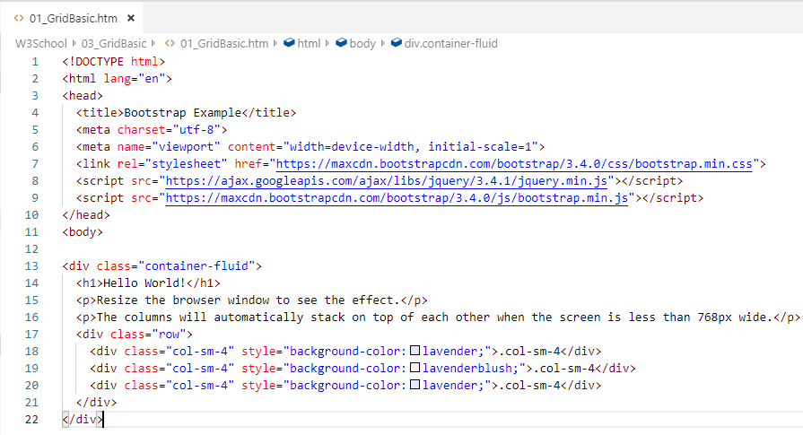
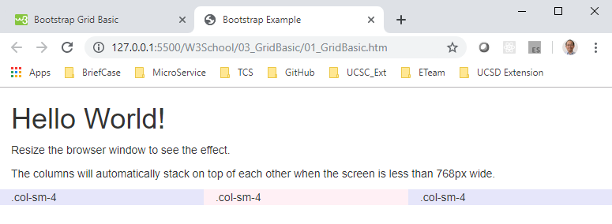
03 Grid Basic
https://www.w3schools.com/bootstrap/default.asp/
The following example shows how to get a three equal-width columns starting at tablets and scaling to large desktops.
On mobile phones or screens that are less than 768px wide, the columns will automatically stack.

Slide 7
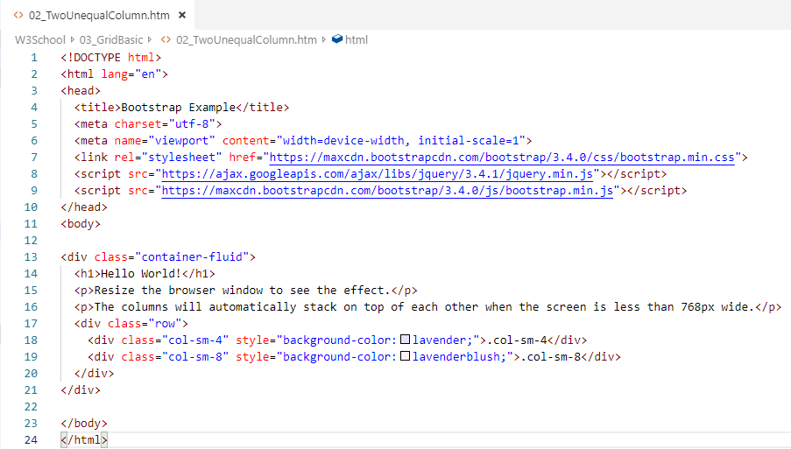
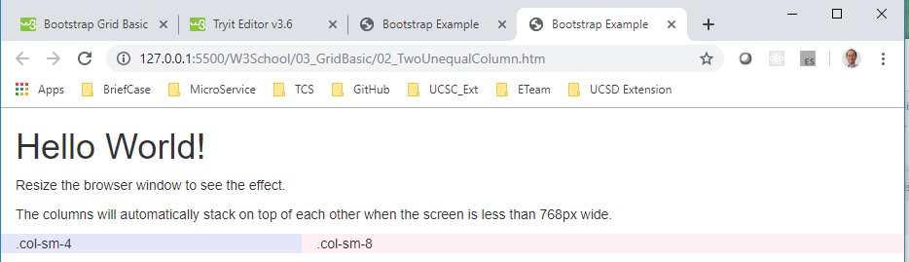
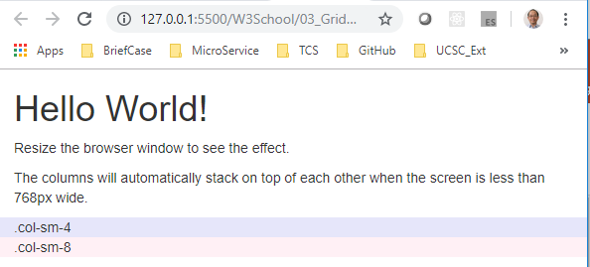
03 Grid Basic
https://www.w3schools.com/bootstrap/default.asp/
The following example shows how to get two various-width columns starting at tablets and scaling to large desktops:

Slide 8
End of Chapter

