Slide 1

04 Typography
Peter H. Chen

Slide 2
04 Typography
https://www.w3schools.com/bootstrap/default.asp/
Bootstrap's Default Settings
Bootstrap's global default font-size is 14px, with a line-height of 1.428.
This is applied to the <body> element and all paragraphs (<p>).
In addition, all <p> elements have a bottom margin that equals half their computed line-height (10px by default).

Slide 3
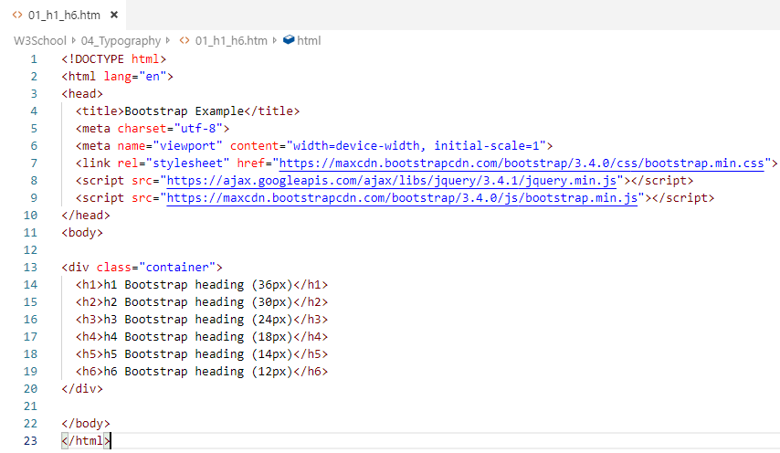
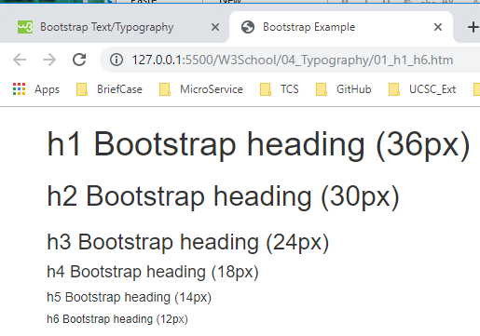
04 Typography
https://www.w3schools.com/bootstrap/default.asp/
Bootstrap vs. Browser Defaults
In this chapter, we will look at some HTML elements that will be styled a little bit differently by Bootstrap than browser defaults.
<h1> - <h6>
By default, Bootstrap will style the HTML headings (<h1> to <h6>) in the following way:

Slide 4
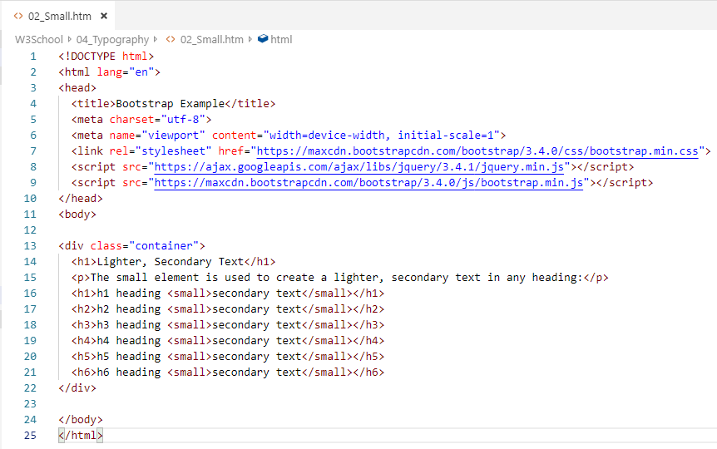
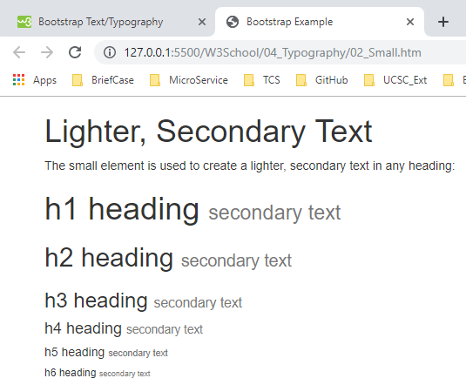
04 Typography
https://www.w3schools.com/bootstrap/default.asp/
<small>
In Bootstrap the HTML <small> element is used to create a lighter, secondary text in any heading:

Slide 5
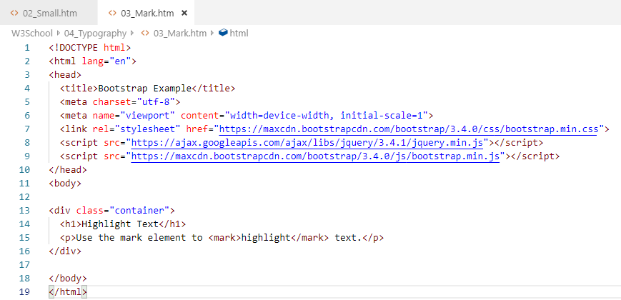
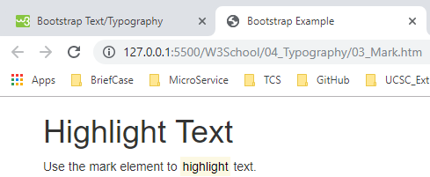
04 Typography
https://www.w3schools.com/bootstrap/default.asp/
<mark>
Bootstrap will style the HTML <mark> element in the following way:
Example
Use the mark element to highlight text.

Slide 6
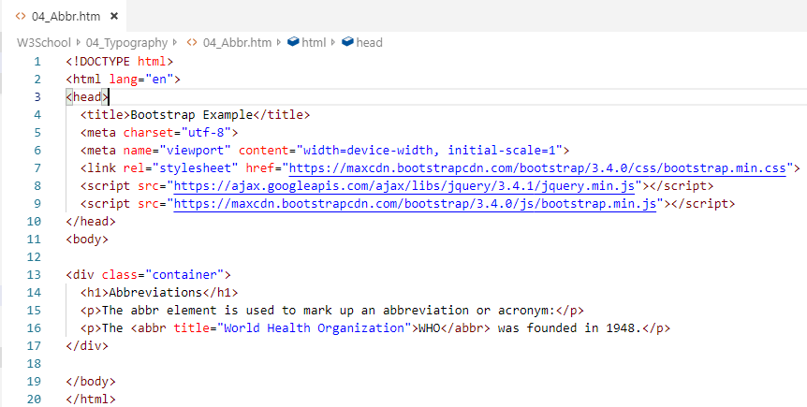
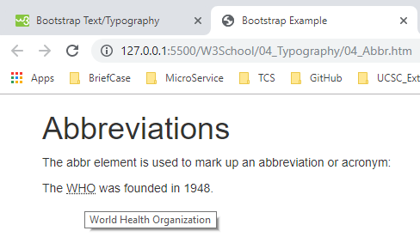
04 Typography
https://www.w3schools.com/bootstrap/default.asp/
<abbr>
Bootstrap will style the HTML <abbr> element in the following way:
Example
The WHO was founded in 1948

Slide 7
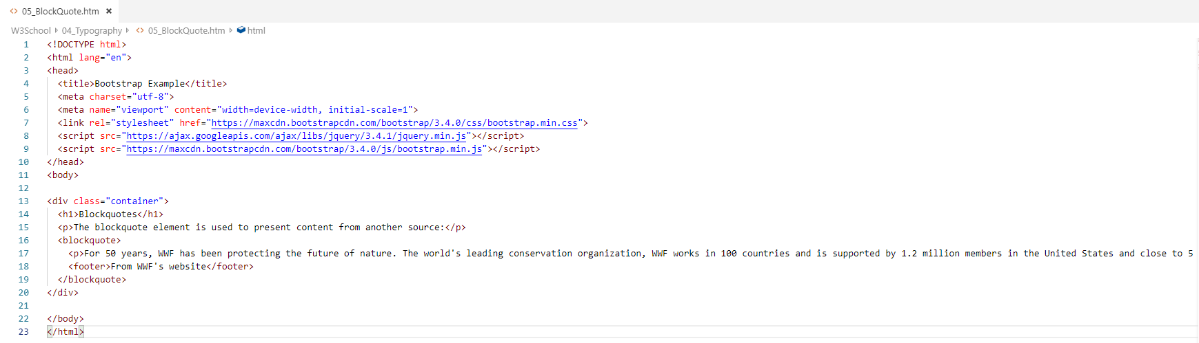
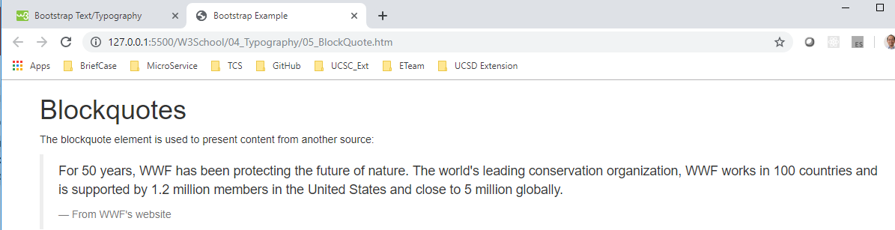
04 Typography
https://www.w3schools.com/bootstrap/default.asp/
<blockquote>
Bootstrap will style the HTML <blockquote> element in the following way:

Slide 8
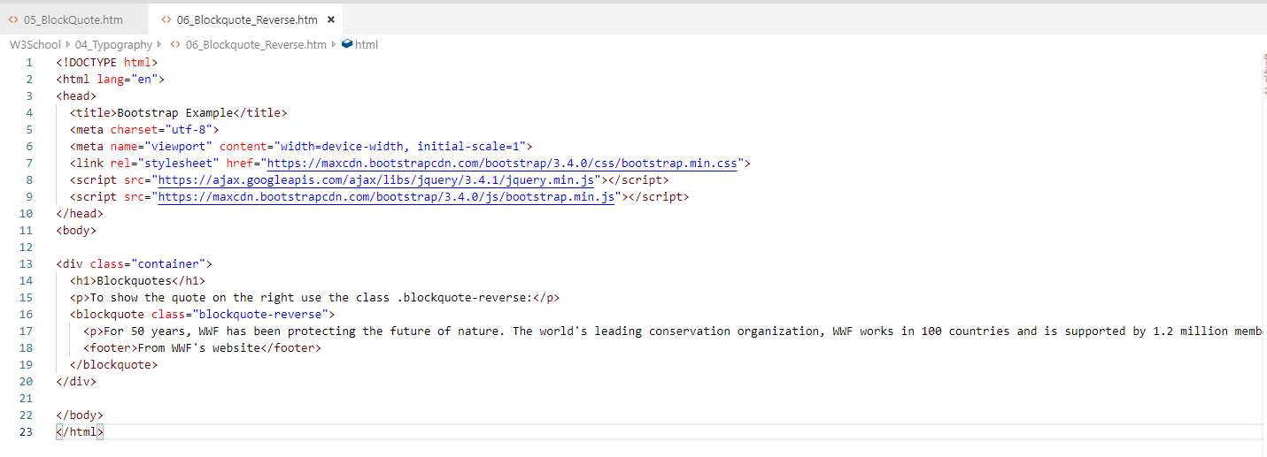
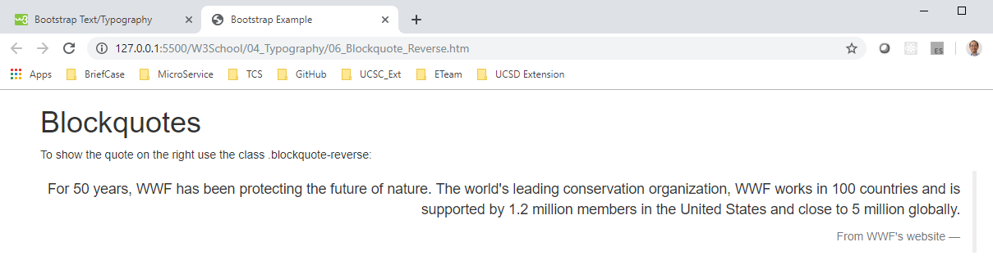
04 Typography
https://www.w3schools.com/bootstrap/default.asp/
To show the quote on the right, use the .blockquote-reverse class:

Slide 9
End of Chapter

