Slide 1

22 Simple Form
Peter H. Chen

Slide 2
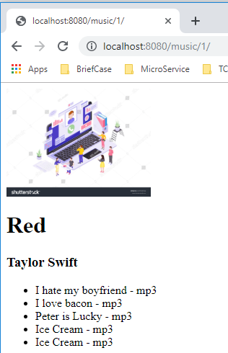
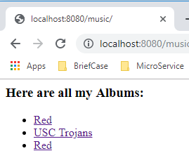
22 Simple Form
https://www.youtube.com/watch?v=wDuqObGbLnI&list=PL6gx4Cwl9DGBlmzzFcLgDhKTTfNLfX1IK&index=22
This section discusses the Removing Hardcoded URLs
> python manage.py runserver 8080
Open Chrome
> localhost:8080/music
> localhost:8080/music/1

Slide 3
22 Simple Form
https://www.youtube.com/watch?v=wDuqObGbLnI&list=PL6gx4Cwl9DGBlmzzFcLgDhKTTfNLfX1IK&index=22
In the detail form, we will put radio button and put a favrotie on the right, and submit button under the form.

Slide 4
22.1 Add Boolean for Favorite
Peter H. Chen

Slide 5
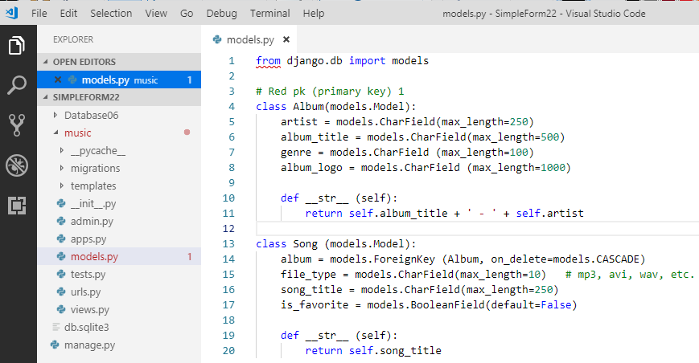
22.1 Add Boolean for Favorite
https://www.youtube.com/watch?v=wDuqObGbLnI&list=PL6gx4Cwl9DGBlmzzFcLgDhKTTfNLfX1IK&index=22
In the music/models.py, we need to add attribute “is_favorite = models.BooleanField (default=False)”.
Whenever user click the star or submit the form, then this field will be set to True. It means the song is the users favorite.

Slide 6
22.2 Upgrade Database
Peter H. Chen

Slide 7
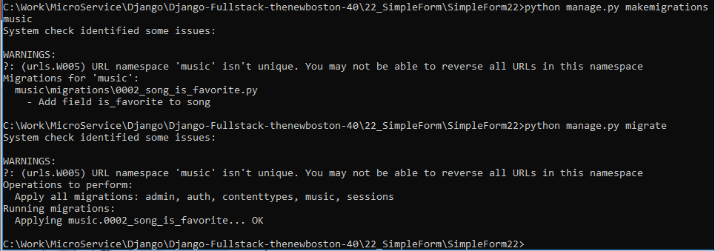
22.2 Upgrade Database
https://www.youtube.com/watch?v=wDuqObGbLnI&list=PL6gx4Cwl9DGBlmzzFcLgDhKTTfNLfX1IK&index=22
When we change the models.py, we need to do the migration
> python manage.py makemigrations music
This means that we change the blueprint of music app.
We need to update the database:
> pyhton manage.py migrate

Slide 8
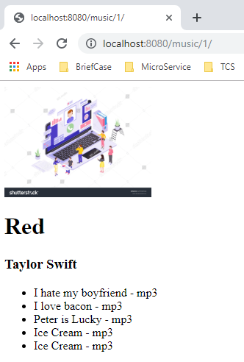
22.2 Upgrade Database
https://www.youtube.com/watch?v=wDuqObGbLnI&list=PL6gx4Cwl9DGBlmzzFcLgDhKTTfNLfX1IK&index=22
Now, our database is up-to-date and structure is upgraded.
Whenever you change the database, you also have to change your server.
> python manage.py runserver 8080
Refresh “localhost:8080/music/1”, we should not see any error.

Slide 9
22.3 Add Favorite View
Peter H. Chen

Slide 10
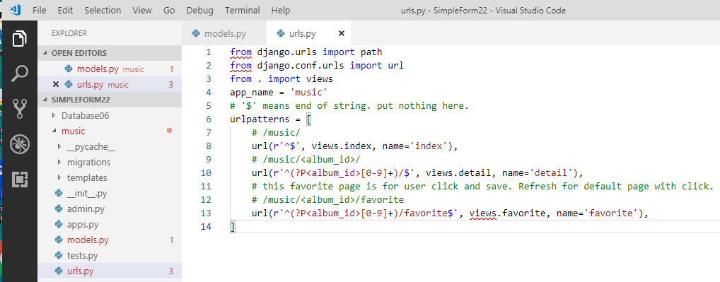
22.3 Add Favorite View
https://www.youtube.com/watch?v=wDuqObGbLnI&list=PL6gx4Cwl9DGBlmzzFcLgDhKTTfNLfX1IK&index=22
When user click favorite and save in database.
Next time, the default page should display with favorite button on.
We need to create another favorite view.

Slide 11
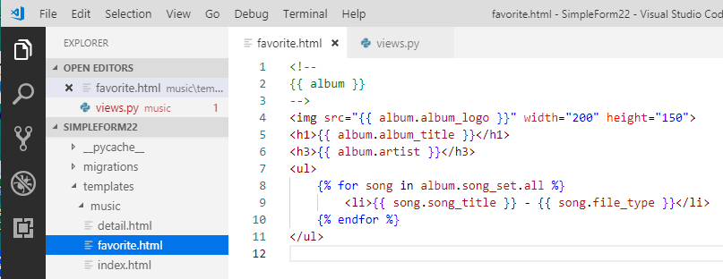
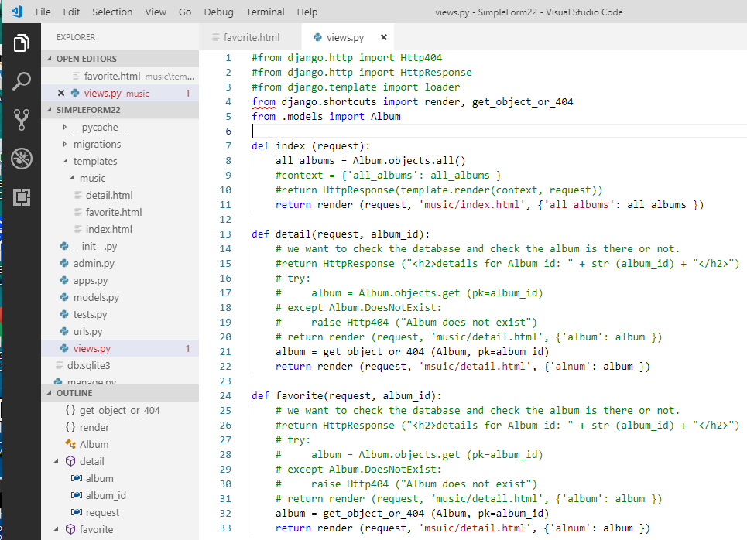
22.3 Add Favorite View
https://www.youtube.com/watch?v=wDuqObGbLnI&list=PL6gx4Cwl9DGBlmzzFcLgDhKTTfNLfX1IK&index=22
We need to create ‘music/template/favorite.html’ (copy from detail.html into favorite.html) and create function favorite() [copy detail() to favorite()] in ‘views.py’
We need to modify favoritye.html and favorite() in the next section.

Slide 12
End of Chapter

