Slide 1

2 Create Project
Peter H. Chen

Slide 2
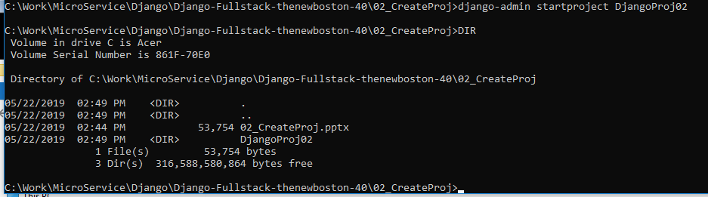
2 Create Project
https://www.youtube.com/watch?v=CHjXtRrhqxc&list=PL6gx4Cwl9DGBlmzzFcLgDhKTTfNLfX1IK&index=2
This section discusses how to create the Django Project.
Create a folder for Django Project.
> django-admin startproject DjangoProj02 # DjangoProj02 is the project-name

Slide 3
2.1 Directory Structure
Peter H. Chen

Slide 4
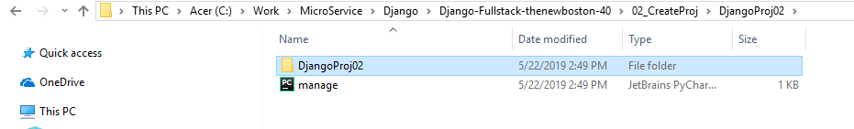
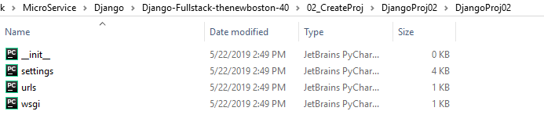
2.1 Directory Structure
https://www.youtube.com/watch?v=CHjXtRrhqxc&list=PL6gx4Cwl9DGBlmzzFcLgDhKTTfNLfX1IK&index=2
In the folder Django02 has:
“manage.py” and
Django02 folder.
In the Django02/Django02 folder,
__init__.py,
settings.py,
urls.py, and
wsgi.py.

Slide 5
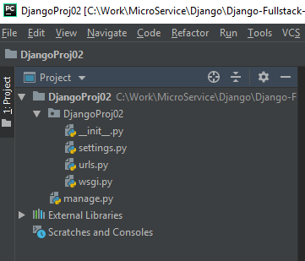
2.1 Directory Structure
https://www.youtube.com/watch?v=CHjXtRrhqxc&list=PL6gx4Cwl9DGBlmzzFcLgDhKTTfNLfX1IK&index=2
Use IDE PyCharm to open the folder Django02.
You can name Django02 to any name.
Django02 is a container to contain all the files.
The folder Django02 inside root Django02. It has the same name as the root folder.
You can rename the root Django02. We keep the same name in this section.

Slide 6
2.2 Manage.py
Peter H. Chen

Slide 7
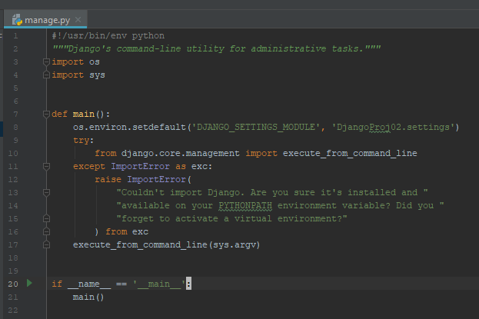
2.2 Manage.py
https://www.youtube.com/watch?v=CHjXtRrhqxc&list=PL6gx4Cwl9DGBlmzzFcLgDhKTTfNLfX1IK&index=2
We start look at this file manage.py.
By the way, never edit this file.
Never try to add anything to it. Do not delete it. Just ignore it. All this is manage UI.
The manage.py comes with Django that lets you do a bunch of cool stuff to your project and it allows you to do things like access database and create users for your website.
We discuss the manage.py later one but never touch this file.

Slide 8
2.3 __init__.py
Peter H. Chen

Slide 9
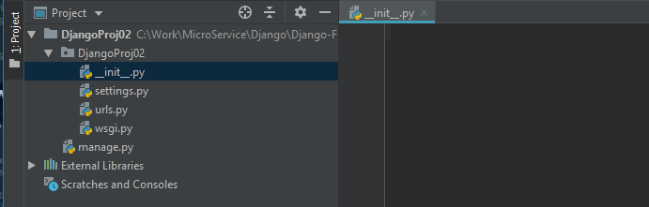
2.3 __init__.py
https://www.youtube.com/watch?v=CHjXtRrhqxc&list=PL6gx4Cwl9DGBlmzzFcLgDhKTTfNLfX1IK&index=2
Where is the files that we are going to working on.
The Django02 director contains some other files that we are going to work on.
The first one is __init__.py.
The __init__.py contains the files that tell the Python to view these directory as a Python Package.
Now, there is nothing inside. You do not need any code in here.
This is the file that tell Python that this is not a normal directory in your computer. This is the directory that contains the Python package.

Slide 10
2.4 settings.py
Peter H. Chen

Slide 11
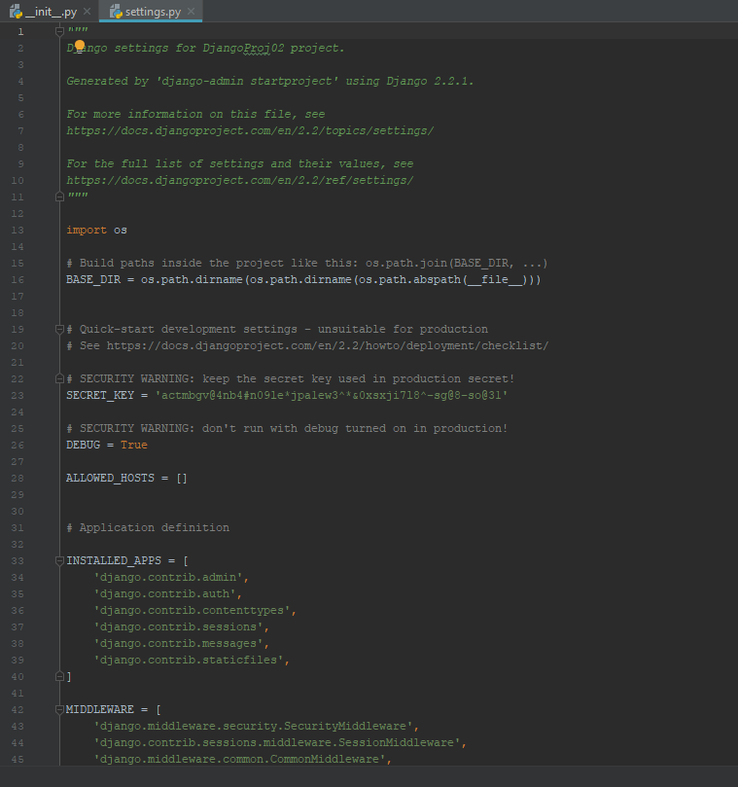
2.4 settings.py
https://www.youtube.com/watch?v=CHjXtRrhqxc&list=PL6gx4Cwl9DGBlmzzFcLgDhKTTfNLfX1IK&index=2
The settings.py contains the configuration options for your project.
Apps, middleware, root URLs, template, , Database, language, and etc.

Slide 12
2.5 urls.py
Peter H. Chen

Slide 13
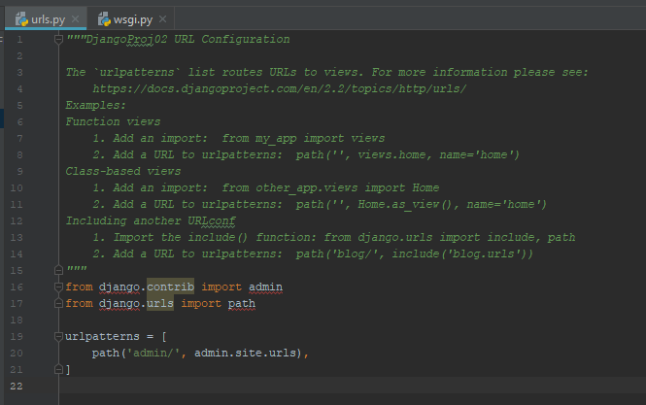
2.5 urls.py
https://www.youtube.com/watch?v=CHjXtRrhqxc&list=PL6gx4Cwl9DGBlmzzFcLgDhKTTfNLfX1IK&index=2
The urls.py contains the table of contents for your website.
It is the page name after the website:
For example, hoeme.php in www.qualcomm.com/home.php, video.php in www.qualcomm.com/video.php, and etc.

Slide 14
2.6 wsgi.py
Peter H. Chen

Slide 15
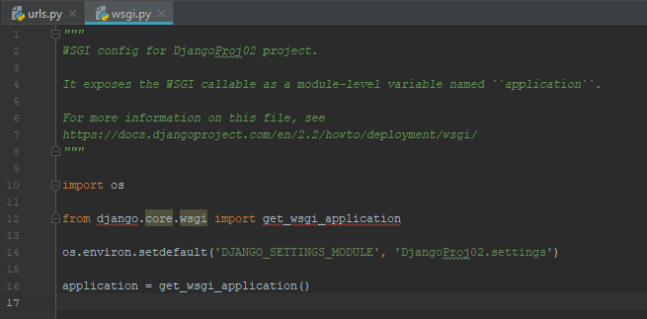
2.6 wsgi.py
https://www.youtube.com/watch?v=CHjXtRrhqxc&list=PL6gx4Cwl9DGBlmzzFcLgDhKTTfNLfX1IK&index=2
The last one is wsgi.py. This stands for web server gateway interface.
It is a special type of web server. We will discuss a lot latter.
Do not worry right now.

Slide 16
2.7 Boot Server
Peter H. Chen

Slide 17
2.7 Boot Server
https://www.youtube.com/watch?v=CHjXtRrhqxc&list=PL6gx4Cwl9DGBlmzzFcLgDhKTTfNLfX1IK&index=2
This is the basic core overview of Django project.
Every project that you have is going to be composed of all these file.
And again, you never touch manage.py.
We will not use __init__.py a lot.
We only use settings.py, urls.py, and wsgi.py.
Whenever you “Django_admin projectstart proj-name”, it comes with a webserver and it is not a full-featured web server like you actually want to host all actual web site with it but it comes with line a little mini web server that you can use for the development.

Slide 18
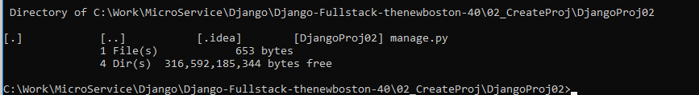
2.7 Boot Server
https://www.youtube.com/watch?v=CHjXtRrhqxc&list=PL6gx4Cwl9DGBlmzzFcLgDhKTTfNLfX1IK&index=2
If you want to check out what our web site looks like right now.
What you need to do is you need to navigate to wherever you created your project.
When you see the file “manage.py” and your project name “Django02”. That is to make sure you are in correct location.

Slide 19
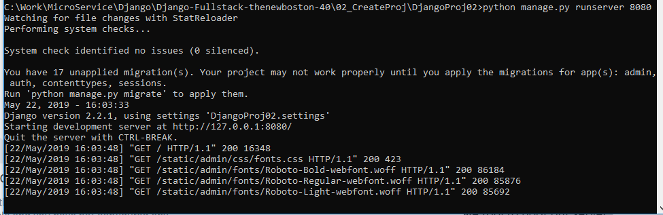
2.7 Boot Server
https://www.youtube.com/watch?v=CHjXtRrhqxc&list=PL6gx4Cwl9DGBlmzzFcLgDhKTTfNLfX1IK&index=2
We are going to use the manage tool to boot our server.
> python manage.py runserver 8080

Slide 20
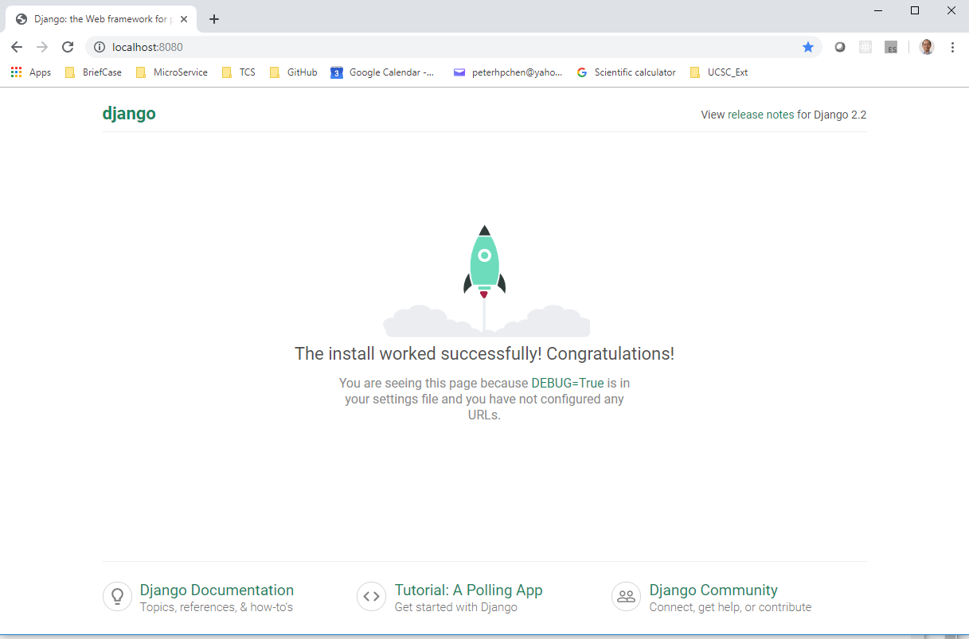
2.7 Boot Server
https://www.youtube.com/watch?v=CHjXtRrhqxc&list=PL6gx4Cwl9DGBlmzzFcLgDhKTTfNLfX1IK&index=2
Open chrome and enter
> localhost:8080

Slide 21
End of Chapter

