Slide 1

11 Admin Interface
Peter H. Chen

Slide 2
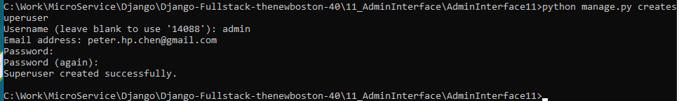
11 Admin Interface
https://www.youtube.com/watch?v=Mjs1elH3Pdg&list=PL6gx4Cwl9DGBlmzzFcLgDhKTTfNLfX1IK&index=11
In the last section, we discuss Admin Interface.
> python manage.py createsuperuser
>>> Email address: peter.hp.chen@gmail.com
>>> Password: Pcxxxx=xx
>>> Password (again): Pcxxxx=xx
>>> Superuser create successfully.

Slide 3
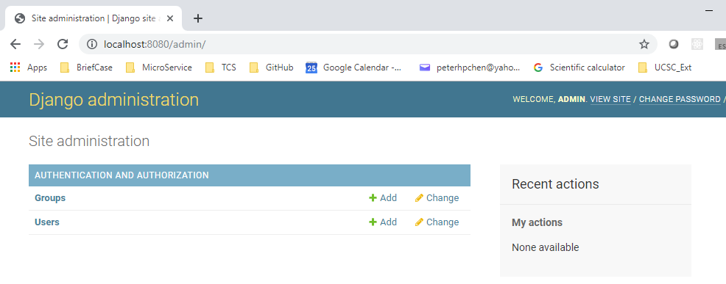
11 Admin Interface
https://www.youtube.com/watch?v=Mjs1elH3Pdg&list=PL6gx4Cwl9DGBlmzzFcLgDhKTTfNLfX1IK&index=11
Start the Python server:
> python manage.py runserver 8080
Open chrome:
> User name: admin
> Password: PCxxxx=xx

Slide 4
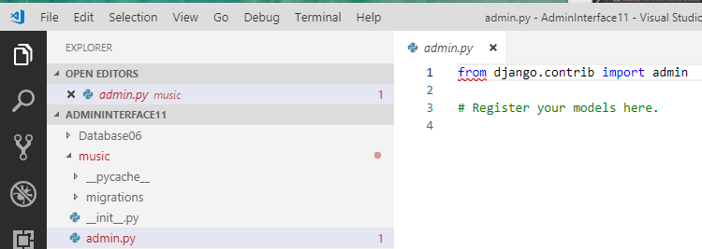
11 Admin Interface
https://www.youtube.com/watch?v=Mjs1elH3Pdg&list=PL6gx4Cwl9DGBlmzzFcLgDhKTTfNLfX1IK&index=11
How do we edit the Album table and Users table?

Slide 5
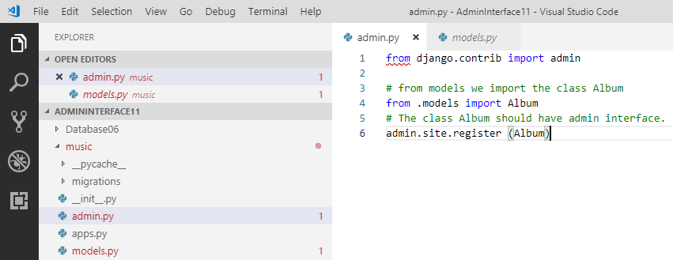
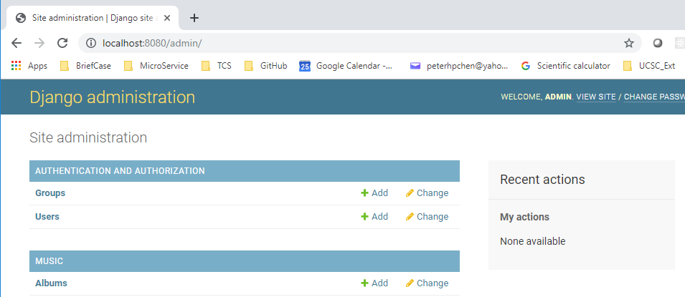
11 Admin Interface
https://www.youtube.com/watch?v=Mjs1elH3Pdg&list=PL6gx4Cwl9DGBlmzzFcLgDhKTTfNLfX1IK&index=11
We add “admin.site.register (Album)’. We have Albums Table created.

Slide 6
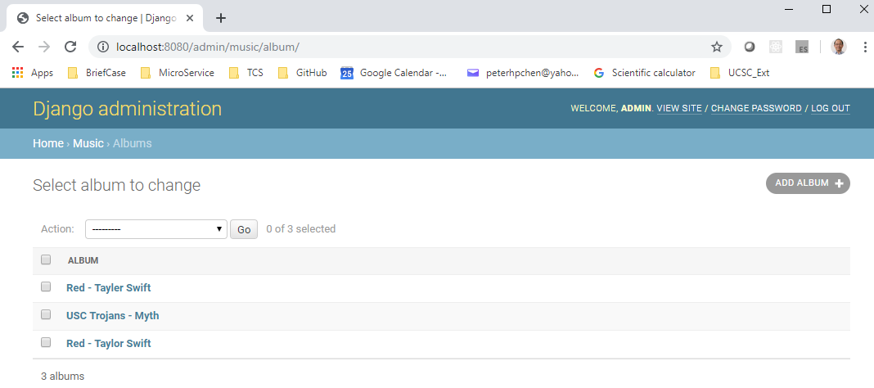
11 Admin Interface
https://www.youtube.com/watch?v=Mjs1elH3Pdg&list=PL6gx4Cwl9DGBlmzzFcLgDhKTTfNLfX1IK&index=11
Click “Albums”, we can see the Album table contains the database.

Slide 7
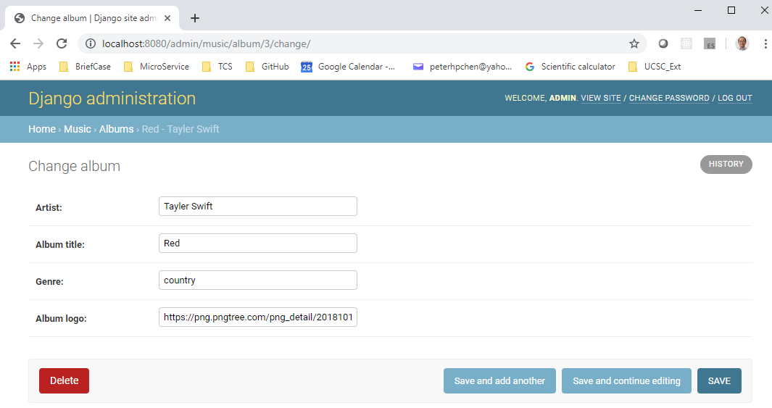
11 Admin Interface
https://www.youtube.com/watch?v=Mjs1elH3Pdg&list=PL6gx4Cwl9DGBlmzzFcLgDhKTTfNLfX1IK&index=11
You can click the desired field, change information and save the information.

Slide 8
End of Chapter

