Slide 1

15 Render Template Shortcut
Peter H. Chen

Slide 2
15 Render Template Shortcut
https://www.youtube.com/watch?v=RkBL9pAF8As&list=PL6gx4Cwl9DGBlmzzFcLgDhKTTfNLfX1IK&index=15
This section discusses template.
Start the server:
> python manage.py runserver 8080

Slide 3
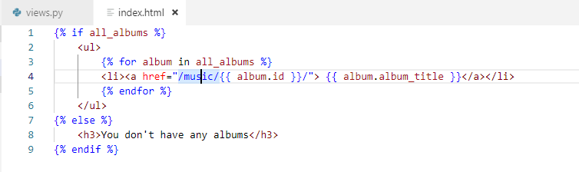
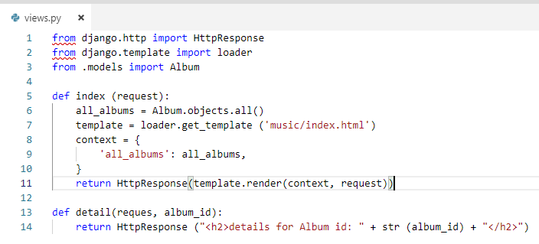
15 Render Template Shortcut
https://www.youtube.com/watch?v=RkBL9pAF8As&list=PL6gx4Cwl9DGBlmzzFcLgDhKTTfNLfX1IK&index=15
How to use template?
From django.template import loader
We load the template.
Render the context.
1
2
3

Slide 4
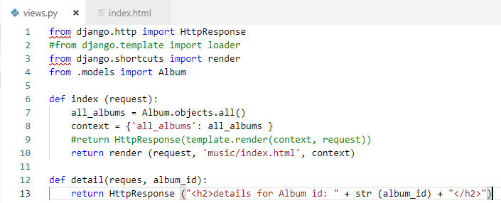
15 Render Template Shortcut
https://www.youtube.com/watch?v=RkBL9pAF8As&list=PL6gx4Cwl9DGBlmzzFcLgDhKTTfNLfX1IK&index=15
How to use template shortcut?
From django.shortcut import render
Render the with load template and context.
1
2

Slide 5
15 Render Template Shortcut
https://www.youtube.com/watch?v=RkBL9pAF8As&list=PL6gx4Cwl9DGBlmzzFcLgDhKTTfNLfX1IK&index=15
Wait a minute, I thought that we need a actual HttpResponse().
The HttpResponse() is actually build in the render () function. Behind the scene, it takes this converts it to an actual valid HTTP response and it is good to go.

Slide 6
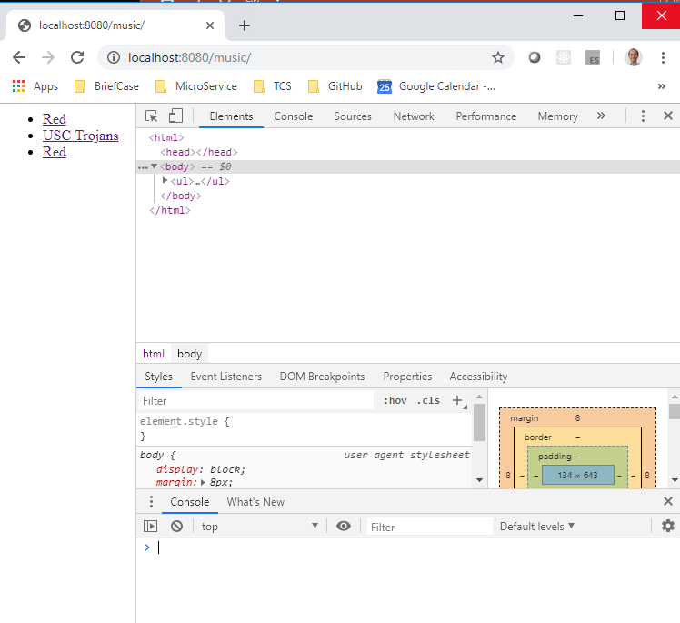
15 Render Template Shortcut
https://www.youtube.com/watch?v=RkBL9pAF8As&list=PL6gx4Cwl9DGBlmzzFcLgDhKTTfNLfX1IK&index=15
Restart Django Server:
> python manage.py runserver 8080
Open chrome
> localhost:8080/music

Slide 7
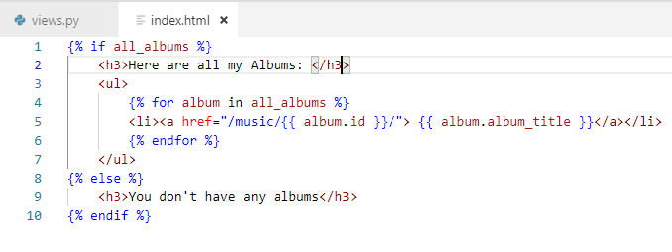
15 Render Template Shortcut
https://www.youtube.com/watch?v=RkBL9pAF8As&list=PL6gx4Cwl9DGBlmzzFcLgDhKTTfNLfX1IK&index=15
How to use template shortcut?
We add ‘Here is all my Albums’
From django.shortcut import render
Render the with load template and context.
1
2

Slide 8
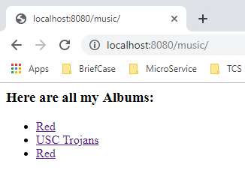
15 Render Template Shortcut
https://www.youtube.com/watch?v=RkBL9pAF8As&list=PL6gx4Cwl9DGBlmzzFcLgDhKTTfNLfX1IK&index=15
Restart Django Server:
> python manage.py runserver 8080
Open chrome
> localhost:8080/music

Slide 9
End of Chapter

