Slide 1

18 Object Set
Peter H. Chen

Slide 2
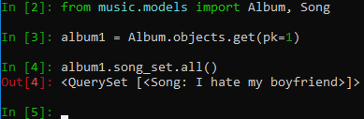
18 Object Set
https://www.youtube.com/watch?v=uvafEFi2bY4&list=PL6gx4Cwl9DGBlmzzFcLgDhKTTfNLfX1IK&index=18
This section discusses the Object set.
> python manage.py runserver 8080
> python manage.py shell
Now, there is another way to add the songs to Album. This is a much quicker way.
If we take a look in the models.py, the Song class is associated with the Album class using the foreign key. In other words, because we related these two objects in this kind of way. It already knows that this Album is going to have a whole set of songs associated with it.
So, what Django did is it slows you to access the songs throughout a set.

Slide 3
18 Object Set
https://www.youtube.com/watch?v=uvafEFi2bY4&list=PL6gx4Cwl9DGBlmzzFcLgDhKTTfNLfX1IK&index=18
Before, we use
> import music.models import Album, Song
> album1 = Album.objects.get(pk=1)
> album1.artist
>>> ‘Taylor Swift’
> song = Song ()
> song.album = album1
> song.file_type = ‘mp3’
> song.song_title = ‘I hate my boyfriend’
> song.save()
> song.song_title = ‘I love my boyfriend’
> song.save()
> album1.song_set.all()
>>> < QuerySet [<Song: I love my boyfriend>]>

Slide 4
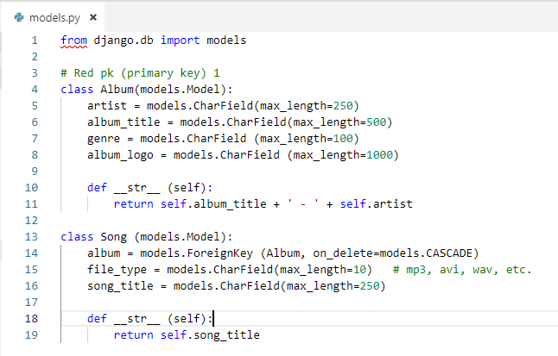
18 Object Set
https://www.youtube.com/watch?v=uvafEFi2bY4&list=PL6gx4Cwl9DGBlmzzFcLgDhKTTfNLfX1IK&index=18
Now, after reference the set and now call a function to create.
We use the album1.song_set.create(). Whenever we create, we need every attributes (file_type and sone_title) except the album = models.foreignKey(…)

Slide 5
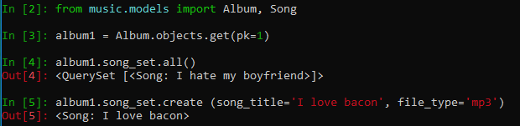
18 Object Set
https://www.youtube.com/watch?v=uvafEFi2bY4&list=PL6gx4Cwl9DGBlmzzFcLgDhKTTfNLfX1IK&index=18
Now, after reference the set and now call a function to create.
We use the album1.song_set.create(). Whenever we create, we need every attributes (file_type and sone_title) except the album = models.foreignKey(…)

Slide 6
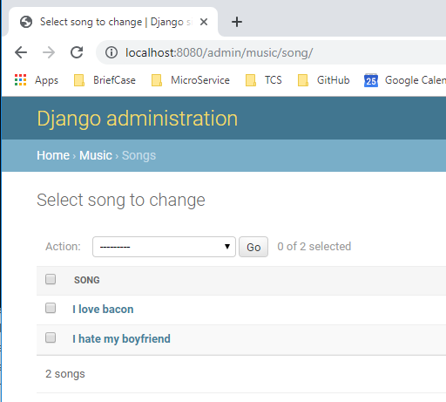
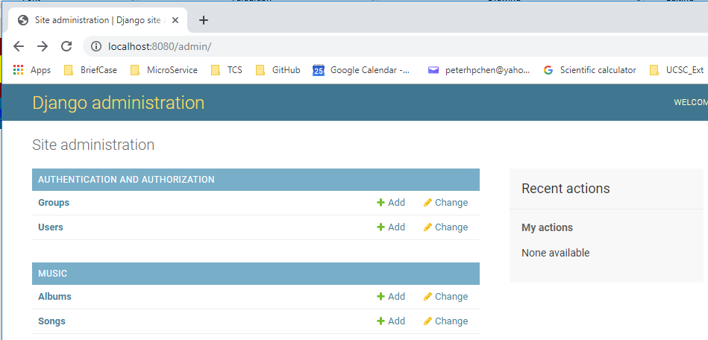
18 Object Set
https://www.youtube.com/watch?v=uvafEFi2bY4&list=PL6gx4Cwl9DGBlmzzFcLgDhKTTfNLfX1IK&index=18
> python manage.py runserver 8080
Open chrome
> localhost:8080/admin

Slide 7
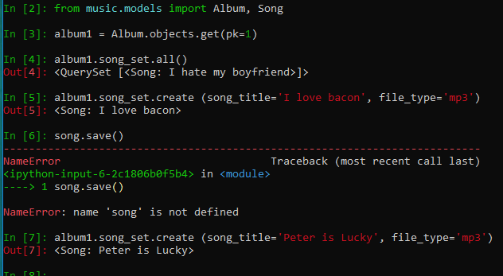
18 Object Set
https://www.youtube.com/watch?v=uvafEFi2bY4&list=PL6gx4Cwl9DGBlmzzFcLgDhKTTfNLfX1IK&index=18
Add another song_title:
> ablum1.song_set.create (song_title=‘Peter is Lucky’, file_type=‘mp3’)

Slide 8
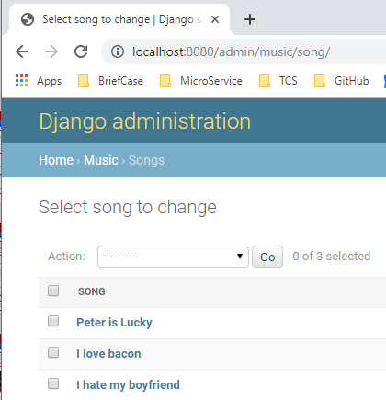
18 Object Set
https://www.youtube.com/watch?v=uvafEFi2bY4&list=PL6gx4Cwl9DGBlmzzFcLgDhKTTfNLfX1IK&index=18
Refresh, we have

Slide 9
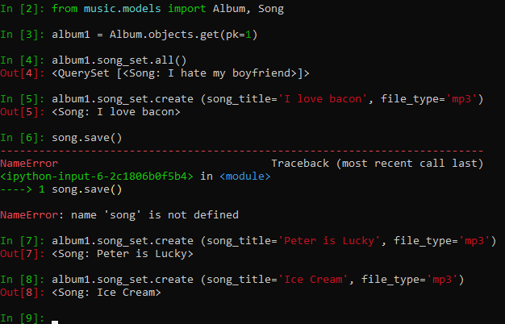
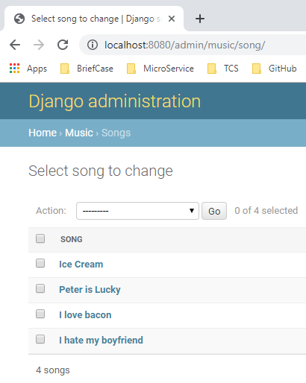
18 Object Set
https://www.youtube.com/watch?v=uvafEFi2bY4&list=PL6gx4Cwl9DGBlmzzFcLgDhKTTfNLfX1IK&index=18
Add another sone_title: “Ice Cream” and refresh the web page.

Slide 10
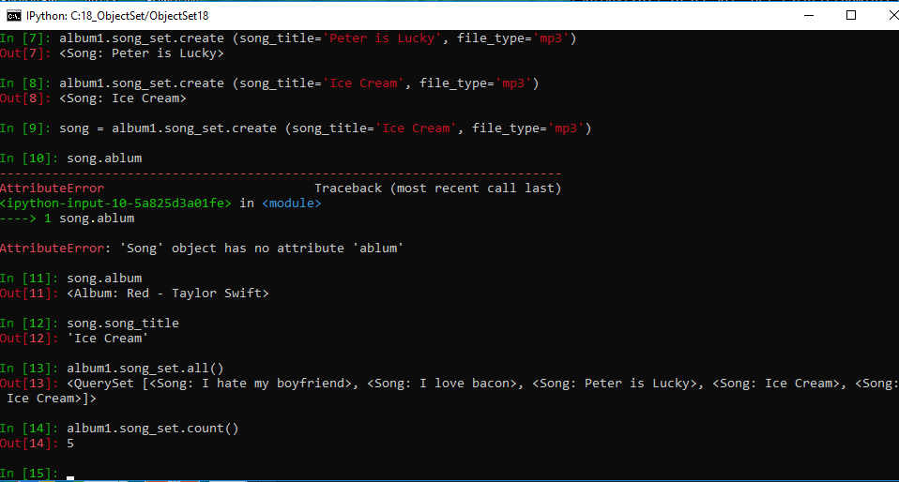
18 Object Set
https://www.youtube.com/watch?v=uvafEFi2bY4&list=PL6gx4Cwl9DGBlmzzFcLgDhKTTfNLfX1IK&index=18
We can assign a variable song to an object: song = album1.song_set.create(..)
We can access the object attributes song.ablum, song.song_title.
We can also access ablum1.song_set.all() and album1.song_set.count()

Slide 11
End of Chapter

