Slide 1

16 Http Error
Peter H. Chen

Slide 2
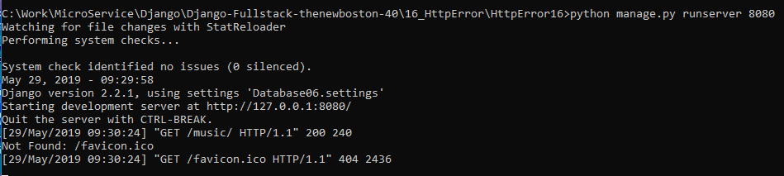
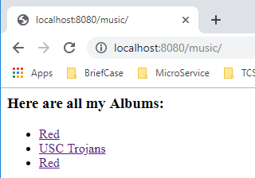
15 Render Template Shortcut
https://www.youtube.com/watch?v=LLcAr3HS8qA&list=PL6gx4Cwl9DGBlmzzFcLgDhKTTfNLfX1IK&index=16
This section discusses the Http Error.
> python manage.py runserver 8080
Open chrome
> localhost:8080/music

Slide 3
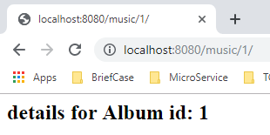
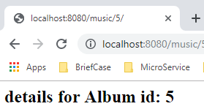
15 Render Template Shortcut
https://www.youtube.com/watch?v=LLcAr3HS8qA&list=PL6gx4Cwl9DGBlmzzFcLgDhKTTfNLfX1IK&index=16
> localhost:8080/music/1
> localhost:8080/music/5
We don’t have id=5. The display is incorrect.
How to display the 404 page not found information?

Slide 4
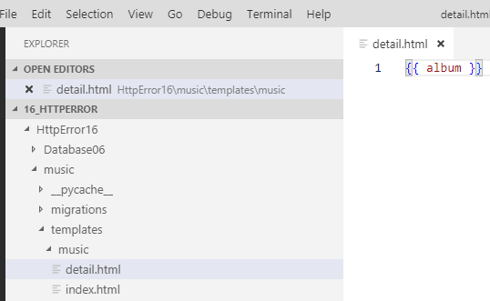
15 Render Template Shortcut
https://www.youtube.com/watch?v=LLcAr3HS8qA&list=PL6gx4Cwl9DGBlmzzFcLgDhKTTfNLfX1IK&index=16
404 means that we don’t have resources to display.
Create file /music/template/music/detail.html.

Slide 5
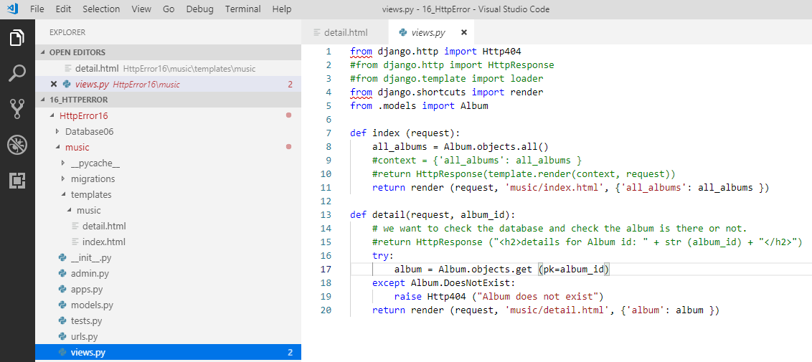
15 Render Template Shortcut
https://www.youtube.com/watch?v=LLcAr3HS8qA&list=PL6gx4Cwl9DGBlmzzFcLgDhKTTfNLfX1IK&index=16
404 means that we don’t have resources to display.
In views.py, add “import django.http import http404”
Change function “def detail (): “ with try .. except block as follows.

Slide 6
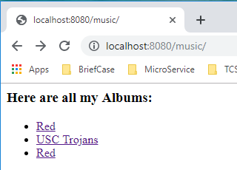
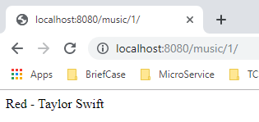
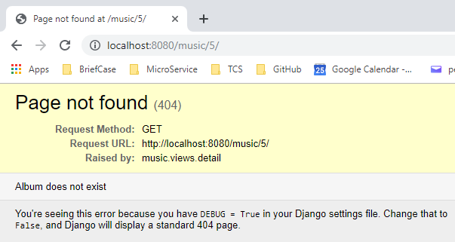
15 Render Template Shortcut
https://www.youtube.com/watch?v=LLcAr3HS8qA&list=PL6gx4Cwl9DGBlmzzFcLgDhKTTfNLfX1IK&index=16
> localhost:8080/music
> localhost:8080/music/1
> localhost:8080/music/5

Slide 7
End of Chapter

