Slide 1

20 Remove Hardcoded URLs
Peter H. Chen

Slide 2
20 Remove Hardcoded URLs
https://www.youtube.com/watch?v=XQll-WgZcpE&list=PL6gx4Cwl9DGBlmzzFcLgDhKTTfNLfX1IK&index=20
This section discusses the Removing Hardcoded URLs
> python manage.py runserver 8080
Open Chrome
> localhost:8080

Slide 3
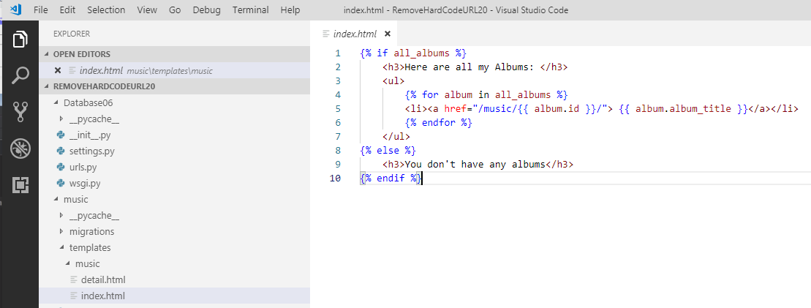
20 Remove Hardcoded URLs
https://www.youtube.com/watch?v=XQll-WgZcpE&list=PL6gx4Cwl9DGBlmzzFcLgDhKTTfNLfX1IK&index=20
Part of URLs (href=“/music/{{ album.id}}/”) is dynamic change.
The /music/ is not dynamic, this is actually called the Hardcoded URLs.
It is not good to have hardcoded URLs in the template. In the actual project, you may have hundreds or thousands of pages.
We want to make /music/ dynamic. How do we do that?

Slide 4
20.1 URLs
Peter H. Chen

Slide 5
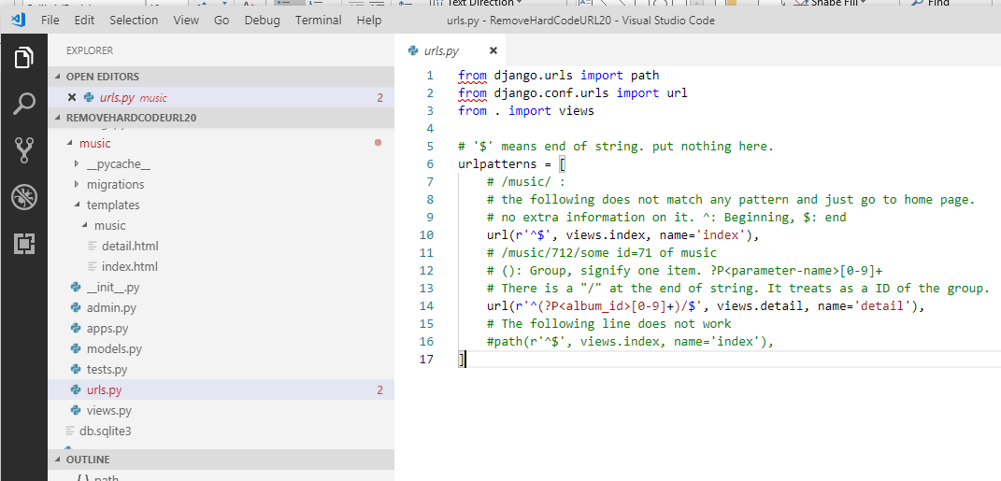
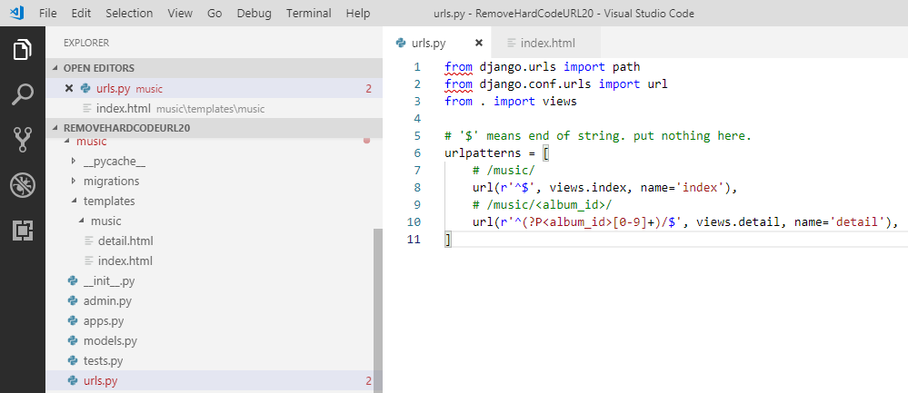
20.1 URLs
https://www.youtube.com/watch?v=XQll-WgZcpE&list=PL6gx4Cwl9DGBlmzzFcLgDhKTTfNLfX1IK&index=20
In the /music/urls.py, the <album_id> is the part of URL.

Slide 6
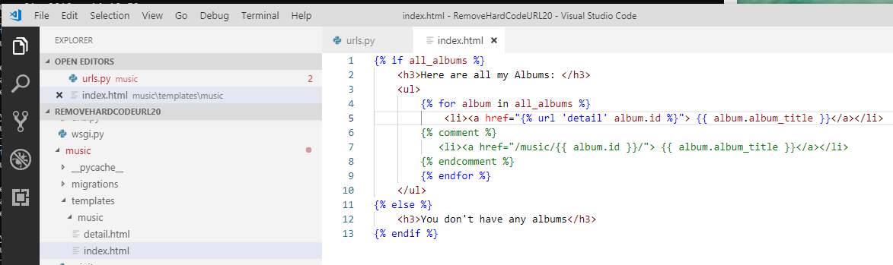
20.1 URLs
https://www.youtube.com/watch?v=XQll-WgZcpE&list=PL6gx4Cwl9DGBlmzzFcLgDhKTTfNLfX1IK&index=20
In the template, change “/music/{{ album.id}}/” into “{% url ‘detail’ album.id %}”

Slide 7
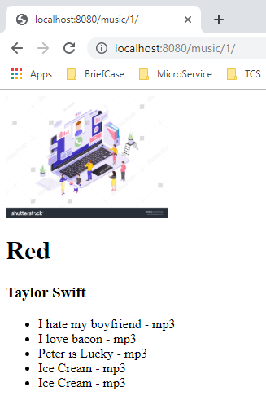
20.1 URLs
https://www.youtube.com/watch?v=XQll-WgZcpE&list=PL6gx4Cwl9DGBlmzzFcLgDhKTTfNLfX1IK&index=20
Refresh web page with:
> localhost:8080/music/1

Slide 8
End of Chapter

