Slide 1

8 Activate Model
Peter H. Chen

Slide 2
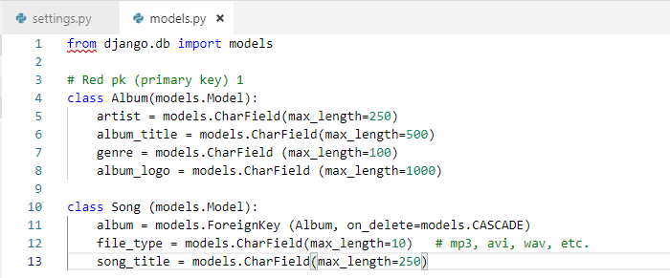
8 Activate Model
https://www.youtube.com/watch?v=dONYOtb2ySI&list=PL6gx4Cwl9DGBlmzzFcLgDhKTTfNLfX1IK&index=8
In the last section, we setup the model in the models.py.

Slide 3
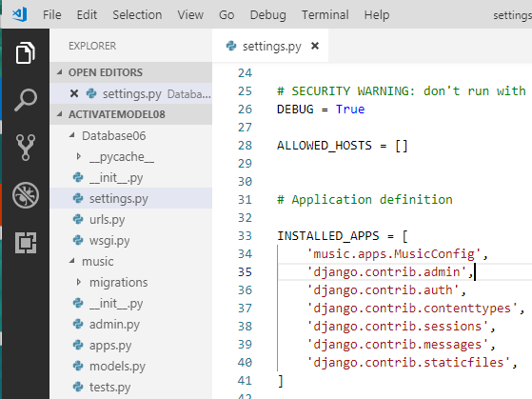
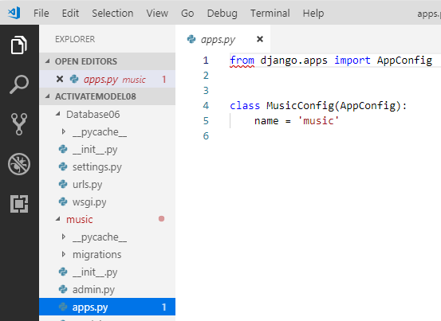
8 Activate Model
https://www.youtube.com/watch?v=dONYOtb2ySI&list=PL6gx4Cwl9DGBlmzzFcLgDhKTTfNLfX1IK&index=8
We want to add music app into the website.
In Database08/settings.py, we add “music.app.MusicConfig” for INSTALLED_APPS in settings.ps.
The music/apps.py contains the “class MusicConfig()”

Slide 4
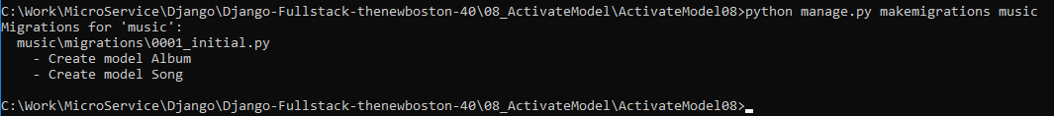
8 Activate Model
https://www.youtube.com/watch?v=dONYOtb2ySI&list=PL6gx4Cwl9DGBlmzzFcLgDhKTTfNLfX1IK&index=8
Models did not meet the database structure yet
We need to make the database migration:
In this case, we add two classes for database
> python manage.py makemigrations music

Slide 5
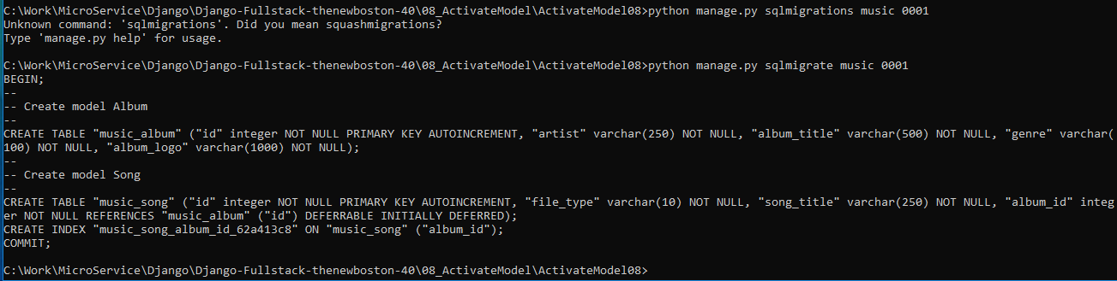
8 Activate Model
https://www.youtube.com/watch?v=dONYOtb2ySI&list=PL6gx4Cwl9DGBlmzzFcLgDhKTTfNLfX1IK&index=8
Make the database migration.
> python manage.py sqlmigrate music 0001

Slide 6
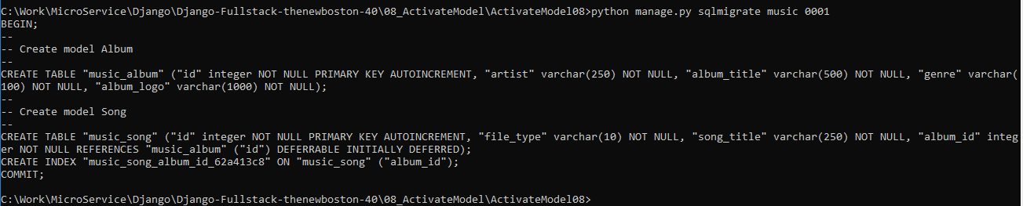
8 Activate Model
https://www.youtube.com/watch?v=dONYOtb2ySI&list=PL6gx4Cwl9DGBlmzzFcLgDhKTTfNLfX1IK&index=8
All the migrations you made are the changes you make in the models.py and converts them to SQL file.
Creating a table for class Album,
Creating another table for class Song, and
Creating a bunch of columns.
The migration is change from class into a database table and columns.
Now, we have SQL file created. The rest of task is to run it.

Slide 7
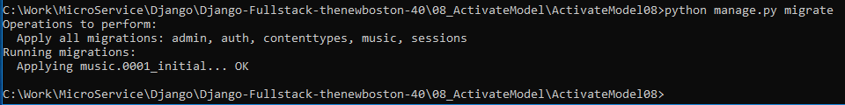
8 Activate Model
https://www.youtube.com/watch?v=dONYOtb2ySI&list=PL6gx4Cwl9DGBlmzzFcLgDhKTTfNLfX1IK&index=8
We have all the SQL tables.
We need to migrate all the changes again.
> python manage.py migrate
>>> Apply all migrations
>>> Run migration

Slide 8
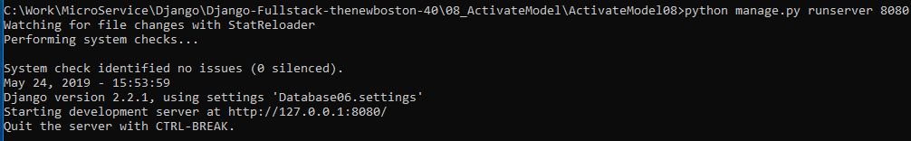
8 Activate Model
https://www.youtube.com/watch?v=dONYOtb2ySI&list=PL6gx4Cwl9DGBlmzzFcLgDhKTTfNLfX1IK&index=8
Our database is sync with the codes.
Rerun the server:
> python manage.py runserver 8080
The server will start and look at all the installed apps by setting.py.
Then, server will boot up with tables Album and Table Song.
Then, server will make sure all the class Album and class Song in your code reflects to whatever in the database.
If it does not sync, then it will be errors.
If no errors, then everything runs fine.

Slide 9
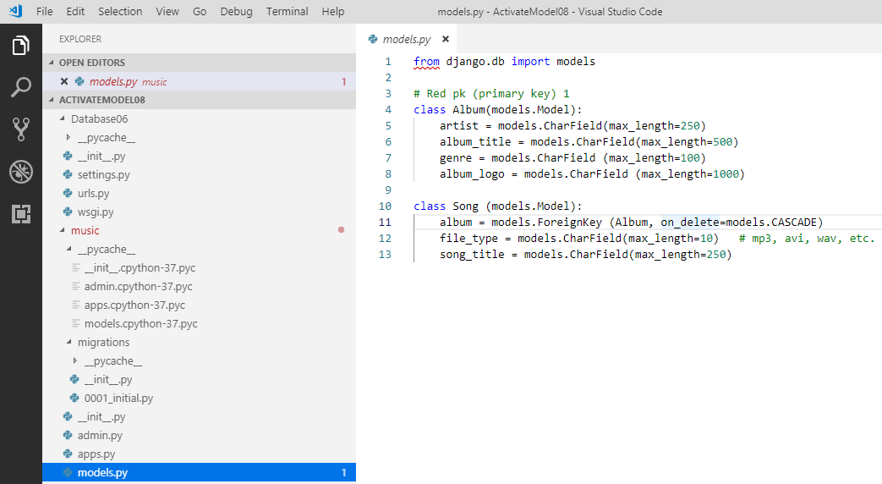
8 Activate Model
https://www.youtube.com/watch?v=dONYOtb2ySI&list=PL6gx4Cwl9DGBlmzzFcLgDhKTTfNLfX1IK&index=8
If you have errors.Then, you need to run the migrate command:
> python manage.py sqlmigrate music 00xx
All you need to remember is three steps:
Define Database structure in models.py. # Python data structure
> python manage.py makemigrations music # Python data structure to SQL database
> python manage.py migrate # SQL database in sync with Python data structure
Make migrations for app data structure to SQL database
2
3
Migrate SQL database to code
1
Define data structure for app

Slide 10
8 Activate Model
https://www.youtube.com/watch?v=dONYOtb2ySI&list=PL6gx4Cwl9DGBlmzzFcLgDhKTTfNLfX1IK&index=8
If you have any changes in database, step 3 will migrate your database in sync with your Python data structure.
Since we have Django framework, working with database become very easy. Database become a piece of cake.

Slide 11
End of Chapter

