Slide 1

10 Database Filter
Peter H. Chen

Slide 2
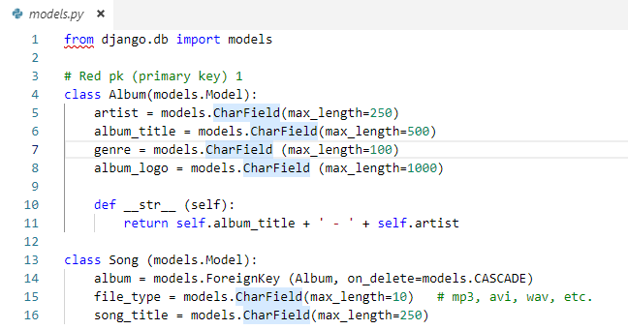
10 Database Filter
https://www.youtube.com/watch?v=GalTlEsOBdo&list=PL6gx4Cwl9DGBlmzzFcLgDhKTTfNLfX1IK&index=10
In the last section, we discuss Database Filter.
To print the information of object, we can add dunder (double underscrore __)
def __str__ (self):
return self.album_title + ‘ – ‘ + self.artist
To print out the album title and artist.

Slide 3
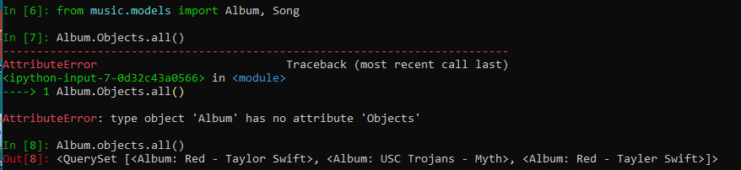
10 Database Filter
https://www.youtube.com/watch?v=GalTlEsOBdo&list=PL6gx4Cwl9DGBlmzzFcLgDhKTTfNLfX1IK&index=10
You start the shell:
> python manage.py shell
> from music.models import Album, Song
> Album.objects.all()
>>> p< Album: Red – Taylor Swift>, <Album: USC Trojans – Myth>, …]>

Slide 4
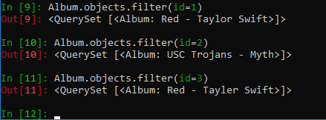
10 Database Filter
https://www.youtube.com/watch?v=GalTlEsOBdo&list=PL6gx4Cwl9DGBlmzzFcLgDhKTTfNLfX1IK&index=10
> Album.objects.filter (id=1)
> Album.objects.filter (id=2)
> Album.objects.filter (id=3)

Slide 5
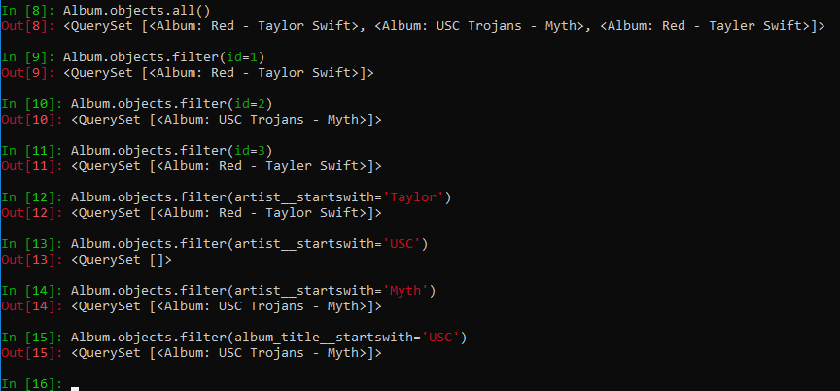
10 Database Filter
https://www.youtube.com/watch?v=GalTlEsOBdo&list=PL6gx4Cwl9DGBlmzzFcLgDhKTTfNLfX1IK&index=10
> Album.objects.filter (artist__startswith__=’Tayler’)
> Album.objects.filter (album_title__startswith__=’USC’)

Slide 6
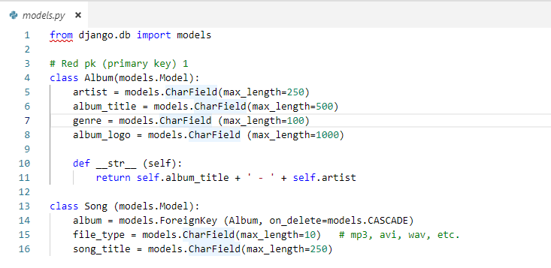
10 Database Filter
https://www.youtube.com/watch?v=GalTlEsOBdo&list=PL6gx4Cwl9DGBlmzzFcLgDhKTTfNLfX1IK&index=10
Django shell is a very convenient way to add to delete the data object.
The code you wrote in the Python API shell. It is the exact code that we are going to be writing in below.
It is easier to play around with it and get your results instantly in the Django shell and you do not have to refresh any page over and over again.

Slide 7
End of Chapter

