Slide 1

9 Database API
Peter H. Chen

Slide 2
9.1 Django Shell
Peter H. Chen

Slide 3
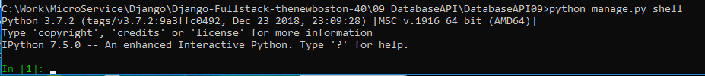
9.1 Django Shell
https://www.youtube.com/watch?v=uYTiPwEGKyQ&list=PL6gx4Cwl9DGBlmzzFcLgDhKTTfNLfX1IK&index=9
In the last section, we discuss Database API.
Now, we got our table set up in out database.
How to use Django API?
There are Django Shell and Python Shell
Django shell:
> python manage.py shell
Python shell:
> python

Slide 4
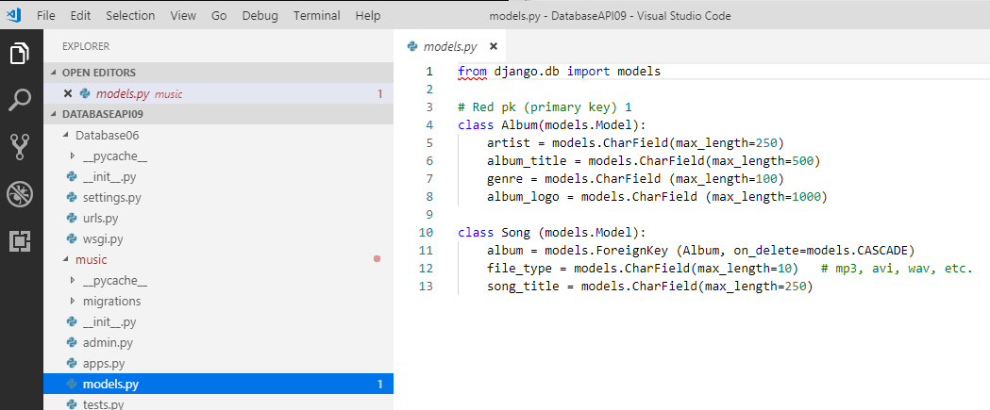
9.1 Django Shell
https://www.youtube.com/watch?v=uYTiPwEGKyQ&list=PL6gx4Cwl9DGBlmzzFcLgDhKTTfNLfX1IK&index=9
In Django shell, we can start using the database command.
We have the database models.py for album and song.
Right now, our database have two tables, Album and Song. We have Django created the tables. The Album table has 4 columns and Song table has 3 columns: album, file_type, and song_title.

Slide 5
9.2 Command: save()
Peter H. Chen

Slide 6
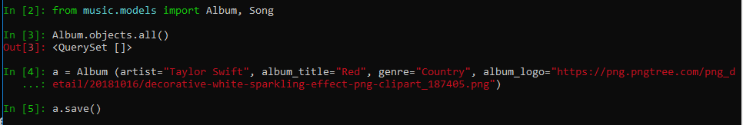
9.2 Command: save()
https://www.youtube.com/watch?v=uYTiPwEGKyQ&list=PL6gx4Cwl9DGBlmzzFcLgDhKTTfNLfX1IK&index=9
There are png files download location: https://png.pngtree.com/png_detail/20181016/decorative-white-sparkling-effect-png-clipart_187405.png
> from music.models import Album, Song
> Album.objects.all()
> a = Album (arties=“Taylor Swift”, album_title=“red”, genre=“Country”, album_logo=“https://png.pngtree.com/png_detail/20181016/decorative-white-sparkling-effect-png-clipart_187405.png”)
Now, we have this object in memory. Right now, this object in shell memory. We need to save into database.
How do we save into database?
> a.save()
This is the actual function that take the object in shell memory into the database.

Slide 7
9.3 Display Object Data
Peter H. Chen

Slide 8
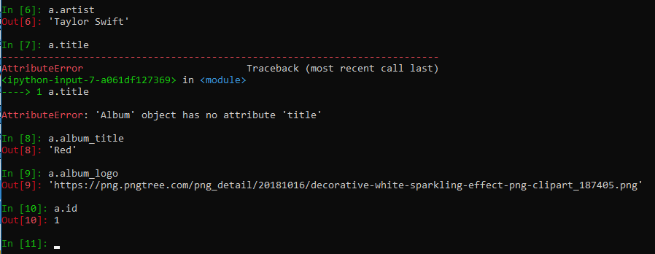
9.3 Display Object Data
https://www.youtube.com/watch?v=uYTiPwEGKyQ&list=PL6gx4Cwl9DGBlmzzFcLgDhKTTfNLfX1IK&index=9
Now, how to we read the database?
> a.artitst
> a.album_title
> a.album_logo
> a.id
The last one “a.id” is automatically gets added by Django called the primary key or id. Some people call it primary key and some people called it an ID or a unique ID.

Slide 9
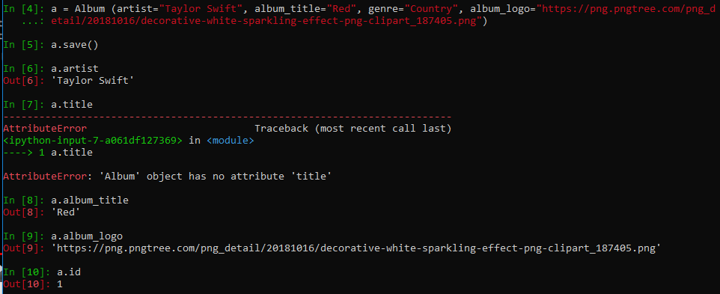
9.3 Display Object Data
https://www.youtube.com/watch?v=uYTiPwEGKyQ&list=PL6gx4Cwl9DGBlmzzFcLgDhKTTfNLfX1IK&index=9
Now, we can see one command to create the database and several commands read the database.
We have the firs item we added artist, album_title, album_log, and id = 1.
The next items we added will be id = 2, id = 3, and etc.

Slide 10
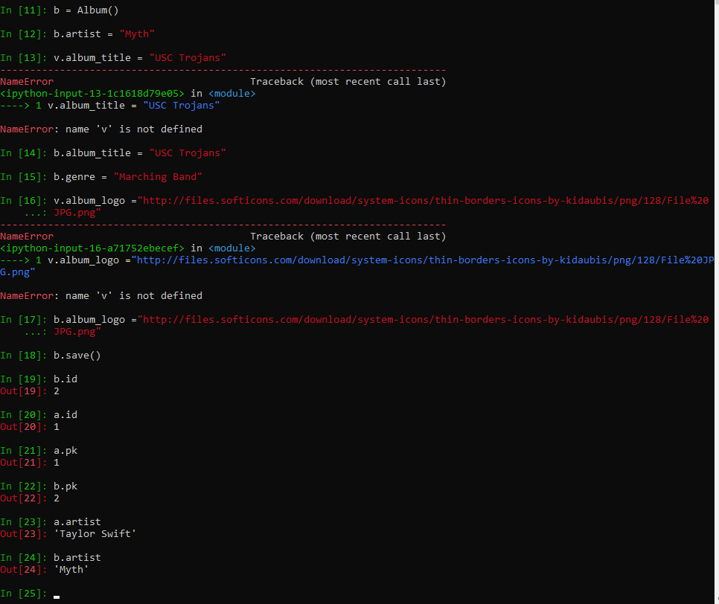
9.3 Display Object Data
https://www.youtube.com/watch?v=uYTiPwEGKyQ&list=PL6gx4Cwl9DGBlmzzFcLgDhKTTfNLfX1IK&index=9
We can create another album
> b = Album()
> b.artist = “Myth”
> b.album_title = “High School”
> b.genre = “Punk”
> b.album_logo=“http://files.softicons.com/download/system-icons/thin-borders-icons-by-kidaubis/png/128/File%20JPG.png”
> b.save()

Slide 11
9.4 Update Object Data
Peter H. Chen

Slide 12
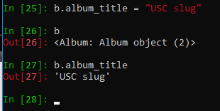
9.4 Update Object Data
https://www.youtube.com/watch?v=uYTiPwEGKyQ&list=PL6gx4Cwl9DGBlmzzFcLgDhKTTfNLfX1IK&index=9
We can change the content of b.album_title:
> b.album_title = “USC Slug”
> b.album_title
>>> “USC slug”

Slide 13

9.4 Update Object Data
https://www.youtube.com/watch?v=uYTiPwEGKyQ&list=PL6gx4Cwl9DGBlmzzFcLgDhKTTfNLfX1IK&index=9
We can see the album objects:
> Album.objects.all()
>>> <QuerSet [<Album: Album object (1)>, <Album: Album object (2)>] >
We can see there are two album objects in our database.

Slide 14
9.5 Convert Object into String Format
Peter H. Chen

Slide 15
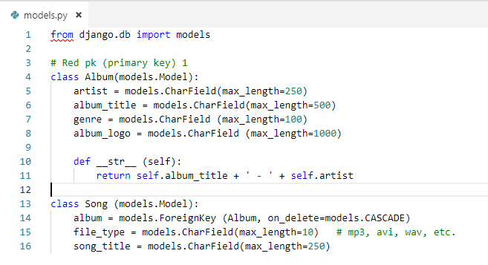
9.5 Convert Object into String Format
https://www.youtube.com/watch?v=uYTiPwEGKyQ&list=PL6gx4Cwl9DGBlmzzFcLgDhKTTfNLfX1IK&index=9
How to print the album artist, album_title in string format?
In the models.py, we add function
> def __str__ (self):
return self.album_title + ‘ – ‘ + self.artist

Slide 16
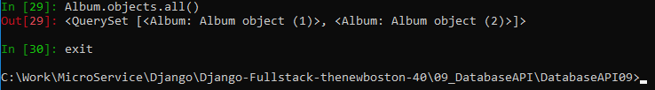
9.5 Convert Object into String Format
https://www.youtube.com/watch?v=uYTiPwEGKyQ&list=PL6gx4Cwl9DGBlmzzFcLgDhKTTfNLfX1IK&index=9
We need to re-start the Django shell. There are old data structure in the code.
> exit() # or exit

Slide 17
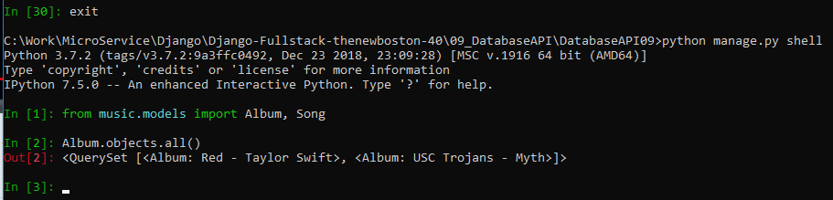
9.5 Convert Object into String Format
https://www.youtube.com/watch?v=uYTiPwEGKyQ&list=PL6gx4Cwl9DGBlmzzFcLgDhKTTfNLfX1IK&index=9
Restart the Django shell:
> python manage.py shell
> from music.models import Album, Song
> Album.objects.all()
>>> <QuerySet [<Album: Red – Taylor Swift>, <Album: USC Trojans – Myth>]>
Note: Because we did not b.save() for “USC Slug”, the database still keep the “USC Trojans”. It just change in the shell but did not update to the database.

Slide 18
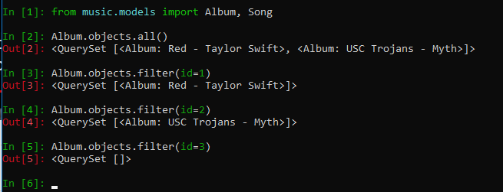
9.5 Convert Object into String Format
https://www.youtube.com/watch?v=uYTiPwEGKyQ&list=PL6gx4Cwl9DGBlmzzFcLgDhKTTfNLfX1IK&index=9
How to show the database by id?
> Album.objects.filter (id=1)
> Album.objects.filter (id=2)
> Album.objects.filter (id=3)
Note: id = 3 is not existed.

Slide 19
9.6 Display Filter
Peter H. Chen

Slide 20
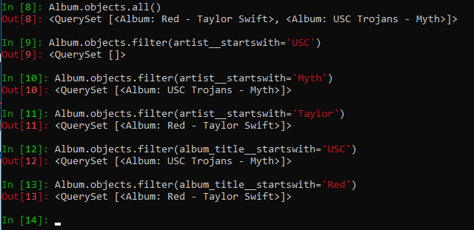
9.6 Display Filter
https://www.youtube.com/watch?v=uYTiPwEGKyQ&list=PL6gx4Cwl9DGBlmzzFcLgDhKTTfNLfX1IK&index=9
How to show the database by artirst name?
> Album.objects.filter(artist__startswith=‘Taylor’)
> Album.objects.filter(artist__startswith=‘Myth’)
> Album.objects.filter(album_title__startswith=‘USC’)
> Album.objects.filter(album_title__startswith=‘Red’)
Note: There is two underscore (__) between the columns names and startswith keywords.

Slide 21
End of Chapter

