Slide 1

19 Detail Template
Peter H. Chen

Slide 2
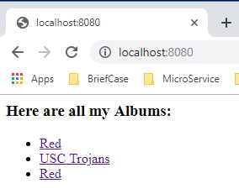
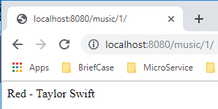
19 Detail Template
https://www.youtube.com/watch?v=ECTouGZGVx0&list=PL6gx4Cwl9DGBlmzzFcLgDhKTTfNLfX1IK&index=19
This section discusses the Detail Template.
> python manage.py runserver 8080
Open Chrome
> localhost:8080
Click “Red” to go to “detail page”

Slide 3
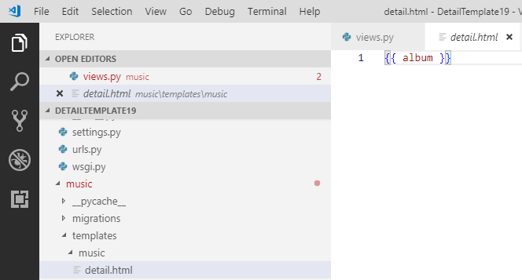
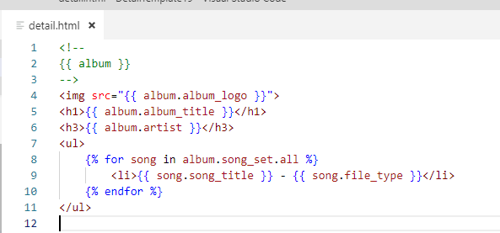
19 Detail Template
https://www.youtube.com/watch?v=ECTouGZGVx0&list=PL6gx4Cwl9DGBlmzzFcLgDhKTTfNLfX1IK&index=19
The current detail.html only have {{ album }}.
Change the detail template.

Slide 4
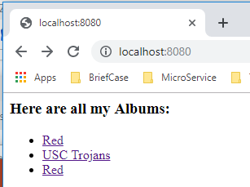
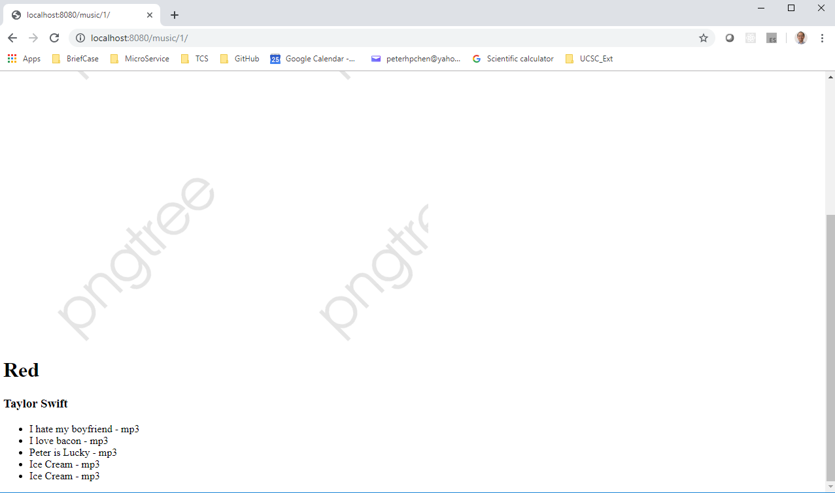
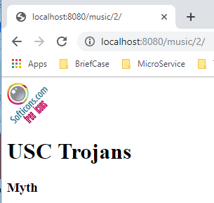
19 Detail Template
https://www.youtube.com/watch?v=ECTouGZGVx0&list=PL6gx4Cwl9DGBlmzzFcLgDhKTTfNLfX1IK&index=19
Click each album to display the detail template.

Slide 5
19.1 Change Logo
Peter H. Chen

Slide 6
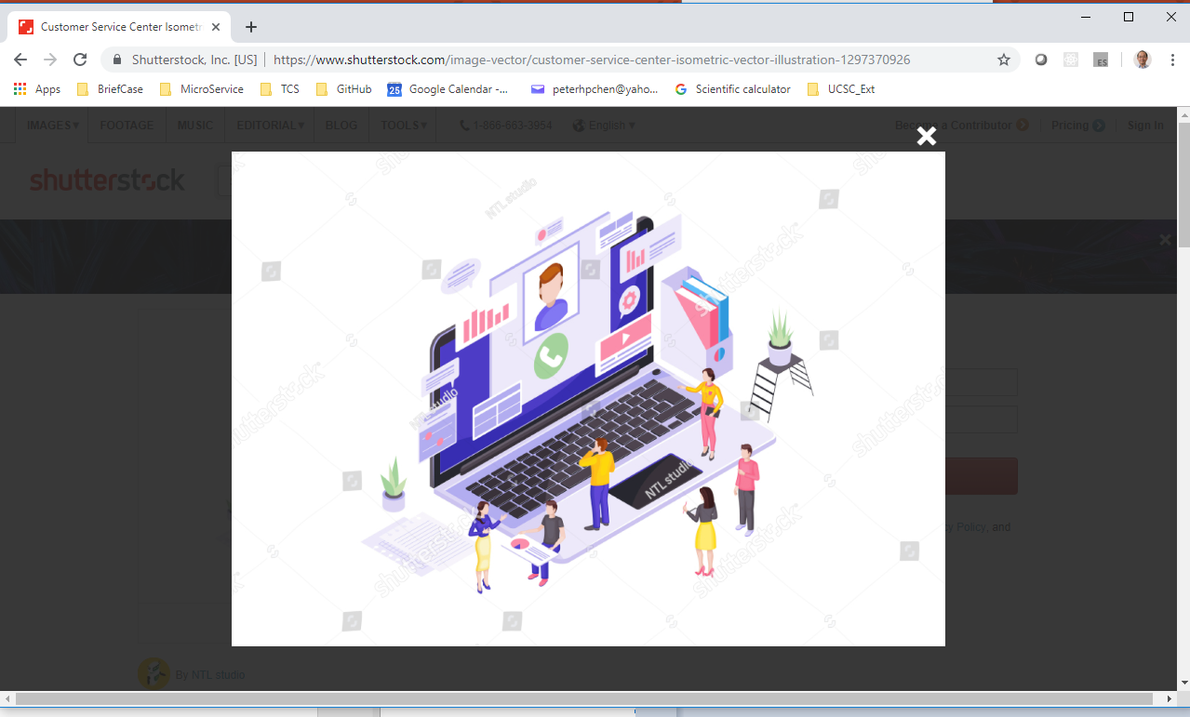
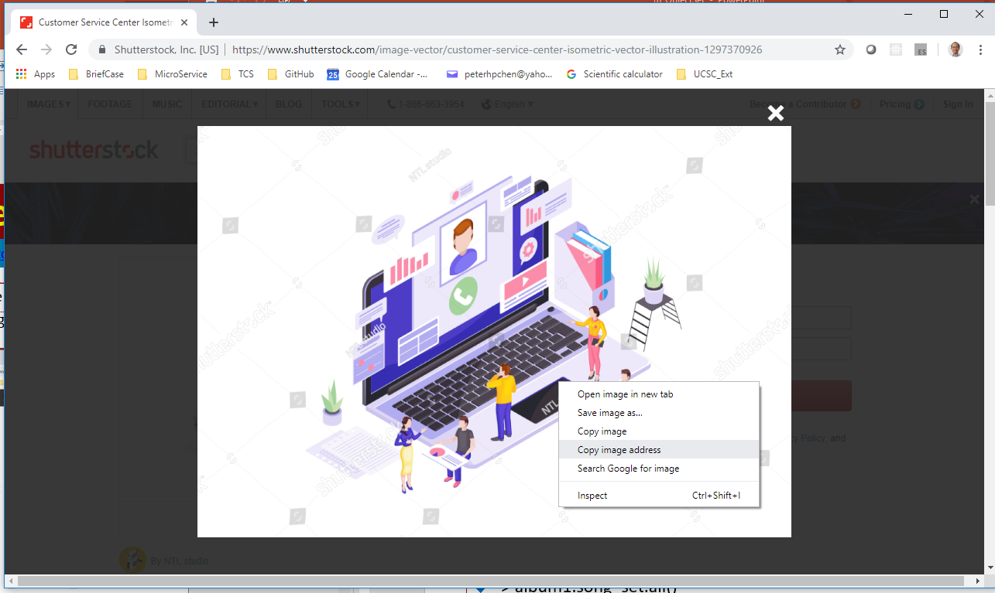
19 Detail Template
https://www.youtube.com/watch?v=ECTouGZGVx0&list=PL6gx4Cwl9DGBlmzzFcLgDhKTTfNLfX1IK&index=19
How to change the logo?
Find a web site with image, e.g., “https://image.shutterstock.com/z/stock-vector-customer-service-center-isometric-vector-illustration-client-online-support-order-processing-1297370926.jpg”
Copy image address

Slide 7
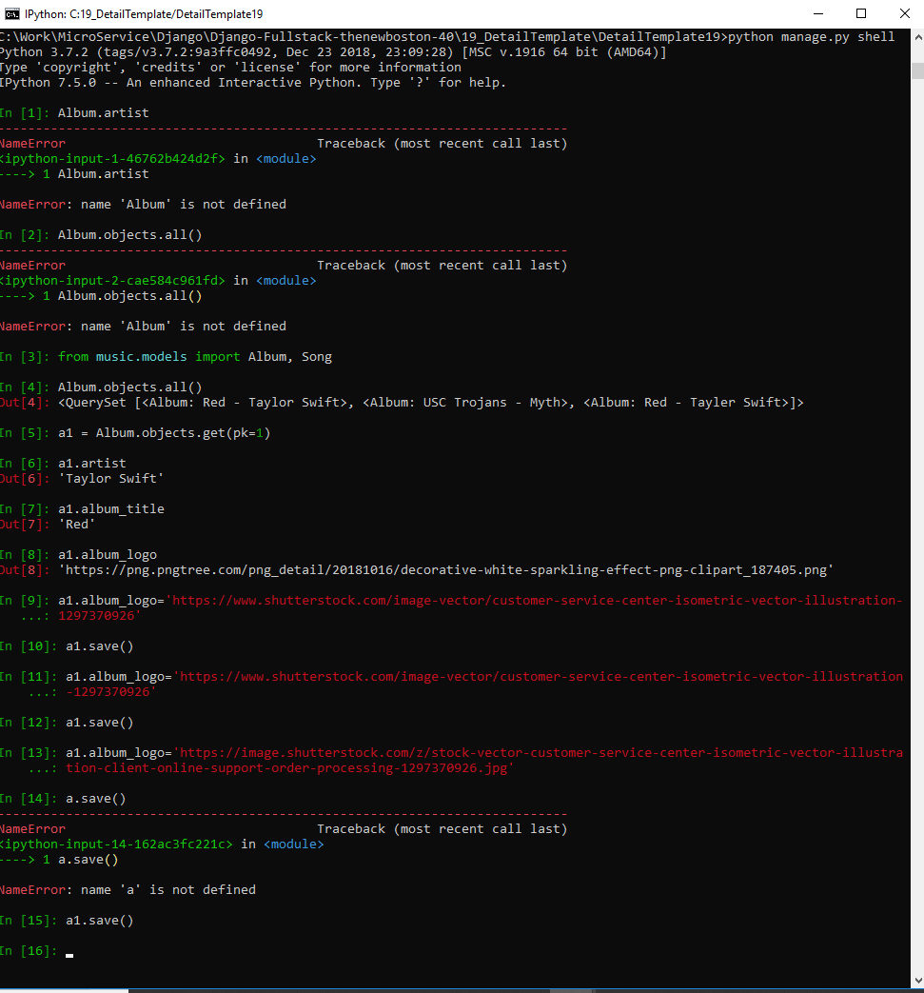
19 Detail Template
https://www.youtube.com/watch?v=ECTouGZGVx0&list=PL6gx4Cwl9DGBlmzzFcLgDhKTTfNLfX1IK&index=19
> python manage.py shell
> Album.objects.all()
> a1 = Album.objects.get(pk=1)
> a1.artist
>>> ‘Taylor Swift’
> a.album_log
>>> a1.album_log = ‘https://…’
> a1.album_log = ‘https//…’
> a1.save()

Slide 8
19.2 Change Display Size
Peter H. Chen

Slide 9
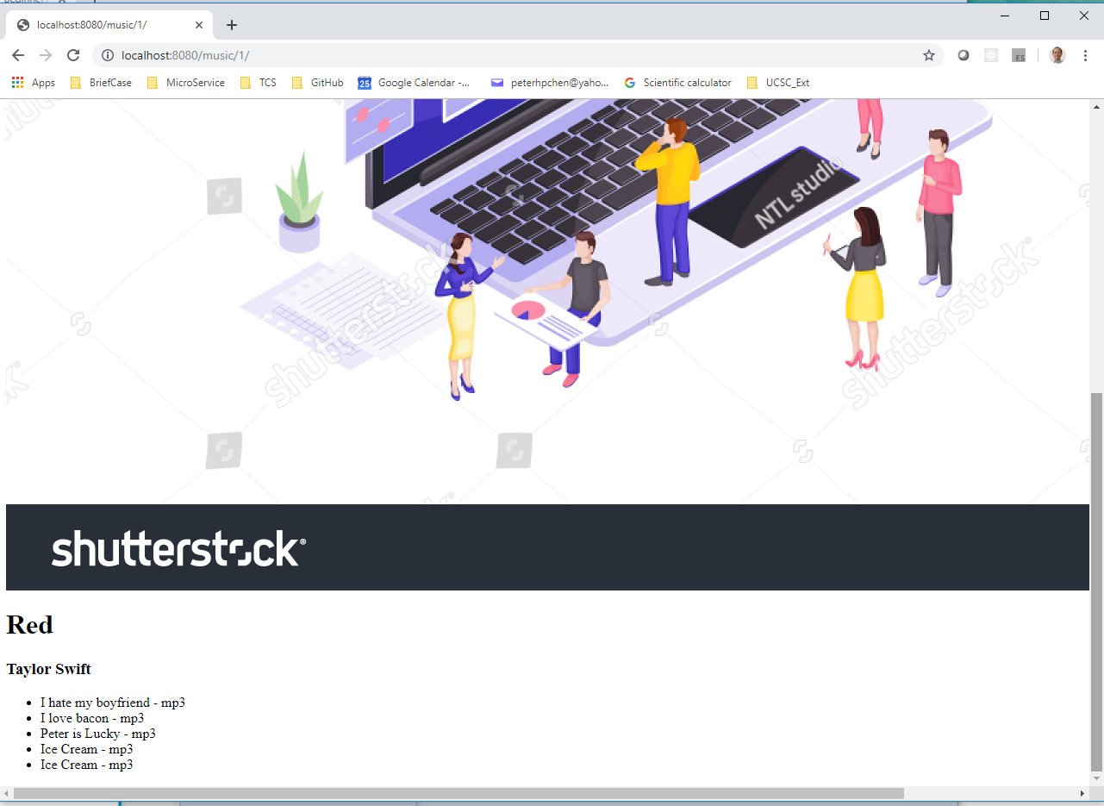
19 Detail Template
https://www.youtube.com/watch?v=ECTouGZGVx0&list=PL6gx4Cwl9DGBlmzzFcLgDhKTTfNLfX1IK&index=19
Refresh the web page. Image is too big.
How to change the image size?

Slide 10
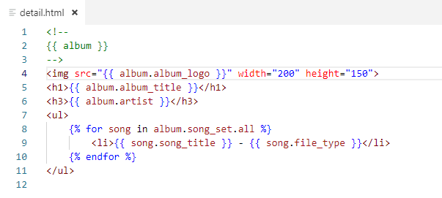
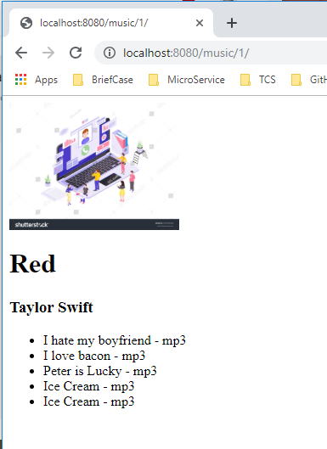
19 Detail Template
https://www.youtube.com/watch?v=ECTouGZGVx0&list=PL6gx4Cwl9DGBlmzzFcLgDhKTTfNLfX1IK&index=19
Change image size to 200 x 150
Refresh the web page.

Slide 11
End of Chapter

