Slide 1

14 Template
Peter H. Chen

Slide 2
14 Template
https://www.youtube.com/watch?v=0HVwUQ0Ok7Y&list=PL6gx4Cwl9DGBlmzzFcLgDhKTTfNLfX1IK&index=14
This section discusses template.
Start the server:
> python manage.py runserver 8080

Slide 3
14 Template
https://www.youtube.com/watch?v=0HVwUQ0Ok7Y&list=PL6gx4Cwl9DGBlmzzFcLgDhKTTfNLfX1IK&index=14
Template is a generic HTML document with a bunch of dummy data in it.
If you are looking for store template, it would have dummy items and have a heading to put title, item description, and etc.
The reason we have template in Django because template allows us to separate our HTML from our back-end stuff that way you can have a web designer and you can have a structure of home page or album detail view.
Template can make something generic and we can have that in one file and later on we can fill in all the information, such as, fill in the album title and etc.
We need to ‘from django.template import loader’
We need to make a separate file for template and load the file in.

Slide 4
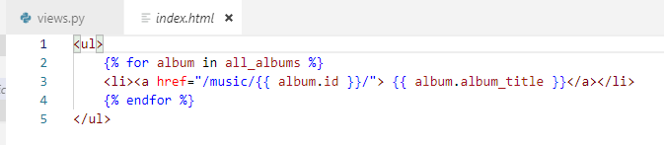
14 Template
https://www.youtube.com/watch?v=0HVwUQ0Ok7Y&list=PL6gx4Cwl9DGBlmzzFcLgDhKTTfNLfX1IK&index=14
Select app ‘music’, create a folder called ‘music/templates’. In the template folder, make a app ‘music/templates/music’ folder. In the ‘/music/templates/music’ folder, create file ‘music/template/music/index.html’
In the index.html, the frontend developer will give us the template as below:
<ul>
<li><a href=“#”>Album Title Here</a></li>
</ul>

Slide 5
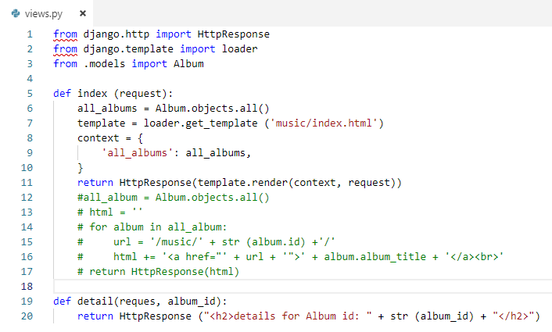
14 Template
https://www.youtube.com/watch?v=0HVwUQ0Ok7Y&list=PL6gx4Cwl9DGBlmzzFcLgDhKTTfNLfX1IK&index=14
We have to plug in all of the pieces.
Let’s go back to the views.py and figure out how to do that?
The ‘template = loader.get_template(‘music/index.html’)’ needs to load all the template file index.html.
The reason that we do not write ‘templates/music/index.html’ because Django by default will read ‘templates’ folder.

Slide 6
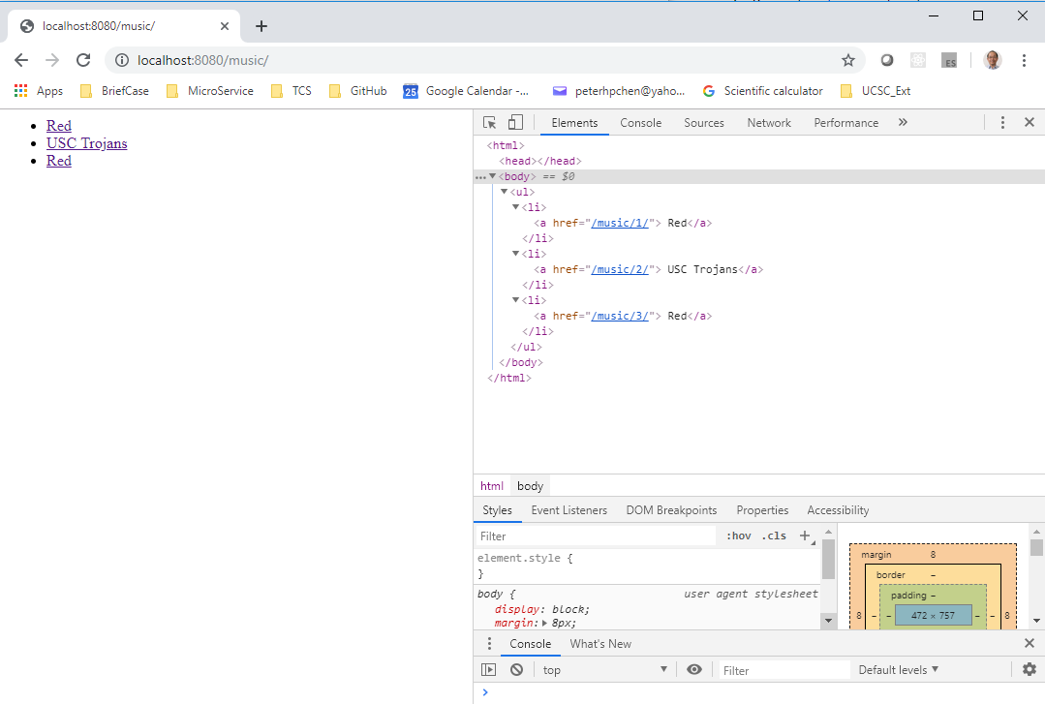
14 Template
https://www.youtube.com/watch?v=0HVwUQ0Ok7Y&list=PL6gx4Cwl9DGBlmzzFcLgDhKTTfNLfX1IK&index=14
Restart the server:
> python manage.py runserver 8080
Open chrome
> localhost:8080/music
We the template is working because the ordered list displayed.
Select the element and check in the console debugger for detailed information.

Slide 7
End of Chapter

