Slide 1

5 Views
Peter H. Chen

Slide 2
5.1 Create View05 Project
Peter H. Chen

Slide 3
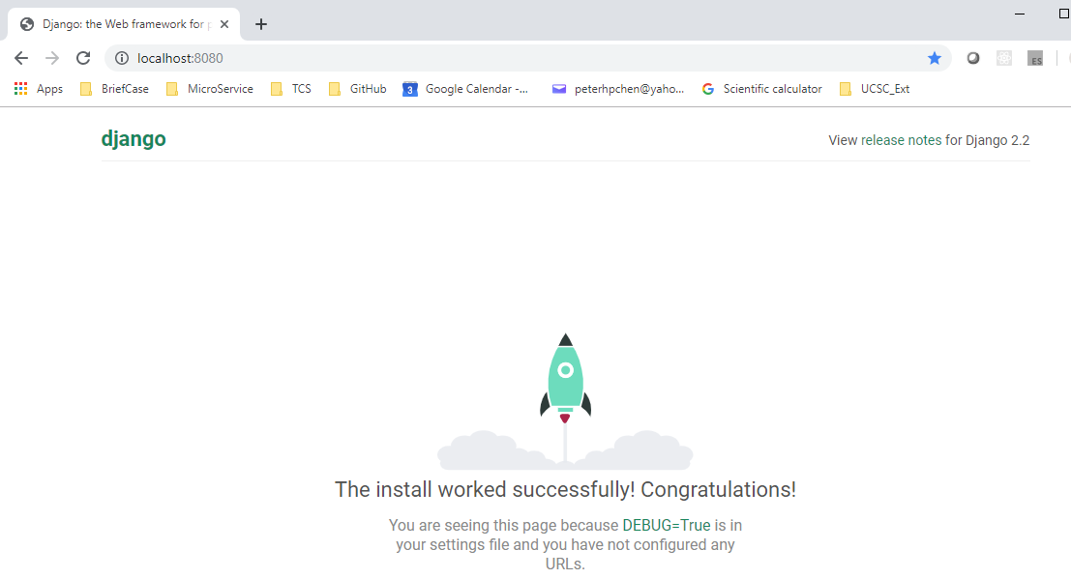
5.1 Create View05 Project
https://www.youtube.com/watch?v=nAn1KpPlN2w&list=PL6gx4Cwl9DGBlmzzFcLgDhKTTfNLfX1IK&index=5
This section discusses Views of Django.
> django-admin startproject View05
> cd View05
Make sure directory contains manage.py
> python manage.py runserver 8080
Open chrome and enter
> localhost:8080

Slide 4
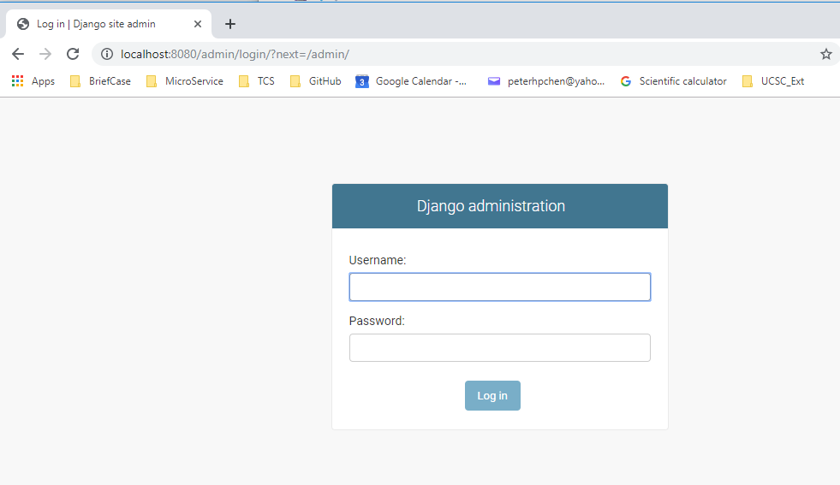
5.1 Create View05 Project
https://www.youtube.com/watch?v=nAn1KpPlN2w&list=PL6gx4Cwl9DGBlmzzFcLgDhKTTfNLfX1IK&index=5
Enter:
> localhost:8080/admin

Slide 5
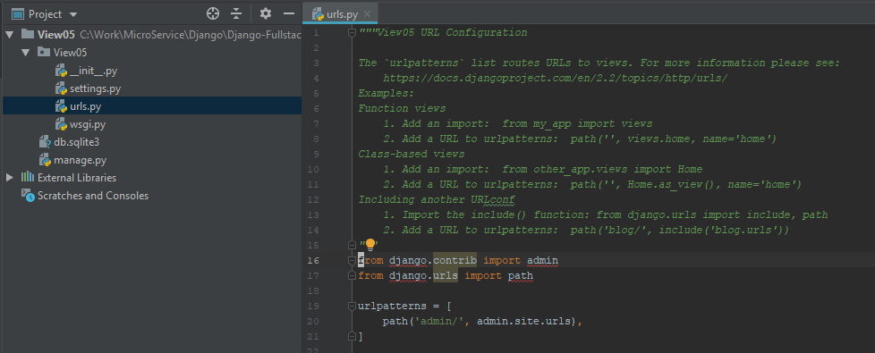
5.1 Create View05 Project
https://www.youtube.com/watch?v=nAn1KpPlN2w&list=PL6gx4Cwl9DGBlmzzFcLgDhKTTfNLfX1IK&index=5
Check the urls.py file.
In the “localhost:8080/admin”, “localhost:8080” is the address of server (domain name) and port number. The “/admin” is the one does matter.
Django will ignore “localhost:8080” and take care “/admin”. This is the user requesting.
The user reuest: The string “admin/” is after “server-address:port-number”
How Django will be respond to user request

Slide 6
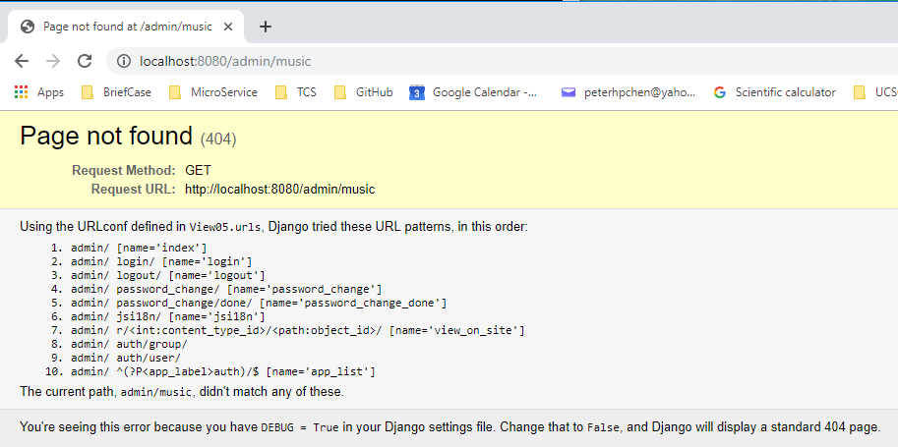
5.1 Create View05 Project
https://www.youtube.com/watch?v=nAn1KpPlN2w&list=PL6gx4Cwl9DGBlmzzFcLgDhKTTfNLfX1IK&index=5
How about the user type in “localhost:8080/music”?
We do not have music app yet.

Slide 7
5.2 Add music app

Slide 8
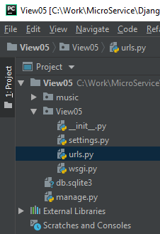
5.2 Add music app
https://www.youtube.com/watch?v=nAn1KpPlN2w&list=PL6gx4Cwl9DGBlmzzFcLgDhKTTfNLfX1IK&index=5
Create a app “music”
> python manage.py startapp music

Slide 9
5.3 Add View05/urls.py

Slide 10
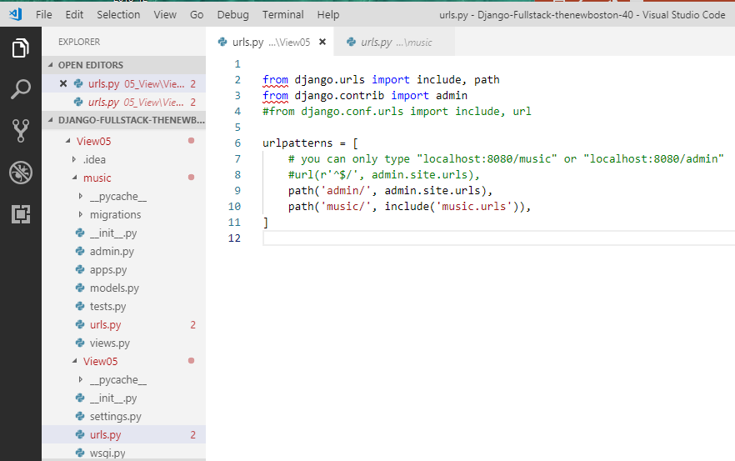
5.3 Add View05/urls.py
https://www.youtube.com/watch?v=nAn1KpPlN2w&list=PL6gx4Cwl9DGBlmzzFcLgDhKTTfNLfX1IK&index=5
Create a file “View05/urls.py”

Slide 11
5.4 Add music/urls.py

Slide 12
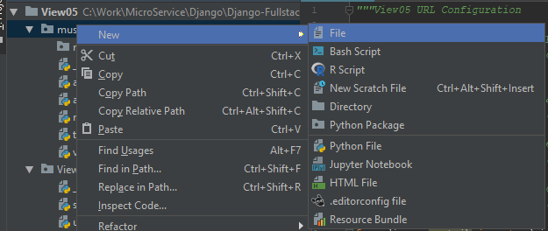
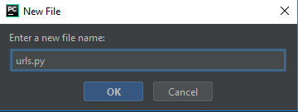
5.4 Add music/urls.py
https://www.youtube.com/watch?v=nAn1KpPlN2w&list=PL6gx4Cwl9DGBlmzzFcLgDhKTTfNLfX1IK&index=5
Create an urls.py in the “music” folder:
Click “music” folder. RMB: New > File
Enter File Name: urls.py

Slide 13
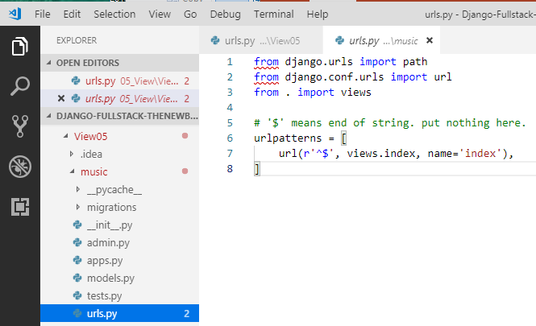
5.4 Add music/urls.py
https://www.youtube.com/watch?v=nAn1KpPlN2w&list=PL6gx4Cwl9DGBlmzzFcLgDhKTTfNLfX1IK&index=5
Create a file “music/urls.py”

Slide 14
5.5 Add music/views.py

Slide 15
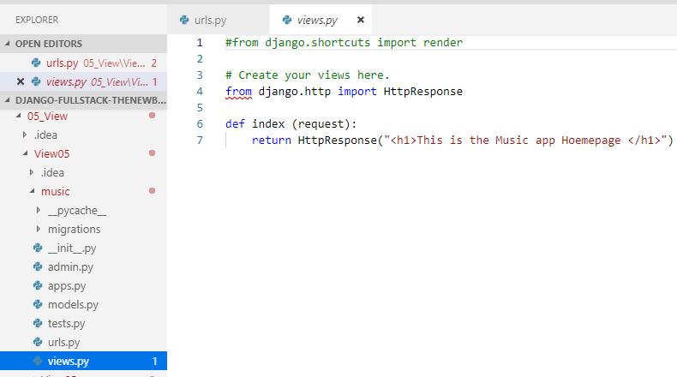
5.5 Add music/views.py
https://www.youtube.com/watch?v=nAn1KpPlN2w&list=PL6gx4Cwl9DGBlmzzFcLgDhKTTfNLfX1IK&index=5
Change “music/views.py”

Slide 16
5.6 Verity Admin and Music

Slide 17
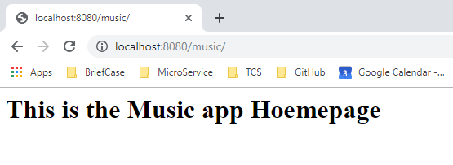
5.6 Verity Admin and Music
https://www.youtube.com/watch?v=nAn1KpPlN2w&list=PL6gx4Cwl9DGBlmzzFcLgDhKTTfNLfX1IK&index=5
Enter: localhost:8080/music

Slide 18
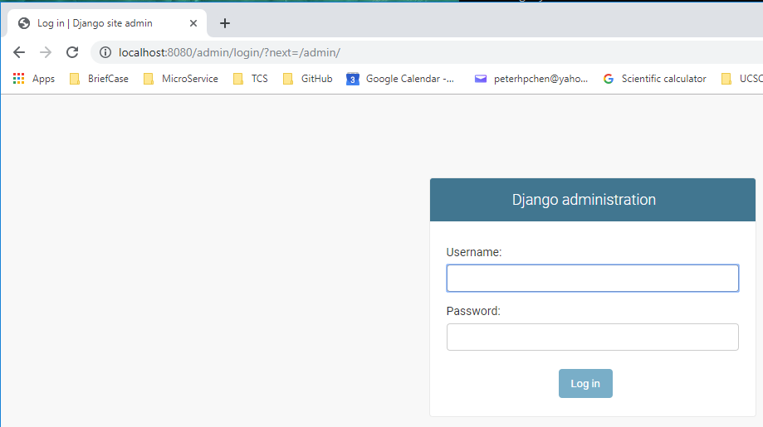
5.6 Verity Admin and Music
https://www.youtube.com/watch?v=nAn1KpPlN2w&list=PL6gx4Cwl9DGBlmzzFcLgDhKTTfNLfX1IK&index=5
Enter: localhost:8080/admin

Slide 19
End of Chapter

