Slide 1

21 HTTP Shortcut
Peter H. Chen

Slide 2
21 Http Shortcut
https://www.youtube.com/watch?v=vhBxt9T4Zvk&list=PL6gx4Cwl9DGBlmzzFcLgDhKTTfNLfX1IK&index=21
This section discusses the Removing Hardcoded URLs
> python manage.py runserver 8080
Open Chrome
> localhost:8080

Slide 3
21.1 Namespacing
Peter H. Chen

Slide 4
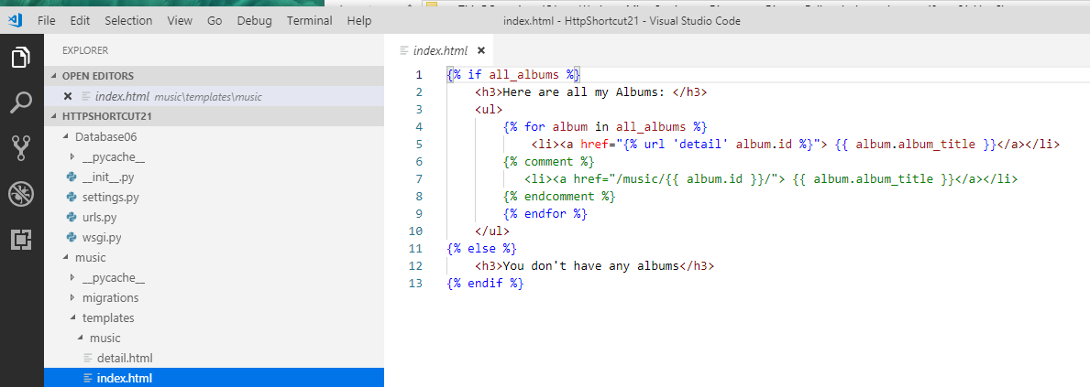
21.1 Namespacing
https://www.youtube.com/watch?v=vhBxt9T4Zvk&list=PL6gx4Cwl9DGBlmzzFcLgDhKTTfNLfX1IK&index=21
Last section, we use the non-hardcoded URLs.
This is the proper way we should use in all of our templates.
Right now, we only have one app ‘music’. We may have 10 or 20 even more apps, such as, profile, videos, and etc.

Slide 5
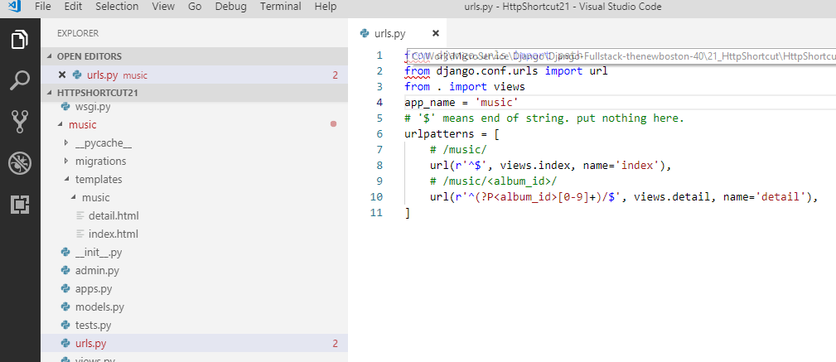
21.1 Namespacing
https://www.youtube.com/watch?v=vhBxt9T4Zvk&list=PL6gx4Cwl9DGBlmzzFcLgDhKTTfNLfX1IK&index=21
What happen when another app inside for music/detail view, such as, video/detail, profile/detail, and etc.?
We solve this problem by namespacing our URLs. That means that we need to specify music/detail view, profile/detail view, or video/details view, and etc.

Slide 6
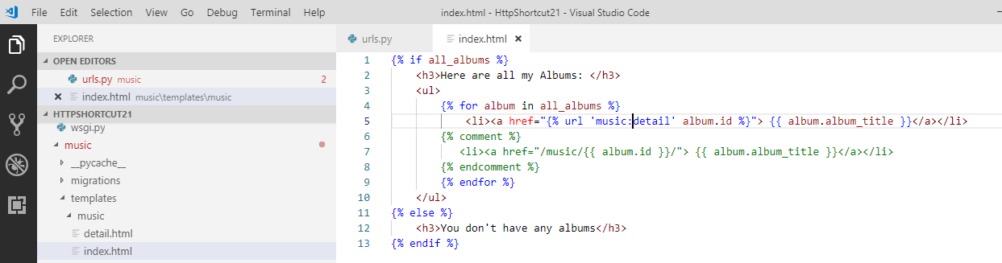
21.1 Namespacing
https://www.youtube.com/watch?v=vhBxt9T4Zvk&list=PL6gx4Cwl9DGBlmzzFcLgDhKTTfNLfX1IK&index=21
In the index.html, we have “music:detail” for namespacing.

Slide 7
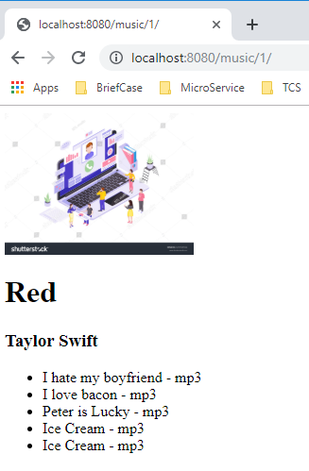
21.1 Namespacing
https://www.youtube.com/watch?v=vhBxt9T4Zvk&list=PL6gx4Cwl9DGBlmzzFcLgDhKTTfNLfX1IK&index=21
Refresh with “localhost:8080/music/1”.

Slide 8
21.2 Http Not Found Shortcut
Peter H. Chen

Slide 9
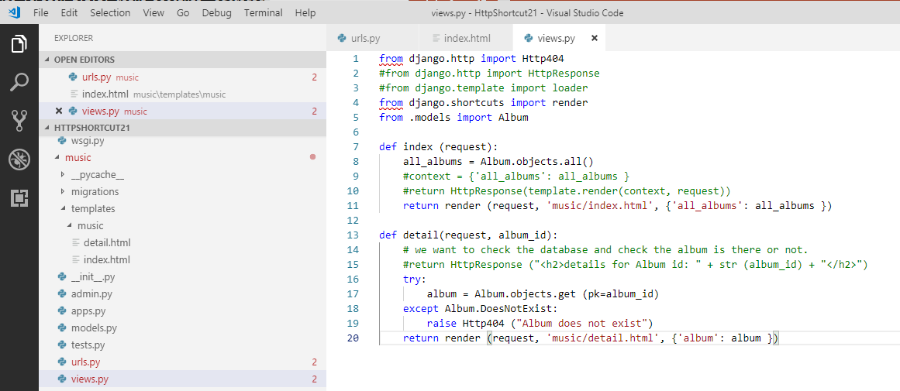
21.2 Http Not Found Shortcut
https://www.youtube.com/watch?v=vhBxt9T4Zvk&list=PL6gx4Cwl9DGBlmzzFcLgDhKTTfNLfX1IK&index=21
In Views.py, when album is not found, we display “404 not found”.
We want to shortcut for try … except “404 not found”.

Slide 10
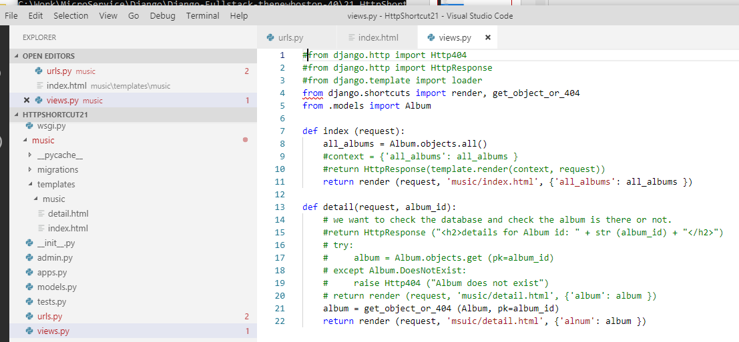
21.2 Http Not Found Shortcut
https://www.youtube.com/watch?v=vhBxt9T4Zvk&list=PL6gx4Cwl9DGBlmzzFcLgDhKTTfNLfX1IK&index=21
How to shortcut for try … except “404 not found”?
Import get_object_04_404.
Remove try…except and use get_object_or_404.

Slide 11
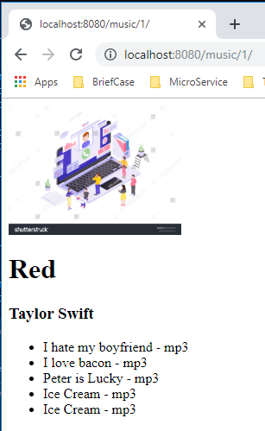
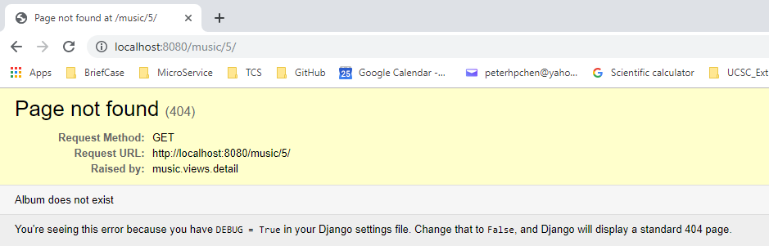
21.2 Http Not Found Shortcut
https://www.youtube.com/watch?v=vhBxt9T4Zvk&list=PL6gx4Cwl9DGBlmzzFcLgDhKTTfNLfX1IK&index=21
Refresh with “localhost:/8080/music/5” for non-existed ID.

Slide 12
End of Chapter

