Slide 1

12 Second View
Peter H. Chen

Slide 2
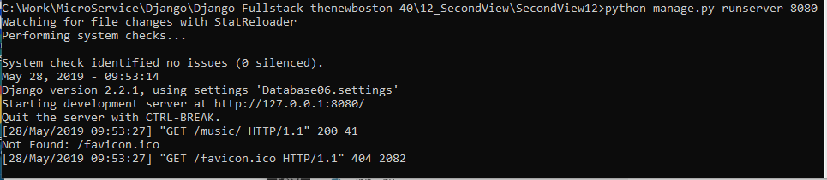
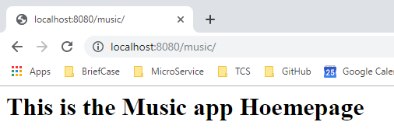
12 Second View
https://www.youtube.com/watch?v=mWofrhTwGWQ&list=PL6gx4Cwl9DGBlmzzFcLgDhKTTfNLfX1IK&index=12
In the last section, we discuss the adding another view of the website.
Start the server:
> python manage.py runserver 8080
Open chrome
> localhost:8080/music

Slide 3
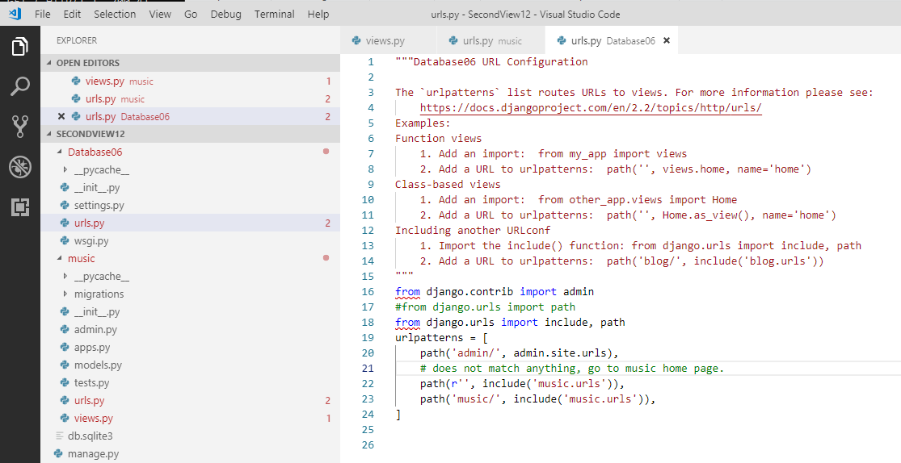
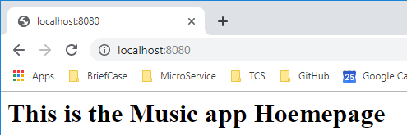
12 Second View
https://www.youtube.com/watch?v=mWofrhTwGWQ&list=PL6gx4Cwl9DGBlmzzFcLgDhKTTfNLfX1IK&index=12
We add the ‘’ for the top of web-page if user type ‘localhost:8080’ without any parameter after the host address.

Slide 4
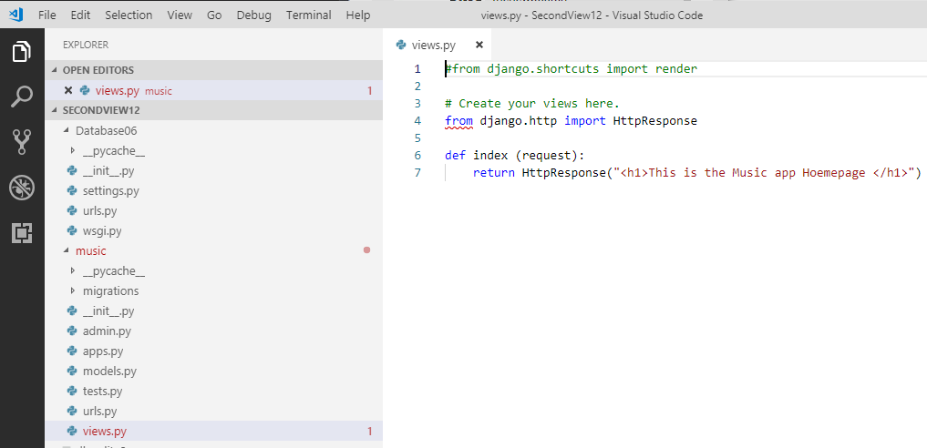
12 Second View
https://www.youtube.com/watch?v=mWofrhTwGWQ&list=PL6gx4Cwl9DGBlmzzFcLgDhKTTfNLfX1IK&index=12
What is a view?
A View is a simple function that return some HTML. That is all it is.

Slide 5
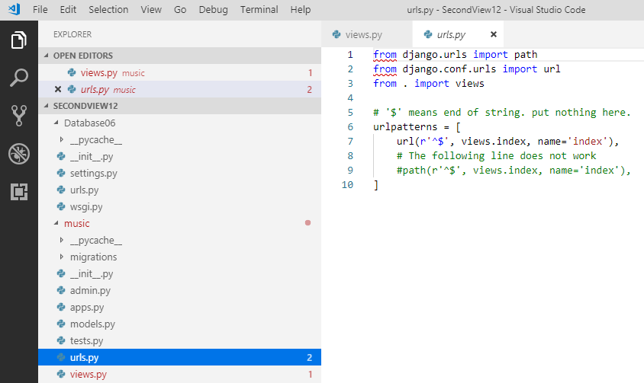
12 Second View
https://www.youtube.com/watch?v=mWofrhTwGWQ&list=PL6gx4Cwl9DGBlmzzFcLgDhKTTfNLfX1IK&index=12
Each URL is connected to a view, i.e., an HTML response.
Each web page is connected to some HTML that needs to be displayed whenever you go to that.

Slide 6
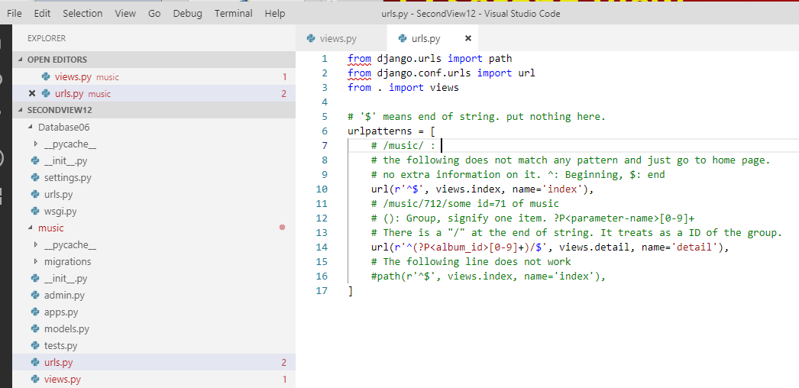
12 Second View
https://www.youtube.com/watch?v=mWofrhTwGWQ&list=PL6gx4Cwl9DGBlmzzFcLgDhKTTfNLfX1IK&index=12
Define URL.

Slide 7
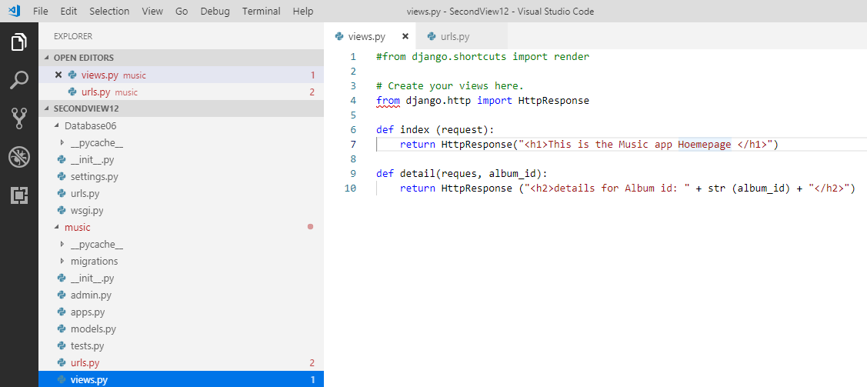
12 Second View
https://www.youtube.com/watch?v=mWofrhTwGWQ&list=PL6gx4Cwl9DGBlmzzFcLgDhKTTfNLfX1IK&index=12
Add Views.

Slide 8
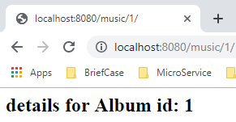
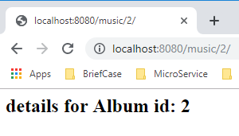
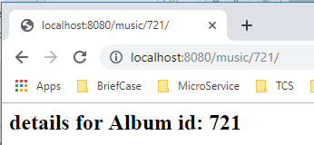
12 Second View
https://www.youtube.com/watch?v=mWofrhTwGWQ&list=PL6gx4Cwl9DGBlmzzFcLgDhKTTfNLfX1IK&index=12
Now, refresh the web page:
> localhost:8080/music/1, 2, 721, or any number.
Right now, we are not connecting to any database yet. Therefore, any number is fine.

Slide 9
End of Chapter

