Slide 1

17 Add Song to DB
Peter H. Chen

Slide 2
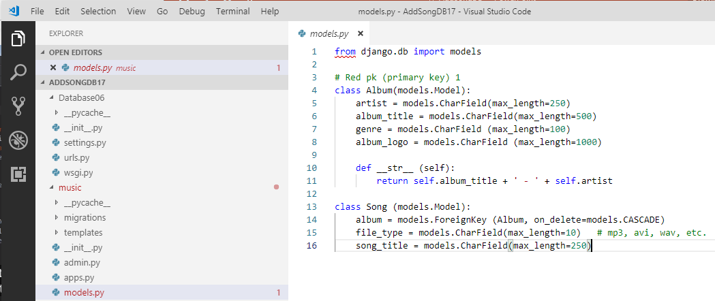
17 Add Song to DB
https://www.youtube.com/watch?v=TnU_I8DKKYQ&list=PL6gx4Cwl9DGBlmzzFcLgDhKTTfNLfX1IK&index=17
This section discusses the Add Song to DB.
> python manage.py runserver 8080
Right now, we add Albums into the database.
How do we add songs to our database? Also, there is a relationship between the Album and Song.

Slide 3
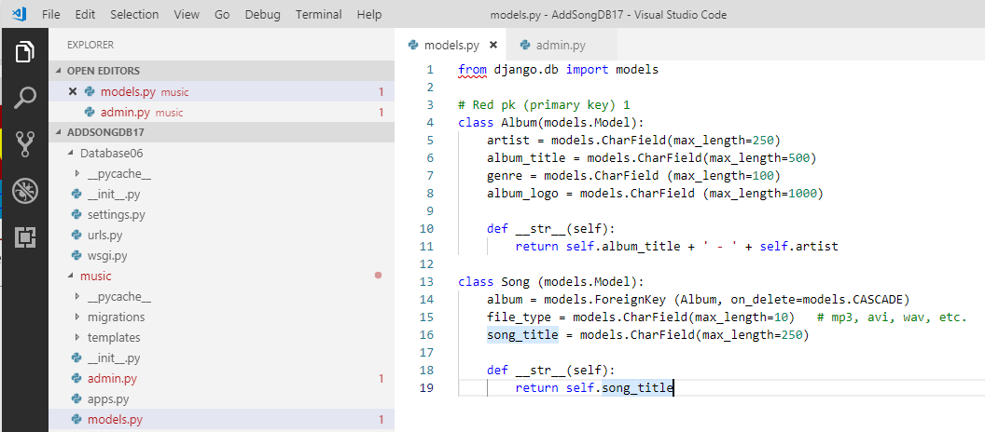
17 Add Song to DB
https://www.youtube.com/watch?v=TnU_I8DKKYQ&list=PL6gx4Cwl9DGBlmzzFcLgDhKTTfNLfX1IK&index=17
We create a string representation of the Song.

Slide 4
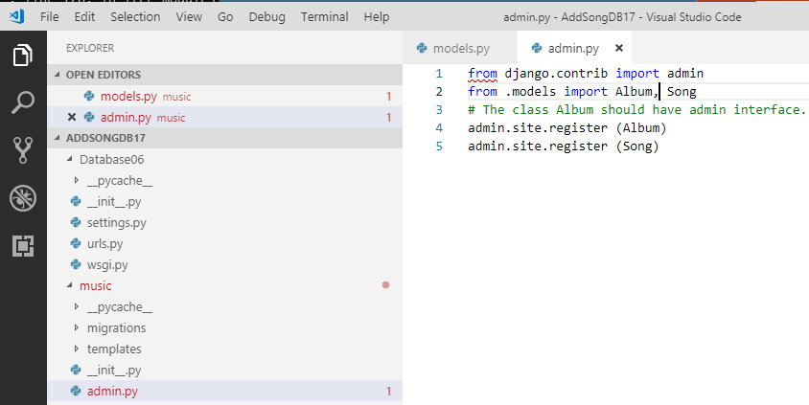
17 Add Song to DB
https://www.youtube.com/watch?v=TnU_I8DKKYQ&list=PL6gx4Cwl9DGBlmzzFcLgDhKTTfNLfX1IK&index=17
Add register song in admin.py

Slide 5
17 Add Song to DB
https://www.youtube.com/watch?v=TnU_I8DKKYQ&list=PL6gx4Cwl9DGBlmzzFcLgDhKTTfNLfX1IK&index=17
Because we modify the models.py, we need to run migration again?
Only we add or delete the attribute, then we add to run the migration.
Right now, we just modify the __str__, we don’t actually change the attribute of table. Therefore, no migration needed.

Slide 6
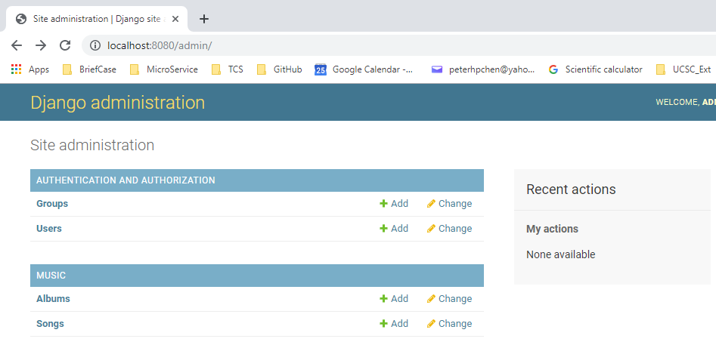
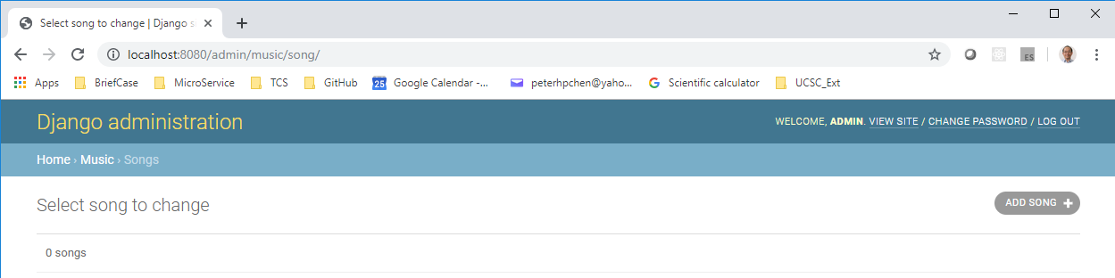
17 Add Song to DB
https://www.youtube.com/watch?v=TnU_I8DKKYQ&list=PL6gx4Cwl9DGBlmzzFcLgDhKTTfNLfX1IK&index=17
Open Chrome:
> localhost:8080/admin
Click “Songs”. Right now, we don’t have any song inside

Slide 7
17.1 Open Python Shell
Peter H. Chen

Slide 8
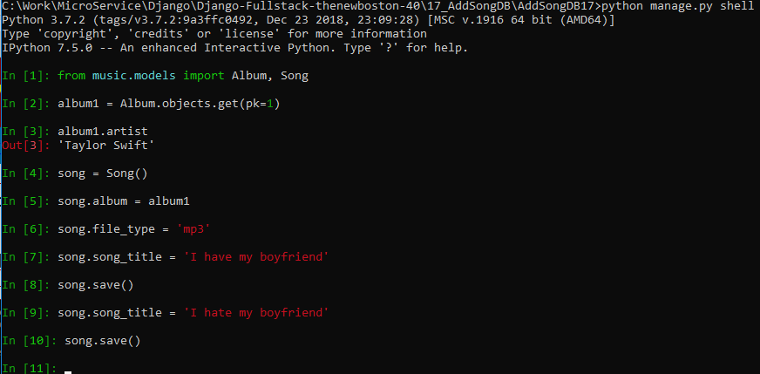
17.1 Open Python Shell
https://www.youtube.com/watch?v=TnU_I8DKKYQ&list=PL6gx4Cwl9DGBlmzzFcLgDhKTTfNLfX1IK&index=17
We need to add song.
> python manage.py shell
> from music.models import Album, Song

Slide 9
17.2 Add Song to Album
Peter H. Chen

Slide 10
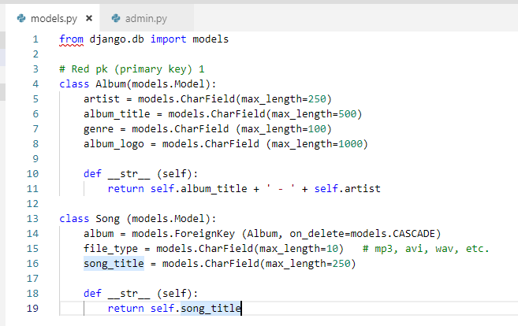
17.2 Add Song to Album
https://www.youtube.com/watch?v=TnU_I8DKKYQ&list=PL6gx4Cwl9DGBlmzzFcLgDhKTTfNLfX1IK&index=17
We need to add song.
> python manage.py shell
> from music.models import Album, Song

Slide 11
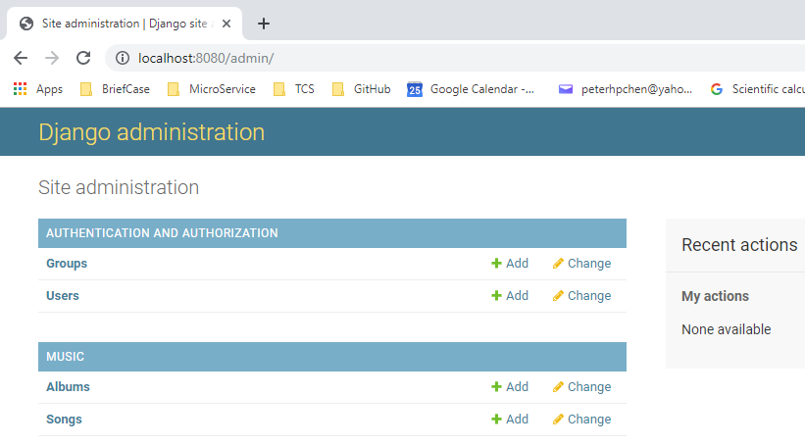
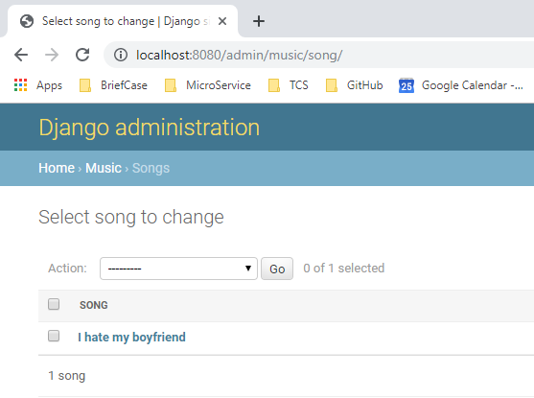
17.2 Add Song to Album
https://www.youtube.com/watch?v=TnU_I8DKKYQ&list=PL6gx4Cwl9DGBlmzzFcLgDhKTTfNLfX1IK&index=17
Restart the server:
> python manage.py runserver 8080
Open Chrome
> localhost:8080/admin
Click the songs. We can see there is one song in the Songs database.

Slide 12
End of Chapter

