Slide 1

23 Add Form to Template
Peter H. Chen

Slide 2
23 Add Form to Template
https://www.youtube.com/watch?v=hKoNbgVWyWc&list=PL6gx4Cwl9DGBlmzzFcLgDhKTTfNLfX1IK&index=23
This section discusses the Removing Hardcoded URLs
> python manage.py runserver 8080
Open Chrome
> localhost:8080/music
> localhost:8080/music/1
If you have errors.Then, you need to run the migrate command:
> python manage.py sqlmigrate music 00xx
All you need to remember is three steps:
Define Database structure in models.py. # Python data structure
> python manage.py makemigrations music # Python data structure to SQL database
> python manage.py migrate # SQL database in sync with Python data structure

Slide 3
23 Add Form to Template
https://www.youtube.com/watch?v=hKoNbgVWyWc&list=PL6gx4Cwl9DGBlmzzFcLgDhKTTfNLfX1IK&index=23
This section discusses the Removing Hardcoded URLs
> python manage.py runserver 8080
Open Chrome
> localhost:8080/music
> localhost:8080/music/1

Slide 4
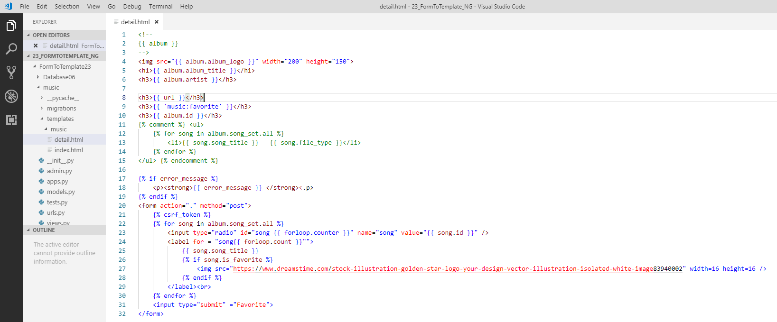
23 Add Form to Template
https://www.youtube.com/watch?v=hKoNbgVWyWc&list=PL6gx4Cwl9DGBlmzzFcLgDhKTTfNLfX1IK&index=23
Detail.html.
Note: url and ‘music:favorite’ do not show value.
Method use “.” instead of path.

Slide 5
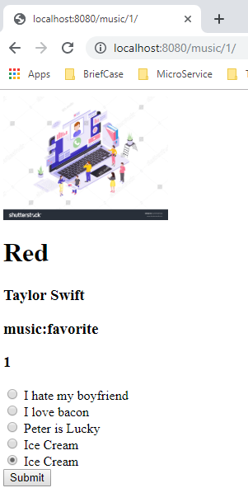
23 Add Form to Template
https://www.youtube.com/watch?v=hKoNbgVWyWc&list=PL6gx4Cwl9DGBlmzzFcLgDhKTTfNLfX1IK&index=23
Refresh web page.

Slide 6
End of Chapter

