Slide 1

13 Connect Database
Peter H. Chen

Slide 2
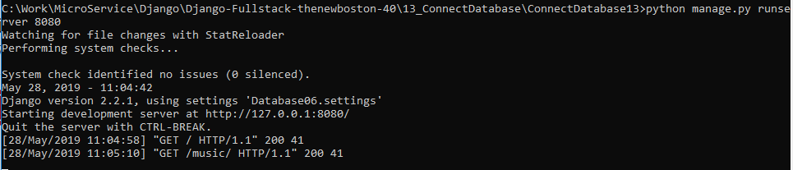
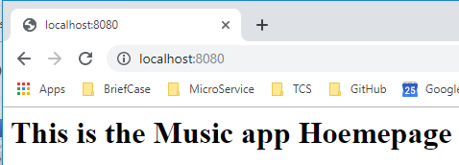
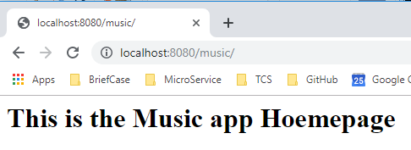
13 Connect Database
https://www.youtube.com/watch?v=b0d09mYsORs&list=PL6gx4Cwl9DGBlmzzFcLgDhKTTfNLfX1IK&index=13
This section discusses connect Database.
Start the server:
> python manage.py runserver 8080

Slide 3
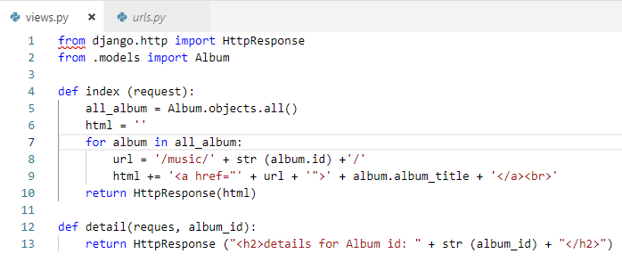
13 Connect Database
https://www.youtube.com/watch?v=b0d09mYsORs&list=PL6gx4Cwl9DGBlmzzFcLgDhKTTfNLfX1IK&index=13
Right now, the default page display the “simple message”.
We will display some pull out all the albums we have from database.
The can click the album name and go to the detail view of single album.
1
Connect to Database
2
Database to array of objects
3
Single object

Slide 4
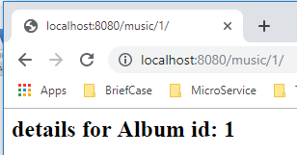
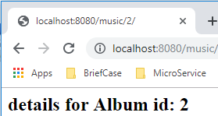
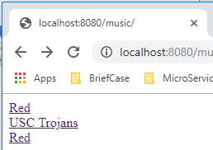
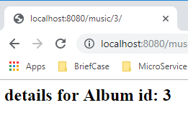
13 Connect Database
https://www.youtube.com/watch?v=b0d09mYsORs&list=PL6gx4Cwl9DGBlmzzFcLgDhKTTfNLfX1IK&index=13
Start the server:
> python manage.py runserver 8080
Open chorme:
> localhost:8080/music

Slide 5
13 Connect Database
https://www.youtube.com/watch?v=b0d09mYsORs&list=PL6gx4Cwl9DGBlmzzFcLgDhKTTfNLfX1IK&index=13
Right now, the final response code is in HTML format.
For frontend people with Angular or React, we need to separate the Python logic out of HTML code.
We should not leave the HTML code in the Python view.
Next section, we discuss how to separate HTML code out of from backend Django Logic.

Slide 6
End of Chapter

