Slide 1

7 Data Model
Peter H. Chen

Slide 2
7 Data Model
https://www.youtube.com/watch?v=UpssHYl6bjA&list=PL6gx4Cwl9DGBlmzzFcLgDhKTTfNLfX1IK&index=7
This section discusses Views of Django.
> django-admin startproject Database05
> cd Database05
Make sure directory contains manage.py
> python manage.py runserver 8080
Create music app
> python manage.py startapp music
Open chrome and enter
> localhost:8080
Enter
> localhost:8080/admin

Slide 3
7 Data Model
https://www.youtube.com/watch?v=UpssHYl6bjA&list=PL6gx4Cwl9DGBlmzzFcLgDhKTTfNLfX1IK&index=7
A model is a blueprint of how you going to store your data.
What kinds of data are we going to be saving?
We are going to saving albums and songs.
The album needs a title, a genre (group), and artist.
Are we going to create the model for database or for actual Python code?
Whenever you make model in Django, it is same thing. You do not have to make one for the database.
You have to configure models.py with the actual Python code. You just make configuration in model.py. The Django will automatically to get each variable form those class and convert it into a column in your database.

Slide 4
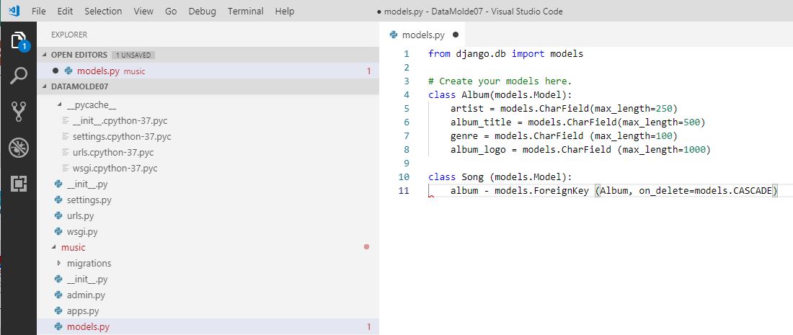
7 Data Model
https://www.youtube.com/watch?v=UpssHYl6bjA&list=PL6gx4Cwl9DGBlmzzFcLgDhKTTfNLfX1IK&index=7
In the music/models.py, we create our very first class “class Album (model.Model)”. Now, every model or blueprint you create has to inherit from models.Model.
The variable name “artist”, “album_title”, “genre”, and “album_logo” are the columns in the database.
Later on, we look at this in the database, the actual column name will be artist, album_title, genre, and album_logo. All these are taking care of behind the scene.

Slide 5
7 Data Model
https://www.youtube.com/watch?v=UpssHYl6bjA&list=PL6gx4Cwl9DGBlmzzFcLgDhKTTfNLfX1IK&index=7
We will create one more class “class Song (models.Model): When we create a song, it needs to be associated with an album. In other words, a song needs to be part of an album. Usually, we have 12 to 15 songs per album. How do we link these together in that kind of way?
Django behind the scene make another column for us.
First, we need to talk about the primary key. Whenever, we create the “class Album” in out database, we are going to have these four columns right there.

Slide 6
7 Data Model
https://www.youtube.com/watch?v=UpssHYl6bjA&list=PL6gx4Cwl9DGBlmzzFcLgDhKTTfNLfX1IK&index=7
Actually, behind the scene, Django will make another column for us. This column is a unique ID number. The very first of Album we create, it is going to give in the ID of one. When we create another one, it is going to give it the ID of two, so on and so forth. Each album we add, it is going to increment it by one.
There are a couple of bands, Tayler swift, and other bands do as well. Then, it is going to get confused. It is good to have a unique ID for each album, i.e., two albums cannot have the same ID number. We call Album ID the primary unique key. These albums are going to have behind the scene.

Slide 7
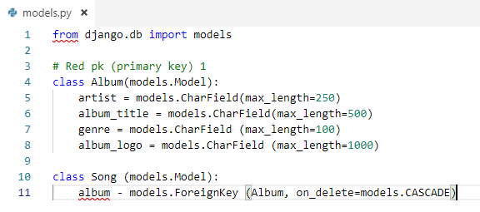
7 Data Model
https://www.youtube.com/watch?v=UpssHYl6bjA&list=PL6gx4Cwl9DGBlmzzFcLgDhKTTfNLfX1IK&index=7
What is the ForeignKey? This is weird.
Each song is gong to be linked to an album. In the album Red, we have the primary key of one, for example.
Whenever we create a song, say Taylor Swift’s song, “I hate my boyfriend over and ever”, we need to link to an album.
The foreign key for this song is just going to be primary key one.
We know that this song is linked to album primary key one which is “Red”.

Slide 8
7 Data Model
https://www.youtube.com/watch?v=UpssHYl6bjA&list=PL6gx4Cwl9DGBlmzzFcLgDhKTTfNLfX1IK&index=7
The primary key just need whenever you have a bunch of elements in the list need a unique ID number. A foreign key is used whenever you have something like a song that is part of something else.
You just give the ID number whatever it belongs to and that is what a Foreign Key is.
What is “on_delete=models.CASCADE”?
You have a lot of songs belongs to a Album. What happens whenever you delete that album? You may delete and Album but the songs still existed.

Slide 9
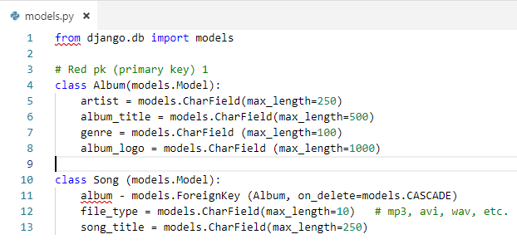
7 Data Model
https://www.youtube.com/watch?v=UpssHYl6bjA&list=PL6gx4Cwl9DGBlmzzFcLgDhKTTfNLfX1IK&index=7
Next is the file type. This can be the mp3, avi, or wav.
You have have the song_title.

Slide 10
7 Data Model
https://www.youtube.com/watch?v=UpssHYl6bjA&list=PL6gx4Cwl9DGBlmzzFcLgDhKTTfNLfX1IK&index=7
This means that whenever we delete the Album red, any songs that were linked to that, will be deleted as well.
In some program, you can keep the songs when Album is deleted. In this case, the songs are deleted together when the album is deleted.

Slide 11
End of Chapter

