Slide 1
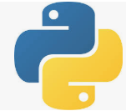
3 First App
Peter H. Chen

Slide 2
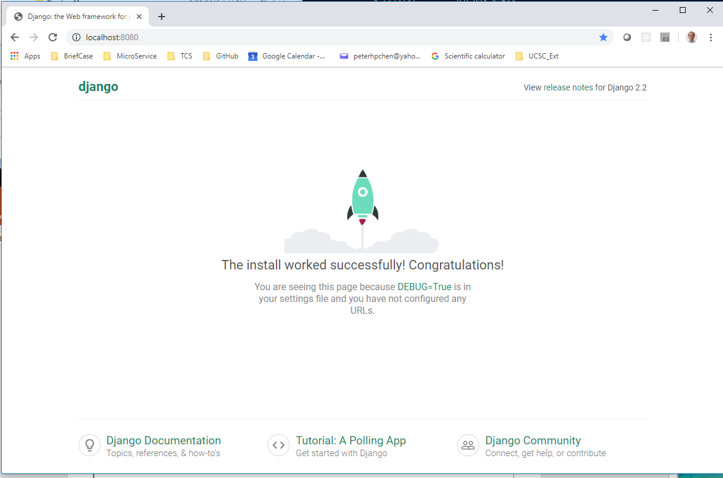
3 First App
https://www.youtube.com/watch?v=4saN7GZnawU&list=PL6gx4Cwl9DGBlmzzFcLgDhKTTfNLfX1IK&index=3
This section discusses how to create the first app.
> django-admin startproject FirstApp03
> cd FirstApp03
Make sure directory contains the maange.py
> python manage.py runserver 8080
Open chrome and enter 8080
> localhost:8080

Slide 3
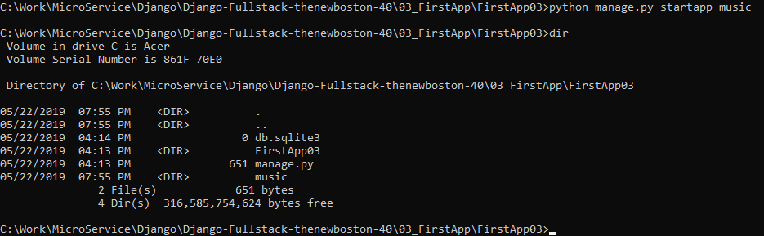
3 First App
https://www.youtube.com/watch?v=4saN7GZnawU&list=PL6gx4Cwl9DGBlmzzFcLgDhKTTfNLfX1IK&index=3
In Django, every web site is broken into several components.
Each component is called an app.
We can start as many app as we want.
The following command start another app called music.
The following command will create another directory “music”.
> python manage.py startapp music

Slide 4
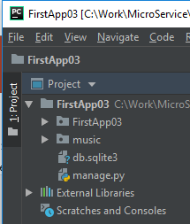
3 First App
https://www.youtube.com/watch?v=4saN7GZnawU&list=PL6gx4Cwl9DGBlmzzFcLgDhKTTfNLfX1IK&index=3
Use PyCharm, you can see a new folder “music” is created.
We have two folder, each folder is an app.
One folder is FirstApp03 and the other folder is music.

Slide 5
End of Chapter

