Slide 1
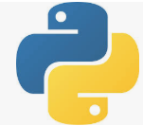
4 Overview First App
Peter H. Chen

Slide 2
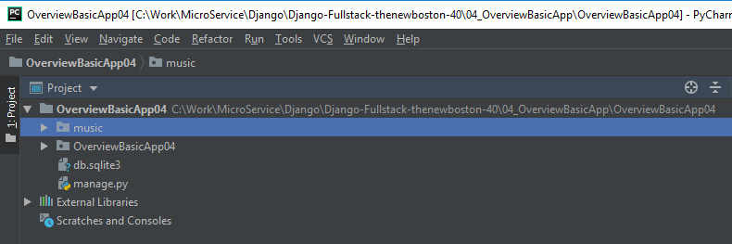
4 Overview First App
https://www.youtube.com/watch?v=4saN7GZnawU&list=PL6gx4Cwl9DGBlmzzFcLgDhKTTfNLfX1IK&index=3
This section discusses Overview the first app.
> django-admin startproject OverviewBasicApp04
> cd OverviewBasicApp04
Make sure directory contains the maange.py
> python manage.py runserver 8080
Open chrome and enter 8080
> localhost:8080
> python manage.py startapp music

Slide 3
4.1 Migration
Peter H. Chen

Slide 4
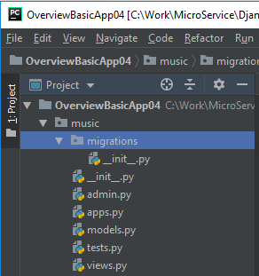
4.1 Migration
https://www.youtube.com/watch?v=4saN7GZnawU&list=PL6gx4Cwl9DGBlmzzFcLgDhKTTfNLfX1IK&index=3
When Django create this app, it gave us a few files and a directory by default.
Now, before we go on, a brief overview of what all of these files are.
The music is actually a package directory.
The migrations are a way that you can hook up or connect your web site all your source code with your database.

Slide 5
4.2 admin.py
Peter H. Chen

Slide 6
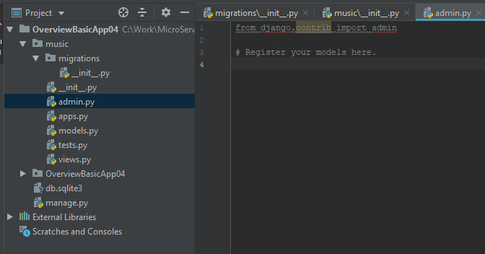
4.2 admin.py
https://www.youtube.com/watch?v=4saN7GZnawU&list=PL6gx4Cwl9DGBlmzzFcLgDhKTTfNLfX1IK&index=3
The admin.py is for Python admin whenever they are creating Django, they realize that almost every website in the world.
The admin.py has an admin section that you can go and access database and delete users and delete posts whatever you want. Instead of make it yourself, it already has that admin functionality.

Slide 7
4.3 apps.py
Peter H. Chen

Slide 8
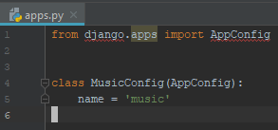
4.3 apps.py
https://www.youtube.com/watch?v=4saN7GZnawU&list=PL6gx4Cwl9DGBlmzzFcLgDhKTTfNLfX1IK&index=3
The apps.py file is a configuration file for settings for this app.
Right now, we do not have a lot of settings.
It has the name is ‘music’.
It is a app ‘music’ that let Django know.

Slide 9
4.4 models.py
Peter H. Chen

Slide 10
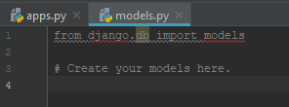
4.4 models.py
https://www.youtube.com/watch?v=4saN7GZnawU&list=PL6gx4Cwl9DGBlmzzFcLgDhKTTfNLfX1IK&index=3
The models.py is a blueprint for your database.
It is a template of how you are going to store data and tables for this app.
How are we going to do that?
How are we going to that in the music app?
For example, we have an album and a song to store.
Each album need a title and the artist. Each song has title and length.
Later on, we create two classes here. One class is for song and another class for song.
The model is the blueprint of our database.

Slide 11
4.4 tests.py
Peter H. Chen

Slide 12

4.4 tests.py
https://www.youtube.com/watch?v=4saN7GZnawU&list=PL6gx4Cwl9DGBlmzzFcLgDhKTTfNLfX1IK&index=3
The test.py is for test. Test is nothing to do with functionality of app.
We can have some tests here to test the app.

Slide 13
4.5 views.py
Peter H. Chen

Slide 14
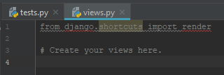
4.5 views.py
https://www.youtube.com/watch?v=4saN7GZnawU&list=PL6gx4Cwl9DGBlmzzFcLgDhKTTfNLfX1IK&index=3
The views.py are functions. They are Python functions. The views take user request and give back something.
95% of time, these are just going to request.
The webpage is like your are looking someone profile that HTML page you look at. A video page, log out, download something, or etc.
Views are Python functions that take a request from the user and respond or get back a response in some kind of way.

Slide 15
End of Chapter

