Slide 1
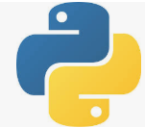
1 Install Django
Peter H. Chen

Slide 2
1 Install Django
https://www.youtube.com/watch?v=qgGIqRFvFFk&list=PL6gx4Cwl9DGBlmzzFcLgDhKTTfNLfX1IK&index=1
This section discusses the Django installation.
When we said create the web development, we are not talking about the button, colors, and etc. from the front end, we talk about the backend of the web development. In other words, we working with the servers and databases.
The Django like the PHP.
We will discuss these with Python.

Slide 3
1.1 System Admin Window

Slide 4
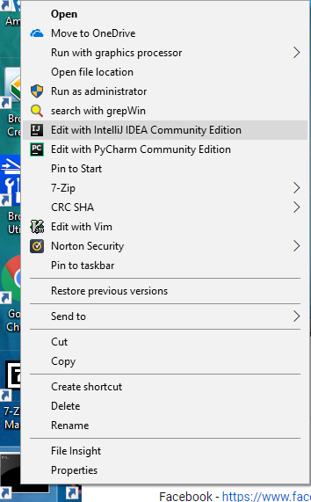
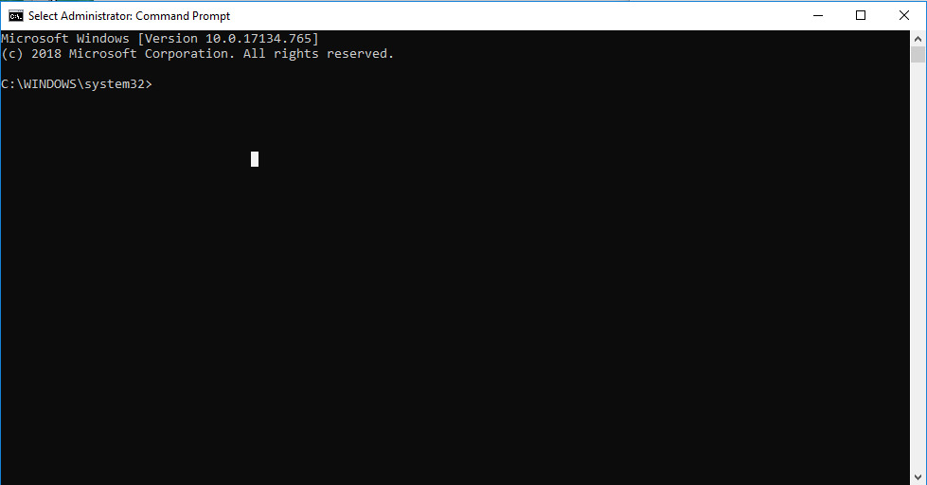
1.1 System Admin Window
https://www.youtube.com/watch?v=qgGIqRFvFFk&list=PL6gx4Cwl9DGBlmzzFcLgDhKTTfNLfX1IK&index=1
In Window, we have to open command prompt by administrator mode.
In Linux or Macs, everything will be the same except we need replace the all the commands under Windows administrator mode into “sudo” (super user mode).
Windows do not have sudo command, that is why we need the administrator mode on windows. In Linux or Macs, we type “sudo” for all the commands.

Slide 5
1.2 Python and easy_install

Slide 6

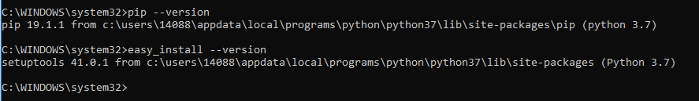
1.2 Python and easy_install
https://www.youtube.com/watch?v=qgGIqRFvFFk&list=PL6gx4Cwl9DGBlmzzFcLgDhKTTfNLfX1IK&index=1
Since we use Python to develop, we need to install the Python. Just verify the installation correctly.
> python --versiojn
>>> Python 3.7.2
The next thing we need to verify is the easy_install or pip setup.
The easy_install and pip tools come with the Python. These are tools allow you to download Django online.
> easy_install --version
>>> setuptools 41.0.1

Slide 7

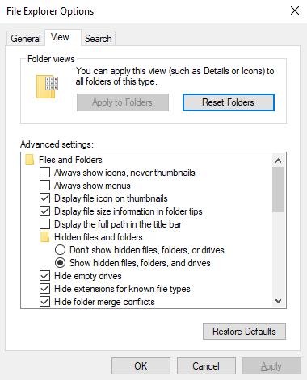
1.2 Python and easy_install
https://www.youtube.com/watch?v=qgGIqRFvFFk&list=PL6gx4Cwl9DGBlmzzFcLgDhKTTfNLfX1IK&index=1
> whereis python
>>> C:\Users\14088\AppData\...
The folder AppData is hidden, we have turn on the “Show hidden files”
To use Explorer Options: In the Taskbar, search “folder” and turn on the “Show hidden files, folders, and drives” as right diagram.

Slide 8
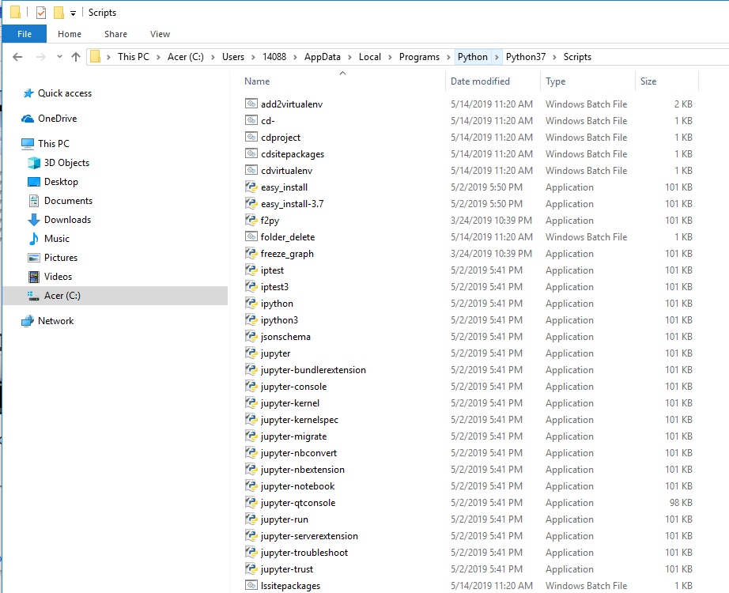
1.2 Python and easy_install
https://www.youtube.com/watch?v=qgGIqRFvFFk&list=PL6gx4Cwl9DGBlmzzFcLgDhKTTfNLfX1IK&index=1
In the scripts folder, there are easy_install, Jupyter-notebook, mkvirtualenv, pip, workon, tensorboard, and etc.
If command does not work, check the environment path setup.

Slide 9
1.3 Install Django

Slide 10
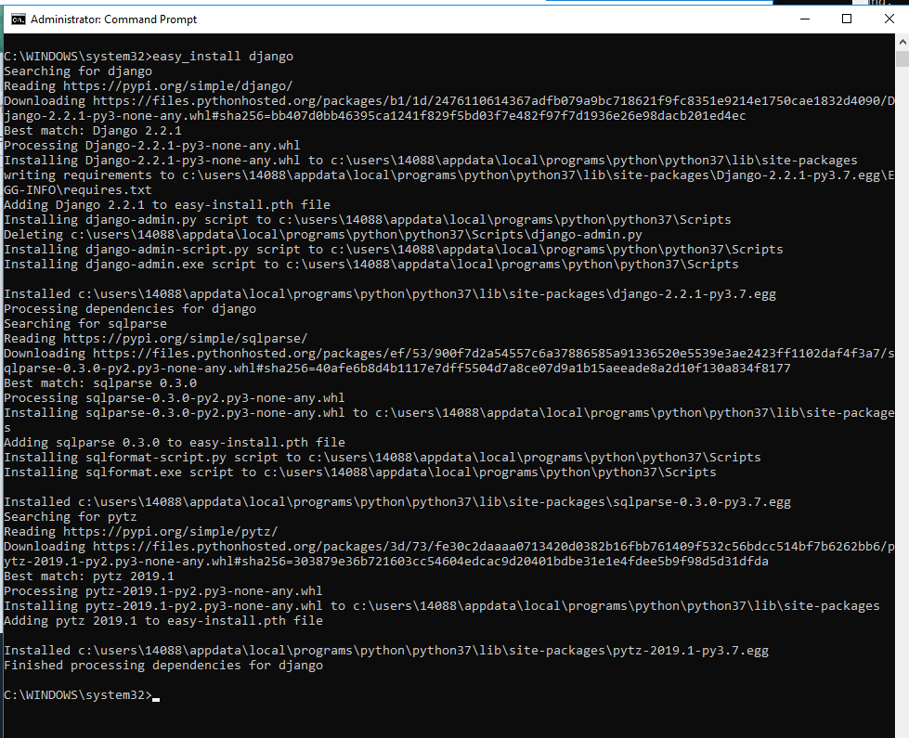
1.3 Install Django
https://www.youtube.com/watch?v=qgGIqRFvFFk&list=PL6gx4Cwl9DGBlmzzFcLgDhKTTfNLfX1IK&index=1
> easy_install django # Install the latest version of Django
If you want Django 1.9, you can use command:
> easy_install django==1.9

Slide 11
End of Chapter

